Slide 1

Estimating Causal Effects of Policy Interventions
Introduction to Causal Inference and Causal Data Science
Oisin Ryan

Slide 2
Context: “Policy Evaluations”
Evaluating what the effect of implementing a particular policy or intervention was on some outcome of interest
Examples:
- What was the effect of raising the maximum speed limit on motorways in the Netherlands on road deaths?
Did introducing an after-school programme in disadvantaged neighbourhoods lead to improved educational outcomes in children from that neighbourhood?

Slide 3
Running Example: Proposition 99
A famous example in policy evaluation literature
In 1988, the state of California imposed a 25% tax on tobacco cigarettes
Did this intervention successfully reduce cigarette sales in California?
Abadie, A., Diamond, A., & Hainmueller, J. (2010). Synthetic control methods for comparative case studies: Estimating the effect of California’s tobacco control program. Journal of the American statistical Association, 105(490), 493-505.

Slide 4
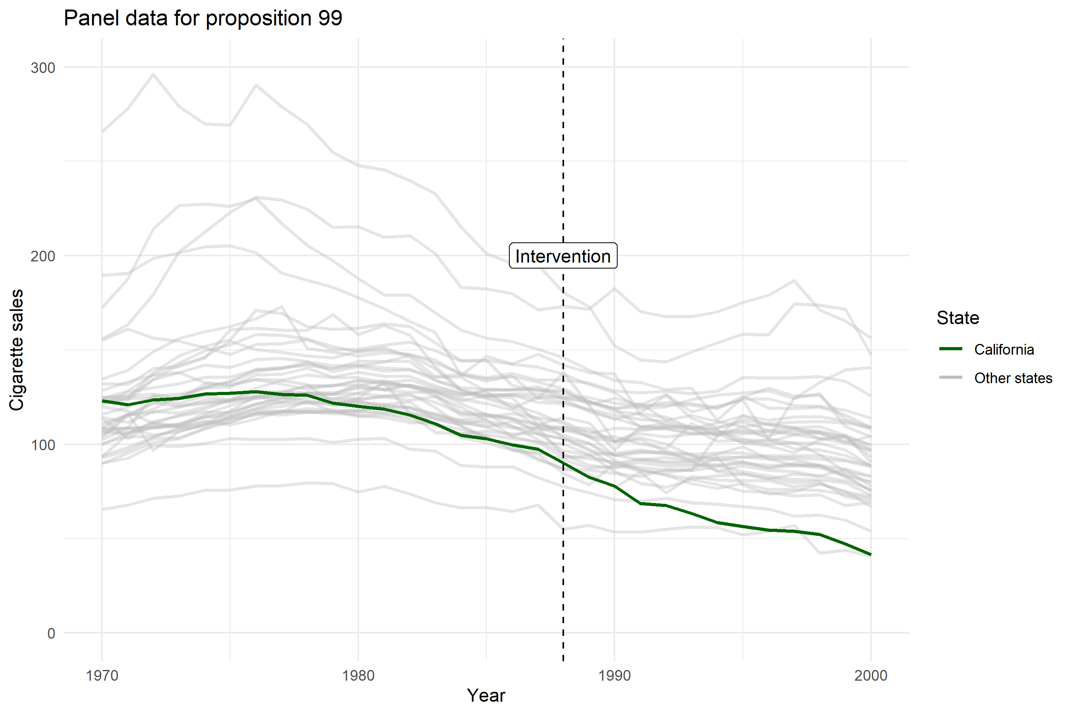
Notes:
cigsale: packs of cigarettes per 100 000 people

Slide 5
Causal Policy Evaluation
Basic Structure:
We have one (or more) unit(s) which we observe before and after some intervention or action
Did the intervention produce a change in the outcome for that unit?
Many different methods/approaches which differ in:
The amount and type of information they use
Amount of time-points and amount of potential “control” units
The specific statistical approach they take
The types of assumptions they rely on for identification

Slide 6
Causal Policy Evaluation
Basic Structure:
We have one (or more) unit(s) which we observe before and after some intervention or action
Did the intervention produce a change in the outcome for that unit?
Many different methods/approaches which differ in:
The amount and type of information they use
Amount of time-points and amount of potential “control” units
The specific statistical approach they take
The types of assumptions they rely on for identification

Slide 7
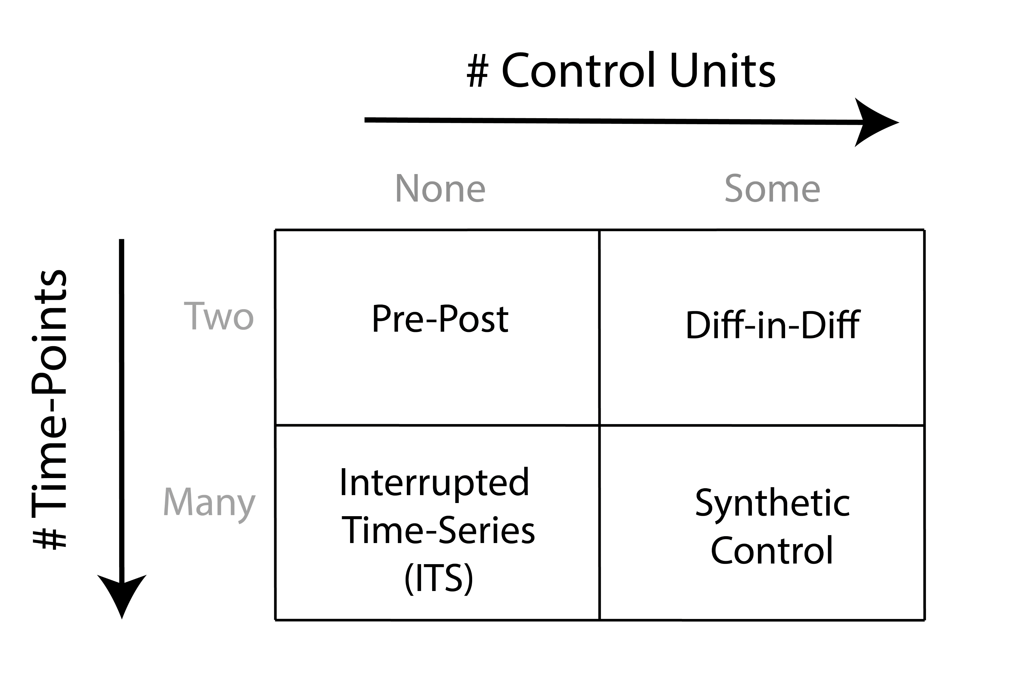

Slide 8
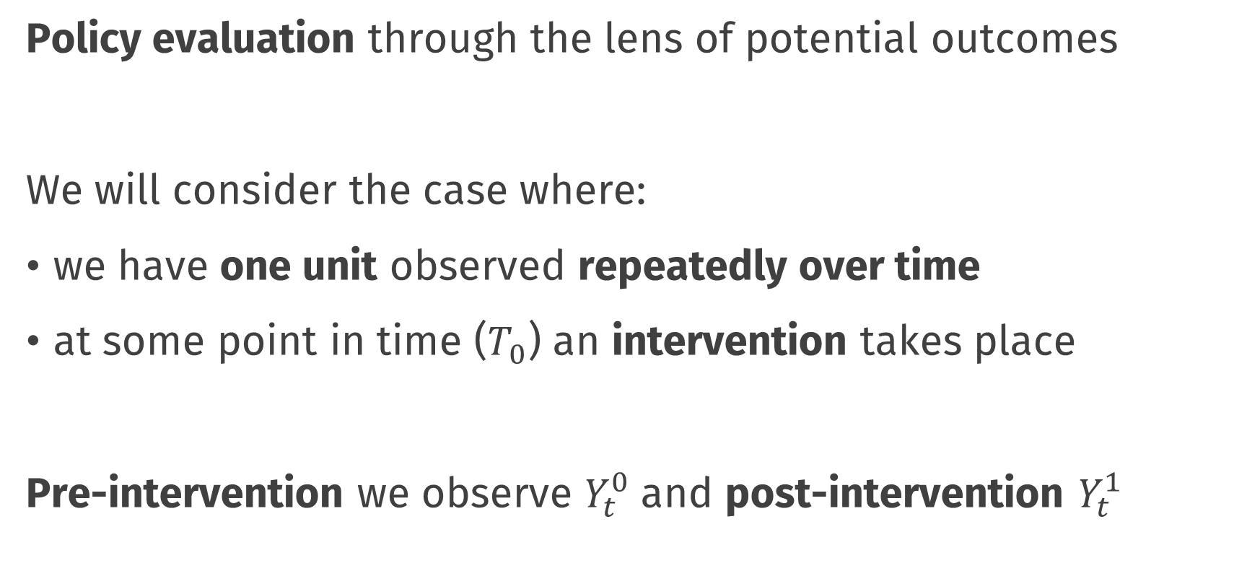
This Lecture
Policy evaluation through the lens of potential outcomes
We will consider the case where:
we have one unit observed repeatedly over time
at some point in time ($T_{0}$) an intervention takes place
Pre-intervention we observe $Y_{t}^{0}$ and post-intervention $Y_{t}^{1}$

Slide 9
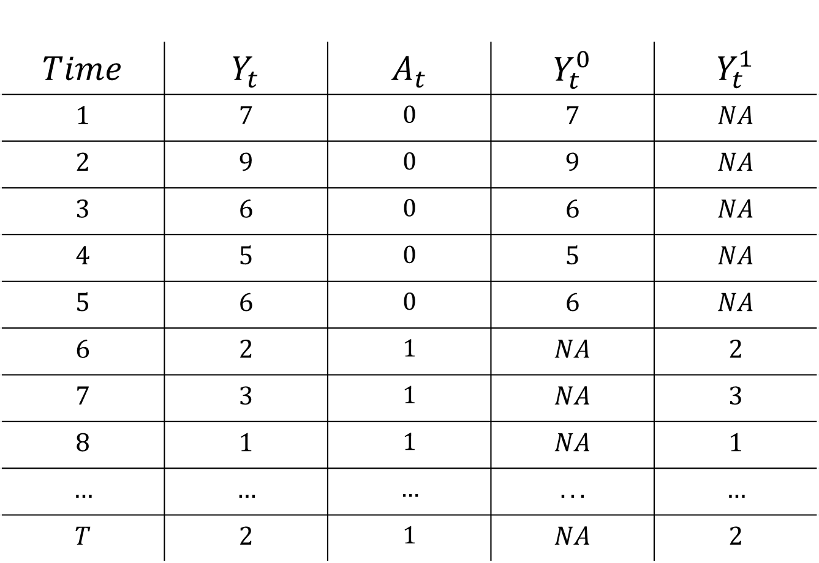
$$Time$$ | $$Y_{t}$$ | $$A_{t}$$ | $$Y_{t}^{0}$$ | $$Y_{t}^{1}$$
$$1$$ | $$7$$ | $$0$$ | $$7$$ | $$NA$$
$$2$$ | $$9$$ | $$0$$ | $$9$$ | $$NA$$
$$3$$ | $$6$$ | $$0$$ | $$6$$ | $$NA$$
$$4$$ | $$5$$ | $$0$$ | $$5$$ | $$NA$$
$$5$$ | $$6$$ | $$0$$ | $$6$$ | $$NA$$
$$6$$ | $$2$$ | $$1$$ | $$NA$$ | $$2$$
$$7$$ | $$3$$ | $$1$$ | $$NA$$ | $$3$$
$$8$$ | $$1$$ | $$1$$ | $$NA$$ | $$1$$
$$…$$ | $$…$$ | $$…$$ | $$...$$ | $$…$$
$$T$$ | $$2$$ | $$1$$ | $$NA$$ | $$2$$

Slide 10
$$Time$$ | $$Y_{t}$$ | $$A_{t}$$ | $$Y_{t}^{0}$$ | $$Y_{t}^{1}$$
$$1$$ | $$7$$ | $$0$$ | $$7$$ | $$NA$$
$$2$$ | $$9$$ | $$0$$ | $$9$$ | $$NA$$
$$3$$ | $$6$$ | $$0$$ | $$6$$ | $$NA$$
$$4$$ | $$5$$ | $$0$$ | $$5$$ | $$NA$$
$$5$$ | $$6$$ | $$0$$ | $$6$$ | $$NA$$
$$6$$ | $$2$$ | $$1$$ | $$NA$$ | $$2$$
$$7$$ | $$3$$ | $$1$$ | $$NA$$ | $$3$$
$$8$$ | $$1$$ | $$1$$ | $$NA$$ | $$1$$
$$…$$ | $$…$$ | $$…$$ | $$...$$ | $$…$$
$$T$$ | $$2$$ | $$1$$ | $$NA$$ | $$2$$

Slide 11
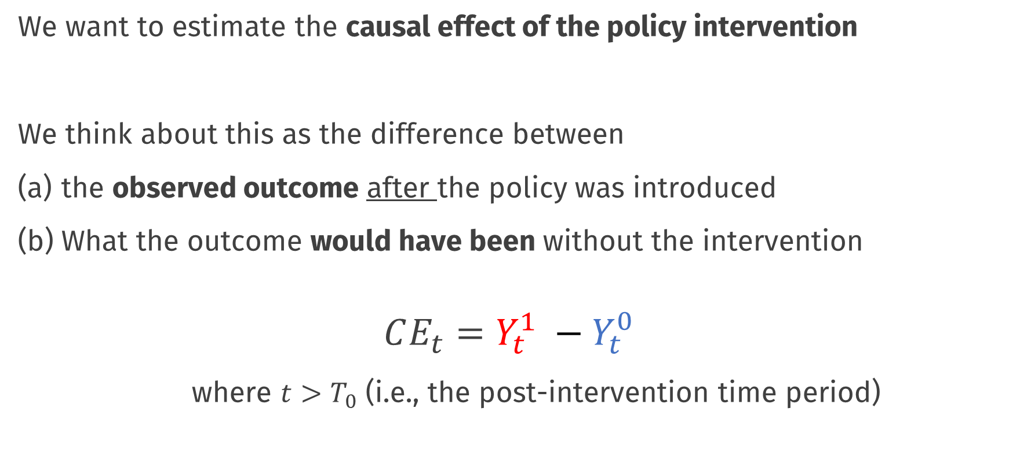
Causal Effects of Policies
We want to estimate the causal effect of the policy intervention
We think about this as the difference between
the observed outcome after the policy was introduced
What the outcome would have been without the intervention
$$CE_{t}=Y_{t}^{1} −Y_{t}^{0}$$
where $t>T_{0}$ (i.e., the post-intervention time period)

Slide 12
$$Time$$ | $$Y_{t}$$ | $$A_{t}$$ | $$Y_{t}^{0}$$ | $$Y_{t}^{1}$$
$$1$$ | $$7$$ | $$0$$ | $$7$$ | $$NA$$
$$2$$ | $$9$$ | $$0$$ | $$9$$ | $$NA$$
$$3$$ | $$6$$ | $$0$$ | $$6$$ | $$NA$$
$$4$$ | $$5$$ | $$0$$ | $$5$$ | $$NA$$
$$5$$ | $$6$$ | $$0$$ | $$6$$ | $$NA$$
$$6$$ | $$2$$ | $$1$$ | $$NA$$ | $$2$$
$$7$$ | $$3$$ | $$1$$ | $$NA$$ | $$3$$
$$8$$ | $$1$$ | $$1$$ | $$NA$$ | $$1$$
$$…$$ | $$…$$ | $$…$$ | $$...$$ | $$…$$
$$T$$ | $$2$$ | $$1$$ | $$NA$$ | $$2$$

Slide 13
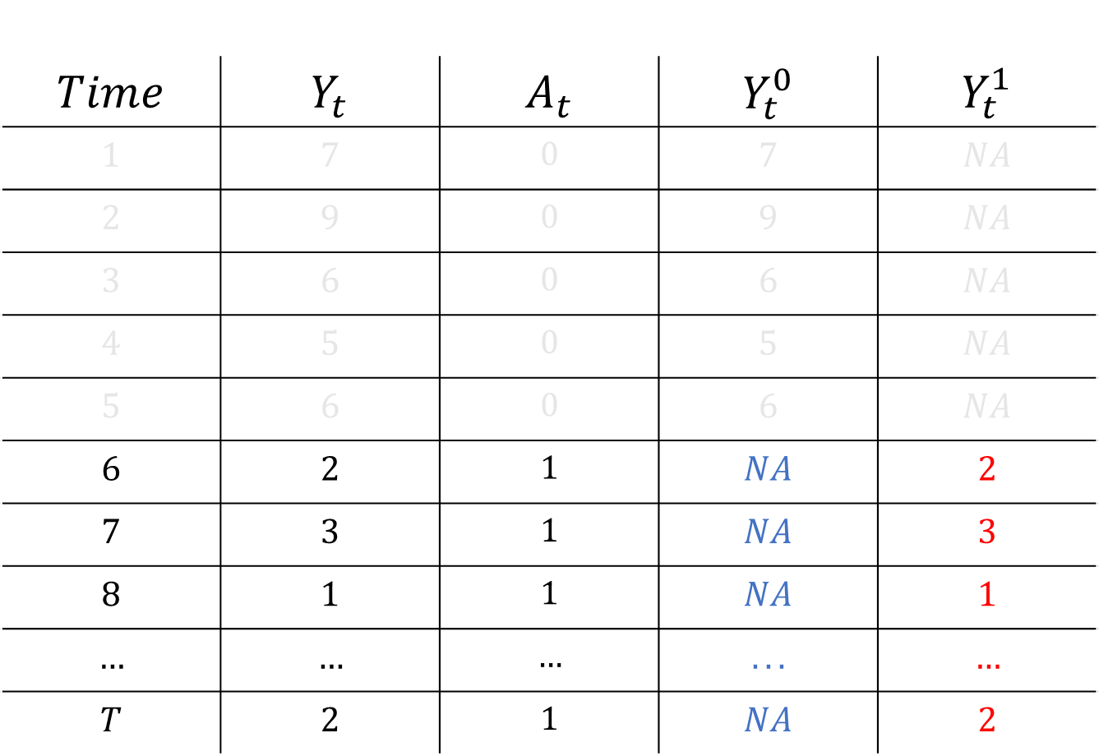
$$Time$$ | $$Y_{t}$$ | $$A_{t}$$ | $$Y_{t}^{0}$$ | $$Y_{t}^{1}$$
$$1$$ | $$7$$ | $$0$$ | $$7$$ | $$NA$$
$$2$$ | $$9$$ | $$0$$ | $$9$$ | $$NA$$
$$3$$ | $$6$$ | $$0$$ | $$6$$ | $$NA$$
$$4$$ | $$5$$ | $$0$$ | $$5$$ | $$NA$$
$$5$$ | $$6$$ | $$0$$ | $$6$$ | $$NA$$
$$6$$ | $$2$$ | $$1$$ | $$NA$$ | $$2$$
$$7$$ | $$3$$ | $$1$$ | $$NA$$ | $$3$$
$$8$$ | $$1$$ | $$1$$ | $$NA$$ | $$1$$
$$…$$ | $$…$$ | $$…$$ | $$...$$ | $$…$$
$$T$$ | $$2$$ | $$1$$ | $$NA$$ | $$2$$
Notes:
Conceptually: similar to the “ATT” or “treatment effect on the treated”

Slide 14

The problem of estimating the effect of a policy intervention is equivalent to the problem of estimating $Y_{t}^{0}$
Abadie, A. (2021). Using synthetic controls: Feasibility, data requirements, and methodological aspects. Journal of Economic Literature, 59(2), 391-425.

Slide 15
Pre-Post Estimator

Slide 16
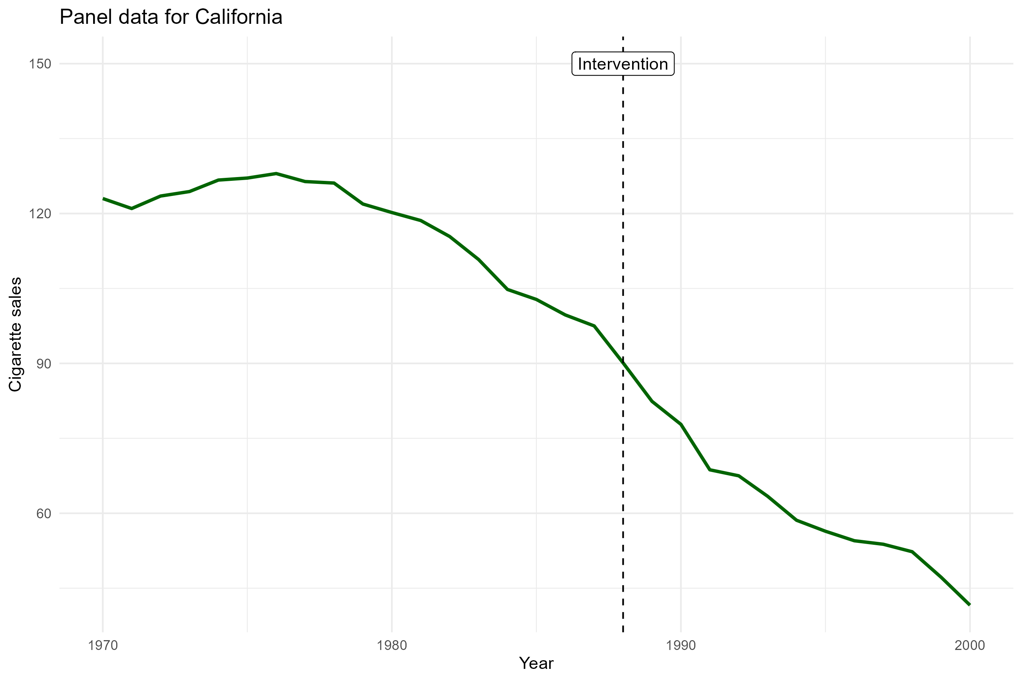
Pre-post estimator
We use only the cigarette sales time series for California

Slide 17
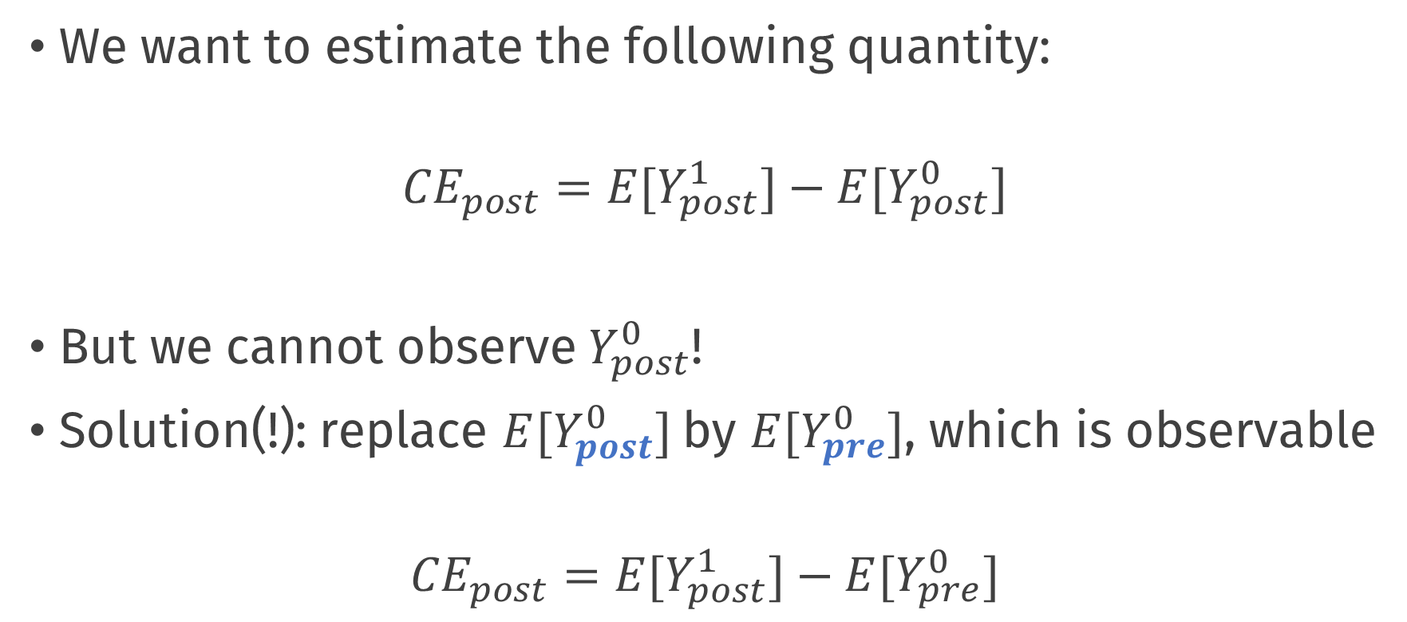
Pre-post estimator
We want to estimate the following quantity:
$${CE}_{post}={E[Y}_{post}^{1}]−{E[Y}_{post}^{0}]$$
But we cannot observe${ Y}_{post}^{0}$!
Solution(!): replace ${E[Y}_{post}^{0}]$by ${E[Y}_{pre}^{0}]$, which is observable
$${CE}_{post}={E[Y}_{post}^{1}]−{E[Y}_{pre}^{0}]$$

Slide 18
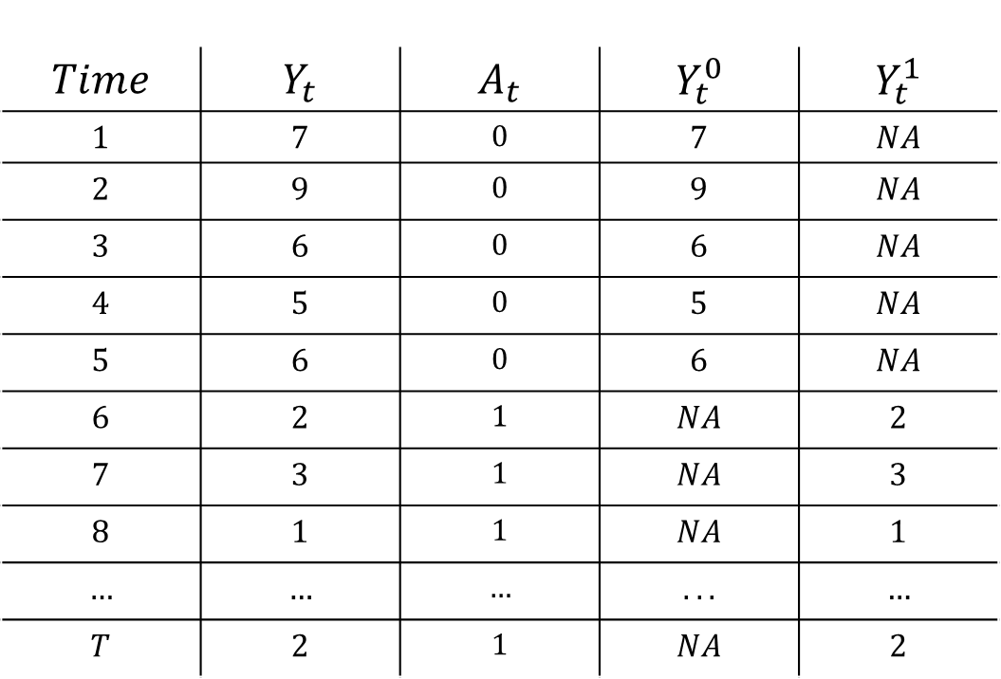
Pre – Post analysis
$$Time$$ | $$Y_{t}$$ | $$A_{t}$$ | $$Y_{t}^{0}$$ | $$Y_{t}^{1}$$
$$1$$ | $$7$$ | $$0$$ | $$7$$ | $$NA$$
$$2$$ | $$9$$ | $$0$$ | $$9$$ | $$NA$$
$$3$$ | $$6$$ | $$0$$ | $$6$$ | $$NA$$
$$4$$ | $$5$$ | $$0$$ | $$5$$ | $$NA$$
$$5$$ | $$6$$ | $$0$$ | $$6$$ | $$NA$$
$$6$$ | $$2$$ | $$1$$ | $$NA$$ | $$2$$
$$7$$ | $$3$$ | $$1$$ | $$NA$$ | $$3$$
$$8$$ | $$1$$ | $$1$$ | $$NA$$ | $$1$$
$$…$$ | $$…$$ | $$…$$ | $$...$$ | $$…$$
$$T$$ | $$2$$ | $$1$$ | $$NA$$ | $$2$$
$${\overline{Y}}_{pre}^{0}$$
$${\overline{Y}}_{post}^{1}$$

Slide 19
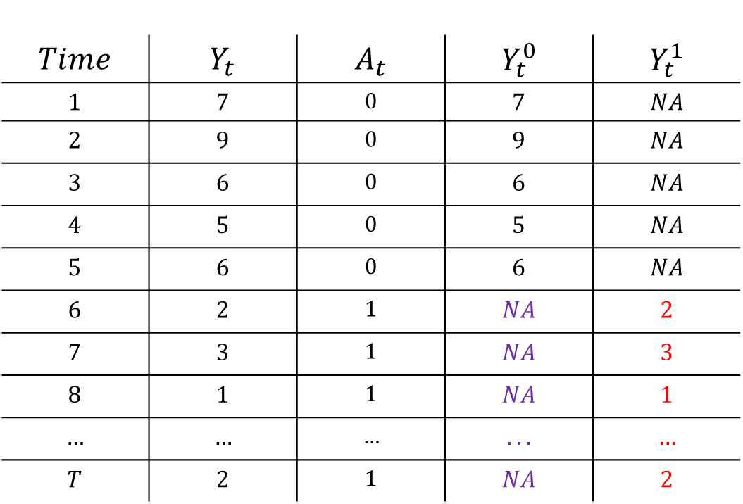

Pre – Post analysis
$$Time$$ | $$Y_{t}$$ | $$A_{t}$$ | $$Y_{t}^{0}$$ | $$Y_{t}^{1}$$
$$1$$ | $$7$$ | $$0$$ | $$7$$ | $$NA$$
$$2$$ | $$9$$ | $$0$$ | $$9$$ | $$NA$$
$$3$$ | $$6$$ | $$0$$ | $$6$$ | $$NA$$
$$4$$ | $$5$$ | $$0$$ | $$5$$ | $$NA$$
$$5$$ | $$6$$ | $$0$$ | $$6$$ | $$NA$$
$$6$$ | $$2$$ | $$1$$ | $$NA$$ | $$2$$
$$7$$ | $$3$$ | $$1$$ | $$NA$$ | $$3$$
$$8$$ | $$1$$ | $$1$$ | $$NA$$ | $$1$$
$$…$$ | $$…$$ | $$…$$ | $$...$$ | $$…$$
$$T$$ | $$2$$ | $$1$$ | $$NA$$ | $$2$$
$${\overline{Y}}_{pre}^{0}$$
Assume equal to
$${\overline{Y}}_{post}^{1}$$
$${ − \overline{Y}}_{post}^{0}$$
$${\hat{CE}}_{post}={\overline{Y}}_{post}^{1}−{\overline{Y}}_{post}^{0}$$

Slide 20
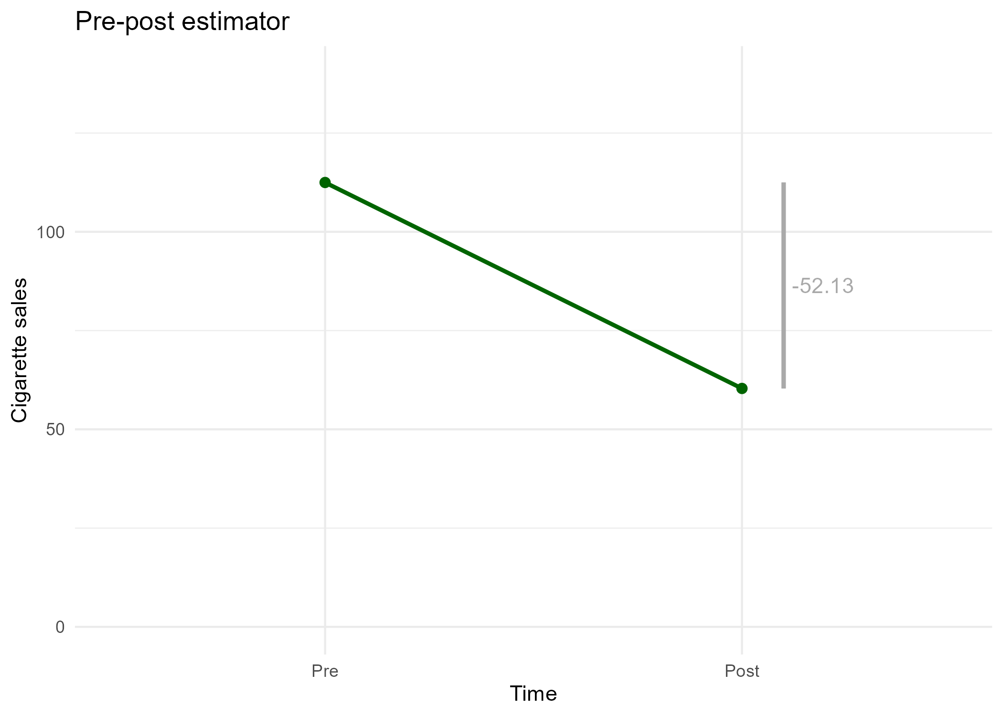
Pre-post estimator
Can estimate uncertainty by using a regression model on the disaggregated data, correcting SEs for unmodelled autocorrelation
Notes:
The causal effect of the tax increase on cigarette sales is an average yearly decrease of 52 packs of cigarettes per 100000 people

Slide 21
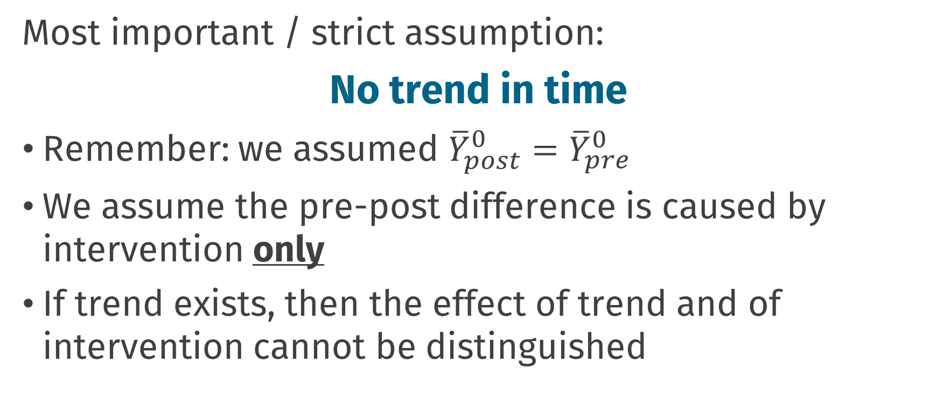
Pre-post estimator
Most important / strict assumption:
No trend in time
Remember: we assumed ${\overline{Y}}_{post}^{0}={\overline{Y}}_{pre}^{0}$
We assume the pre-post difference is caused by intervention only
If trend exists, then the effect of trend and of intervention cannot be distinguished

Slide 22
Difference-in-Differences

Slide 23
,,transparent and often at least superficially plausible”
Angrist, J. D. and Krueger, A. B. (1999). Empirical strategies in labor economics. In Handbook of labor economics, volume 3, pages 1277–1366. Elsevier.

Slide 24
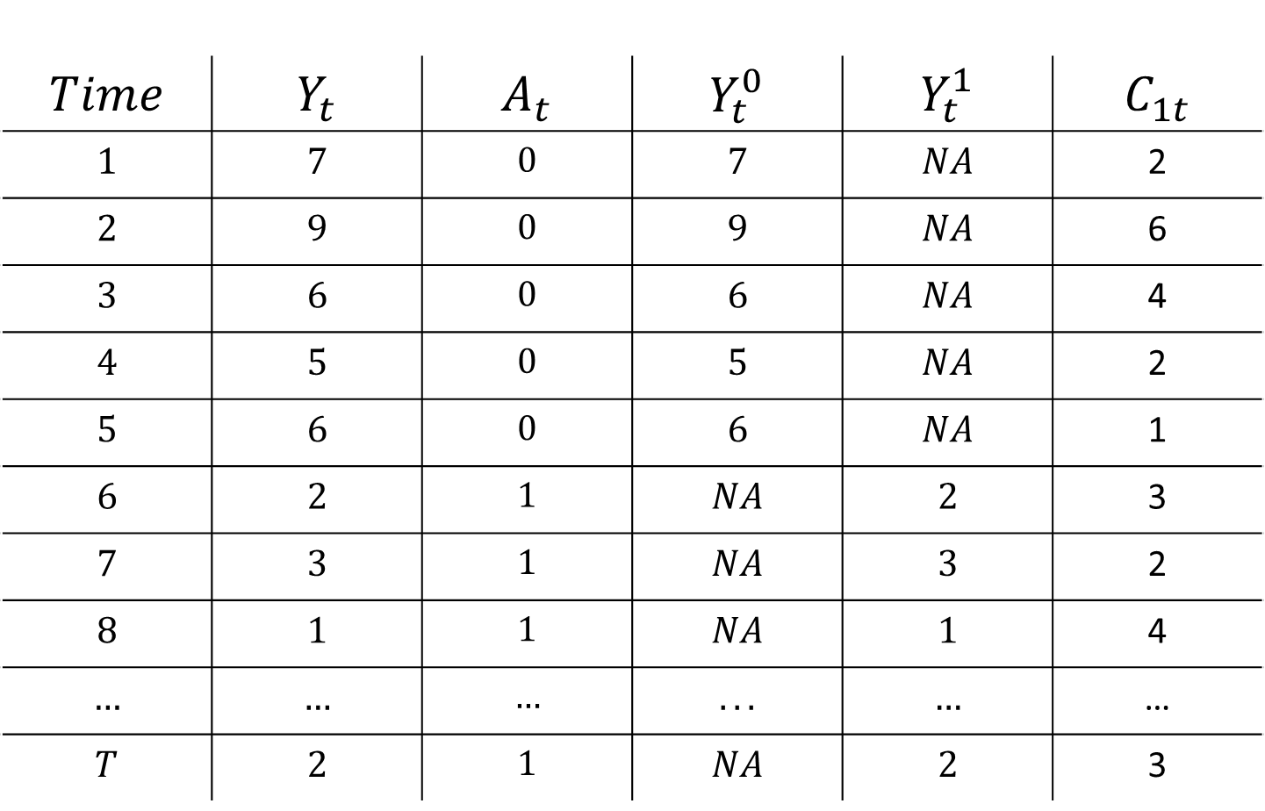
$$Time$$ | $$Y_{t}$$ | $$A_{t}$$ | $$Y_{t}^{0}$$ | $$Y_{t}^{1}$$ | $$C_{1t}$$
$$1$$ | $$7$$ | $$0$$ | $$7$$ | $$NA$$ | 2
$$2$$ | $$9$$ | $$0$$ | $$9$$ | $$NA$$ | 6
$$3$$ | $$6$$ | $$0$$ | $$6$$ | $$NA$$ | 4
$$4$$ | $$5$$ | $$0$$ | $$5$$ | $$NA$$ | 2
$$5$$ | $$6$$ | $$0$$ | $$6$$ | $$NA$$ | 1
$$6$$ | $$2$$ | $$1$$ | $$NA$$ | $$2$$ | 3
$$7$$ | $$3$$ | $$1$$ | $$NA$$ | $$3$$ | 2
$$8$$ | $$1$$ | $$1$$ | $$NA$$ | $$1$$ | 4
$$…$$ | $$…$$ | $$…$$ | $$...$$ | $$…$$ | …
$$T$$ | $$2$$ | $$1$$ | $$NA$$ | $$2$$ | 3
Notes:
The key extra piece of information here is the addition of a control time series; observations of the same variable, for a different unit, which does not receive the intervention

Slide 25
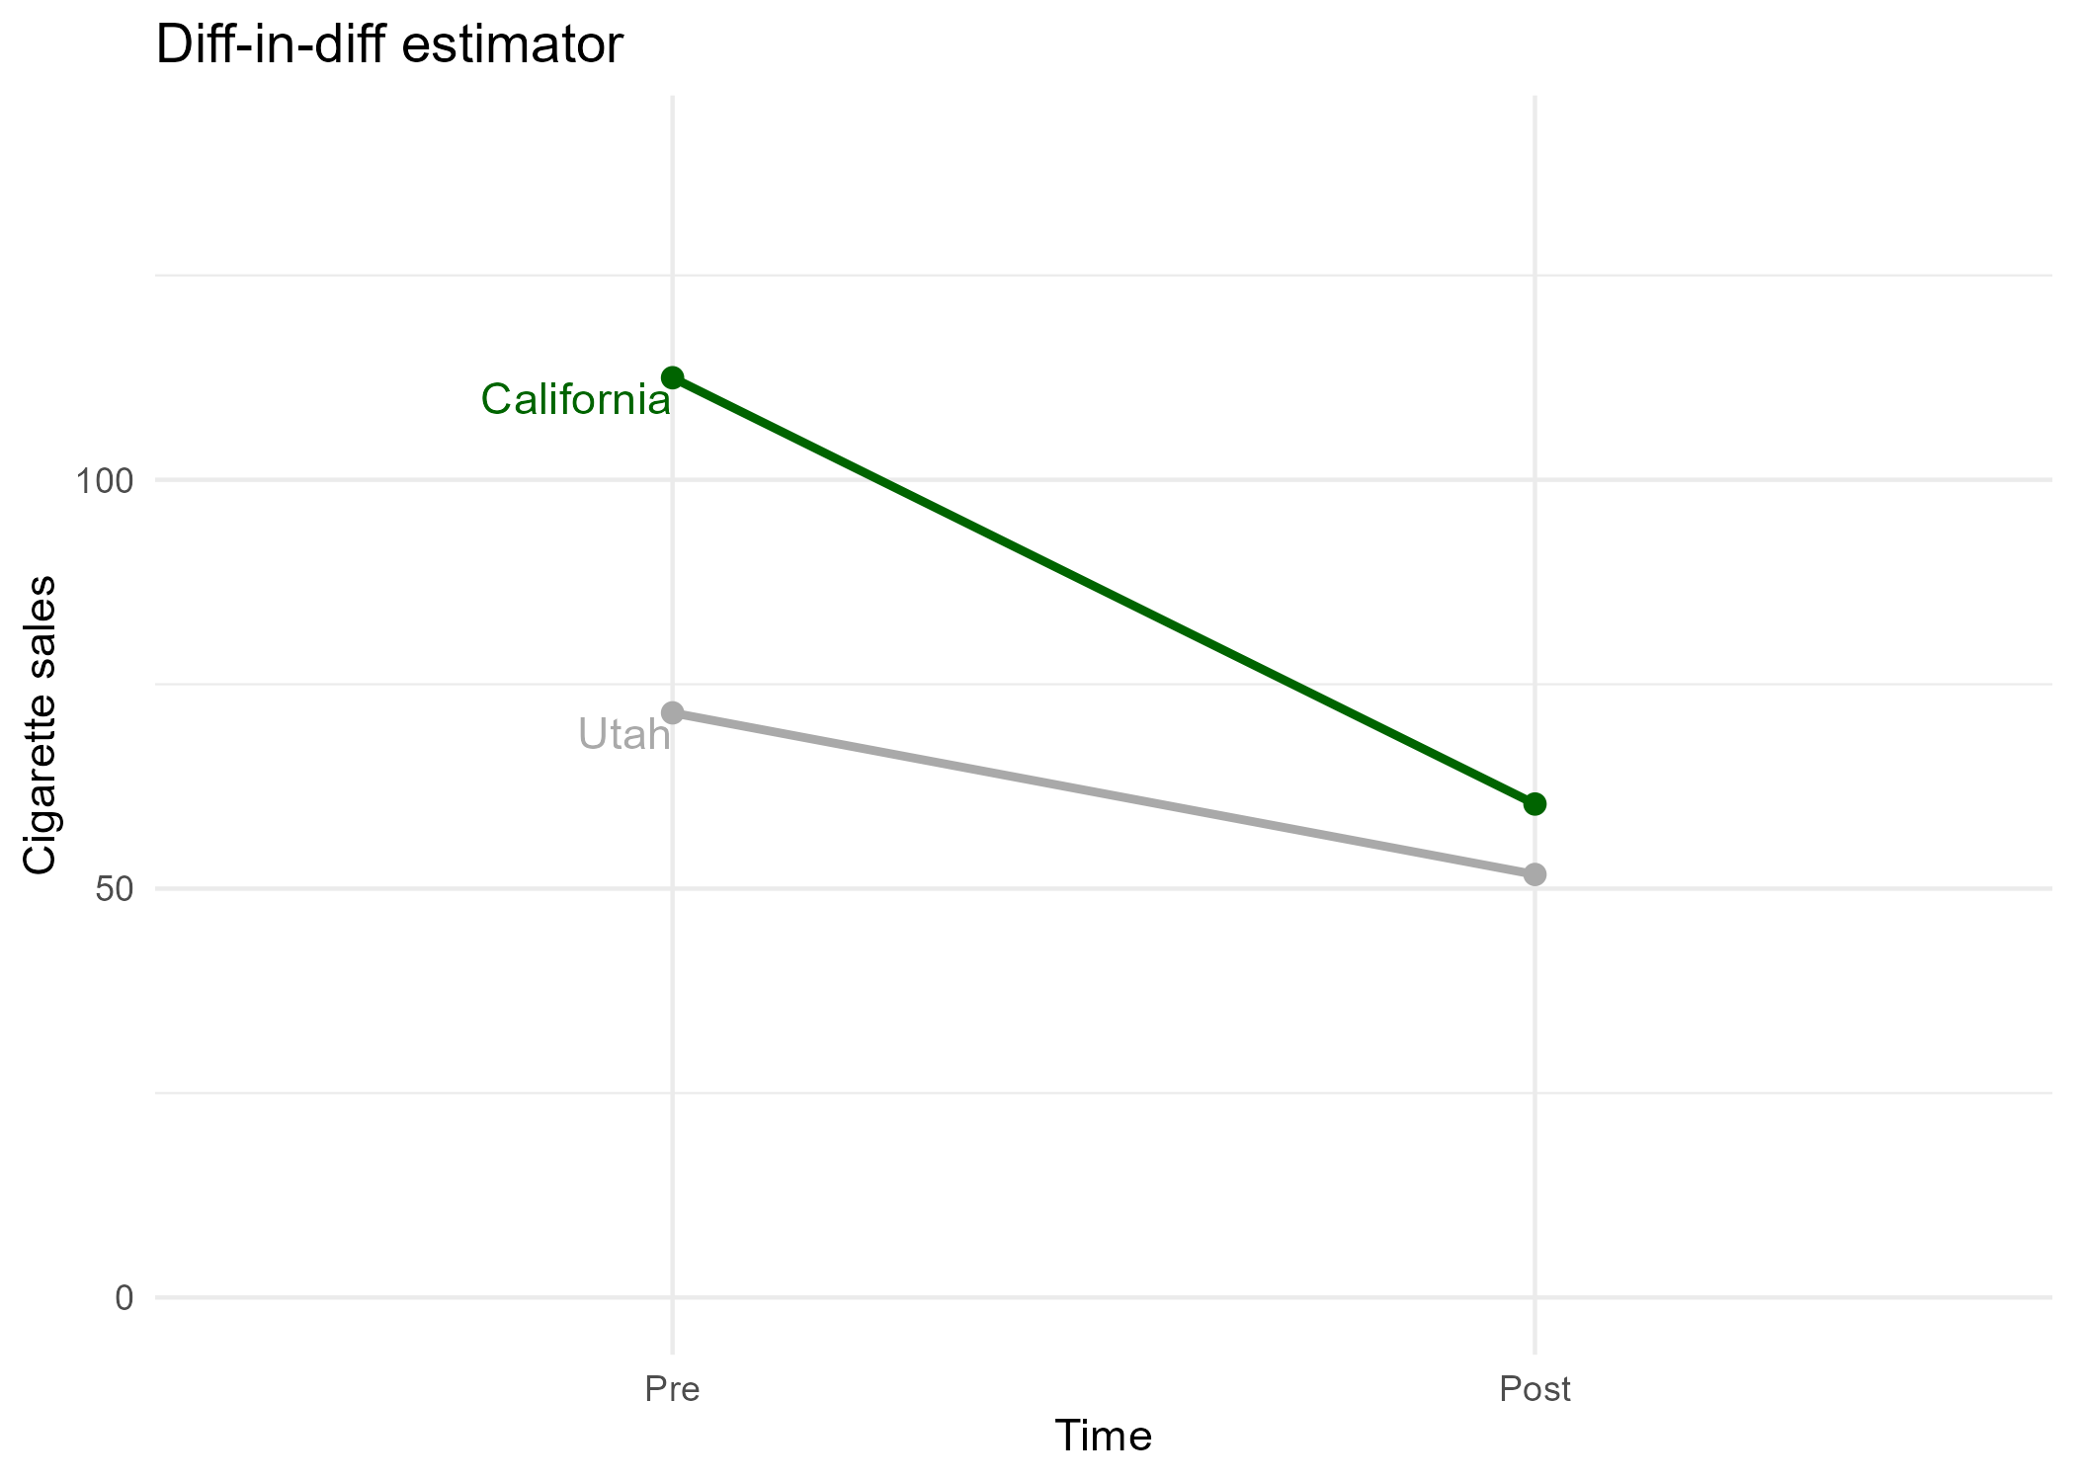
Difference-in-differences

Slide 26
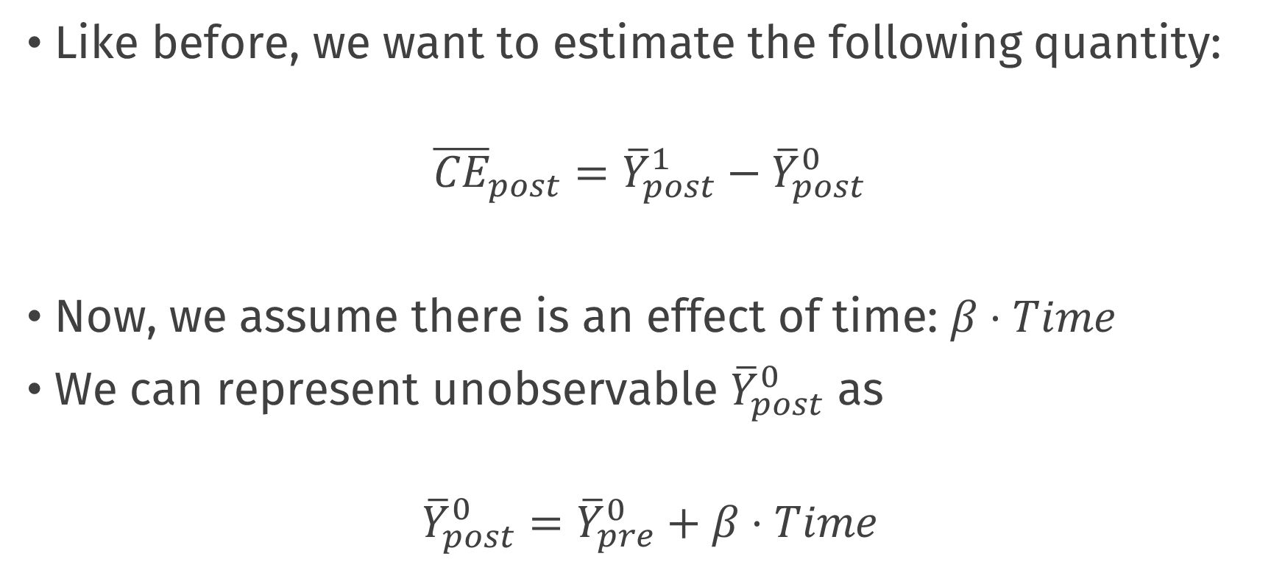
Difference-in-differences
Like before, we want to estimate the following quantity:
$${\overline{CE}}_{post}={\overline{Y}}_{post}^{1}−{\overline{Y}}_{post}^{0}$$
Now, we assume there is an effect of time: $β⋅Time$
We can represent unobservable ${\overline{Y}}_{post}^{0}$ as
$${\overline{Y}}_{post}^{0}={\overline{Y}}_{pre}^{0}+β⋅Time$$

Slide 27
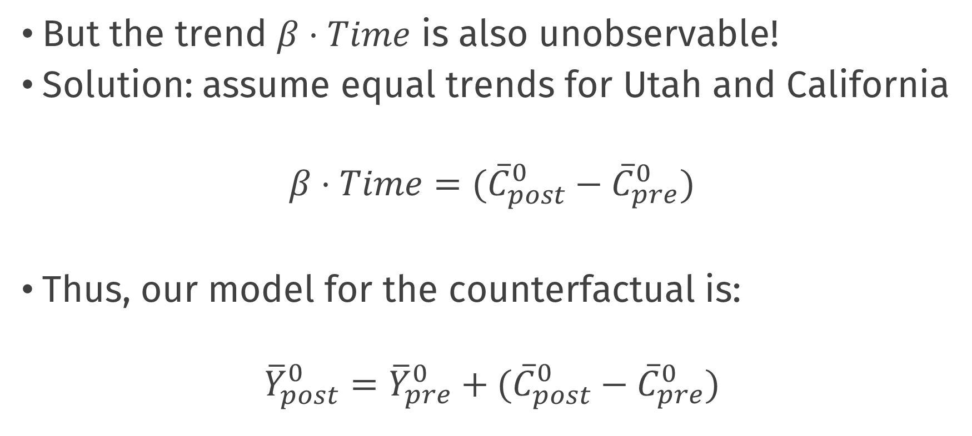
Difference-in-differences
But the trend $β⋅Time$ is also unobservable!
Solution: assume equal trends for Utah and California
$$β⋅Time=({\overline{C}}_{post}^{0}−{\overline{C}}_{pre}^{0})$$
Thus, our model for the counterfactual is:
$${\overline{Y}}_{post}^{0}={\overline{Y}}_{pre}^{0}+({\overline{C}}_{post}^{0}−{\overline{C}}_{pre}^{0})$$

Slide 28
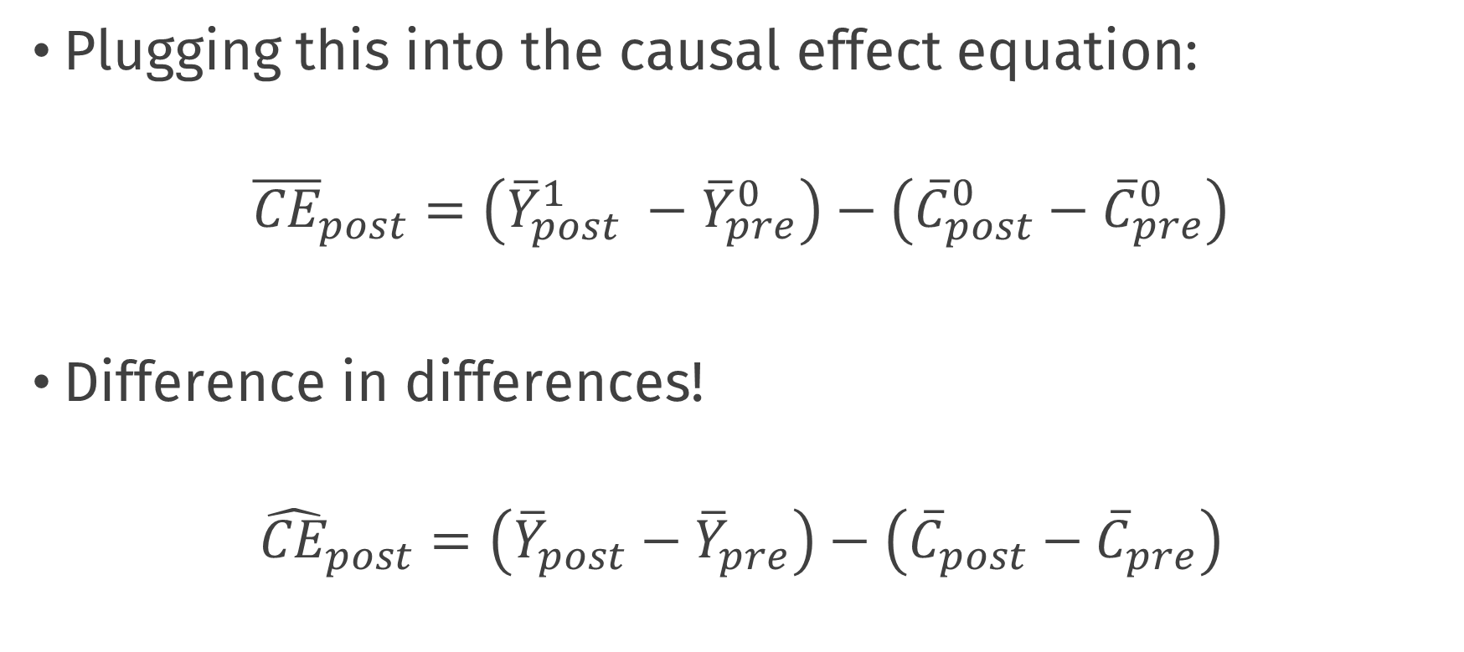
Difference-in-differences
Plugging this into the causal effect equation:
$${\overline{CE}}_{post}=\left({\overline{Y}}_{post}^{1} −{\overline{Y}}_{pre}^{0}\right)−\left({\overline{C}}_{post}^{0}−{\overline{C}}_{pre}^{0}\right)$$
Difference in differences!
$${\hat{CE}}_{post}=\left({\overline{Y}}_{post}−{\overline{Y}}_{pre}\right)−\left({\overline{C}}_{post}−{\overline{C}}_{pre}\right)$$

Slide 29
Difference-in-differences

Slide 30




Difference-in-differences
$${\overline{Y}}_{pre}^{0}$$
$${\overline{Y}}_{post}^{1}$$
$${\overline{C}}_{pre}^{0}$$
$${\overline{C}}_{post}^{0}$$

Slide 31
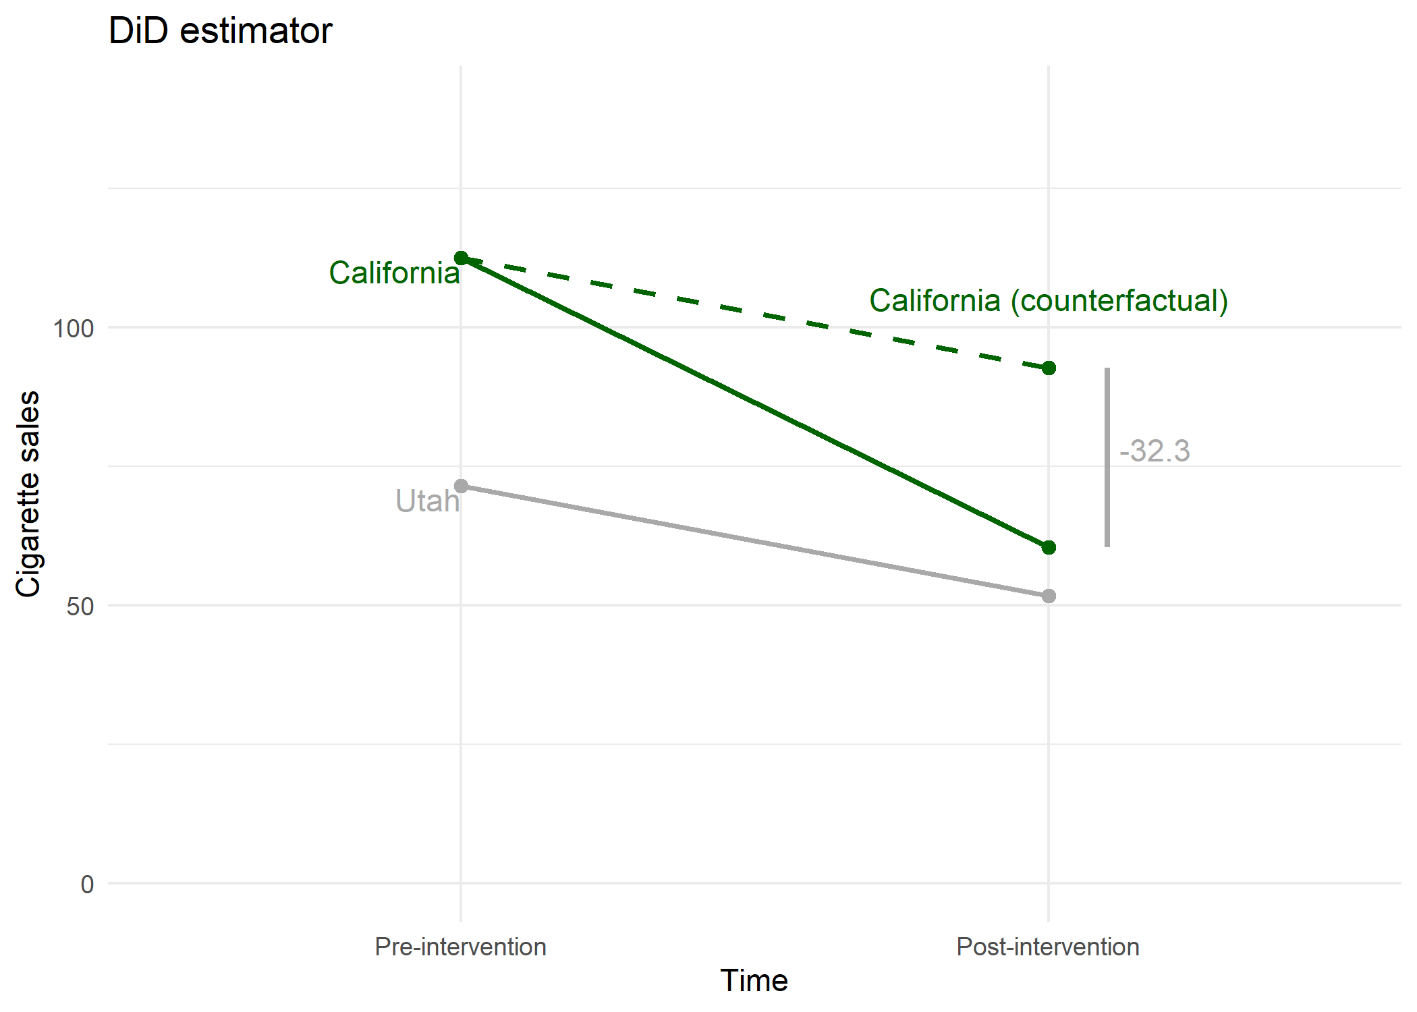

Difference-in-differences
$${\overline{Y}}_{pre}^{0}$$
$${\overline{Y}}_{post}^{0}$$
$${\overline{Y}}_{post}^{1}$$
$${\overline{C}}_{pre}^{0}$$
$${\overline{C}}_{post}^{0}$$

Slide 32
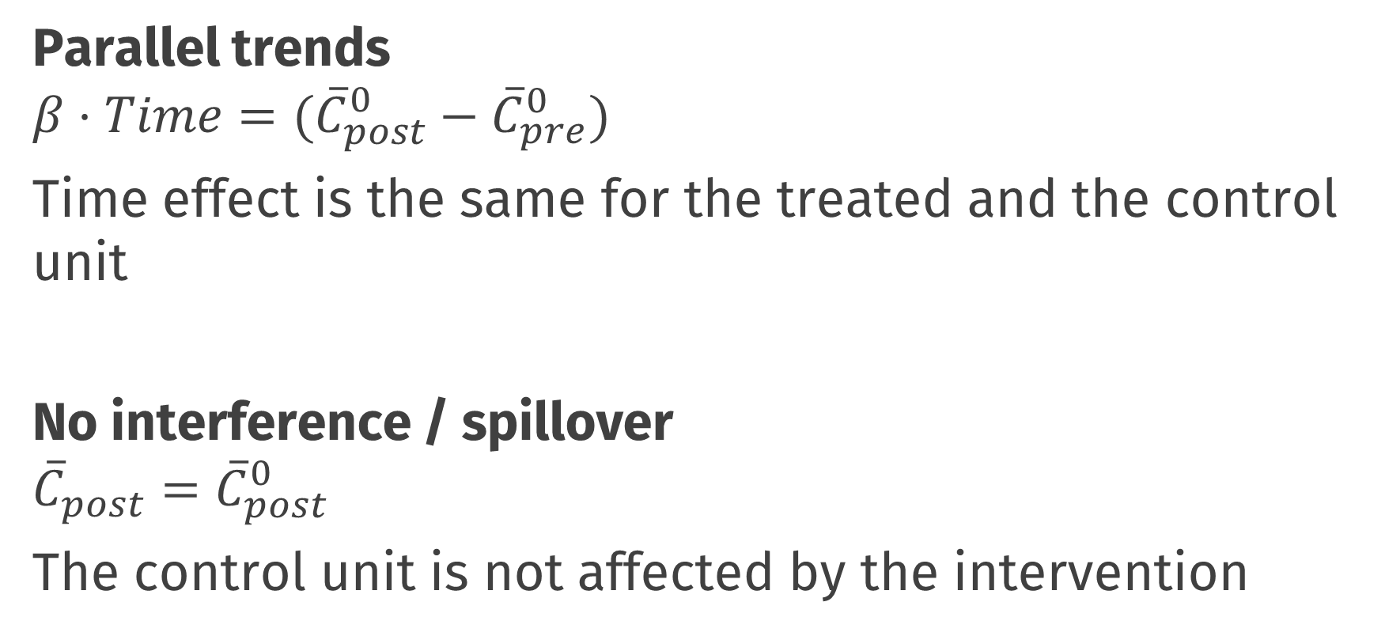
Most important assumptions
Parallel trends
$$β⋅Time=({\overline{C}}_{post}^{0}−{\overline{C}}_{pre}^{0})$$
Time effect is the same for the treated and the control unit
No interference / spillover
$${{\overline{C}}_{post}=\overline{C}}_{post}^{0}$$
The control unit is not affected by the intervention
Notes:
No interference; the fact that California has a smoking ban has no effect on cigarette sales in Utah (cig sales in Utah is the same as it would have been if California had no cigarette ban).

Slide 33
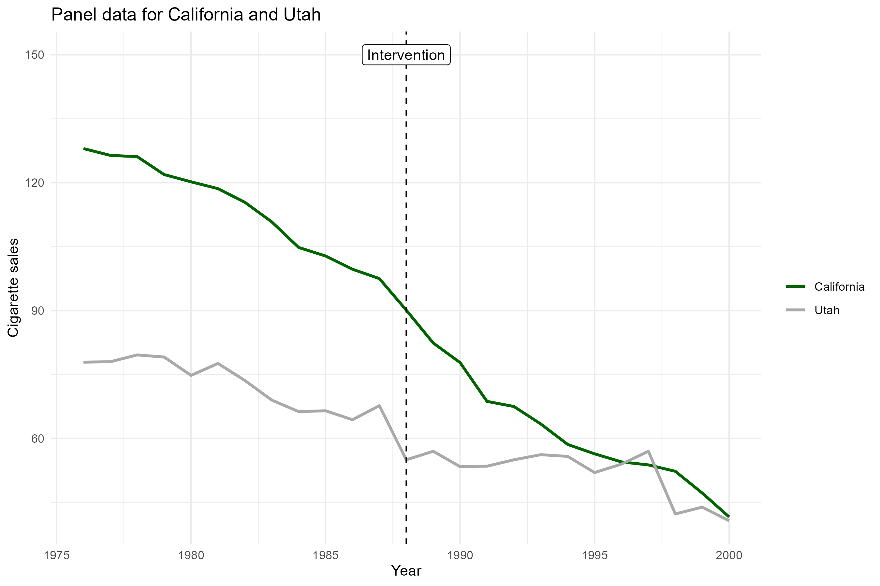
Most important assumptions
Can we assume parallel trends?
Superficially plausible?

Slide 35
Synthetic Control

Slide 36
,,arguably the most important innovation in the policy evaluation literature in the last 15 years”
Athey, S., & Imbens, G. W. (2017). The state of applied econometrics: Causality and policy evaluation. Journal of Economic perspectives, 31(2), 3-32.

Slide 37
Basic idea
With diff-in-diff we used a control unit to attempt a correction for unmeasured time-varying confounders (e.g., macroeconomic situation in U.S.A.)
You need a good control unit to make the parallel trends assumption at least superficially plausible
But how much is Utah really like California?
We can instead use a weighted average of a donor pool of control units to create a synthetic control unit
Choose the weights such that control is like California

Slide 39
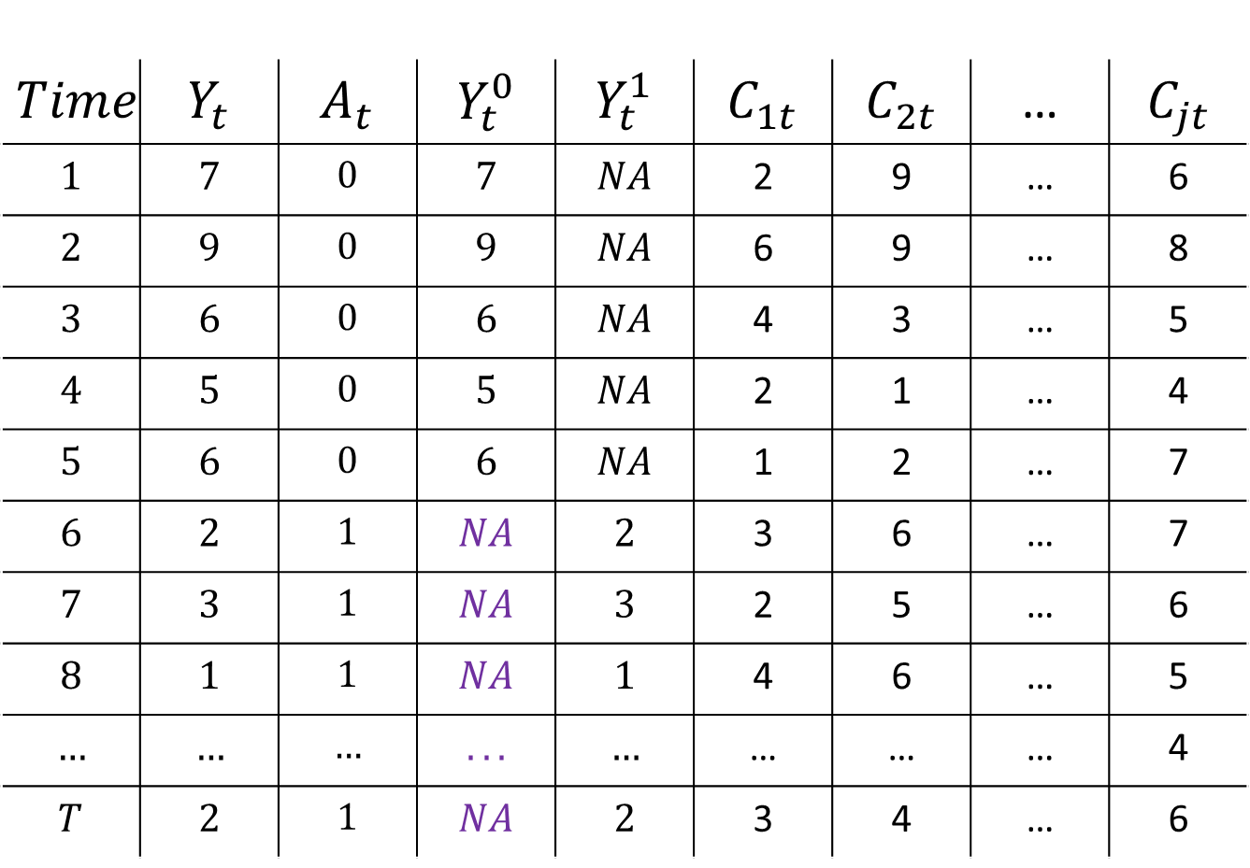
$$Time$$ | $$Y_{t}$$ | $$A_{t}$$ | $$Y_{t}^{0}$$ | $$Y_{t}^{1}$$ | $$C_{1t}$$ | $$C_{2t}$$ | … | $$C_{jt}$$
$$1$$ | $$7$$ | $$0$$ | $$7$$ | $$NA$$ | 2 | 9 | … | 6
$$2$$ | $$9$$ | $$0$$ | $$9$$ | $$NA$$ | 6 | 9 | … | 8
$$3$$ | $$6$$ | $$0$$ | $$6$$ | $$NA$$ | 4 | 3 | … | 5
$$4$$ | $$5$$ | $$0$$ | $$5$$ | $$NA$$ | 2 | 1 | … | 4
$$5$$ | $$6$$ | $$0$$ | $$6$$ | $$NA$$ | 1 | 2 | … | 7
$$6$$ | $$2$$ | $$1$$ | $$NA$$ | $$2$$ | 3 | 6 | … | 7
$$7$$ | $$3$$ | $$1$$ | $$NA$$ | $$3$$ | 2 | 5 | … | 6
$$8$$ | $$1$$ | $$1$$ | $$NA$$ | $$1$$ | 4 | 6 | … | 5
$$…$$ | $$…$$ | $$…$$ | $$...$$ | $$…$$ | … | … | … | 4
$$T$$ | $$2$$ | $$1$$ | $$NA$$ | $$2$$ | 3 | 4 | … | 6

Slide 40

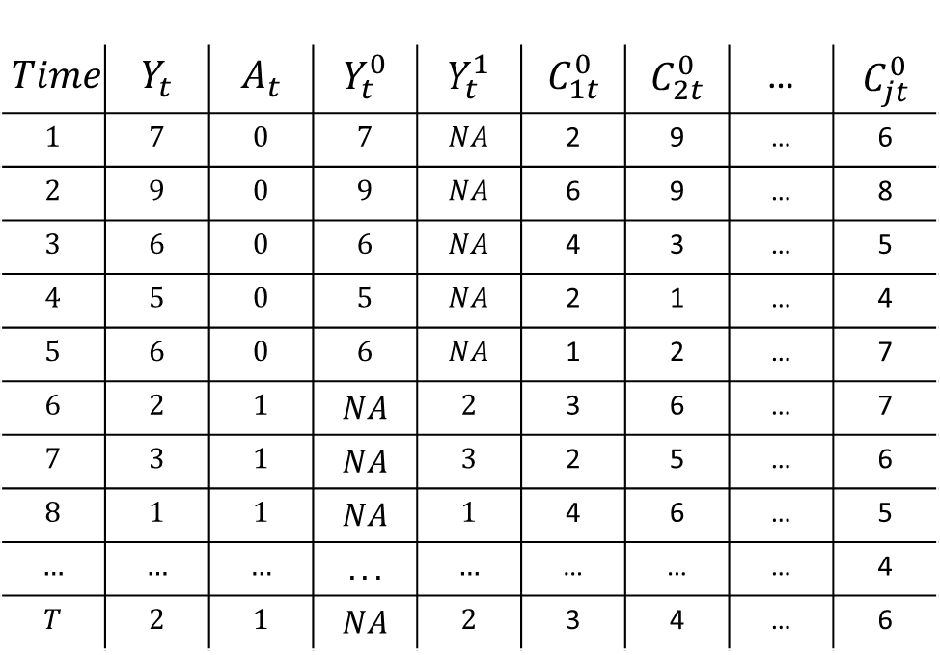

Synthetic Control
$$Time$$ | $$Y_{t}$$ | $$A_{t}$$ | $$Y_{t}^{0}$$ | $$Y_{t}^{1}$$ | $$C_{1t}^{0}$$ | $$C_{2t}^{0}$$ | … | $$C_{jt}^{0}$$
$$1$$ | $$7$$ | $$0$$ | $$7$$ | $$NA$$ | 2 | 9 | … | 6
$$2$$ | $$9$$ | $$0$$ | $$9$$ | $$NA$$ | 6 | 9 | … | 8
$$3$$ | $$6$$ | $$0$$ | $$6$$ | $$NA$$ | 4 | 3 | … | 5
$$4$$ | $$5$$ | $$0$$ | $$5$$ | $$NA$$ | 2 | 1 | … | 4
$$5$$ | $$6$$ | $$0$$ | $$6$$ | $$NA$$ | 1 | 2 | … | 7
$$6$$ | $$2$$ | $$1$$ | $$NA$$ | $$2$$ | 3 | 6 | … | 7
$$7$$ | $$3$$ | $$1$$ | $$NA$$ | $$3$$ | 2 | 5 | … | 6
$$8$$ | $$1$$ | $$1$$ | $$NA$$ | $$1$$ | 4 | 6 | … | 5
$$…$$ | $$…$$ | $$…$$ | $$...$$ | $$…$$ | … | … | … | 4
$$T$$ | $$2$$ | $$1$$ | $$NA$$ | $$2$$ | 3 | 4 | … | 6
Estimate Weights
$$Y_{t}= \sum_{j=1}^{J}{\hat{w_{j}}C_{jt}}$$
$$t<T_{0}$$

Slide 41


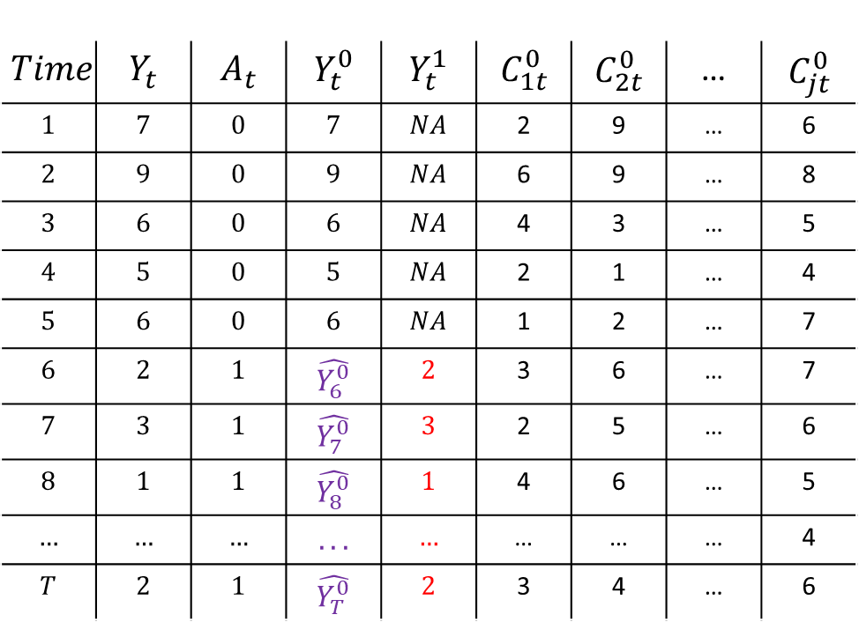


Synthetic Control
$$Time$$ | $$Y_{t}$$ | $$A_{t}$$ | $$Y_{t}^{0}$$ | $$Y_{t}^{1}$$ | $$C_{1t}^{0}$$ | $$C_{2t}^{0}$$ | … | $$C_{jt}^{0}$$
$$1$$ | $$7$$ | $$0$$ | $$7$$ | $$NA$$ | 2 | 9 | … | 6
$$2$$ | $$9$$ | $$0$$ | $$9$$ | $$NA$$ | 6 | 9 | … | 8
$$3$$ | $$6$$ | $$0$$ | $$6$$ | $$NA$$ | 4 | 3 | … | 5
$$4$$ | $$5$$ | $$0$$ | $$5$$ | $$NA$$ | 2 | 1 | … | 4
$$5$$ | $$6$$ | $$0$$ | $$6$$ | $$NA$$ | 1 | 2 | … | 7
$$6$$ | $$2$$ | $$1$$ | $$\hat{Y_{6}^{0}}$$ | $$2$$ | 3 | 6 | … | 7
$$7$$ | $$3$$ | $$1$$ | $$\hat{Y_{7}^{0}}$$ | $$3$$ | 2 | 5 | … | 6
$$8$$ | $$1$$ | $$1$$ | $$\hat{Y_{8}^{0}}$$ | $$1$$ | 4 | 6 | … | 5
$$…$$ | $$…$$ | $$…$$ | $$...$$ | $$…$$ | … | … | … | 4
$$T$$ | $$2$$ | $$1$$ | $$\hat{Y_{T}^{0}}$$ | $$2$$ | 3 | 4 | … | 6
Estimate Weights
$$Y_{t}= \sum_{j=1}^{J}{\hat{w_{j}}C_{jt}}$$
$$t<T_{0}$$
$$\hat{Y_{t}^{0}}= \sum_{j=1}^{J}{\hat{w_{j}}C_{jt}}$$
$$t>T_{0}$$
Impute counterfactual
$$\hat{CE_{t}}=Y_{t}^{1} −\hat{Y_{t}^{0}}$$

Slide 42
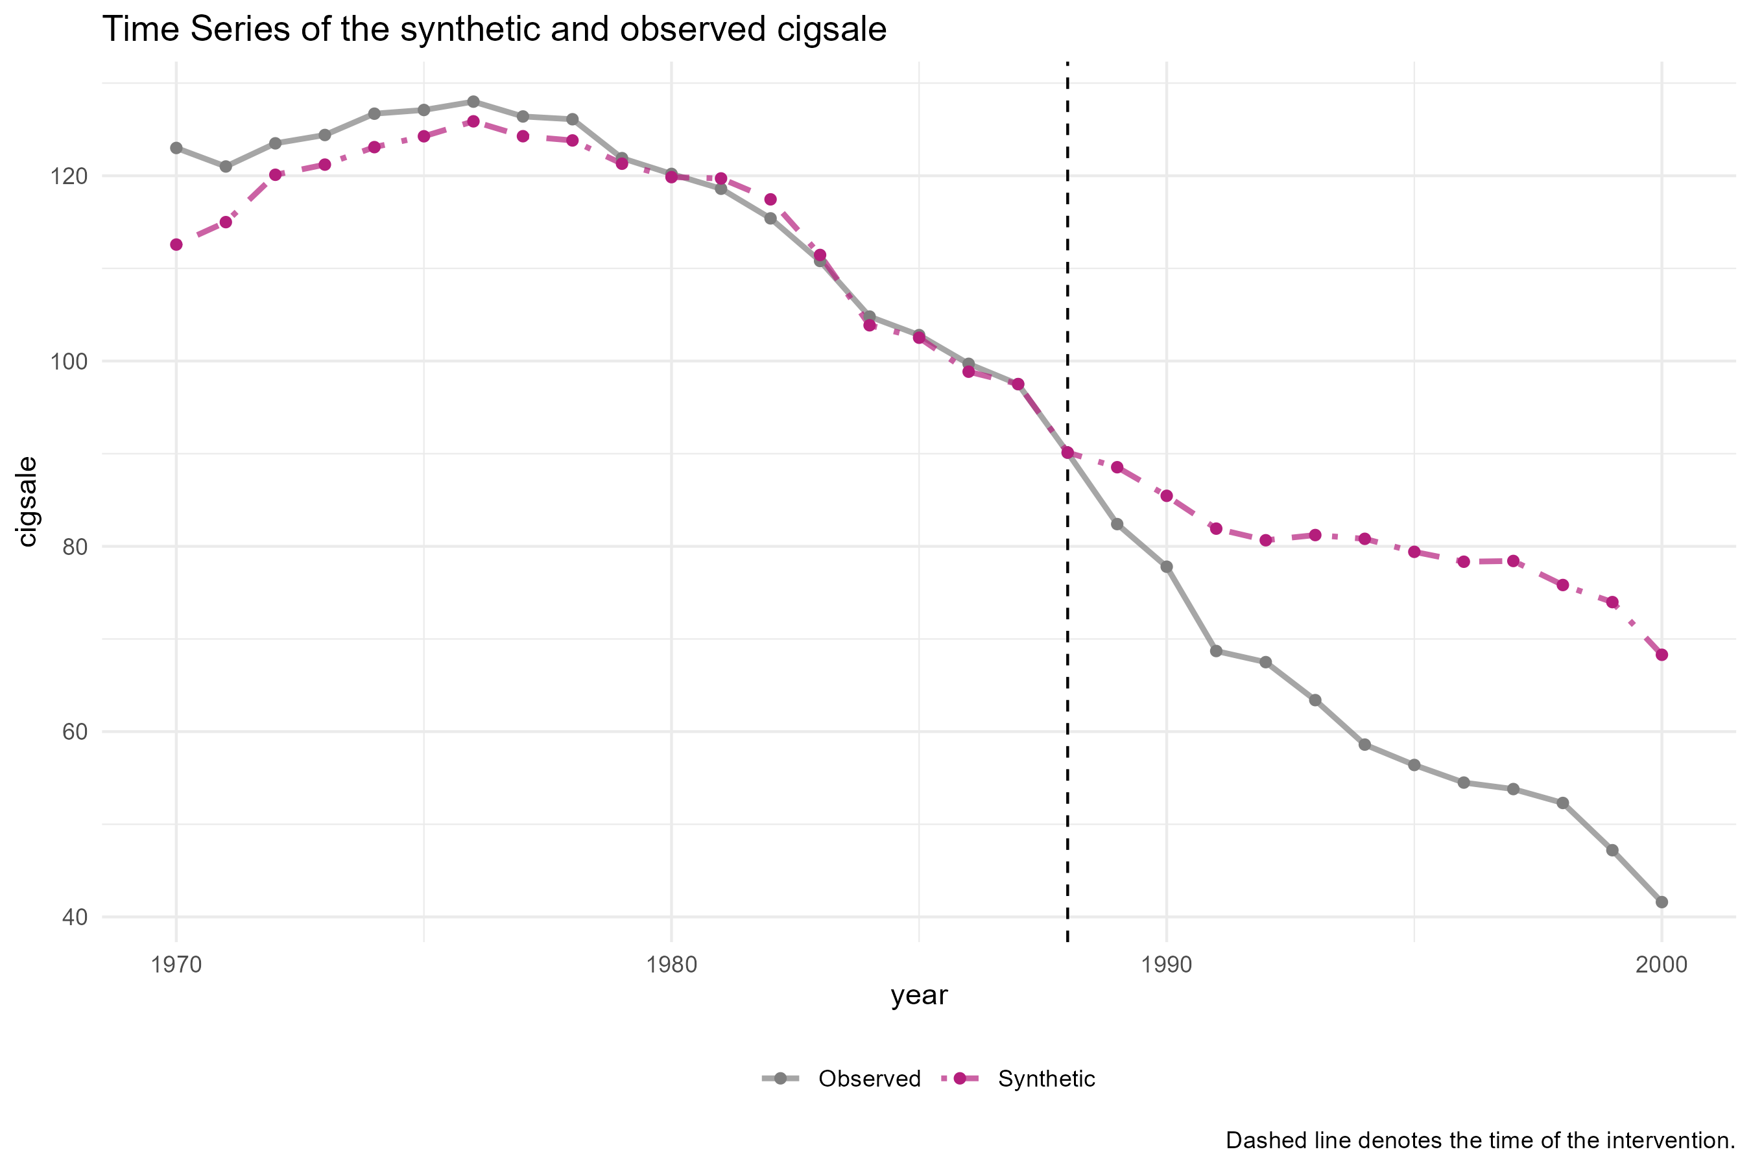


$$Y_{t}^{0}$$
$$Y_{t}^{1}$$

Slide 43
Estimating weights
Choose weights such that the synthetic control looks like the treated unit
Use only pre-intervention data for this
Weights should be positive and sum to one Interpolation constraint / convex hull

Slide 44
$$Y_{t}^{0}$$
$$Y_{t}^{1}$$

Slide 45
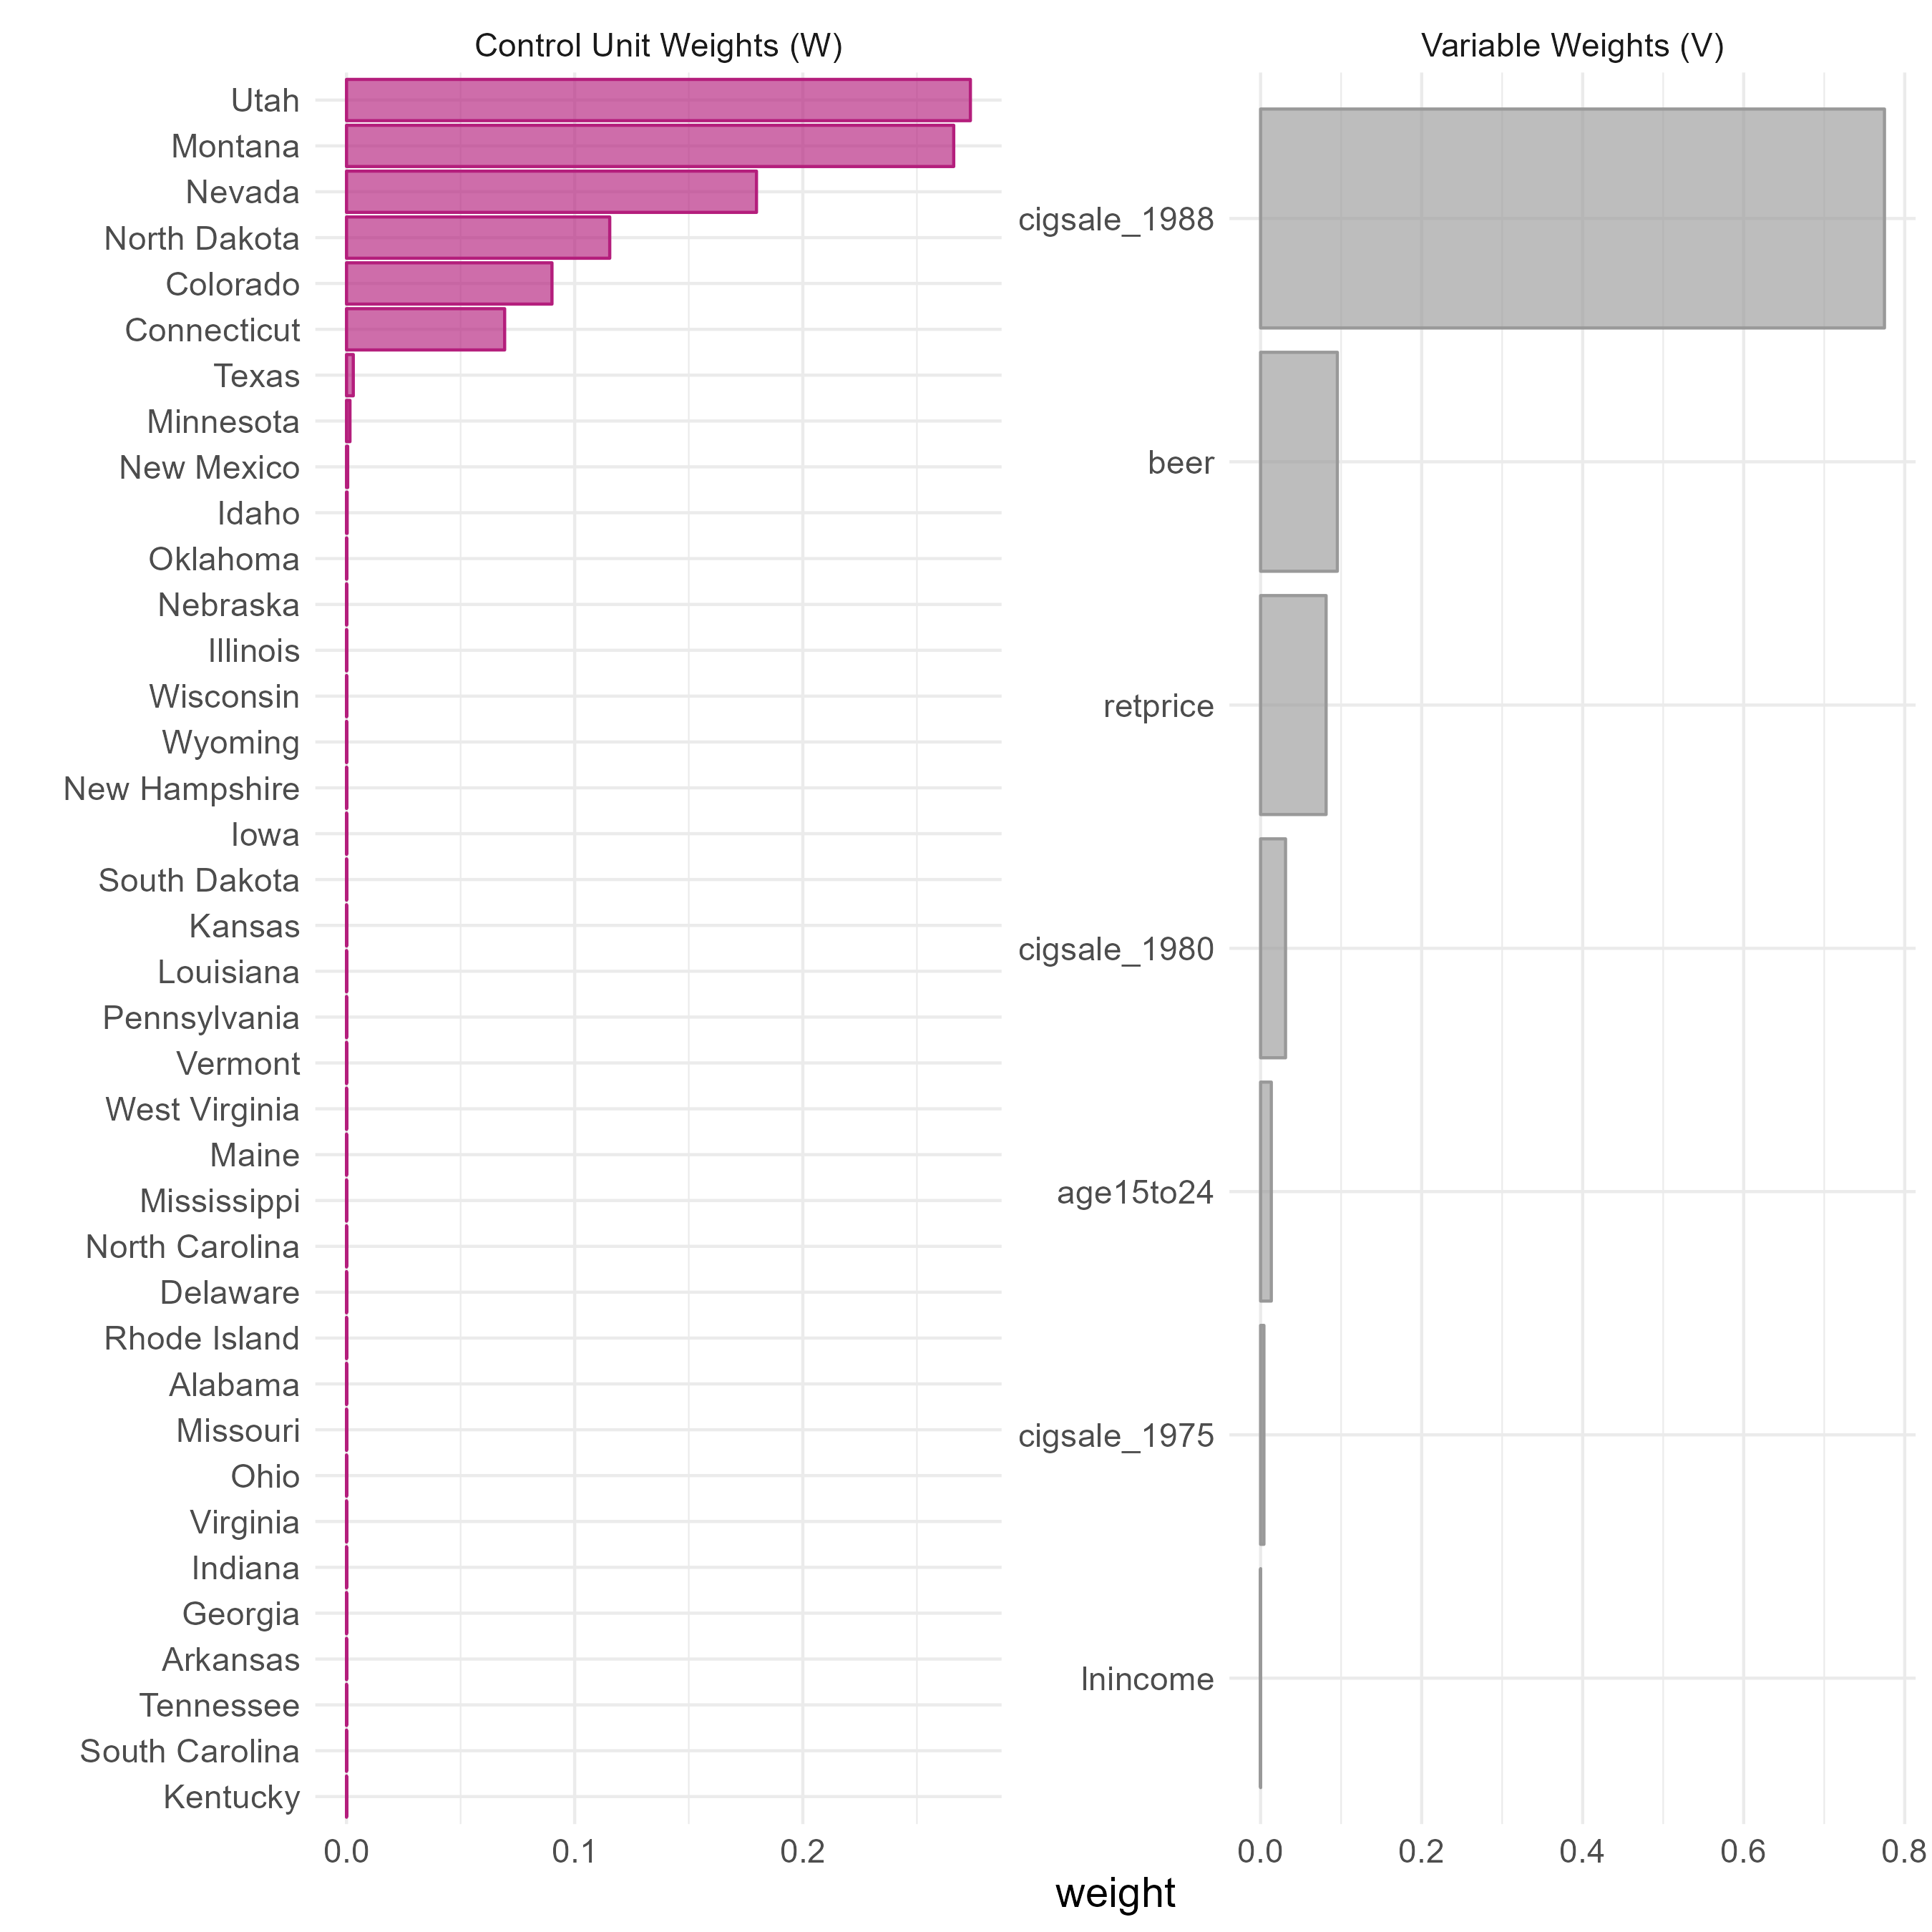

Slide 46
Key Assumption
No interference / spillover:
The donor pool units do not receive any intervention effect
Example spillover effects
Californians living near the border may buy their cigarettes in states across the border
Other states may pass laws similar to on California

Slide 47
There are many choices
Which units in the donor pool?
Which control variables?
What should my weights optimize?
How many nonzero unit weights should I get?
What settings do I give to the nonlinear optimizer?
“researcher degrees of freedom”

Slide 48
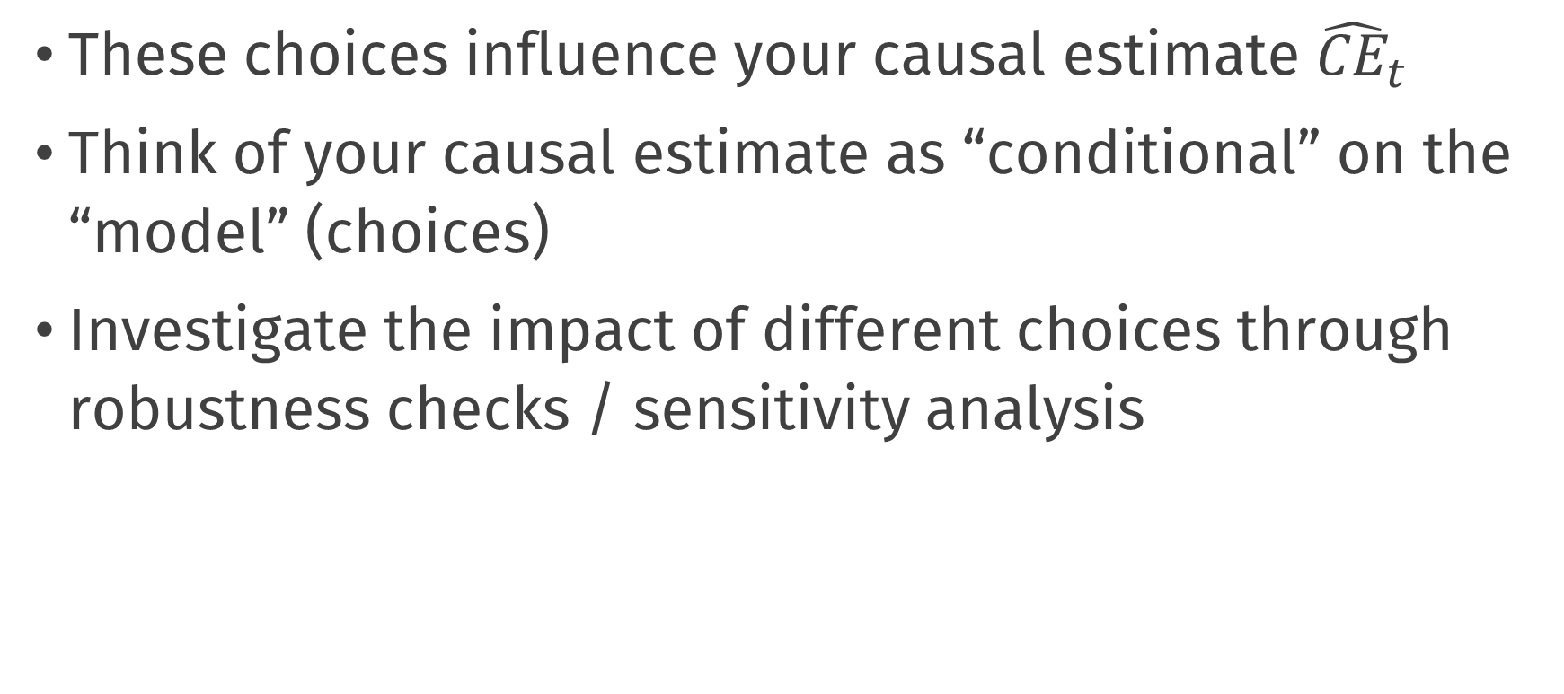
There are many choices
These choices influence your causal estimate ${\hat{CE}}_{t}$
Think of your causal estimate as “conditional” on the “model” (choices)
Investigate the impact of different choices through robustness checks / sensitivity analysis

Slide 49
Interrupted Time Series

Slide 51
Interrupted Time Series
Another popular method which is built on predicting the counterfactual
Here the prediction is based on a time-forward or forecasting model
I.e. we use past pre-intervention data to impute the missing counterfactual at each point in time

Slide 52

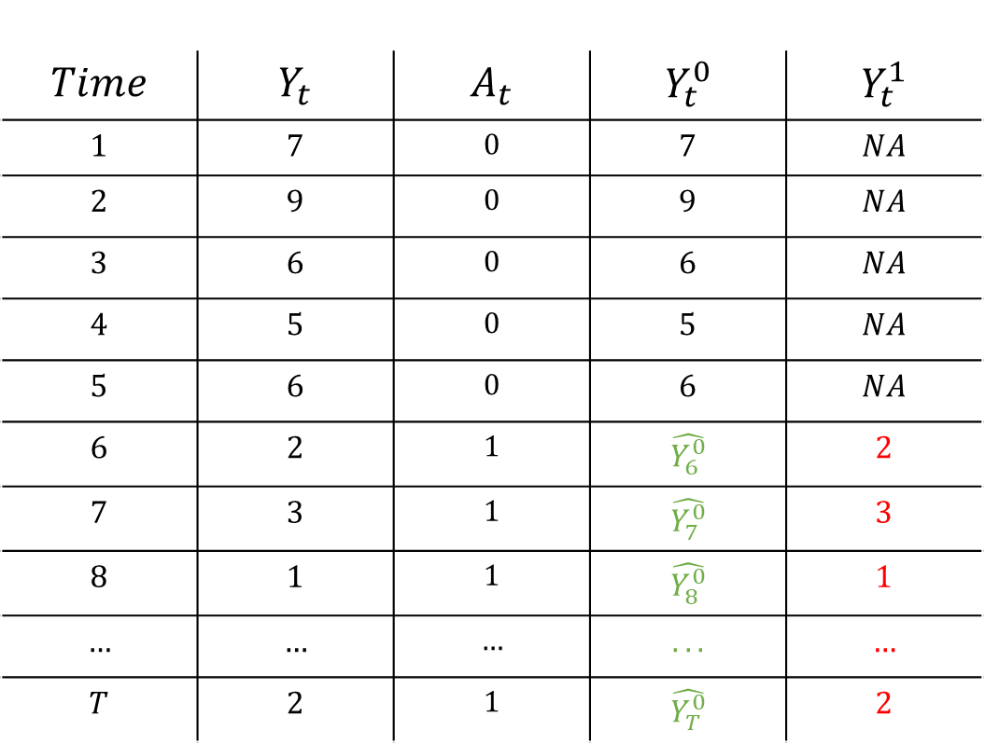

Interrupted Time Series
$$Time$$ | $$Y_{t}$$ | $$A_{t}$$ | $$Y_{t}^{0}$$ | $$Y_{t}^{1}$$
$$1$$ | $$7$$ | $$0$$ | $$7$$ | $$NA$$
$$2$$ | $$9$$ | $$0$$ | $$9$$ | $$NA$$
$$3$$ | $$6$$ | $$0$$ | $$6$$ | $$NA$$
$$4$$ | $$5$$ | $$0$$ | $$5$$ | $$NA$$
$$5$$ | $$6$$ | $$0$$ | $$6$$ | $$NA$$
$$6$$ | $$2$$ | $$1$$ | $$\hat{Y_{6}^{0}}$$ | $$2$$
$$7$$ | $$3$$ | $$1$$ | $$\hat{Y_{7}^{0}}$$ | $$3$$
$$8$$ | $$1$$ | $$1$$ | $$\hat{Y_{8}^{0}}$$ | $$1$$
$$…$$ | $$…$$ | $$…$$ | $$...$$ | $$…$$
$$T$$ | $$2$$ | $$1$$ | $$\hat{Y_{T}^{0}}$$ | $$2$$
Train a forecasting model, e.g.
$$\hat{Y_{t}}=φ_{1}Y_{t−1}+φ_{2}Y_{t−2}+…β ∗ Time$$
Make forecasts
$$\hat{CE_{t}}=Y_{t}^{1} −\hat{Y_{t}^{0}}$$

Slide 53




Building a forecasting model
Much of the challenge of this approach is in choosing an appropriate forecasting model
These can be very simple or very complex, e.g.:
We can forecast by fitting a growth curve which would model the overall time trend
$$Y_{t}=β_{0}+ β_{1} Time+e_{t}$$
We can forecast by using time-series models that model autocorrelation
e.g. ARIMA models can account for autocorrelation and time trends
$$Y_{t}=φ_{1}Y_{t−1 }+e_{t}$$
$$Y_{t}=φ_{1}Y_{t−1 }+φ_{2}Y_{t−2}+e_{t}$$
$$Y_{t}−Y_{t−1}=γe_{t−1} +e_{t}$$

Slide 54
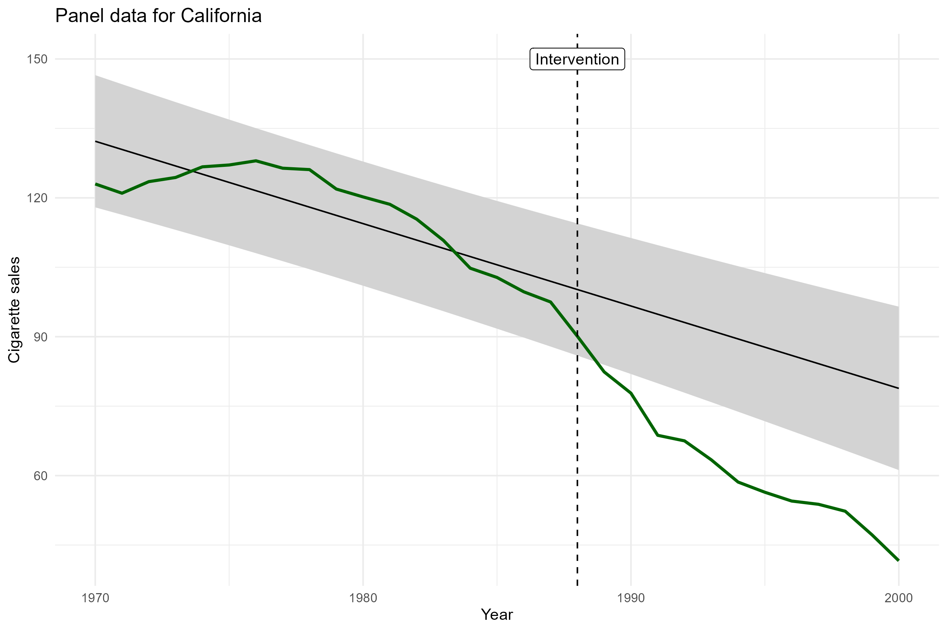

Slide 55
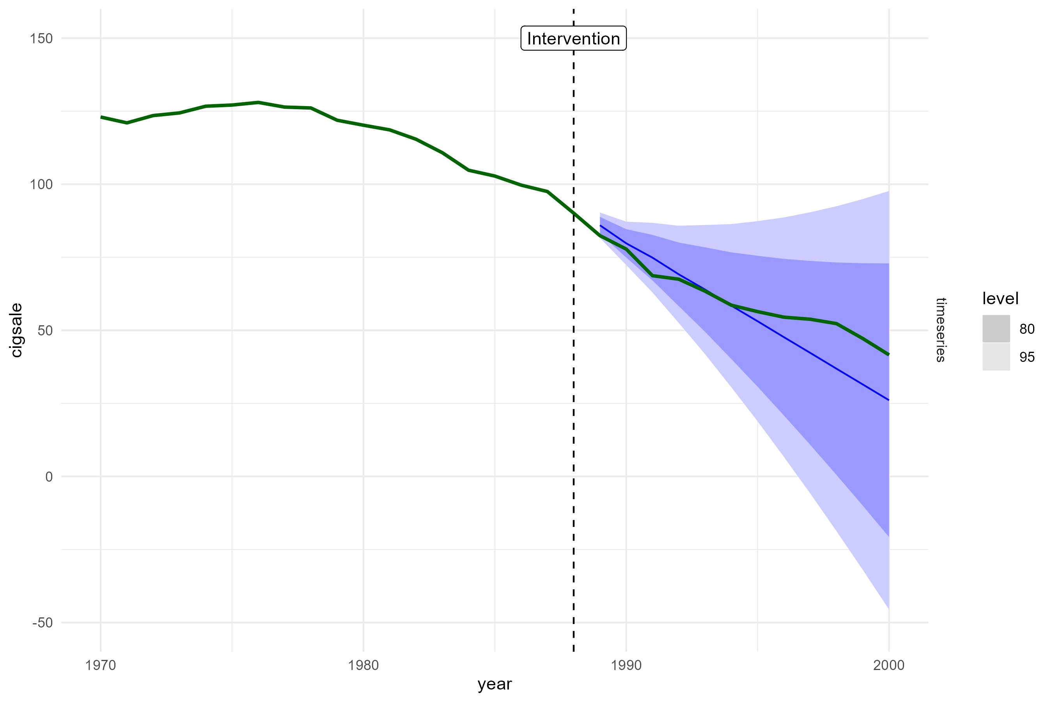

Slide 56
Key Assumptions
Compared to pre-post, we do not assume away the trend, but instead model it directly
But our inferences about the causal effect are entirely dependent on being able to fit an appropriate forecasting model
i.e. one that correctly captures the trend(s) and autocorrelation structures in the data
In practice, this may be very difficult

Slide 57
Discussion

Slide 58
Summary
Different policy evaluation methods have been developed across a variety of different disciplines
Economics, Epidemiology/Public health, Social Sciences
These methods differ in terms of:
The amount and type of information they use
Amount of time-points and amount of potential “control” units
The specific statistical approach they take
The types of assumptions they make
Using potential outcomes, we can more readily understand and compare these different methods

Slide 60
So which method is best?
The answer in part depends on what type and amount of data you have
But this is the easy part
The answer in practice depends on domain knowledge
The hard part is to figure out which assumptions you need for causal inference and whether they are reasonable in your particular use case
It may simply not be possible in some cases!
E.g. DiD won’t work if trends are not parallel; synthetic control won’t work if there is interference between units (no matter how much data you have!)
Often, methods which are “data hungry” can relax some assumptions, but:
There is no free lunch!

Slide 61
Useful References
Difference in Differences
Angrist, J. D., & Krueger, A. B. (1999). Empirical strategies in labor economics. In Handbook of labor economics (Vol. 3, pp. 1277-1366). Elsevier.
Angrist, J. D., & Pischke, J. S. (2009). Mostly harmless econometrics: An empiricist's companion. Princeton university press.
Caniglia, E. C., & Murray, E. J. (2020). Difference-in-difference in the time of cholera: a gentle introduction for epidemiologists. Current epidemiology reports, 7, 203-211.
Interrupted Time Series
Bernal, J. L., Cummins, S., & Gasparrini, A. (2017). Interrupted time series regression for the evaluation of public health interventions: a tutorial. International journal of epidemiology, 46(1), 348-355.
Bernal, J.L, Cummins, S., & Gasparrini, A. (2019). Difference in difference, controlled interrupted time series and synthetic controls. International journal of epidemiology, 48(6), 2062-2063.

Slide 62
Useful References
Synthetic Control
Abadie, A., Diamond, A., & Hainmueller, J. (2010). Synthetic control methods for comparative case studies: Estimating the effect of California’s tobacco control program. Journal of the American Statistical Association, 105(490), 493-505.
Abadie, A. (2021). Using synthetic controls: Feasibility, data requirements, and methodological aspects. Journal of Economic Literature, 59(2), 391-425.
CausalImpact
Brodersen, K. H., Gallusser, F., Koehler, J., Remy, N., & Scott, S. L. (2015). Inferring causal impact using Bayesian structural time-series models. The Annals of Applied Statistics, 247-274.
Linden, A. (2018). Combining synthetic controls and interrupted time series analysis to improve causal inference in program evaluation. Journal of evaluation in clinical practice, 24(2), 447-453.
http://google.github.io/CausalImpact/CausalImpact.html

Slide 63
Useful References
Synthetic DiD
Arkhangelsky, D., Athey, S., Hirshberg, D. A., Imbens, G. W., & Wager, S. (2021). Synthetic difference-in-differences. American Economic Review, 111(12), 4088-4118.
More on Causal Policy Evaluation
Free online course materials made by Andrew Heiss
Program Evaluation for Public Service
https://evalf22.classes.andrewheiss.com/content/

Slide 65
Q&A
Introduction to Causal Inference and Causal Data Science
Oisin Ryan & Bas Penning de Vries

