Slide 1
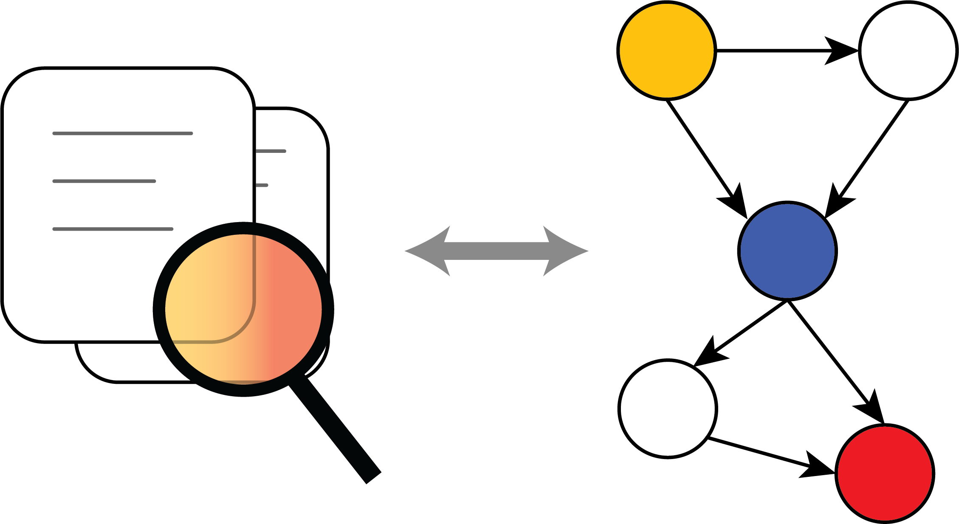
Special Interest Group Causal Data Science

Slide 2
Members
Biomedical Sciences
Julius Center
Princes Maxima Centrum
Pharmaceutical Sciences
Epidemiology and Health Economics
Institute for Risk Assessment Sciences
Social and Behavioural Sciences
Methods & Statistics
Sociology
Law, Economics & Governance
REBO
Utrecht School of Economics (USE)
Science Faculty
Information and Computing Sciences

Slide 3
University Medical Center Utrecht
Julius Center for Health Sciences and Primary Care
Department of Data Science and Biostatistics

Slide 4
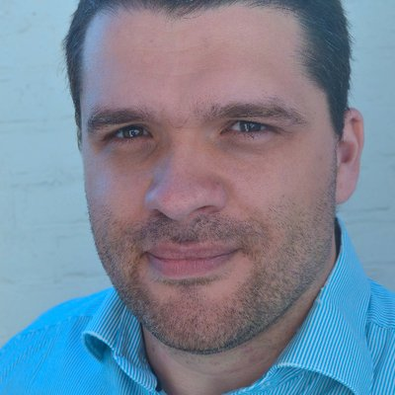
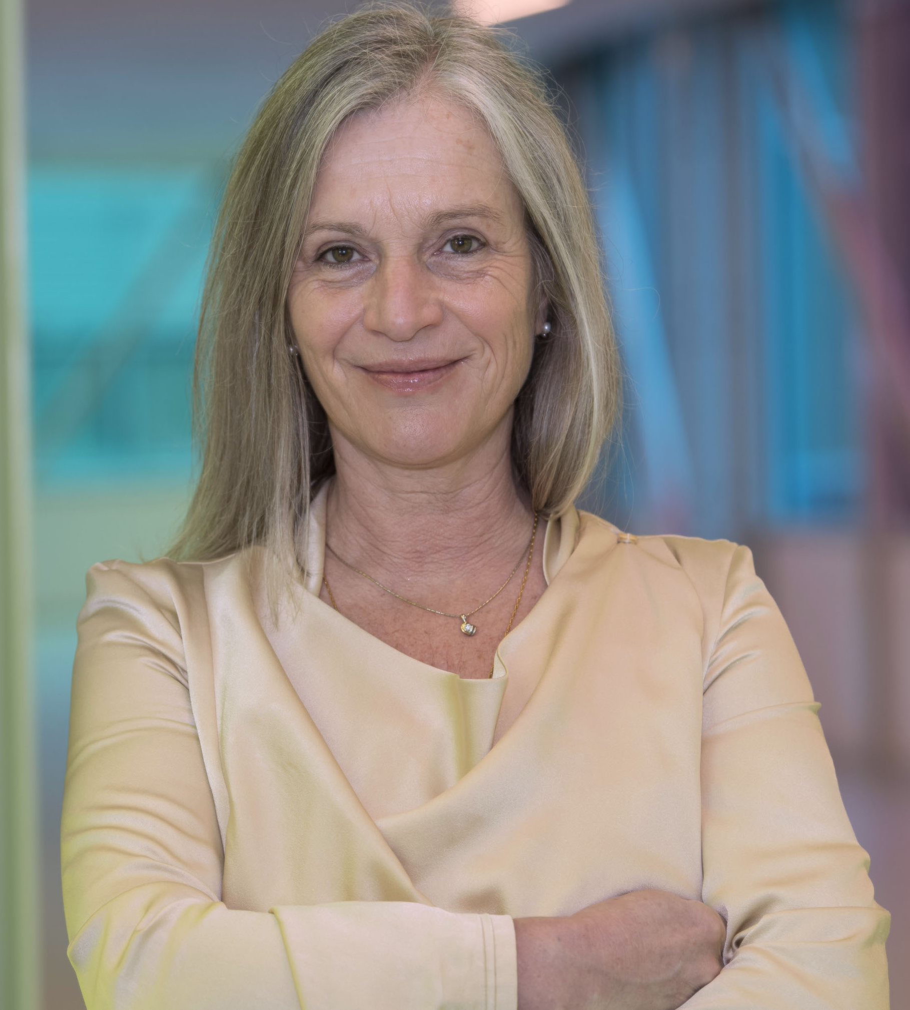
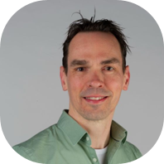
Department of Data Science & Biostatistics
Data Science
Real World Evidence
Clinical Trial Methodology

Slide 5
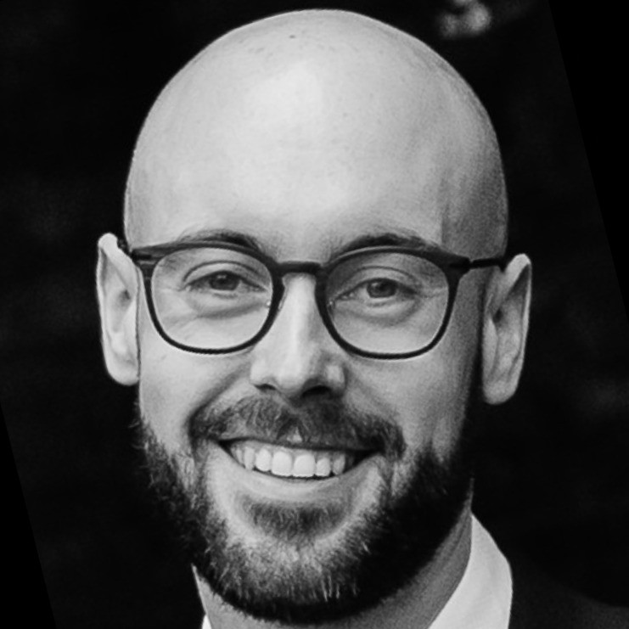
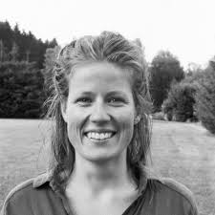
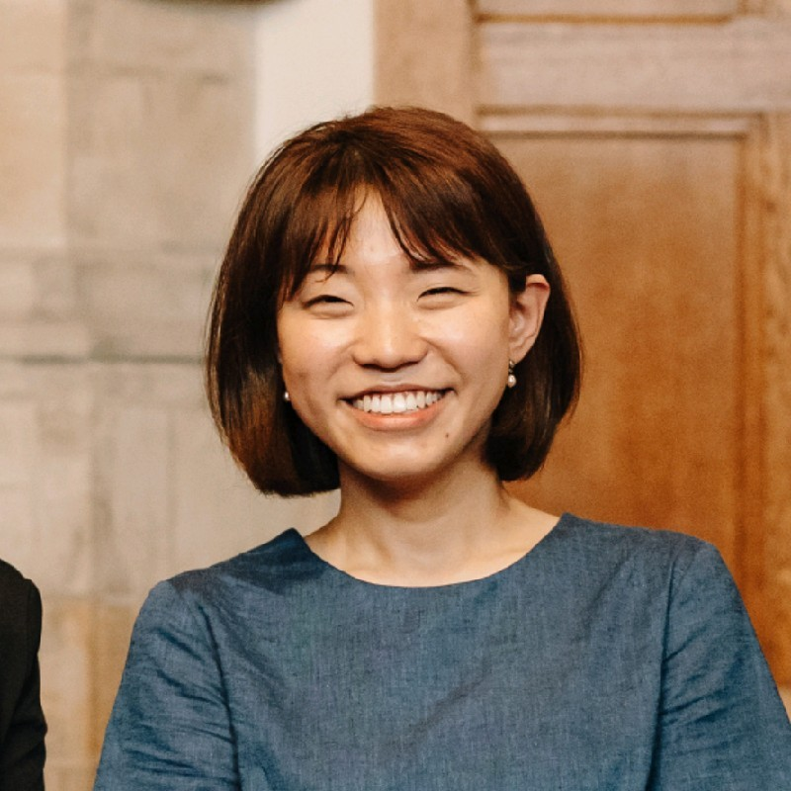
Causal Inference & Stats Team @RWE
Answering causal research questions, typically around the effectiveness and safety of drugs and medicines
Causal Inference & Stats Team: Address methodological challenges in answering causal research questions in these settings
Oisín Ryan
Linda Nab
Jungyeon Choi

Slide 6

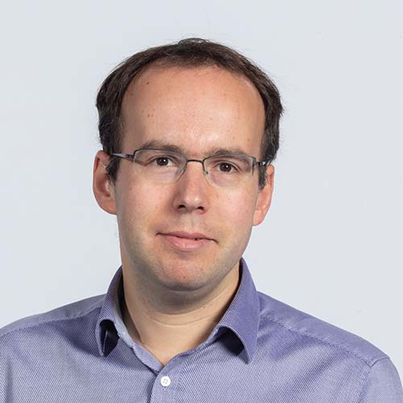
Clinical Trial Methodology
Design and Analysis of Clinical Trials
Methodological research on innovative trial designs and analysis techniques
Adaptive Trial Design
Trials within Cohorts (TwiCs) design
Close collaboration with oncology researchers
Including observational data in RCTs
Peter van de Ven
Joost van Rosmalen

Slide 7
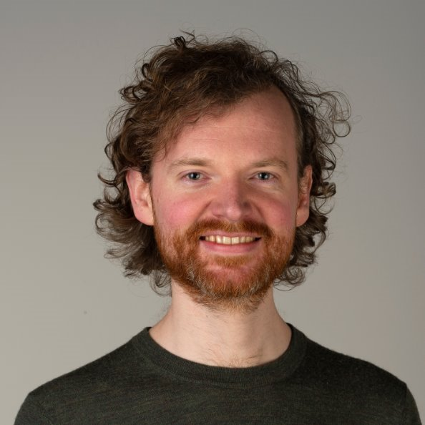
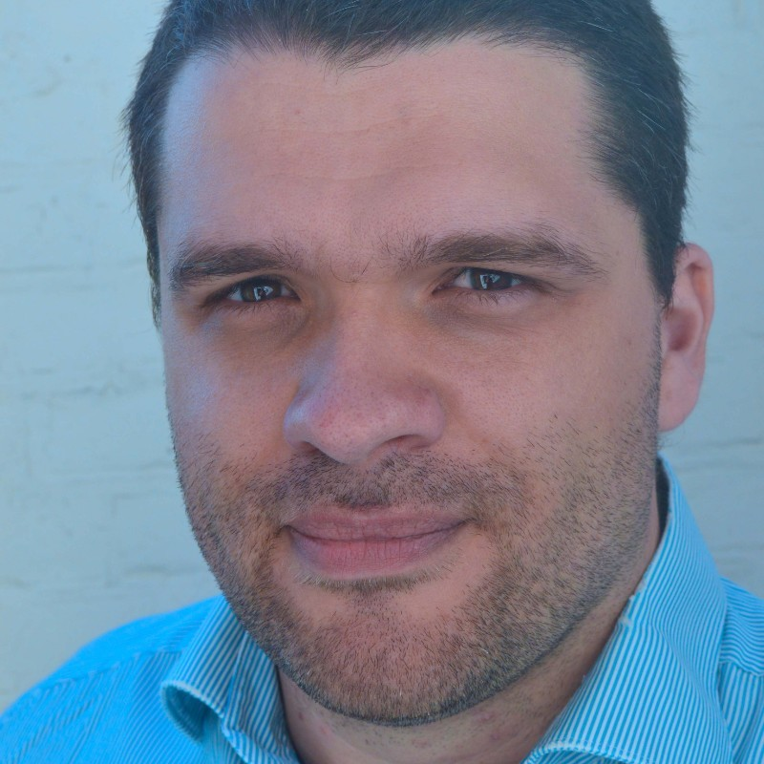
Causal Machine Learning / Prediction
Prediction under intervention models
Evaluation of prediction models for decision making
Understanding and improving generalization with causal inference
Wouter van Amsterdam
Maarten van Smeden

Slide 8
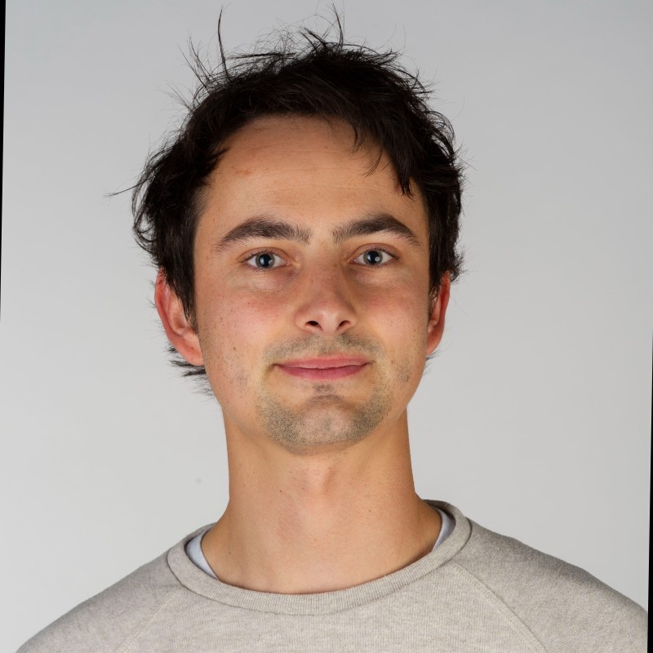
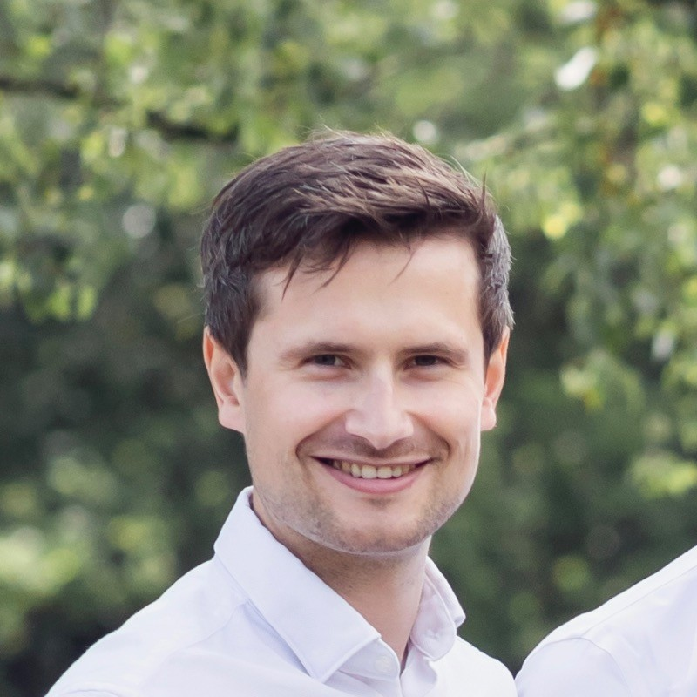
Outcome predictions under radiotherapy
Tuur Leeuwenberg
Bas Penning-de Vries
Jungyeon Choi

Slide 9
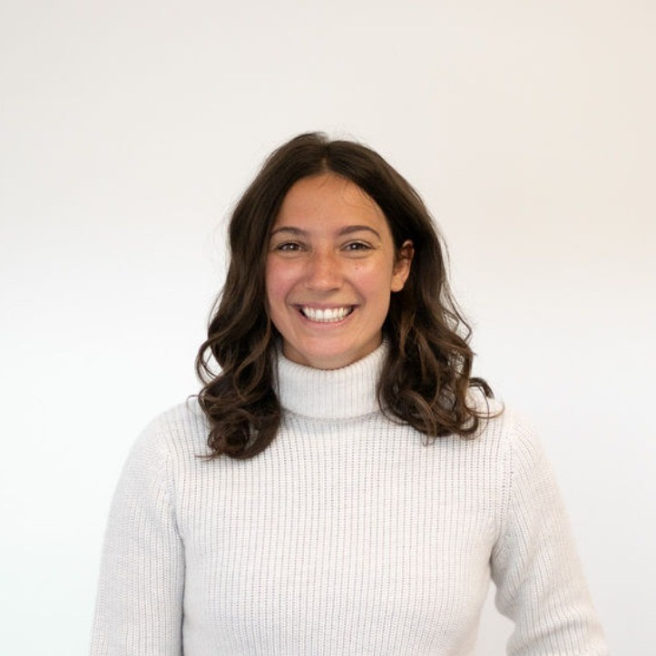
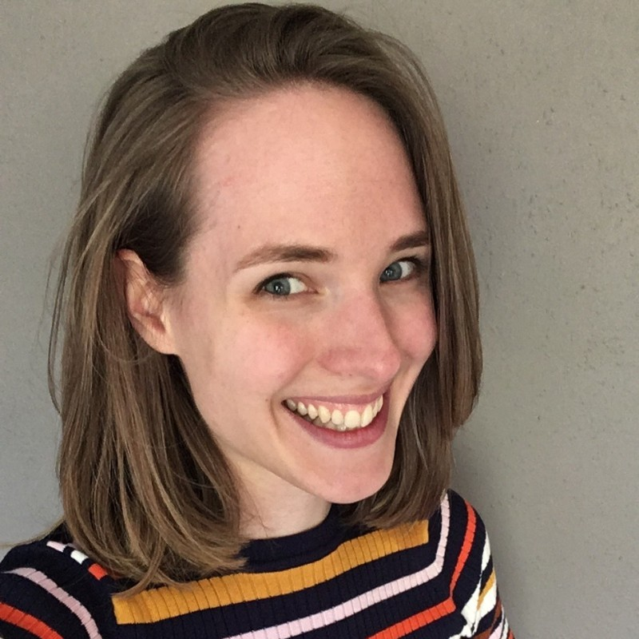
XAI from a causal viewpoint
Alex Carriero
Anne de Hond
Maarten van Smeden

Slide 10
UU
University Medical Center Utrecht
Julius Center for Health Sciences and Primary Care
Department of Data Science and Biostatistics

Slide 11
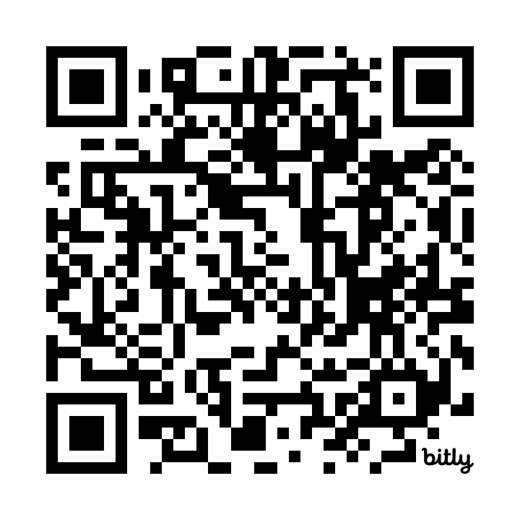
Plug: Introduction to Causal Inference and Causal Data Science
Summer school: July 7-11
Utrecht
bit.ly/causalsummerschool
Oisín Ryan
Bas Penning-de Vries
Wouter van Amsterdam

