Slide 1




Note
Please feel free to photograph and share these slides on social media.

Slide 2
Wouter van Amsterdam University Medical Center Utrecht – Julius Center for Health Sciences
An intro to causal inference
and its use in radiotherapy

Slide 3
Disclosures
No competing interests
Not a physicist (do have BSc. in physics)
Not a clinician (do have MD)
Methodologist studying machine learning and causal inference and their intersection
methods and applications in health

Slide 4
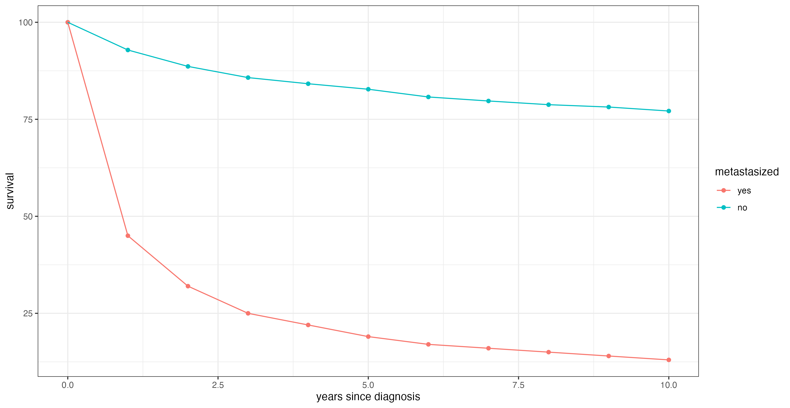
Why causal inference? We want to now what to do
What can statistical learning do?
statistical learning from passively collected data:
observe: patients with metastases poor survival
Dutch cancer registrion (NKR)
all cancer types (stage I-III vs IV)
accessed 2024-05-04

Slide 5
Why causal inference?
What can statistical learning do?
statistical learning from passively collected data:
from these data we can learn what to expect when we passively observe the world
observe: stage I lung cancer patients
with surgery: good survival
with radiotherapy: worse survival

Slide 6
Why causal inference?
if we now stop using radiotherapy and only operate, regardless of age, comorbidities, fitness, would the patients live longer?

Slide 7
Why causal inference?
What can statistical learning do?
statistical learning from passively collected data:
from these data we can learn what to expect when we passively observe the world
not what to expect when we change something
this applies regardless of:
simple (regression) or complex (machine learning) learning methods
retrospective vs prospective data collection
model updates (‘continual learning’)
small (100s) or big (millions) data

Slide 8
Why causal inference?
health care professionals are typically concerned with improving the world, meaning making changes (interventions) that improve outcomes
the best way to learn about effects of treatments (or interventions) is by performing them experimentally in a randomized controlled trial (RCT)
though RCTs are ideal from a theoretical point of view, they are challenged by logistical, financial and ethical issues
RCT for every possible change (e.g. dose adjustment, radiotherapy fractioning) infeasible
we do have non-experimental (observational), can we estimate treatment effects from them?
in comes causal inference

Slide 9
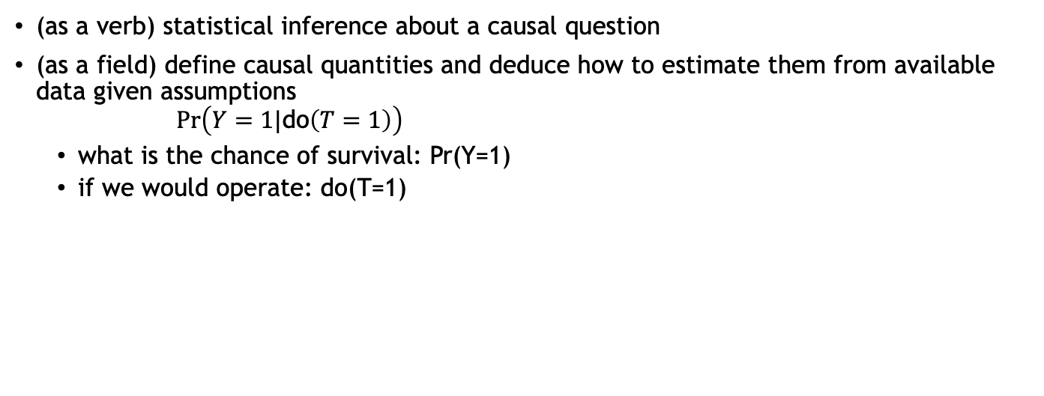
What is causal inference?
(as a verb) statistical inference about a causal question
(as a field) define causal quantities and deduce how to estimate them from available data given assumptions
$$Pr\left(Y=1|\text{do}\left(T=1\right)\right)$$
what is the chance of survival: Pr(Y=1)
if we would operate: do(T=1)

Slide 10
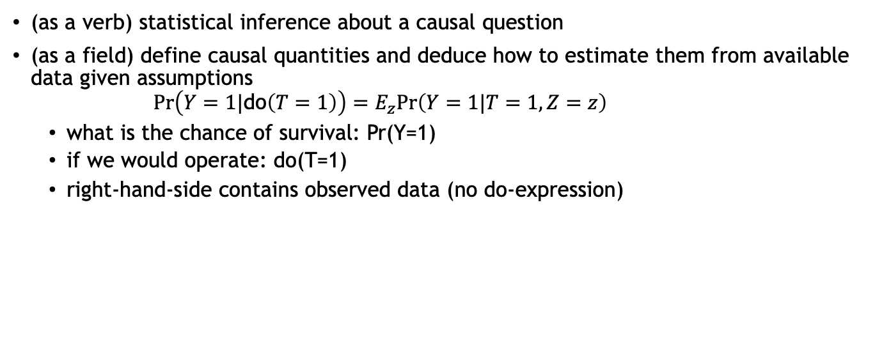
What is causal inference?
(as a verb) statistical inference about a causal question
(as a field) define causal quantities and deduce how to estimate them from available data given assumptions
$$Pr\left(Y=1|\text{do}\left(T=1\right)\right)=E_{z}Pr\left(Y=1|T=1,Z=z\right)$$
what is the chance of survival: Pr(Y=1)
if we would operate: do(T=1)
right-hand-side contains observed data (no do-expression)

Slide 11
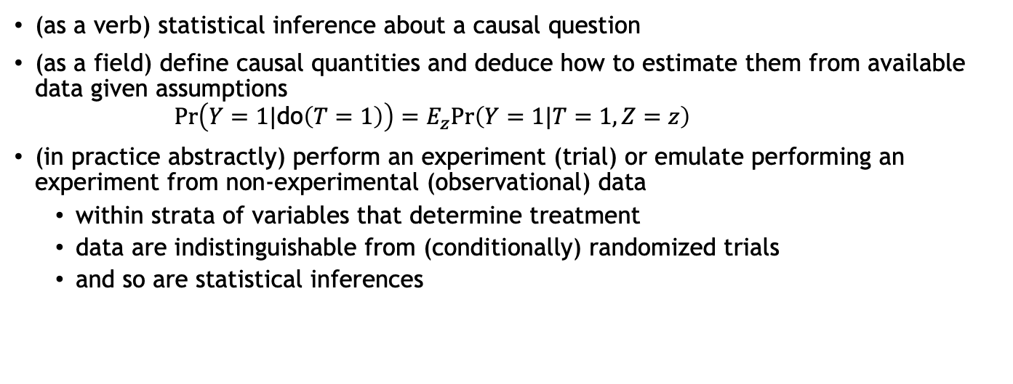
What is causal inference?
(as a verb) statistical inference about a causal question
(as a field) define causal quantities and deduce how to estimate them from available data given assumptions
$$Pr\left(Y=1|\text{do}\left(T=1\right)\right)=E_{z}Pr\left(Y=1|T=1,Z=z\right)$$
(in practice abstractly) perform an experiment (trial) or emulate performing an experiment from non-experimental (observational) data
within strata of variables that determine treatment
data are indistinguishable from (conditionally) randomized trials
and so are statistical inferences

Slide 12
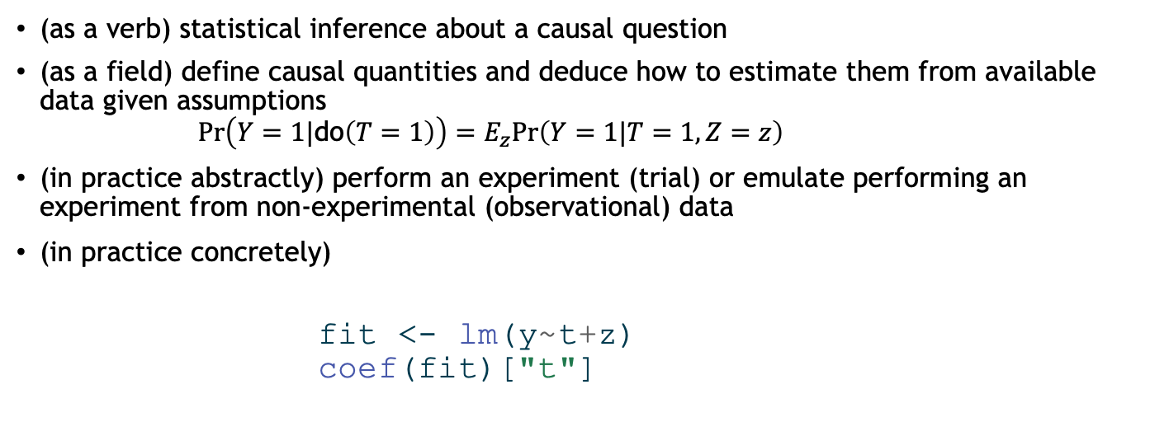
What is causal inference?
(as a verb) statistical inference about a causal question
(as a field) define causal quantities and deduce how to estimate them from available data given assumptions
$$Pr\left(Y=1|\text{do}\left(T=1\right)\right)=E_{z}Pr\left(Y=1|T=1,Z=z\right)$$
(in practice abstractly) perform an experiment (trial) or emulate performing an experiment from non-experimental (observational) data
(in practice concretely)
fit <- lm(y~t+z) coef(fit)["t"]

Slide 13
Causal inference frameworks, a high-level introduction
Potential outcome framework
for individual: define potential outcome as outcome that would be observed when giving a certain treatment
define individual treatment effect (ITE) as difference in potential outcomes under treatments
fundamental problem: only one potential outcome observed (the other is counterfactual)
average of ITEs is the average treatment effect (ATE): can be estimated in RCTs, providing evidence for treatment guidelines

Slide 14
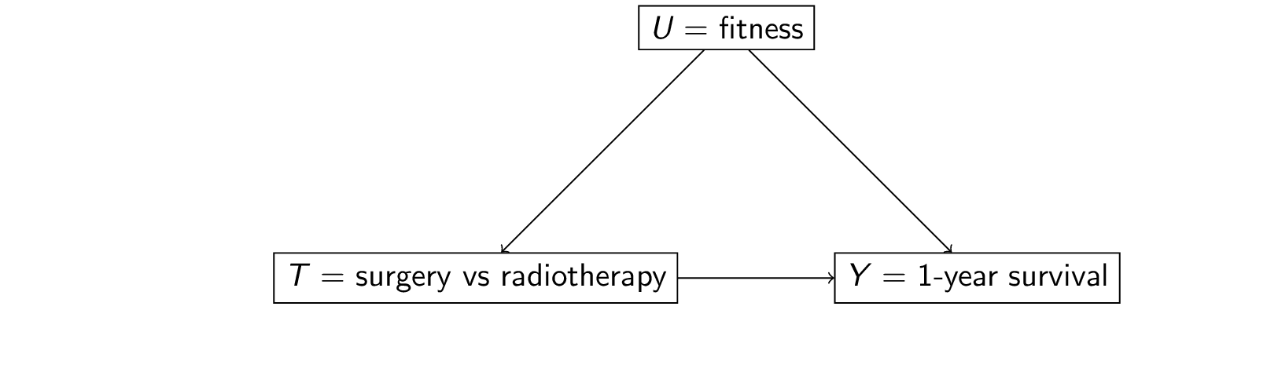
Causal inference frameworks, a high-level introduction
causal directed acyclic graphs (DAGs) / structural causal models
formalize model of world with variables (treatment, determinants of treatment, outcome) and causal relationships between these variables

Slide 15
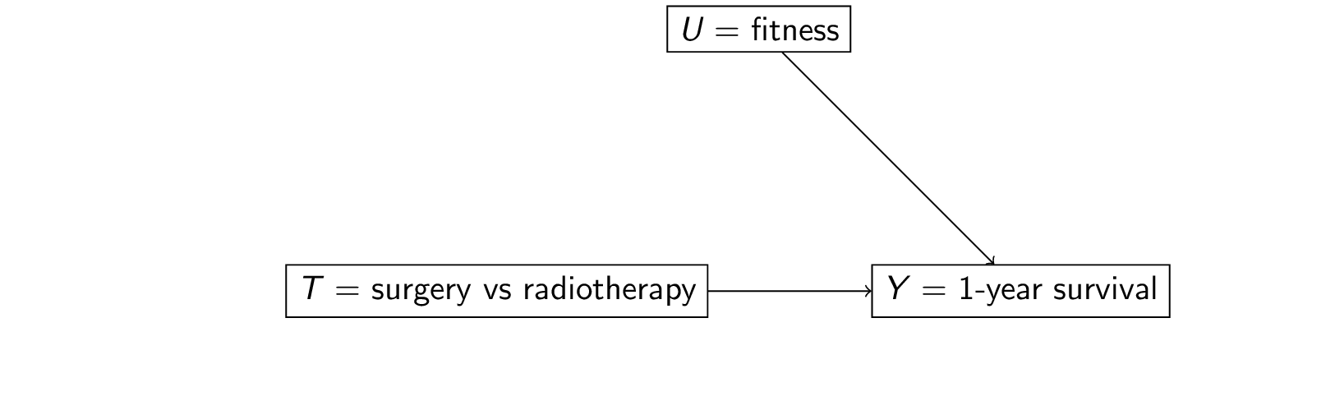
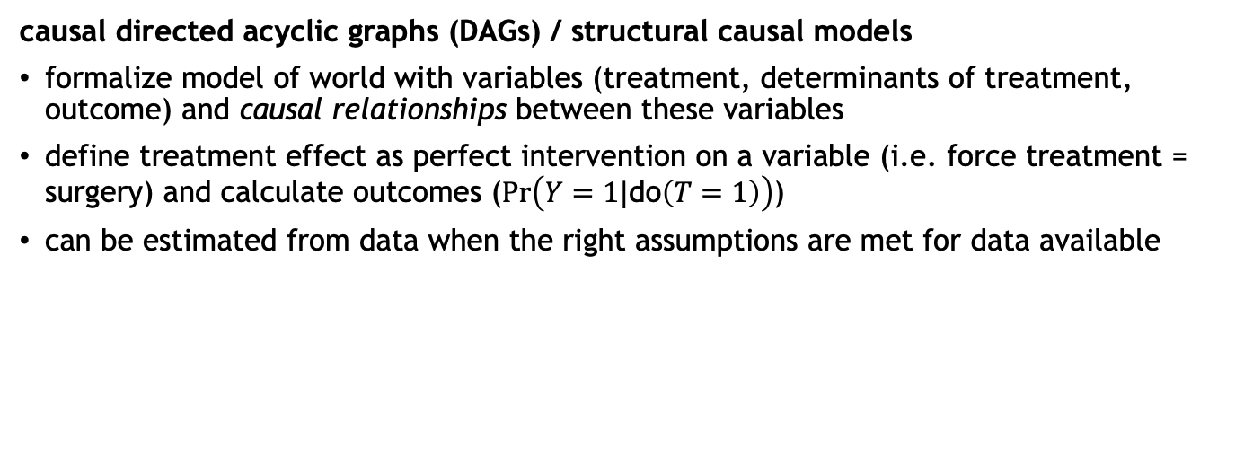
Causal inference frameworks, a high-level introduction
causal directed acyclic graphs (DAGs) / structural causal models
formalize model of world with variables (treatment, determinants of treatment, outcome) and causal relationships between these variables
define treatment effect as perfect intervention on a variable (i.e. force treatment = surgery) and calculate outcomes ($Pr\left(Y=1|\text{do}\left(T=1\right)\right)$)
can be estimated from data when the right assumptions are met for data available

Slide 16
Causal inference frameworks
Differences and agreements
frameworks address the question of identification: can a causal question be estimated from observed data?
when given same data and assumptions, inferences are the same
main concerns in both settings: identify confounders, assume positivity
inferences rely on unverifyable assumptions
PO: definitions less abstract
DAGs: specifying assumptions less abstract

Slide 17
DAGs and their uses
determine identifyability
read off variable ‘types’
confounders (ancestors of treatment and outcome)
colliders (common effects)
mediators
other uses:
missing data mechanisms
selection diagrams
transportability

Slide 18
Setting up a causal inference study
define question and target trial
gather data
formalize assumptions (e.g. DAG)
decide how to estimate
sensitivity analyses
statistical inference
interpret

Slide 19
challenges and opportunities of causal inference with observational data in oncology

Slide 20
challenge: unobserved confounding by overall fitness

Slide 21
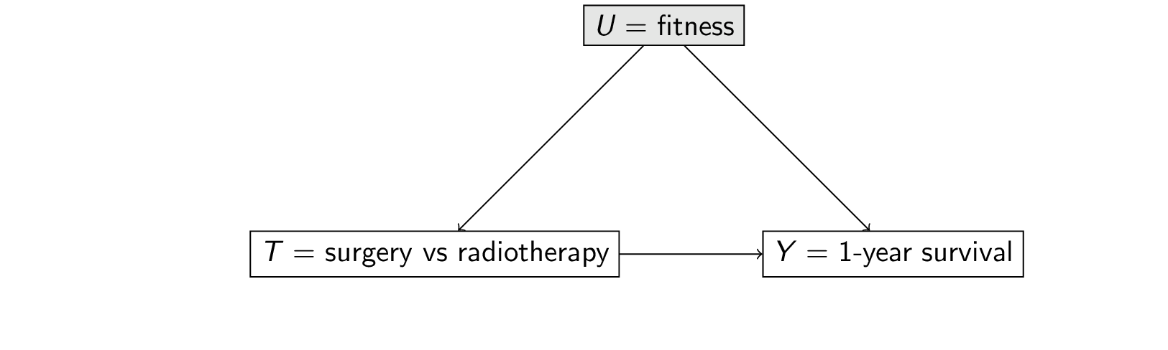
challenge: unobserved confounding by overall fitness
cannot use confounder adjustment
outcome regression, propensity score adjustment, doubly robust estimators

Slide 22
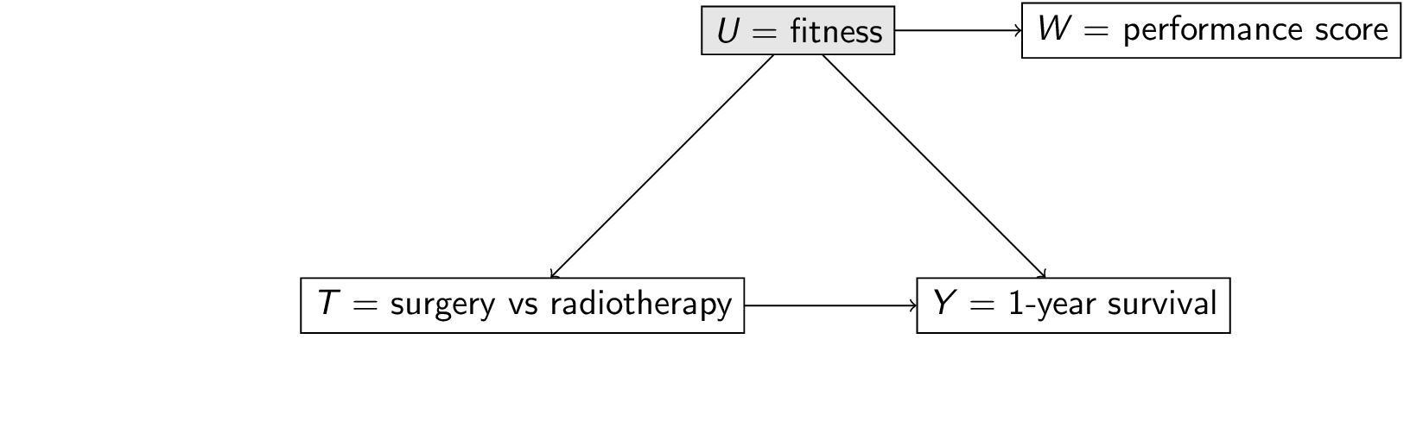
challenge: unobserved confounding by overall fitness
cannot use confounder adjustment, use other methods:
proxy variable based methods

Slide 23
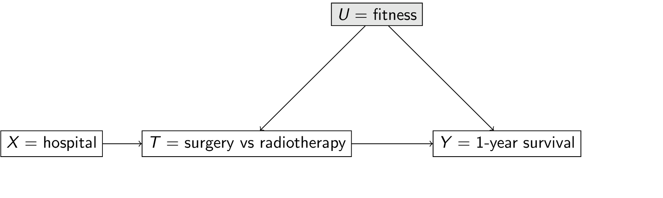
challenge: unobserved confounding by overall fitness
cannot use confounder adjustment, use other methods:
proxy variable based methods
instrumental variables analyses

Slide 24
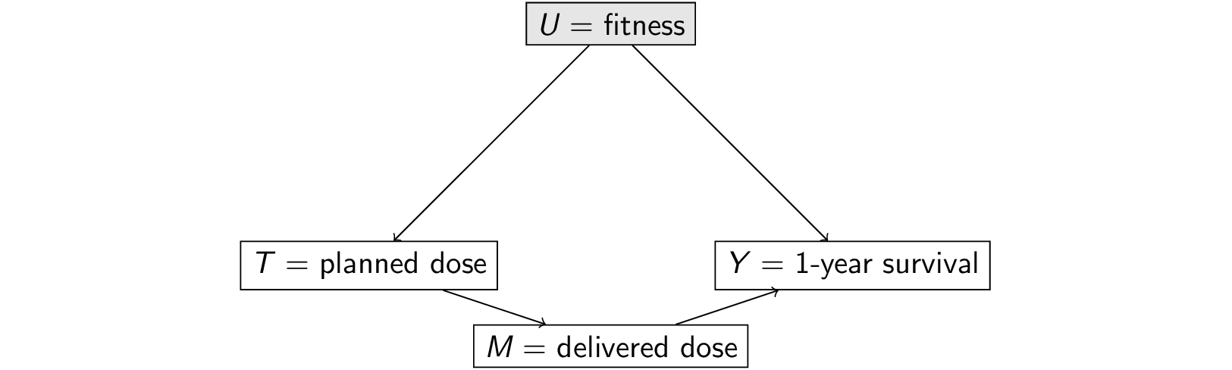
challenge: unobserved confounding by overall fitness
cannot use confounder adjustment, use other methods:
proxy variable based methods
instrumental variables analyses
front-door adjustment

Slide 25
opportunities and use cases of causal inference in oncology
new biomarkers: need estimate of treatment effect before running an RCT
generalization of RCT estimates to general population
risk based treatment decisions: e.g. decide on adjuvant therapy based on risk of recurrence under no adjuvant therapy
this risk has / needs a causal interpretation
i.e. under the intervention of not given adjuvant therapy …
as would be observed in the control arm of an RCT)
prediction-under-intervention: expected outcome under hypothetical treatment options

Slide 26
Concluding remarks
causal inference gives us what we want: what will happen when we change something
this comes at a high price (high value, high cost)
RCTs: costly and time-consuming
observational data: unverifyable assumptions
cancer has some unique challenges and opportunities
further reading:
Book of Why (DAGs/SCM, Judea Pearl)
What If? (Potential Outcomes, Robins, Hernan)

