Slide 1
Setting up a local Embedded Web Server
KUL 4.0 IIOT
Jan van Deventer

Slide 2
STM32 IoT Node
Setup:
Tera Term (a free and open source terminal emulation application)
WiFi Access
Web browser
Google Chrome
Safari

Slide 3
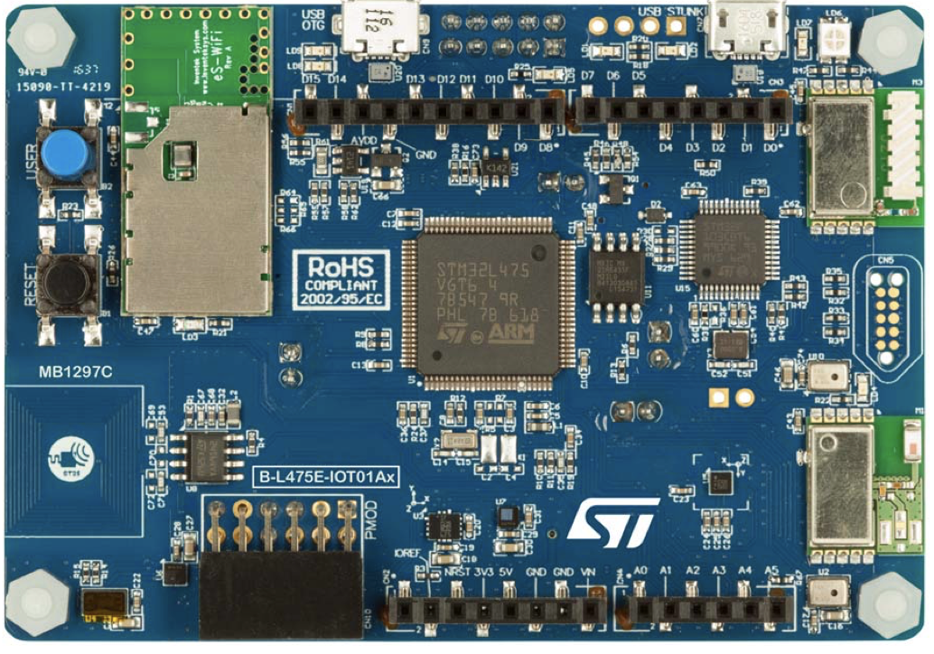
The STM32 IoT node
The newest model is
Discovery kit for IoT node, multi-channel communication with STM32L4+ Series, allows users to develop applications with direct connection to cloud servers.
https://www.st.com/resource/en/data_brief/b-l4s5i-iot01a.pdf
The demonstration software, included in the STM32Cube MCU Package corresponding to the on-board microcontroller, is preloaded in the STM32 Flash memory for easy demonstration of the device peripherals in standalone mode. The latest versions of the demonstration source code and associated documentation can be downloaded from www.st.com.

Slide 4
Setup WiFi
Install the free Tera-Term or PuTTY,
Connect the development board to PC with a Micro-USB cable,
Find out to which COM port the device is connected to using the Device Manager,
Setup the serial communication,
COM port, end of line (LF) and 115200 baud rate
Type in WiFi information as requested by the board.
Notes:
free and open-source terminal emulator, serial console and network file transfer application

Slide 5
Communicate with Web Browser
In the emulated terminal, the board provides a URI for the web service
Type the URI in Google Chrome
You will see the temperature being displayed
You should be able to turn on and off an LED on the development board
The latter works for Google Chrome but not Safari on a computer.

