Slide 1
Week 2 Introduction
KUL 4.0 IIOT
Jan van Deventer

Slide 2
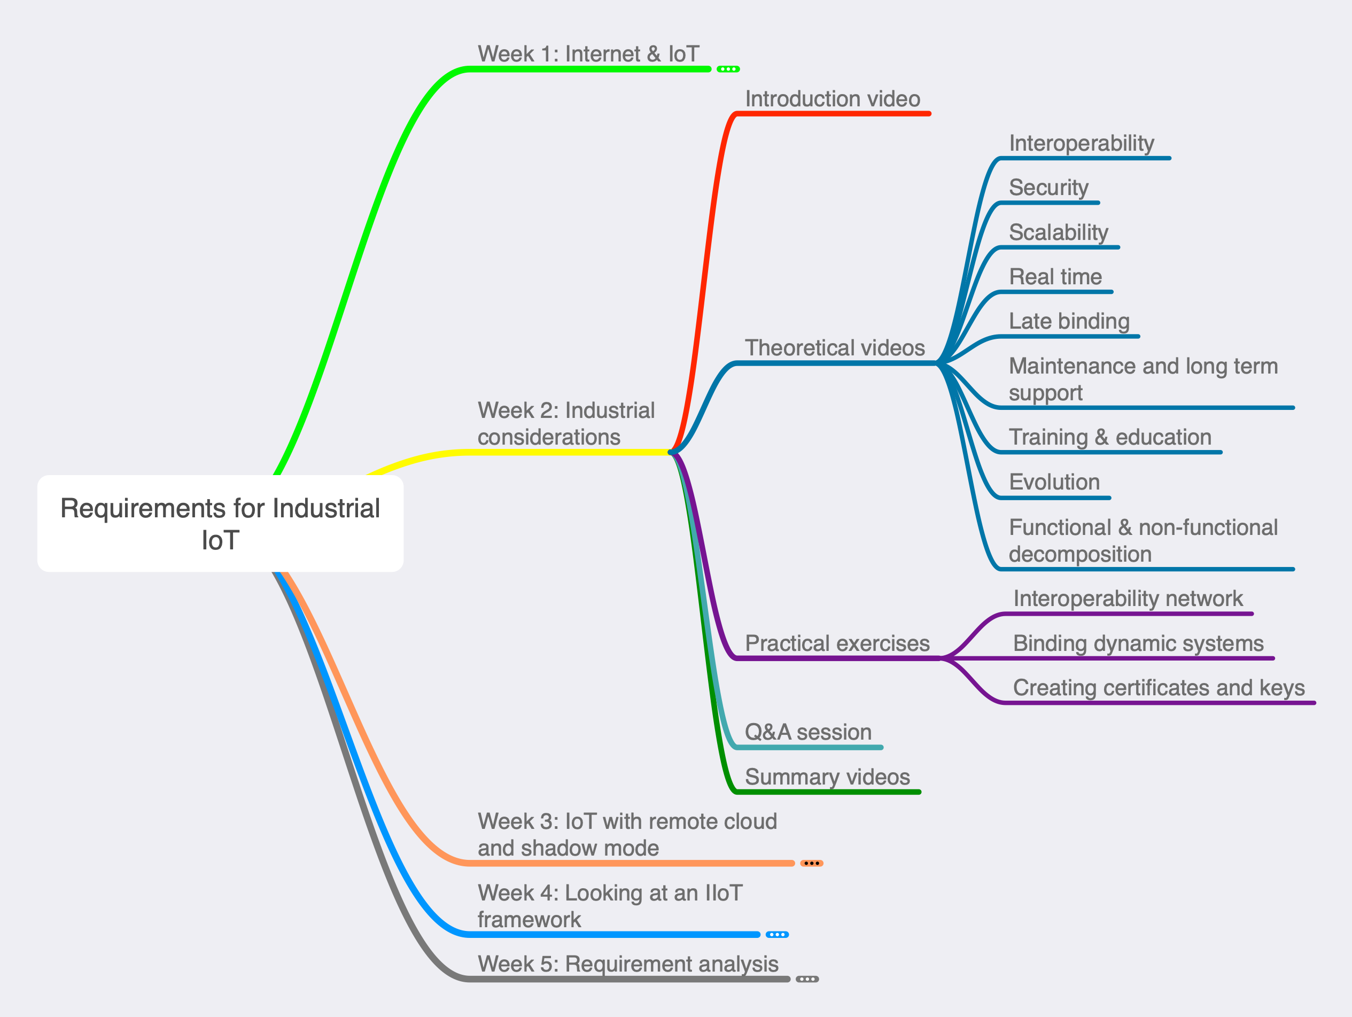
Week 2 Mind Map

