Slide 1
SOA & Late Binding
KUL 4.0 IIOT
Jan van Deventer

Slide 2
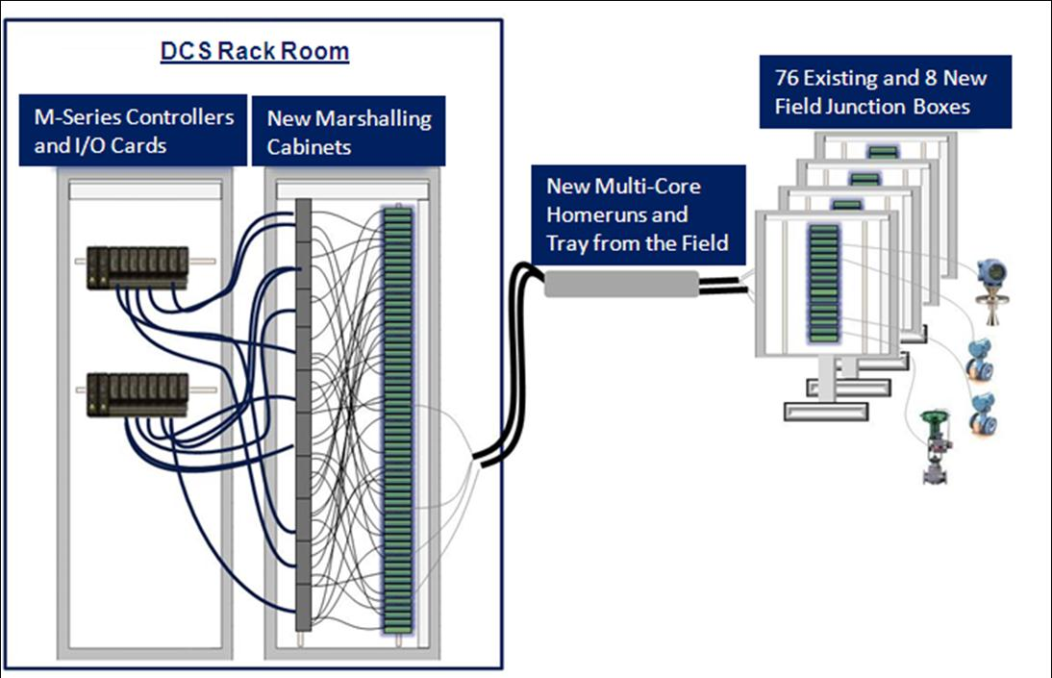
Connections
What do you see when you look under your desk or behind your TV?
We are connecting different systems all over the place, with cables and wireless communications.
How do we connect to the correct endpoints?
Source: DeltaV Whitepaper: Modernizing Your Automation System with I/O on Demand

Slide 3
Correct Connection
The problems we face are:
Finding which services (URIs) we want since they can come and go at anytime.
Connecting to the correct resource at anytime, i.e., not just at design time since things change all the time.

Slide 4
How do we do it as intelligent people?
Let us be silly and try to buy a Norwegian sweater
https://www.google.com/search?client=safari&rls=en&q=norwegian+sweater&ie=UTF-8&oe=UTF-8

Slide 5
What happened?
At runtime, we could discover the service that offers Norwegian sweater sales
that is the URI of the web service
This is because the service was somehow “registered”

Slide 6
Service Oriented Architecture
Service-oriented architecture (SOA) is a style of software design where services are provided to the other components by application components, through a communication protocol over a network.
Some form of registry

Slide 7
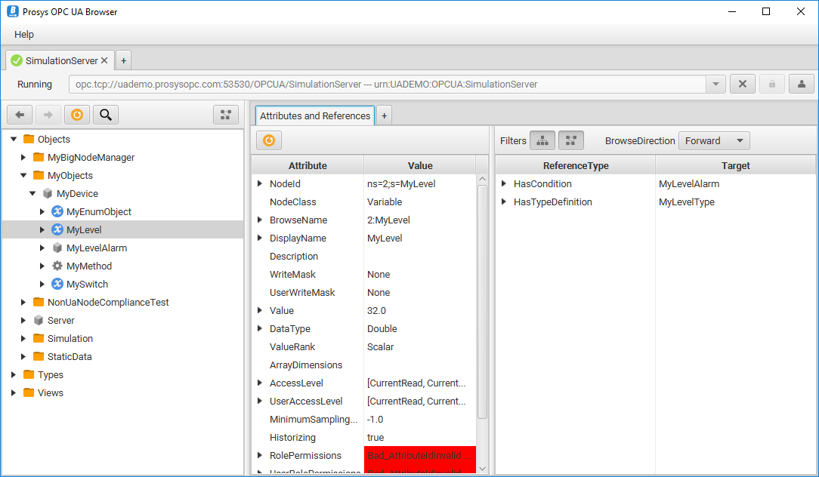
An industrial example
OPC UA
Free Prosys OPC UA Browser
Free Prosys Simulation server

Slide 8
How does a consumer find a service?
At design time, we can hard code where the services are (URI)
but when things change …
At runtime, how does a consumer find the needed and correct service?
Week’s third assignment: type on a half page how you would solve this problem.

Slide 9
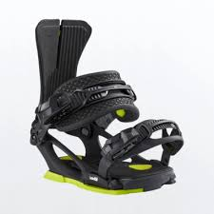

Coupling & Binding
Loose coupling
Late binding

Slide 10
Synopsis
How does a new service advertises itself (e.g., at runtime when things change)?
How does a service consumer find the needed and correct service (e.g., at runtime when things change)?
You do “it” when you buy a sweater online…

