Slide 1
Real Time & Scalability
KUL 4.0 IIOT
Jan van Deventer

Slide 2
Real Time
Time might be real but real time is relative
For some a variable delay of 3 minutes can be acceptable, while for others, 3 ms is unacceptable.
It really depends on the application and its associated requirements.
Heating systems with slow valves and large thermal inertia
Telesurgery with surgical robots
Racing car or an airplane
https://doi.org/10.7326/M20-0418

Slide 3

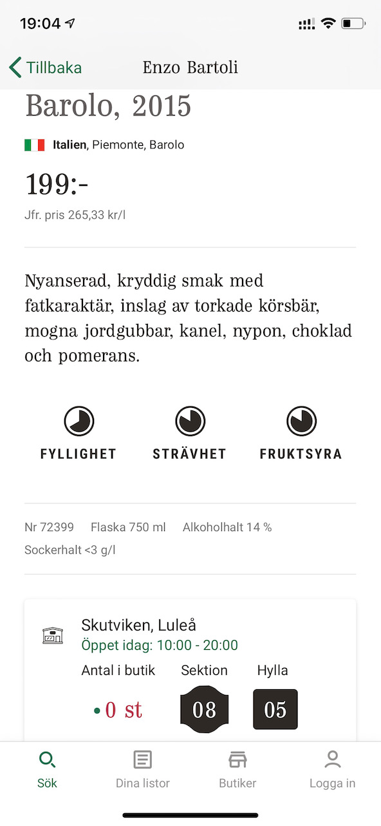
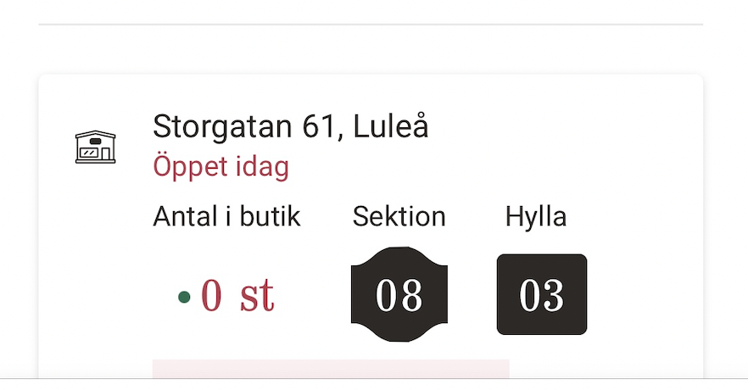
Wine purchase in “real time”
Rushing to get the last bottles, which I did
Realtime information can be important

Slide 4
Pinging as a submarine
ping localhost
ping google.com
ping 196.168.1.9 (my demo board)

Slide 5
Scalability
With IPv4 and even more with IPv6, we can connect to a huge number of devices
so, in that sense, scalability of the Internet of Things is not an issue!
Among the scalability issues are
service discovery
service authorization
At Design time, operation time, thereby including maintenance and evolution.

Slide 6
Synopsis
Real time is important and depends on the application
Scalability covers different issues.
A simple demo is not a proof of scalability.

