Slide 1
A Concrete Example
KUL 4.0 IIoT
Jan van Deventer

Slide 2
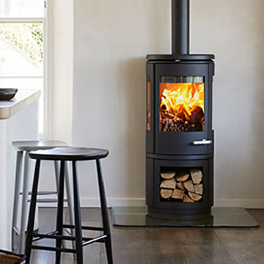
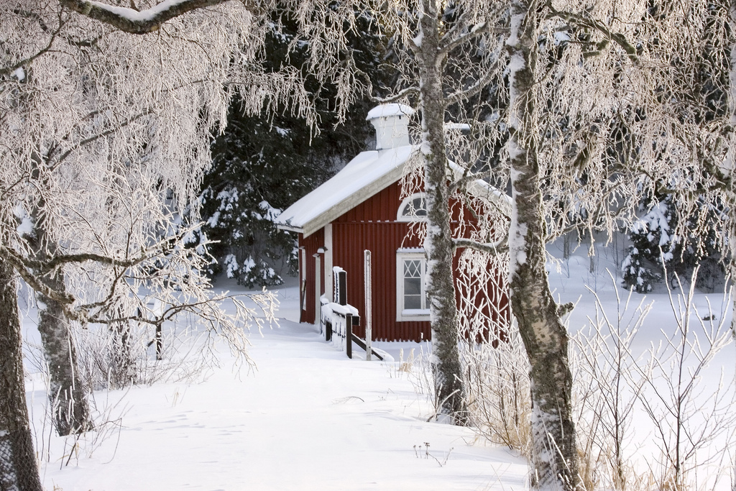
Keeping warm
Fireplace and wood
Cold when waking up in the morning

Slide 3
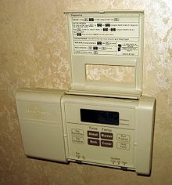
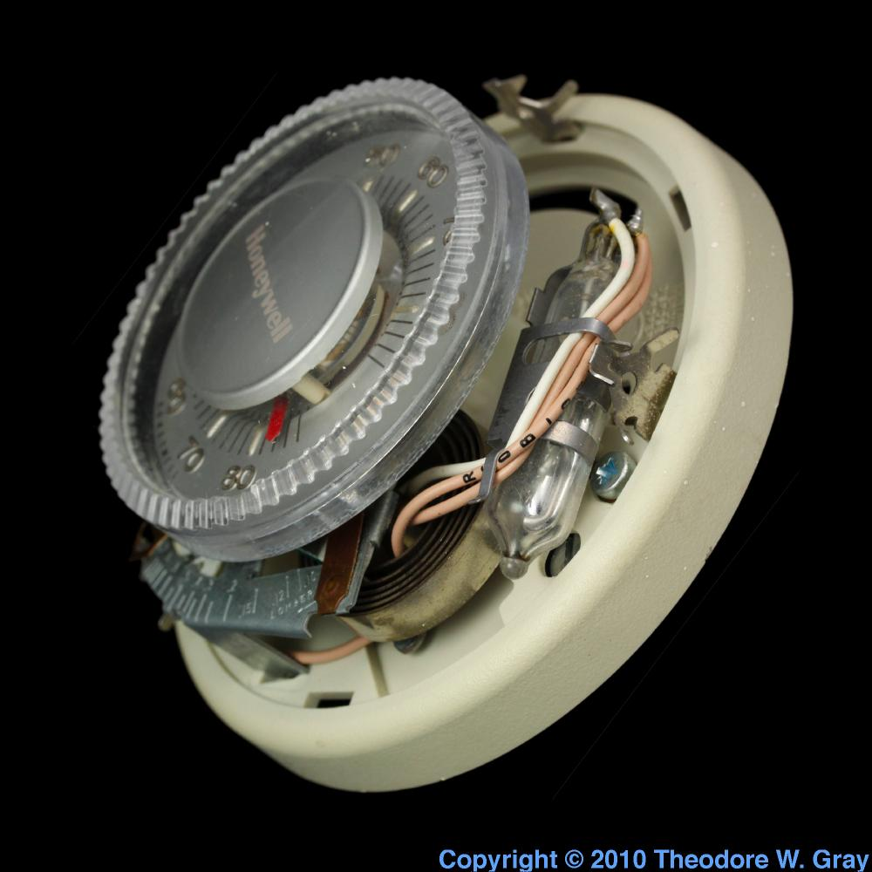
Central heating
Thermostat (analog)
bimetallic coil
Mercury switch
Thermostat (digital)
micro-controller
…

Slide 4
Let us digitalize that
Three “Things”
Thermometer
connections, certificate & keys, authorizations
Thermostat
connections, certificate & keys, authorizations
Switch or valve
connections, certificate & keys, authorizations
Notes:
Digitalize does not mean a digital version but a digital version that works over the Internet
Things or IoT devices

Slide 5
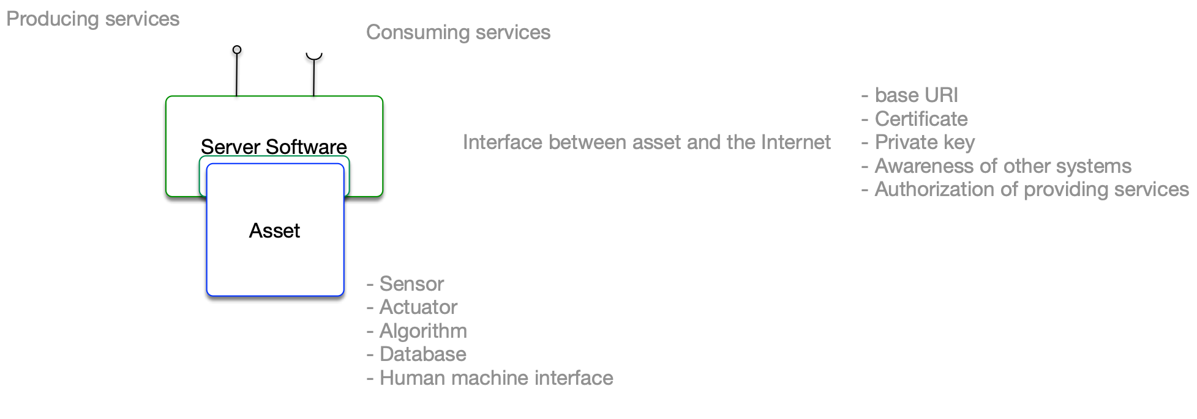
A system’s representation
Notes:
Here is my way of representing an IoT system

Slide 6
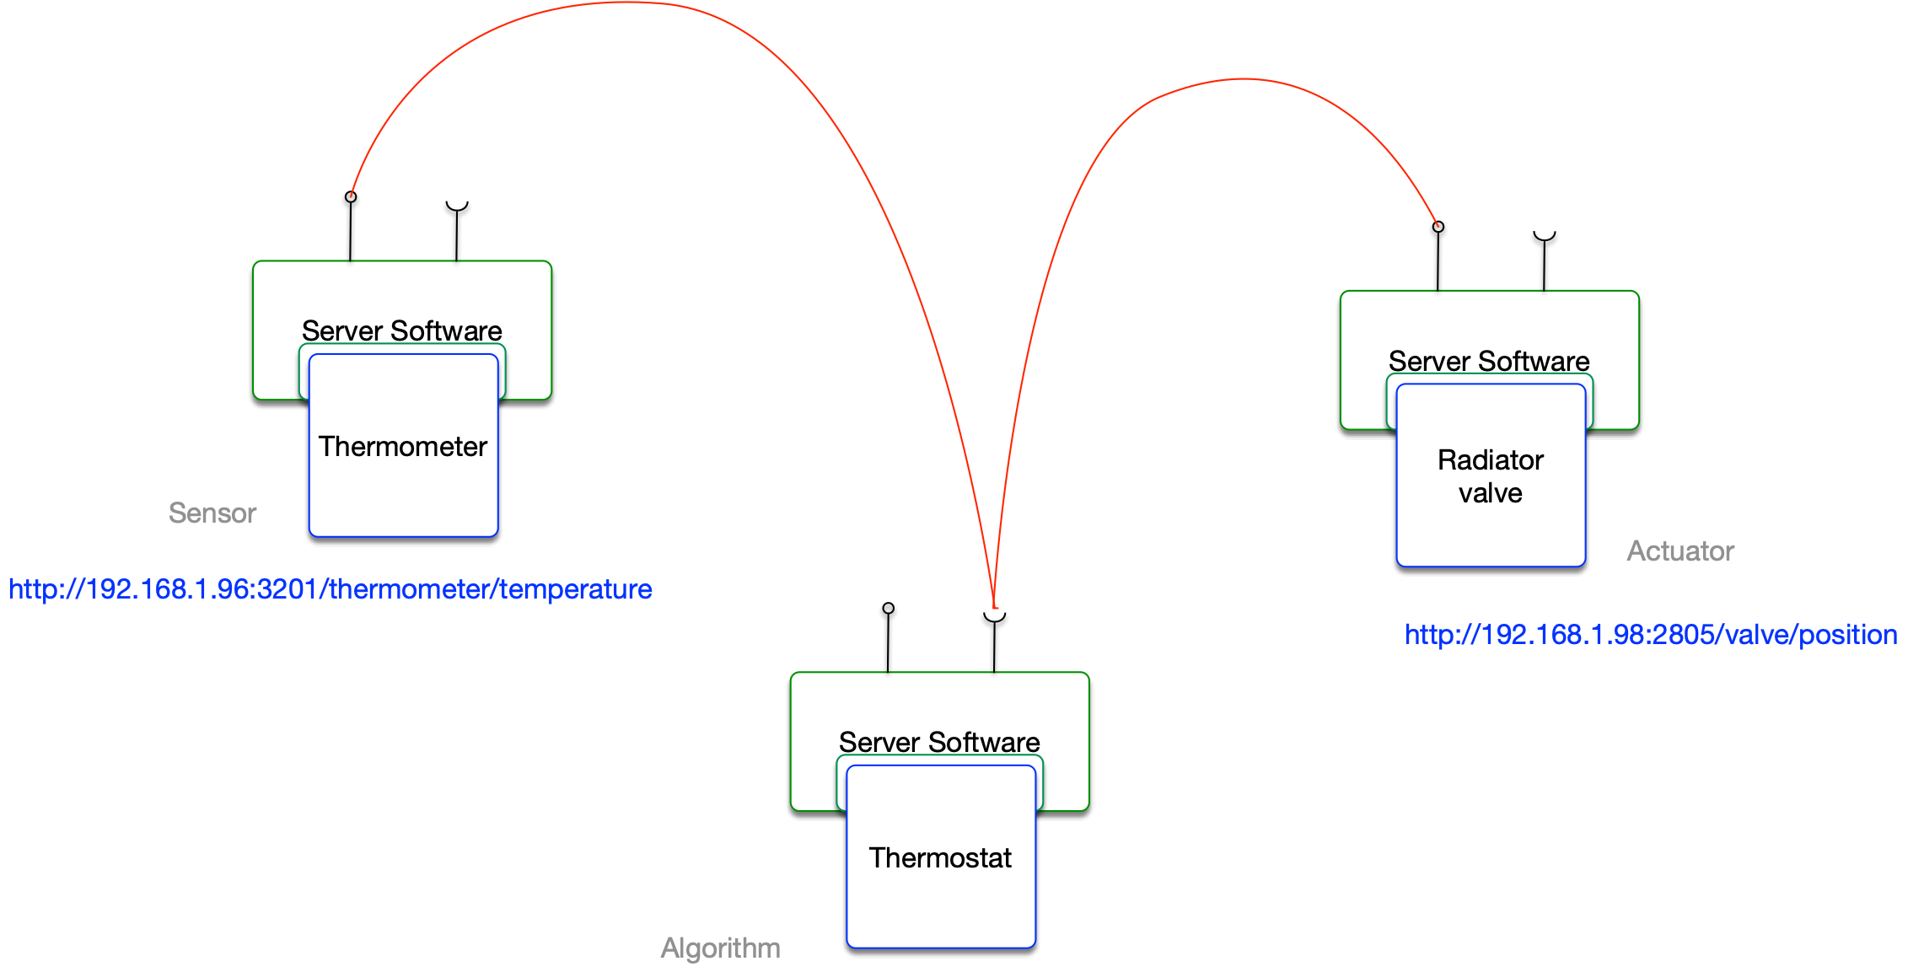
Thermal system of systems

Slide 7
Oh, why making it more complicated?
Do not break something that works!
Is this more robust?
This is far too complicated to make it worth it…
Seriously! What is the point?
…

Slide 8
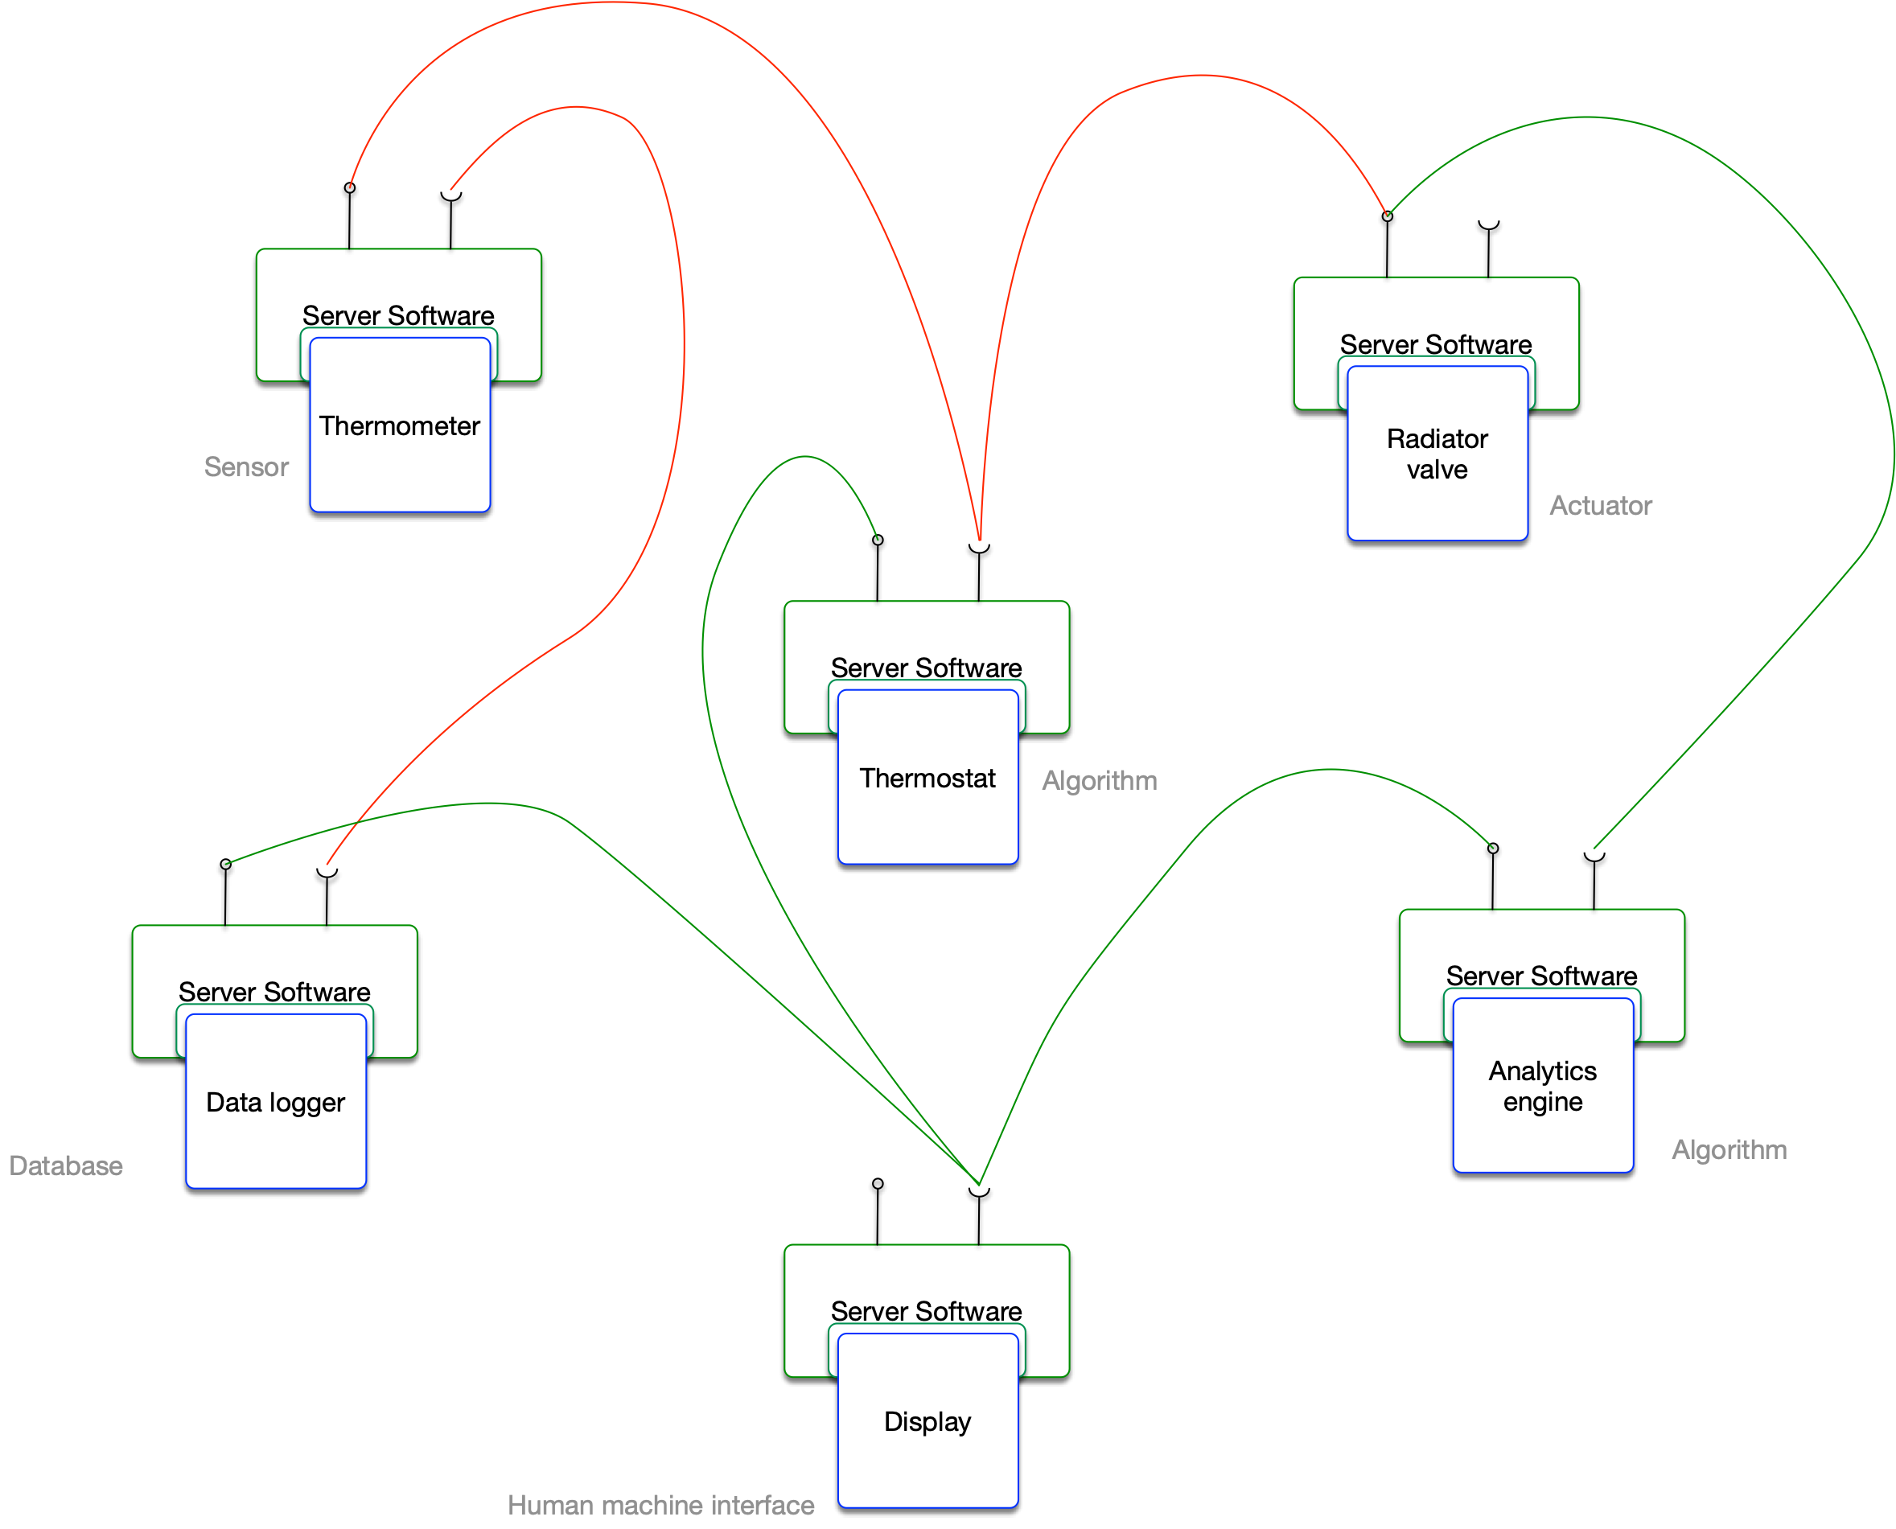
Easily extending the system of systems

Slide 9
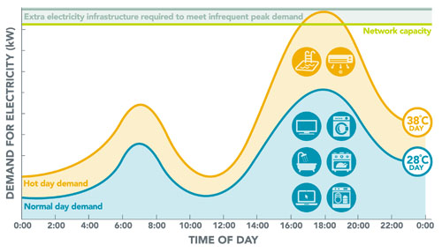
Daily variations in energy demand
www.endeavourenergy.com.au

Slide 10
Demand response
(CHP) Heat and Power (electricity) production Plant must communicate with energy consuming buildings to balance production and demand.
Heat and power have different rates of delivery.
How do we connect these systems?

Slide 11
Synopsis
Digital does not imply Digitalization, the Internet must be part of the picture,
The added functionality is not initially free as it requires a whole IT infrastructure,
If designed properly, an IIoT solution provides a flexible and secure system of systems that can be easily expanded.

