Slide 1
Week 2 Summary
KUL 4.0 IIoT
Jan van Deventer

Slide 2
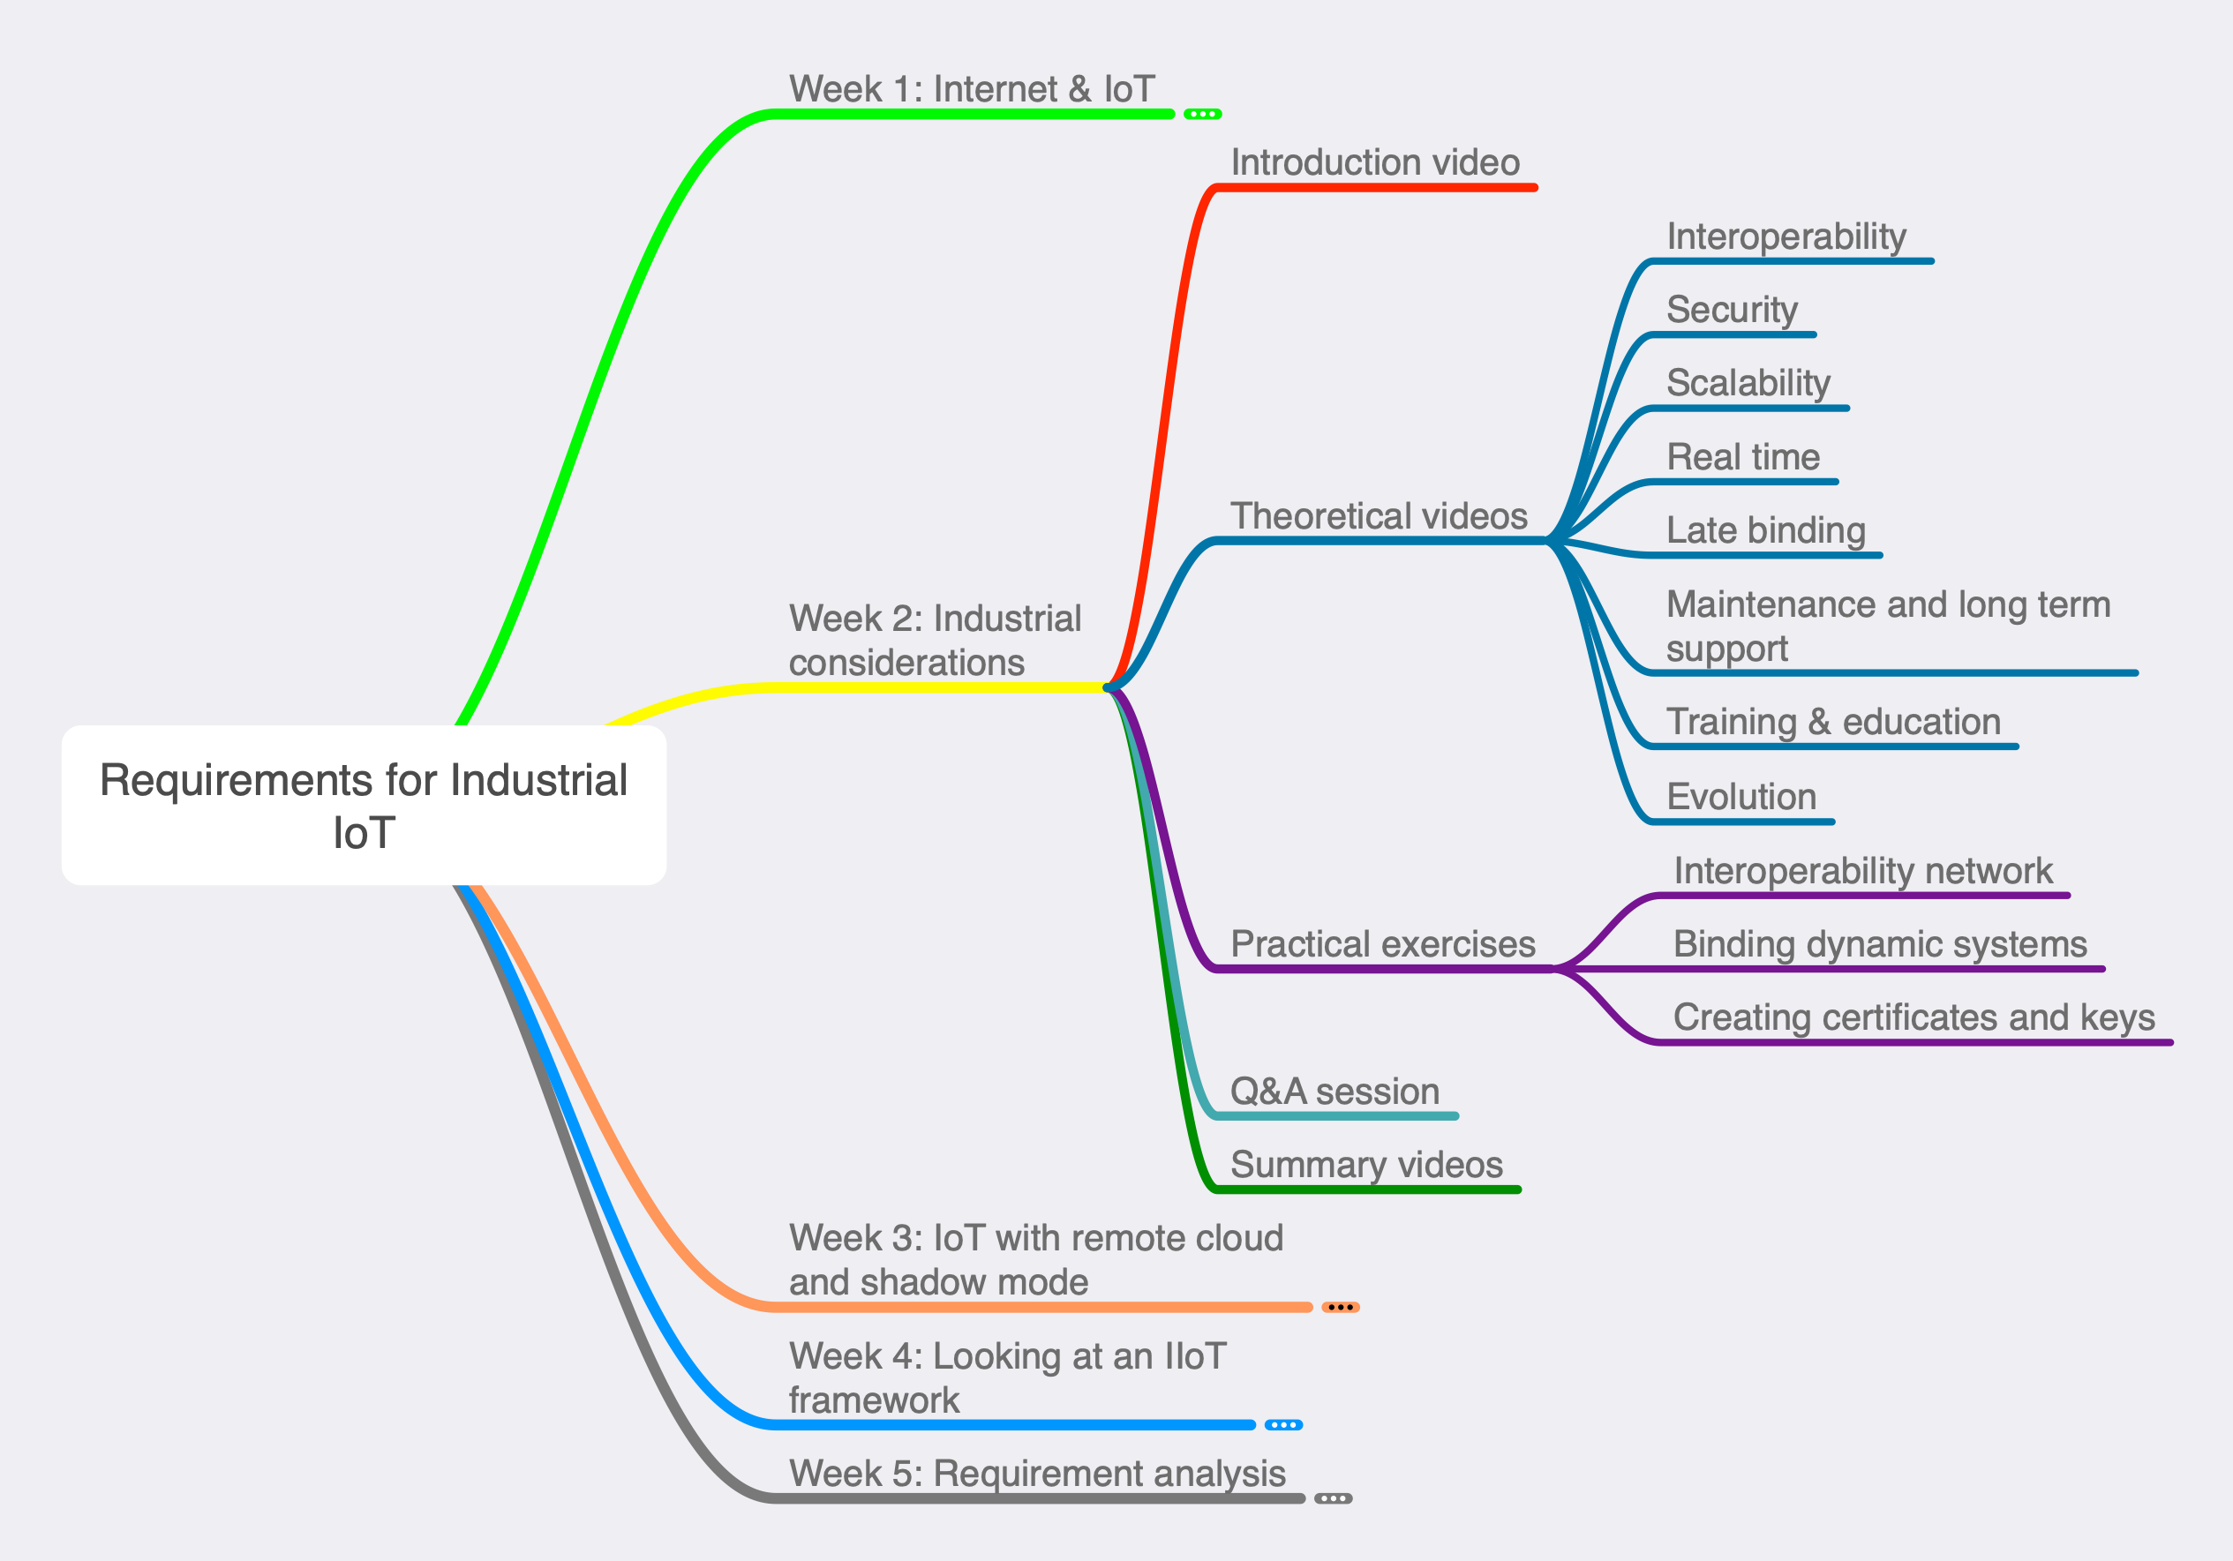
Week 2 Mind Map

Slide 3
IIoT Requirements
There is a lot to consider when contemplating an IoT solution.
It is simpler and much less expensive to be clear about the requirements before commissioning the solution than to try to fix it afterwards when it is in the early phases of operation.

