Slide 1
Local Cloud & Core Systems
KUL 4.0 IIoT
Jan van Deventer

Slide 2
Issues that need to be addressed
Latency
Security: Authentication and Authorization
Service Oriented Architecture
Late Binding
Independence and interdependence
Interoperability
Manageability, scalability,
Code ownership and IPR

Slide 3
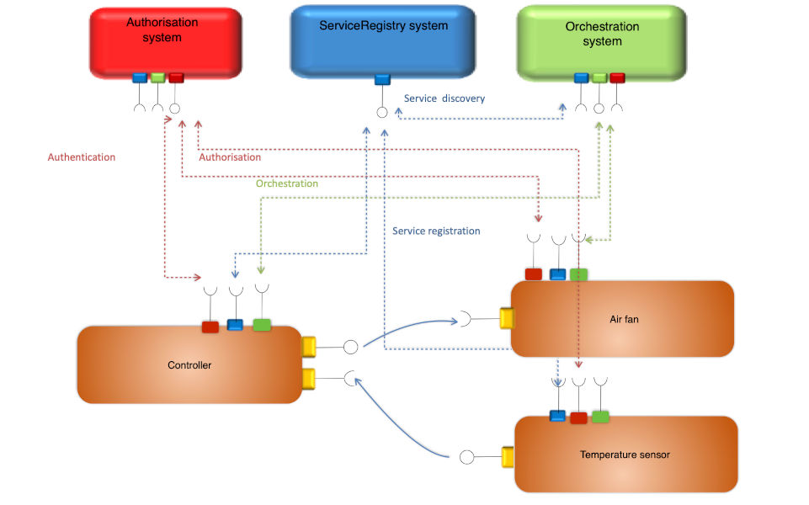
A Local Cloud
Notes:
Latency
security

Slide 4
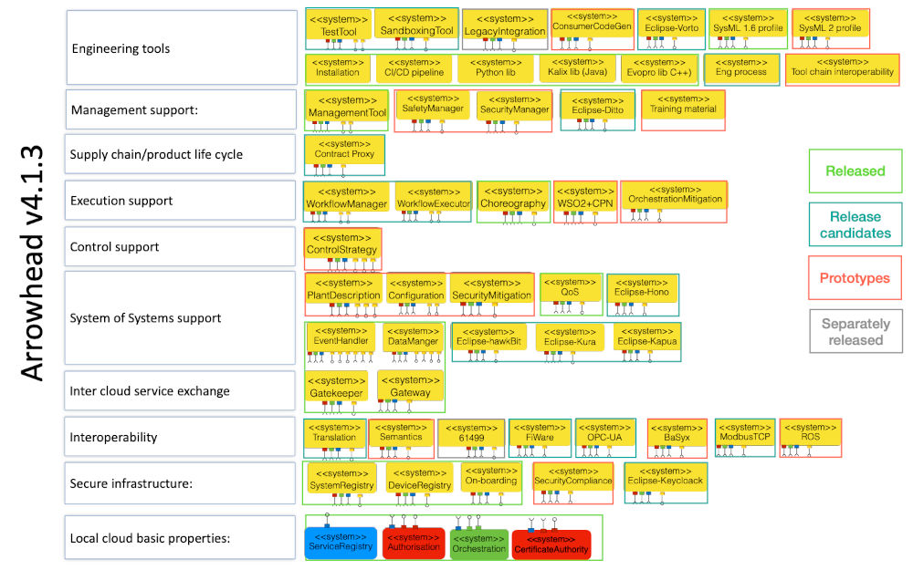
Core Systems

Slide 5
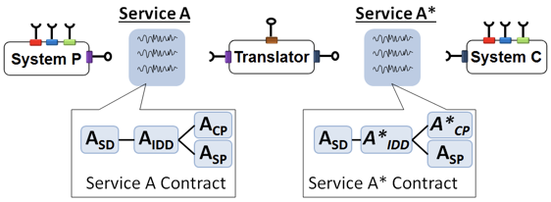
Protocol Interoperability
Notes:
An example of these systems is the Translator system, which promotes interoperability

Slide 6
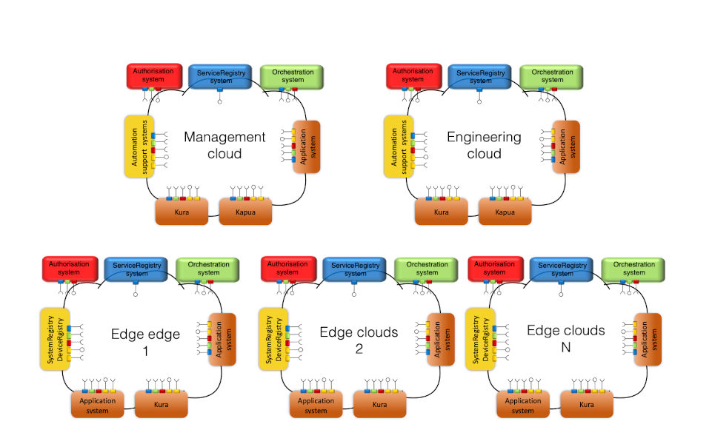
Manageability, Scalability, & more
Notes:
Independence and interdependence

Slide 7
Eclipse Arrowhead
The Arrowhead Framework has always been open source
Eclipse Foundation
The Eclipse Foundation provides our global community of individuals and organizations with a mature, scalable, and business-friendly environment for open source software collaboration and innovation.
The Eclipse Foundation provides four key services to the Eclipse community: 1) IP Management, 2) Ecosystem Development, 3) Development Process, and 4) IT Infrastructure.
Notes:
It is now being assimilated into the Eclipse foundation
The foundation provides business-friendly environment for open source software collaboration and innovation
Being under the Eclipse Foundation umbrella supports the framework with at least three assets
A quality stamp about the framework
It ensures that businesses should not have intellectual property rights issues with the use of the framework,
And, it promotes the framework.

Slide 8
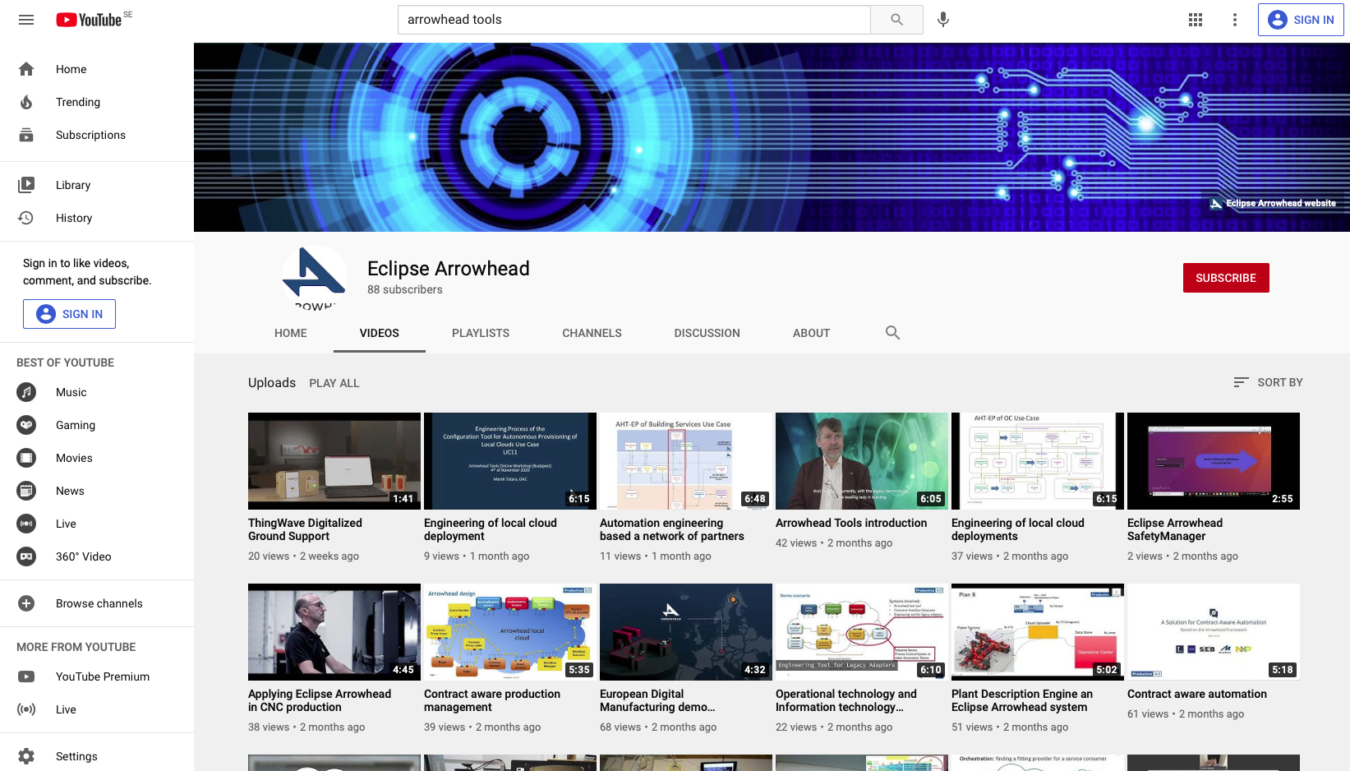
Demonstrators

Slide 9
Synopsis
Frameworks are being developed to enable the integration of industrial IoT, which movements like Industry 4.0 and Industrial Internet Consortium are striving for.
The Eclipse Arrowhead framework is striving to address this development with a local cloud paradigm, while being interoperable with other frameworks and platforms.

