Slide 1
The working concepts of the Internet
KUL 4.0 IIOT
Jan van Deventer

Slide 2
Do we need to know about how it works?
This video might seem a bit technical so one might wonder if it is necessary:
Do we need to know how the Internet works?
If it works as it should: the answer is
Well, yes, at least at a conceptual level.
When it does not work: the answer is
Understanding some concepts will help guide you as you seek support.

Slide 3
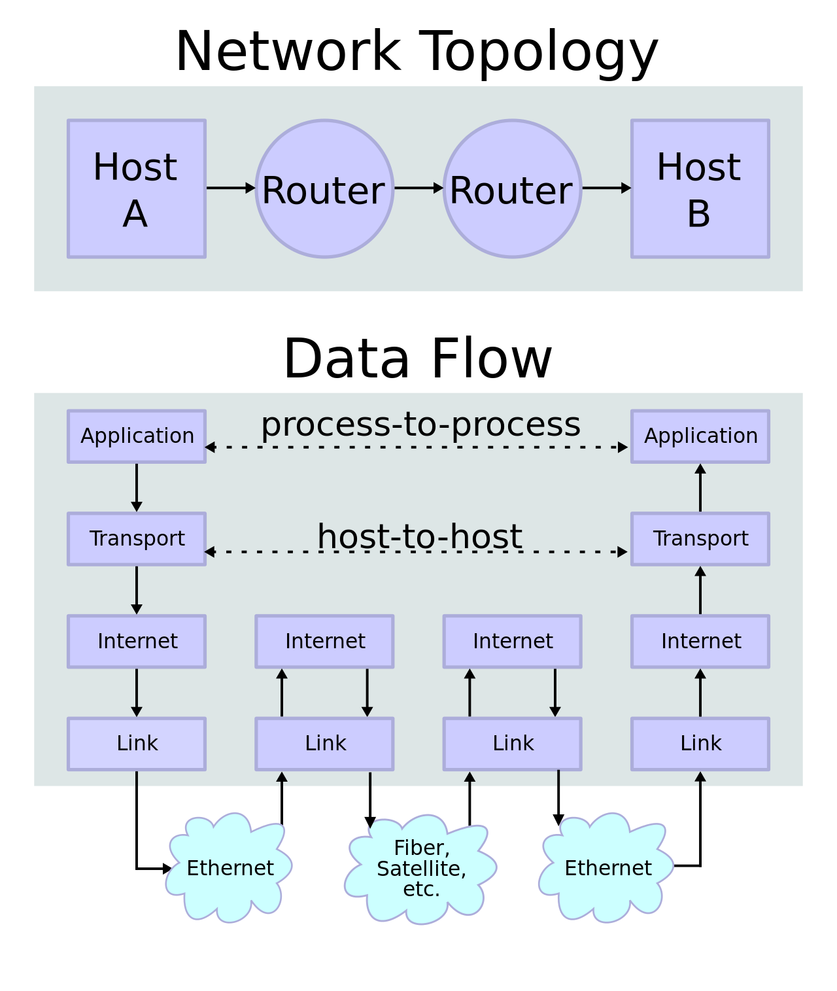
Getting the “information” to the destination
https://en.wikipedia.org/wiki/Internet#/media/File:IP_stack_connections.svg

Slide 4
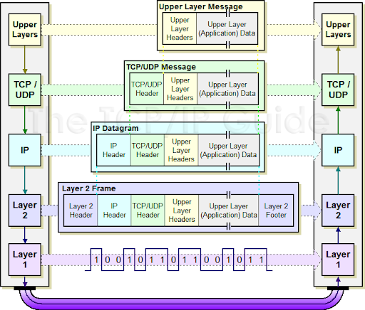
Encapsulation into lower layers
http://www.tcpipguide.com/free/t_IPDatagramEncapsulation.htm

Slide 5
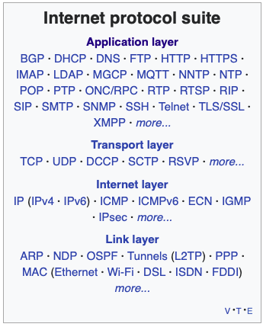
Internet protocol suite
The Internet protocol suite provides end-to-end data communication specifying how data should be packetized, addressed, transmitted, routed, and received.

Slide 6
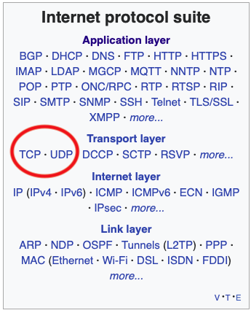
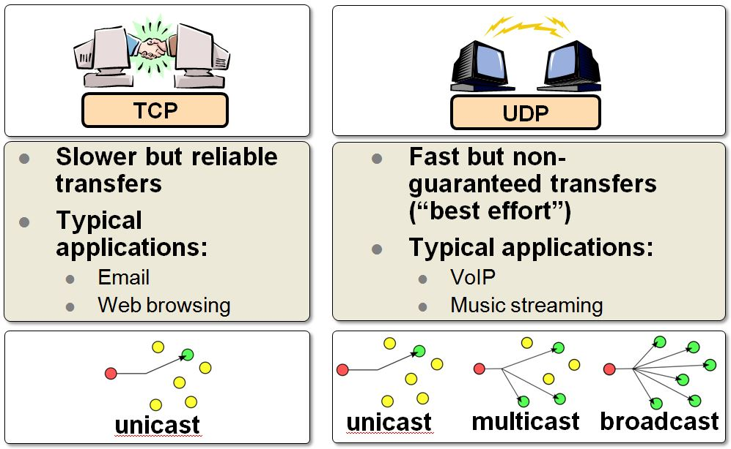
Transport Layer
https://microchip.wikidot.com/tcpip:tcp-vs-udp?_ga=2.239880451.182262365.1609342761-152243937.1609342761

Slide 7
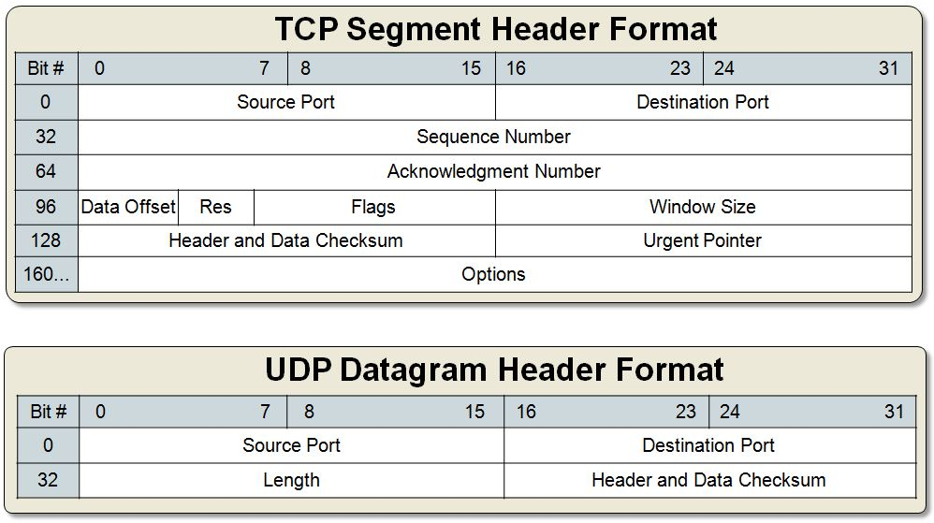
TCP & UDP Headers

Slide 8
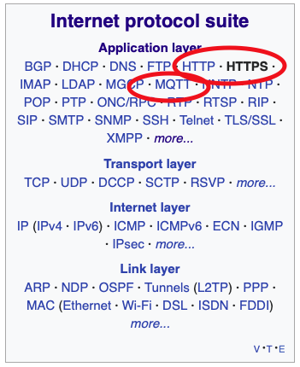
Application Layer
The Hypertext Transfer Protocol (HTTP) is an application layer protocol for distributed, collaborative, hypermedia information systems.^{[1]} HTTP is the foundation of data communication for the World Wide Web, where hypertext documents include hyperlinks to other resources that the user can easily access
In HTTPS, the communication protocol is encrypted using Transport Layer Security (TLS)
MQTT (Message Queuing Telemetry Transport) is a lightweight, publish-subscribe network protocol that transports messages between devices. The protocol usually runs over TCP/IP

Slide 9
Standard Payloads
HTML is a markup language that web browsers use to interpret and compose text, images, and other material into visual or audible web pages. Default characteristics for every item of HTML markup are defined in the browser, and these characteristics can be altered or enhanced by the web page designer's additional use of CSS.
Extensible Markup Language (XML) is a markup language that defines a set of rules for encoding documents in a format that is both human-readable and machine-readable.
XML and HTML were designed with different goals:
XML was designed to carry data - with focus on what data is
HTML was designed to display data - with focus on how data looks
XML tags are not predefined like HTML tags are
JSON (JavaScript Object Notation) is a lightweight data-interchange format. It is easy for humans to read and write. It is easy for machines to parse and generate. It is based on a subset of the JavaScript Programming Language

Slide 10
JSON and XML Weather Example
{
"coord": {
"lon": -122.08,
"lat": 37.39
},
"weather": [
{
"id": 800,
"main": "Clear",
"description": "clear sky",
"icon": "01d"
}
],
"base": "stations",
"main": {
"temp": 282.55,
"feels_like": 281.86,
"temp_min": 280.37,
"temp_max": 284.26,
"pressure": 1023,
"humidity": 100
},
"visibility": 16093,
"wind": {
"speed": 1.5,
"deg": 350
},
"clouds": {
"all": 1
},
"dt": 1560350645,
"sys": {
"type": 1,
"id": 5122,
"message": 0.0139,
"country": "US",
"sunrise": 1560343627,
"sunset": 1560396563
},
"timezone": -25200,
"id": 420006353,
"name": "Mountain View",
"cod": 200
}
<current>
<city id="0" name="Mountain View">
<coord lon="-122.09" lat="37.39" />
<country>US</country>
<timezone>-28800</timezone>
<sun rise="2020-01-07T15:22:59" set="2020-01-08T01:05:37" />
</city>
<temperature value="278.07" min="273.15" max="282.59" unit="kelvin" />
<feels_like value="275.88" unit="kelvin" />
<humidity value="86" unit="%" />
<pressure value="1026" unit="hPa" />
<wind>
<speed value="0.93" unit="m/s" name="Calm" />
<gusts />
<direction value="23" code="NNE" name="North-northeast" />
</wind>
<clouds value="1" name="clear sky" />
<visibility value="16093" />
<precipitation mode="no" />
<weather number="800" value="clear sky" icon="01n" />
<lastupdate value="2020-01-07T11:33:40" />
</current>
https://openweathermap.org/current

Slide 11
Web Service
The term Web service (WS) is either:
a service offered by an electronic device to another electronic device, communicating with each other via the World Wide Web, or
a server running on a computer device, listening for requests at a particular port over a network, serving web documents (HTML, JSON, XML, images), and creating web applications services, which serve in solving specific domain problems over the Web (WWW, Internet, HTTP)
In a Web service a Web technology such as HTTP is used for transferring machine-readable file formats such as XML and JSON.
The W3C defined a Web service as:
A web service is a software system designed to support interoperable machine-to-machine interaction over a network. It has an interface described in a machine-processable format (specifically WSDL). Other systems interact with the web service in a manner prescribed by its description using SOAP-messages, typically conveyed using HTTP with an XML serialization in conjunction with other web-related standards.
— W3C, Web Services Glossary^{[3]}
https://en.wikipedia.org/wiki/Web_service

Slide 12
Not that different of how you use the Internet
World Wide Web
Web browser
Bank:
https://www.nordea.se
https://www.handelsbanken.se/sv/
https://seb.se
Service:
What is my balance?
Transfer 500 SeK from savings to retirement account!

Slide 13
Uniform Resource Identifier
userinfo host port
┌──┴───┐ ┌──────┴──────┐ ┌┴┐
https://john.doe@www.example.com:123/forum/questions/?tag=networking&order=newest#top
└─┬─┘ └───────────┬──────────────┘└───────┬───────┘ └───────────┬─────────────┘ └┬┘
scheme authority path query fragment
ldap://[2001:db8::7]/c=GB?objectClass?one
└┬─┘ └─────┬─────┘└─┬─┘ └──────┬──────┘
scheme authority path query
mailto:John.Doe@example.com
└─┬──┘ └────┬─────────────┘
scheme path
news:comp.infosystems.www.servers.unix
└┬─┘ └─────────────┬─────────────────┘
scheme path
tel:+1-816-555-1212
└┬┘ └──────┬──────┘
scheme path
telnet://192.0.2.16:80/
└─┬──┘ └─────┬─────┘│
scheme authority path
urn:oasis:names:specification:docbook:dtd:xml:4.1.2
└┬┘ └──────────────────────┬──────────────────────┘
scheme path
imessage://+46706791336

Slide 14
What’s the point to requirements?
Technical presentation but the point is not to make the audience computer scientists
The point it to have some understanding of the complexity that might bubble up later on, and which we want to delegate before it becomes a problem.
It is also a preparation for exercises with the development board
Direct communication with HTTP & HTML
Indirect communication with MQTT

Slide 15
Take away
Information transfer from one host to another
payload wrapped as it travel down the TCP/IP layers at sending host
payload unwrapped as it back up to the application layer
At the application layer, we have formats and protocol to match.

