Slide 1
Introduction to the course on IIoT
KUL 4.0 IIoT
Jan van Deventer
Notes:
Hello and welcome to this course!
This is the introduction video for the first week and course on industrial IoT
My name is Jan van Deventer, and I am the teacher for this course
The course is part of the KUL 4.0 Vinnova project
Kursutveckling för livslångt lärande inom basindustrin
Projektets syfte är att tillsammans med behovsägare utveckla samt utvärdera ett deltagardrivet kursutbud både till form och innehåll. Fokus för det här projektet ligger på basindustrin, främst stål-, process- och gruvindustrin samt massa- och pappersindustrin. Projektet kommer ta fram ett paket av kortare kurser inom effektiva produktionsprocesser, underhåll och tillämpad AI. Målet för projektet är att öka utbudet och tillgängligheten av korta flexibla kurser för basindustrin för att de ska kunna möta Industri 4.0.

Slide 2
Lecture and week outline
Expectations of the course (from the employer’s, student’s, & teacher’s point of view)
Intended learning outcomes
Teaching activities
Assessment
What is the big deal with the Internet?
packets, layers, protocols, …
IoT, IIoT, and CPS
Local web server on IoT device hands on experience
Notes:
Let us begin with what we cover during this first week instead of the whole course. We shall look at the whole course at the end the video.
Important are the stakeholders’ expectations of the course, and that includes what is to be learned, how it is taught, and how it is assessed.
In other videos this week, we shall review concepts about the Internet, IoT, industrial IoT and Cyber Physical Systems.
The students will also set up a local web server using their STM32 IoT node development board.

Slide 3
General descriptions of the course
Commissioned education
The subject of the course is IoT (Internet of Things)
2.5 ECTS points
Notes:
To start, we consider a general description of the course.
The course is commissioned by the industry to promote life long learning.
The topic of the course is Internet of Things or IoT.
The course is classified as a 2.5 ECTS points, where ECTS stands for European Credit Transfer and Accumulation System (ECTS) and that really means that a student will have to put in about 60 to 80 study hours to complete the course. https://www.mastersportal.com/articles/388/all-you-need-to-know-about-the-european-credit-system-ects.html

Slide 4
Reflections on course’s expectations
This whole course pivots on one’s expectations.
You should now pause the course stream or video, and write down on paper your expectations of the course.
PRESS PAUSE!
continue when you are done writing about your expectations.
Notes:
The topic of expectations is key to this course.
So, we begin by reflecting and practicing to articulate our anticipations with the goals of the course.
You, the student will therefore asked to pause the video and write down on paper what you expects to learn about IoT with 60 to 80 hours of studies.
Once done with jotting down your thought, please resume the video and I where I will share with you my expectations of the course.

Slide 5
Teacher’s goals with the course
2.5 points is a very small course
Far too little to train someone to develop IoT solutions
Good introduction to specify requirements for an IoT solution to be purchased in your industry
The ability to express as accurately as possible what you want will get you closer to what you really need!
Notes:
If we are honest, 60 to 80 study hours a period too short to train somebody to develop IoT solutions.
Using these hours, we make use of this opportunity to develop skills that are vital for the employers by teaching employees to reflect what they should require when requesting IoT solutions for their work activities.
So, the course is about how or what to specify in terms of requirements when purchasing an IoT solution.
The ability to express as accurately as possible what you want will get you closer to what you really need!

Slide 6
How do I know what I want?
That is a very general life question….
Practice and repetition does help….
Let us here focus on the industrial use of Internet of Things
Learn some basic theory around IIoT
Practice deploying an IoT solution
It is both very easy and very hard
Practice in writing IIoT specifications.
Notes:
To clearly describe what one wants is really a skill.
Usually, we tend to be vague or flexible in our requirements, and complain later on what we got
In this course we will focus on Industrial IoT, and the students will …

Slide 7
Intended leaning outcomes (ILOs)
Upon completion of the course, the student should have
learned some of the basic implementation and challenges with IIoT,
learned to implement a simple secure IoT solution,
experienced writing requirements for an IIoT solution.
Notes:
In academical terms, we can talk about the intended learning outcome of the course …

Slide 8
Teaching & learning activities (TLAs)
The course activities are divided into three interleaved parts:
review of theoretical concepts,
practical IoT experience (uploading sensor data to the cloud and downloaded to a mobile phone),
IIoT requirements writing and presentation.
Notes:
The activities performed to reach these intended learning outcomes include:

Slide 9
Assessment
Weekly presentations during Q&A sessions,
Quizzes week 1, 2 and 4,
The main assessment of the course is the presentation to the teacher and your peers of the requirements for an IIoT solution around your work activities.
Notes:
To pass the course, the students have to demonstrate what they have learned.
Since the learning is mostly based on reflections, there is no real right or wrong answers.
But certainly, there are different answers from which we can all learn.
The students will present their work in the Q&A session weekly and at the end of the course.

Slide 10
This week’s assignments
Report
Your expectations of the course prior to start of the course,
Description of what an IoT solution would be in your work/position @ your employer,
With a browser, you should be able to connect to your STM32 IoT node development board and obtain the temperature in the room and turn on & off an LED on the board.
Notes:
This week’s report assignments that should be uploaded to Canvas include
your initial expectation of the course, which you type up in your favorite word processor and save as a PDF. This will not be shared with other students.
It should also include a description of an IoT solution that your boss might want at work.
Industrial IoT examples include:
if you work with a heating system, you might want to know temperature at different points in the system.
if you work with logistics, you might want to know where parts or components are in real time.
if you work with economy, you might want to know how many parts where delivered in the past hour.
if you work in human resources, you might want to know the comfort states of offices.
You will also have to set up your first web server and connect to it with a web browser

Slide 11
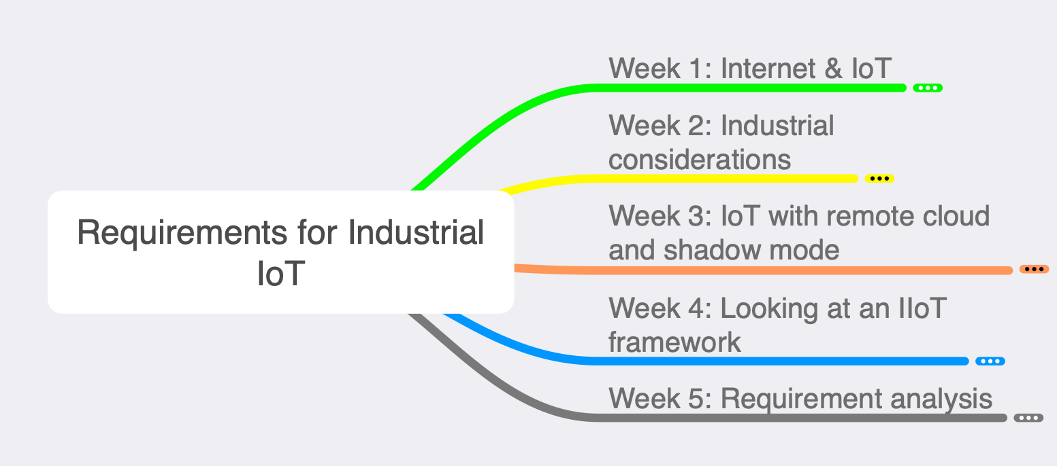
Weekly topics
Notes:
The course is given over five weeks.
The syllabus is therefore broken down in five weekly parts.
Shown here is a mind map over the five weeks.
The topics are: …

Slide 12
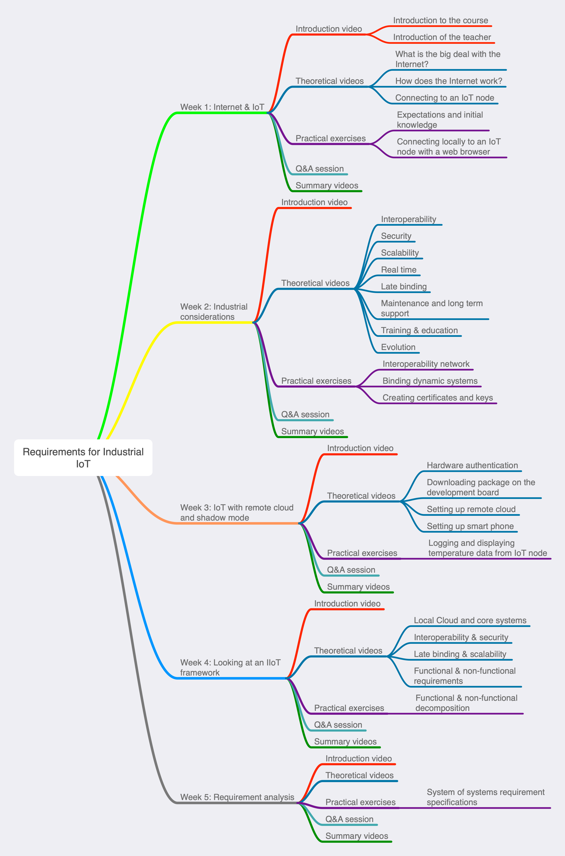
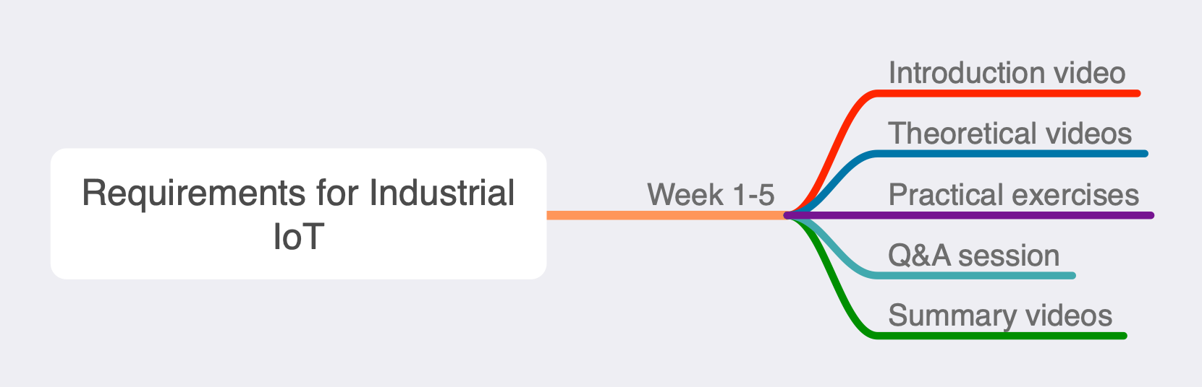
Weekly activities
Notes:
Each week has five moments.
The unreadable picture in upper left is the extended mind map of the whole course.

Slide 13
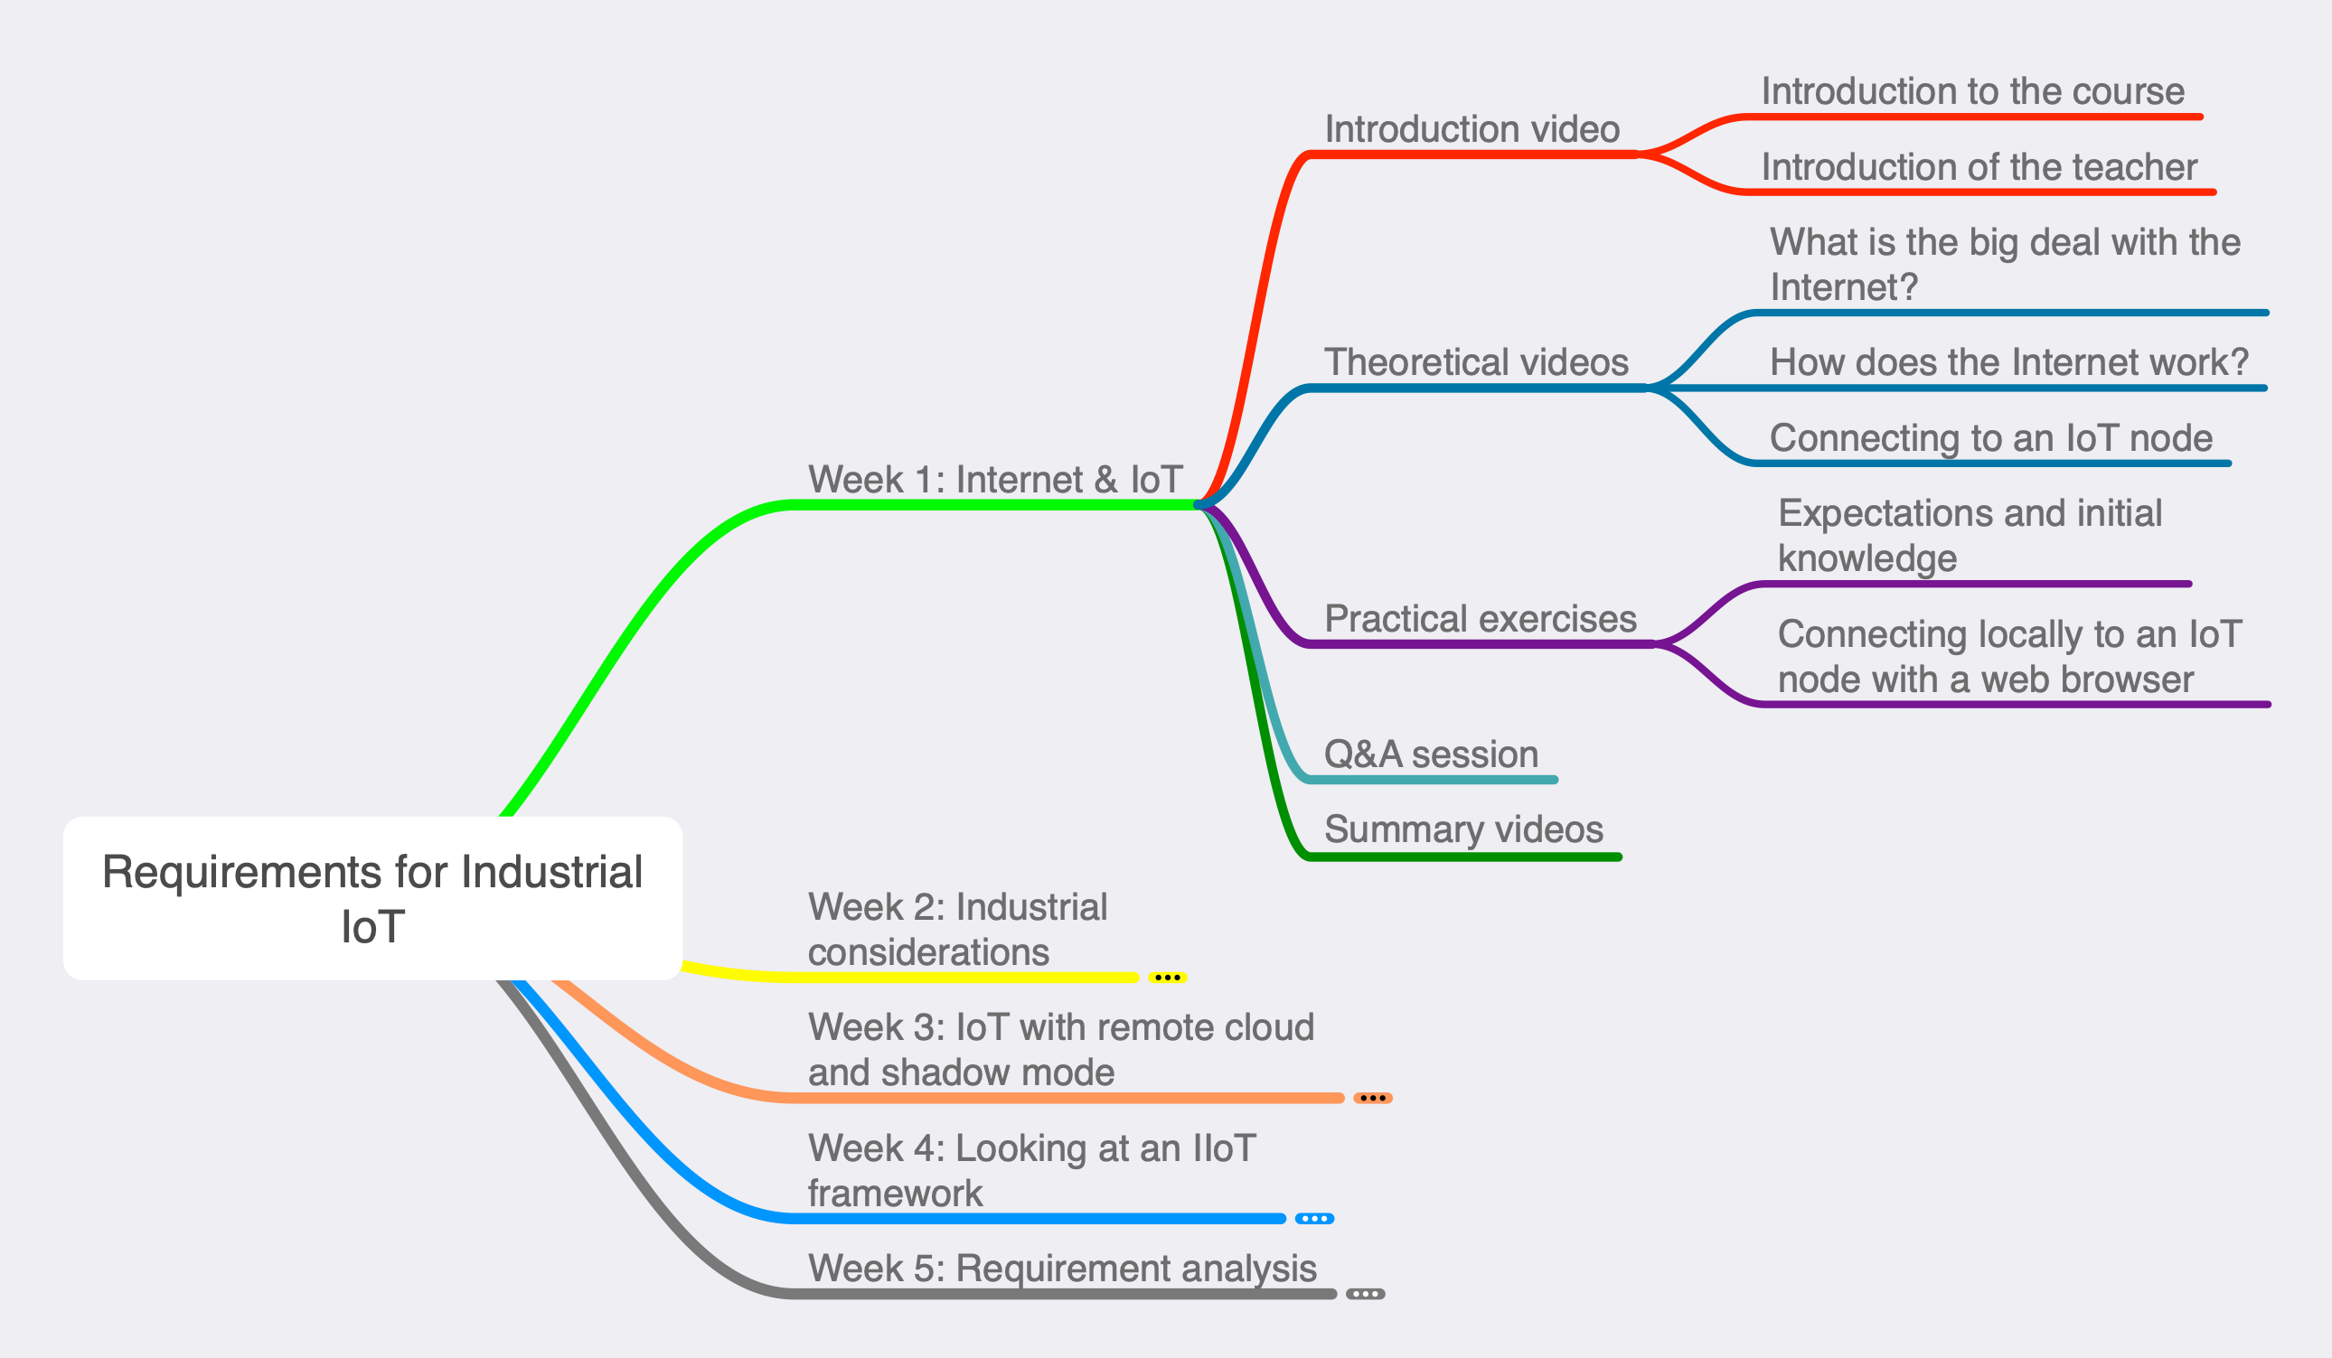
Week 1: Internet and IoT
Notes:
So this week, we have the current video and one where I better introduce myself.
We then start looking into the Internet and our first technical assignment, which is to read the temperature from our development board and turning on and off an LED, all using a web browser.

Slide 14
IIoT is everywhere
Whatever you work with, you IIoT will be part of your work life whether you like it or not
If you master it, you should have computers work for you
If you let technology master you, you will be enslaved (e.g., look at you email inbox)
Notes:
In the next videos, we will dive deeper in what is the Internet of things.
With the adjective industrial, the term IoT reaches toward a higher quality over a long period.
In consumer products, one might be able to accept that an IoT product is outdated within two years of purchase, this is not the case in industry.
We cannot escape easily advances in technologies if we are part of our society.
We therefore have to embrace it as IoT is nowadays quite pervasive.

Slide 15
Synopsis
IoT is part of your life (e.g., do you use a smart phone?),
Know what you want from them (without becoming a software engineer) or you will become their slave,
IoT technology is both simple and very complex
master the simple things,
delegate (with knowledge) the complex details to solution suppliers.

