Slide 1
Week 3 Introduction
KUL 4.0 IIoT
Jan van Deventer

Slide 2
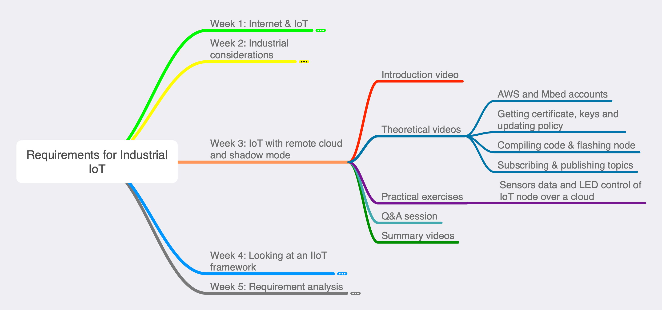
Week 3’s Map

