Slide 1
Week 4: Introduction
KUL 4.0 IIoT
Jan van Deventer

Slide 2
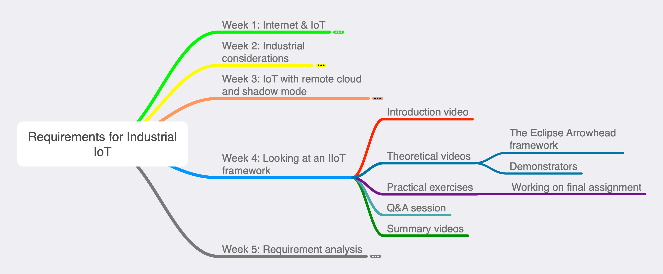
Week’s Map

Slide 3
WARNING: Biased Week
This week, we are looking only at ONE industrial IoT framework.
The development of the Arrowhead Framework funds my research.
It is not the only IoT framework!
“A survey of commercial frameworks for the Internet of Things” (not fresh, from 2015) gives an idea of others.

