Slide 1
CS4100: 計算機結構
Course Outline
國立清華大學資訊工程學系
一零零學年度第二學期

Slide 2
為什麼電腦不用十進位
而用二進位？

Slide 3
Signal: Two States (二進制)
對、錯
本土化、非本土化
陰、陽
high、low
正、反
勝、負
真、偽

Slide 4
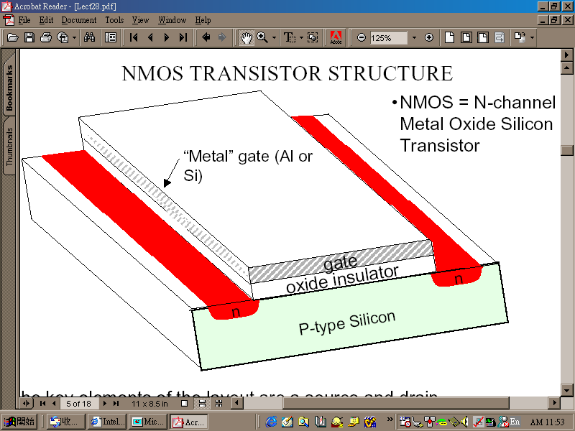
Switch (電子開關)
“gate” as the switch

Slide 5
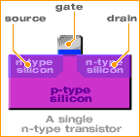
A Working Transistor (1/5)
Transistors consist of three terminals; the source, the gate, and the drain:

Slide 6
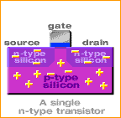
A Working Transistor (2/5)
In the n-type transistor, both the source and the drain are negatively-charged and sit on a positively-charged well of p-silicon.

Slide 7
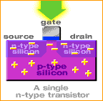
A Working Transistor (3/5)
When positive voltage is applied to the gate, electrons in the p-silicon are attracted to the area under the gate forming an electron channel between the source and the drain.

Slide 8
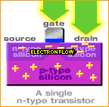
A Working Transistor (4/5)
When positive voltage is applied to the drain, the electrons are pulled from the source to the drain. In this state the transistor is on.
開

Slide 9
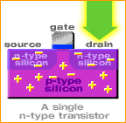
A Working Transistor (5/5)
If the voltage at the gate is removed, electrons are not attracted to the area between the source and drain. The pathway is broken and the transistor is turned off.
關

Slide 10
相關電壓電流特性
及電路分析等知識
我們是在＿＿＿課中介紹的
答：「電子電路學」「超大型積體電路設計」

Slide 11
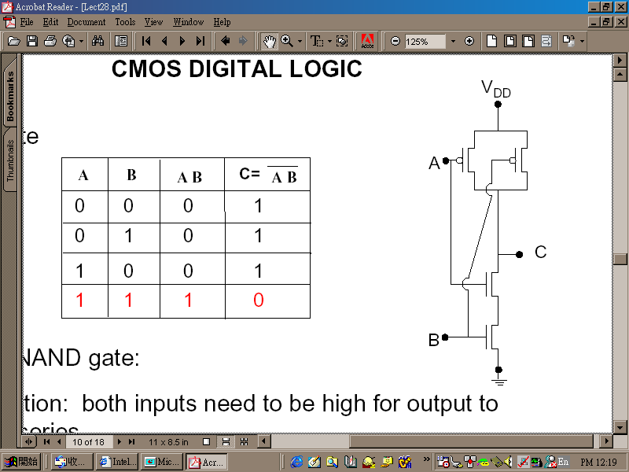
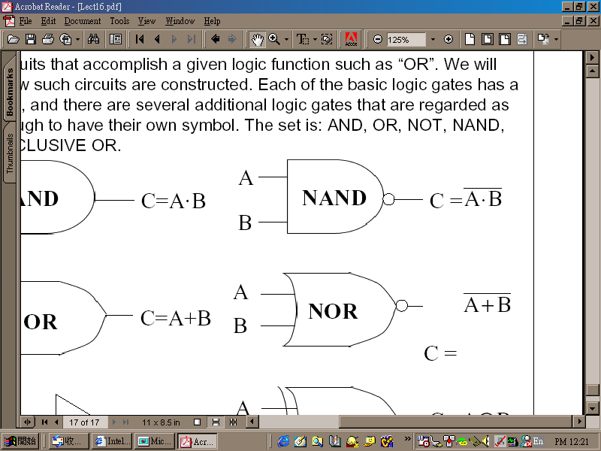
有了開關就可以做邏輯閘
CMOS NAND:

Slide 12
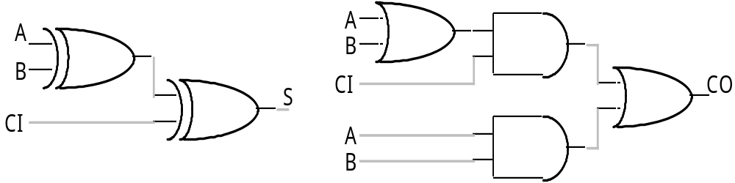
有了邏輯閘就可做邏輯電路
加法器：

Slide 13

也可以做記憶元件
可存一個bit的東西：
R'
R
Q
clock'
Q'
S'
S

Slide 14
這部份的學問叫＿＿＿＿
答：「數位邏輯設計」

Slide 15
最後，
電腦的主要部份就都可以做了
暫存器
記憶體
控制器
控制信號
ALU
N
Z
clock
IR
PC

Slide 16
Basic Organization of Any Computer
Computer
Keyboard,
Mouse
Processor
(active)
Memory
(passive)
(where
programs,
data
live when
running)
Devices
Disk
(where
programs,
data
live when
not running)
Control
(“brain”)
Input
Datapath
(“brawn”)
Output
Display,
Printer
Notes:
That is, any computer, no matter how primitive or advance, can be divided into five parts:
1. The input devices bring the data from the outside world into the computer.
2. These data are kept in the computer’s memory until ...
3. The datapath request and process them.
4. The operation of the datapath is controlled by the computer’s controller.
All the work done by the computer will NOT do us any good unless we can get the data back to the outside world.
5. Getting the data back to the outside world is the job of the output devices.
The most COMMON way to connect these 5 components together is to use a network of busses.

Slide 17
Computer Organization
Capabilities and performance characteristics of principal functional units, e.g., registers, ALU, shifters, ...
Ways in which these components are interconnected (structure)
Information flows between components (data, datapath)
Logic and means by which such information flow is controlled (control logic)
Register Transfer Level (RTL) description
Notes:
Deeper view. Design state of art organization in 1990. This is only the computer organization. What is computer architecture ?

Slide 18
What is Computer Architecture?
Computer Architecture =
Instruction Set Architecture
+ Machine Organization
Application (IE)
Operating
Compiler
System
(MS Windows)
Software
Assembler
Hardware
Instruction Set
Architecture
Processor
Memory
I/O system
Datapath & Control
Digital Design
Circuit Design
Machine Organization
Transistors

Slide 19
Instruction Set as a Critical Interface
Coordination of many levels of abstraction
software
instruction set
hardware
Does it have to be hardware?

Slide 20
Another Perspective
High Level Language Program
temp = v[k];
v[k] = v[k+1];
v[k+1] = temp;
Compiler
Assembly Language Program
lw $15, 0($2)
lw $16, 4($2)
sw $16, 0($2)
sw $15, 4($2)
ISA
Assembler
Machine Language Program
0000 1001 1100 0110 1010 1111 0101 1000
1010 1111 0101 1000 0000 1001 1100 0110
1100 0110 1010 1111 0101 1000 0000 1001
0101 1000 0000 1001 1100 0110 1010 1111
Machine Interpretation
Control Signal Specification
ALUOP[0:3] <= InstReg[9:11] & MASK
°
°

Slide 21
Instruction Set Architecture (ISA)
“... the attributes of a [computing] system as seen by the programmer, i.e. the conceptual structure and functional behavior, as distinct from the organization of the data flows and controls, the logic design, and the physical implementation.”
— Amdahl, Blaaw, and Brooks, 1964
Organization of Programmable
Storage
Data Types and Data Structures:
Encodings and Representations
Instruction Set
Instruction Formats
Modes of Addressing and Accessing Data Items and Instructions
Exceptional Conditions
SOFTWARE

Slide 22
MIPS R3000 ISA
Registers
Instruction categories:
  Load/Store
  Computational
  Jump and Branch
  Floating Point
    coprocessor
  Memory Management
  Special
R0 - R31
PC
HI
LO
3 Instruction Formats: all 32 bits wide
OP
rs
rt
rd
sa
funct
OP
rs
rt
immediate
OP
jump target

Slide 23
Example ISA
Digital Alpha (v1, v3) 1992-97
HP PA-RISC (v1.1, v2.0) 1986-96
Sun Sparc (v8, v9) 1987-95
SGI MIPS (MIPS I, II, III, IV, V) 1986-96
Intel (8086,80286,80386, 1978-
80486,Pentium, MMX,
SIMD, IA-64, ...)
ARM (v1,v2…v8) 1985-

Slide 24
Why Do Computer Architecture?
RAPID CHANGES
It is exciting!
It has never been more exciting!
It impacts every other aspect of electrical engineering and computer science

Slide 25
Course Administration
授課老師: 黃婷婷
  辦公室: 資電442 電話: 31310
  email: tingting@cs.nthu.edu.tw
助教:
許博揚 pyhsu@cs.nthu.edu.tw Office Hour: wed 16:00-17:00 (資電227)
張洸鋐 s100062540@m100.nthu.edu.tw O.H.: thu 17:00-18:00 (資電 228)
丁慧玲 s100062541@m100.nthu.edu.tw O.H.: wed 17:00-18:00 (資電 228)
楊惠敏 s100062585@m100.nthu.edu.tw O.H.: tue 17:00-18:00 (資電228)
上課時間:
  CS4100-02: 星期二10:10-12:00
  星期四10:10-12:00
上課地點: 台達館 132室
課程網頁: http://www.cs.nthu.edu.tw/~tingting/courses/cs4100.html

Slide 26
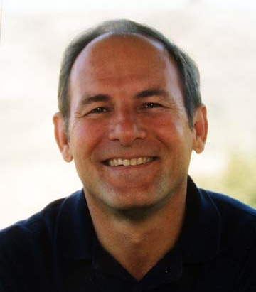
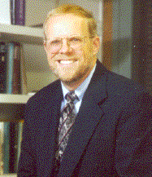
Text Book
Computer Organization and Design: The Hardware/Software Interface, 4th ed.,
David Patterson and John Hennessy, 2010
RISC, RAID
史丹福大學
校長

Slide 27
Topics Covered
Computer Organization and Design: The Hardware/Software Interface,4th ed.,
D. Patterson and J. Hennessy, 2010
Topic Chapter
Introduction 1
The Role of Performance 1
Instructions: Language of the Machine 2
Arithmetic for Computers 3
The Processor: Datapath and Control 4
Enhancing Performance with Pipelining 4
Exploiting Memory Hierarchy 5
Storage and Other I/O Topics * 6
Multicores, Multiprocessors and Clusters* 7

Slide 28
Prerequisite
Prerequisite courses:
  Logic design

Slide 29
Expected Course Workload
Learn MIPS instruction set
Learn processor emulators and benchmarking
6+ homework assignments (1 per 2 weeks) & 1 final project
  Each assignment is a mixture of design, calculation, programming, measurement, and discussion problems
  Assignments will be posted on the course homepage
  Independent of, but complement, examinations
One mid-term and one final examination
Grade breakdown
  Homework Assignments & Final project 30%
  Midterm Exam (April 24): 35%
  Final Exam (June 12): 35%

Slide 30
Course Problems
Cannot make examinations
  No makeup examinations
Cannot turn in homework on time
  No late homework is accepted
What is cheating?
  Study together in groups is encouraged
  Work must be your own

