Slide 1
CS4100: 計算機結構
Instruction Set Architecture
國立清華大學資訊工程學系
一零零學年度第二學期

Slide 2
Outline
Instruction set architecture (Sec 2.1)
Operands
  Register operands and their organization
  Memory operands, data transfer
  Immediate operands
Signed and unsigned numbers
Representing instructions
Operations
  Logical
  Decision making and branches
Supporting procedures in hardware
Communicating with people
Addressing for 32-bit immediate and addresses
Translating and starting a program
A sort example
Arrays versus pointers
ARM and x86 instruction sets
Instruction Set-<number>

Slide 3
What Is Computer Architecture?
Computer Architecture =
Instruction Set Architecture
+ Machine Organization
“... the attributes of a [computing] system as seen by the [____________ language] programmer, i.e. the conceptual structure and functional behavior …”
assembly
What are specified?
Instruction Set-<number>

Slide 4
Recall in C Language
Operators: +, -, *, /, % (mod), ...
  7/4==1, 7%4==3
Operands:
  Variables: lower, upper, fahr, celsius
  Constants: 0, 1000, -17, 15.4
Assignment statement:
variable = expression
  Expressions consist of operators operating on operands, e.g.,
    celsius = 5*(fahr-32)/9;
    a = b+c+d-e;
Instruction Set-<number>

Slide 5
When Translating to Assembly ...
a = b + 5;
load $r1, M[b]
load $r2, 5
add $r3, $r1, $r2
store $r3, M[a]
Statement
Constant
Operands
Memory
Register
Operator (op code)
Instruction Set-<number>

Slide 6
Components of an ISA
Organization of programmable storage
  registers
  memory: flat, segmented
  modes of addressing and accessing data items and instructions
Data types and data structures
  encoding and representation
Instruction formats
Instruction set (or operation code)
  ALU, control transfer, exceptional handling
Instruction Set-<number>

Slide 7
MIPS ISA as an Example
Registers
Instruction categories:
  Load/Store
  Computational
  Jump and Branch
  Floating Point
  Memory Management
  Special
$r0 - $r31
PC
HI
LO
3 Instruction Formats: all 32 bits wide
OP
$rs
$rt
$rd
sa
funct
OP
$rs
$rt
immediate
OP
jump target
Instruction Set-<number>

Slide 8
Outline
Instruction set architecture
Operands (Sec 2.2, 2.3)
  Register operands and their organization
  Memory operands, data transfer
  Immediate operands
Signed and unsigned numbers
Representing instructions
Operations
  Logical
  Decision making and branches
Supporting procedures in hardware
Communicating with people
Addressing for 32-bit immediate and addresses
Translating and starting a program
A sort example
Arrays versus pointers
ARM and x86 instruction sets
Instruction Set-<number>

Slide 9
Operations of Hardware
Syntax of basic MIPS arithmetic/logic instructions:
      1 2 3 4
  add $s0,$s1,$s2 # f = g + h
1) operation by name
  2) operand getting result (“destination”)
  3) 1st operand for operation (“source1”)
  4) 2nd operand for operation (“source2”)
Each instruction is 32 bits
Syntax is rigid: 1 operator, 3 operands
  Why? Keep hardware simple via regularity
Design Principle 1: Simplicity favors regularity
  Regularity makes implementation simpler
  Simplicity enables higher performance at lower cost
Instruction Set-<number>

Slide 10
Example
How to do the following C statement?
  f = (g + h) - (i + j);
Compiled MIPS code:
    add t0, g, h # temp t0 = g + h
    add t1, i, j # temp t1 = i + j
    sub f, t0, t1 # f = t0 - t1
Instruction Set-<number>

Slide 11
Operands and Registers
Unlike high-level language, assembly don’t use variables
=> assembly operands are registers
  Limited number of special locations built directly into the hardware
  Operations are performed on these
Benefits:
  Registers in hardware => faster than memory
  Registers are easier for a compiler to use
    e.g., as a place for temporary storage
  Registers can hold variables to reduce memory traffic and improve code density (since register named with fewer bits than memory location)
Instruction Set-<number>

Slide 12
MIPS Registers
32 registers, each is 32 bits wide
  Why 32? Design Principle 2: smaller is faster
  Groups of 32 bits called a word in MIPS
  Registers are numbered from 0 to 31
  Each can be referred to by number or name
  Number references:
  $0, $1, $2, … $30, $31
  By convention, each register also has a name to make it easier to code, e.g.,
  $16 - $22 ➔ $s0 - $s7 (C variables)
  $8 - $15 ➔ $t0 - $t7 (temporary)
32 x 32-bit FP registers (paired DP)
Others: HI, LO, PC
Instruction Set-<number>

Slide 13
Registers Conventions for MIPS
0 zero constant 0
1 at reserved for assembler
2 v0 expression evaluation &
3 v1 function results
4 a0 arguments
5 a1
6 a2
7 a3
8 t0 temporary: caller saves
. . . (callee can clobber)
15 t7
16 s0 callee saves
. . . (caller can clobber)
23 s7
24 t8 temporary (cont’d)
25 t9
26 k0 reserved for OS kernel
27 k1
28 gp pointer to global area
29 sp stack pointer
30 fp frame pointer
31 ra return address (HW)
Fig. 2.18
Instruction Set-<number>

Slide 14
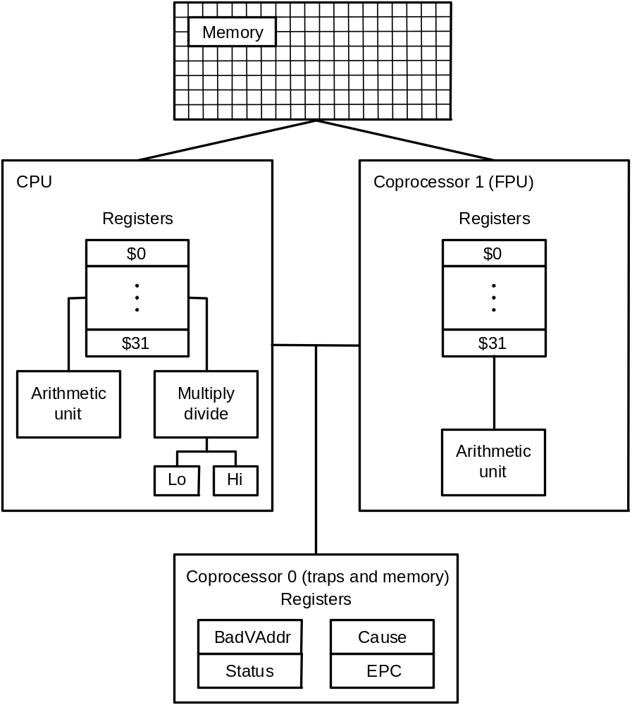
MIPS R2000 Organization
Fig. A.10.1

Slide 15
Example
How to do the following C statement?
  f = (g + h) - (i + j);
f, …, j in $s0, …, $s4
use intermediate temporary register t0,t1
      add $t0,$s1,$s2 # t0 = g + h
      add $t1,$s3,$s4 # t1 = i + j
      sub $s0,$t0,$t1 # f=(g+h)-(i+j)
Instruction Set-<number>

Slide 16
Operations of Hardware
Syntax of basic MIPS arithmetic/logic instructions:
      1 2 3 4
  add $s0,$s1,$s2 # f = g + h
1) operation by name
  2) operand getting result (“destination”)
  3) 1st operand for operation (“source1”)
  4) 2nd operand for operation (“source2”)
Each instruction is 32 bits
Syntax is rigid: 1 operator, 3 operands
  Why? Keep hardware simple via regularity
Design Principle 1: Simplicity favors regularity
  Regularity makes implementation simpler
  Simplicity enables higher performance at lower cost
Instruction Set-<number>

Slide 17
Register Architecture
Accumulator (1 register):
1 address: add A acc ← acc + mem[A]
1+x address: addx A acc ← acc + mem[A+x]
Stack:
0 address: add tos ← tos + next
General Purpose Register:
2 address: add A,B EA(A) ← EA(A) + EA(B)
3 address: add A,B,C EA(A) ← EA(B) + EA(C)
Load/Store: (a special case of GPR)
3 address: add $ra,$rb,$rc $ra ← $rb + $rc
load $ra,$rb $ra ← mem[$rb]
store $ra,$rb mem[$rb] ← $ra
Instruction Set-<number>
Notes:
Invented index register
Reverse polish stack = HP calculator
GPR = last 20 years
L/S variant = last 10 years

Slide 18
Register Organization Affects Programming
Code for C = A + B for four register organizations:
Stack Accumulator Register Register
(reg-mem) (load-store)
Push A Load A Load $r1,A Load $r1,A
Push B Add B Add $r1,B Load $r2,B
Add Store C Store C,$r1 Add $r3,$r1,$r2
Pop C Store C,$r3
=> Register organization is an attribute of ISA!
Comparison: Byte per instruction? Number of instructions? Cycles per instruction?
Since 1975 all machines use GPRs
Instruction Set-<number>

Slide 19
Outline
Instruction set architecture
Operands (Sec 2.2, 2.3)
  Register operands and their organization
  Memory operands, data transfer
  Immediate operands
Signed and unsigned numbers
Representing instructions
Operations
  Logical
  Decision making and branches
Supporting procedures in hardware
Communicating with people
Addressing for 32-bit immediate and addresses
Translating and starting a program
A sort example
Arrays versus pointers
ARM and x86 instruction sets
Instruction Set-<number>

Slide 20
Memory Operands
C variables map onto registers; what about large data structures like arrays?
  Memory contains such data structures
But MIPS arithmetic instructions operate on registers, not directly on memory
  Data transfer instructions (lw, sw, ...) to transfer between memory and register
  A way to address memory operands
Instruction Set-<number>

Slide 21
Data Transfer: Memory to Register (1/2)
To transfer a word of data, need to specify two things:
  Register: specify this by number (0 - 31)
  Memory address: more difficult
    Think of memory as a 1D array
    Address it by supplying a pointer to a memory address
    Offset (in bytes) from this pointer
    The desired memory address is the sum of these two values, e.g., 8($t0)
    Specifies the memory address pointed to by the value in $t0, plus 8 bytes (why “bytes”, not “words”?)
    Each address is 32 bits
Instruction Set-<number>
Notes:
Computers need to access 8-bit bytes as well as words.

Slide 22
Data Transfer: Memory to Register (2/2)
Load Instruction Syntax:
    1 2 3 4
lw $t0,12($s0)
  1) operation name
  2) register that will receive value
  3) numerical offset in bytes
  4) register containing pointer to memory
Example: lw $t0,12($s0)
  lw (Load Word, so a word (32 bits) is loaded at a time)
  Take the pointer in $s0, add 12 bytes to it, and then load the value from the memory pointed to by this calculated sum into register $t0
Notes:
  $s0 is called the base register, 12 is called the offset
  Offset is generally used in accessing elements of array: base register points to the beginning of the array
Instruction Set-<number>

Slide 23
Example
$s0 = 1000
lw $t0, 12($s0)
$t0 = ?
Memory
‧
‧
‧
1000
1004
1008
1012
999
1016
‧
‧
‧
Instruction Set-<number>
Instruction Set-<number>

Slide 24
Data Transfer: Register to Memory
Also want to store value from a register into memory
Store instruction syntax is identical to Load instruction syntax
Example: sw $t0,12($s0)
  sw (meaning Store Word, so 32 bits or one word are stored at a time)
  This instruction will take the pointer in $s0, add 12 bytes to it, and then store the value from register $t0 into the memory address pointed to by the calculated sum
Instruction Set-<number>

Slide 25
Example
$s0 = 1000
$t0 = 25
sw $t0, 12($s0)
M[?] = 25
Memory
‧
‧
‧
1000
1004
1008
1012
1016
‧
‧
‧
Instruction Set-<number>
Instruction Set-<number>

Slide 26
Compilation with Memory
Compile by hand using registers:
$s1:g, $s2:h, $s3:base address of A
g = h + A[8];
What offset in lw to select an array element A[8] in a C program?
  4x8=32 bytes to select A[8]
  1st transfer from memory to register:
lw $t0,32($s3) # $t0 gets A[8]
  Add 32 to $s3 to select A[8], put into $t0
Next add it to h and place in g
add $s1,$s2,$t0 # $s1 = h+A[8]
Instruction Set-<number>

Slide 27
Memory Operand Example 2
C code:
A[12] = h + A[8];
  h in $s2, base address of A in $s3
Compiled MIPS code:
  Index 8 requires offset of 32
lw $t0, 32($s3) # load word
add $t0, $s2, $t0
sw $t0, 48($s3) # store word
Instruction Set-<number>

Slide 28
Addressing: Byte versus Word
Every word in memory has an address, similar to an index in an array
Early computers numbered words like C numbers elements of an array:
  Memory[0], Memory[1], Memory[2], …
Called the “address” of a word
Computers need to access 8-bit bytes as well as words (4 bytes/word)
Today, machines address memory as bytes, hence word addresses differ by 4
  Memory[0], Memory[4], Memory[8], …
  This is also why lw and sw use bytes in offset
Instruction Set-<number>

Slide 29
A Note about Memory: Alignment
MIPS requires that all words start at addresses that are multiples of 4 bytes
Called Alignment: objects must fall on address that is multiple of their size
0 1 2 3
Aligned
Not
Aligned
Instruction Set-<number>

Slide 30
Another Note: Endianess
Byte order: numbering of bytes within a word
Big Endian: address of most significant byte at least address of a word
  IBM 360/370, Motorola 68k, MIPS, Sparc, HP PA
Little Endian: address of least significant byte at least address
  Intel 80x86, DEC Vax, DEC Alpha (Windows NT)
little endian byte 0
3 2 1 0
msb
lsb
0 1 2 3
big endian byte 0
word address
Instruction Set-<number>

Slide 31
Role of Registers vs. Memory
What if more variables than registers?
  Compiler tries to keep most frequently used variables in registers
  Writes less common variables to memory: spilling
Why not keep all variables in memory?
  Smaller is faster:
  registers are faster than memory
  Registers more versatile:
    MIPS arithmetic instructions can read 2 registers, operate on them, and write 1 per instruction
    MIPS data transfers only read or write 1 operand per instruction, and no operation
Instruction Set-<number>

Slide 32
Outline
Instruction set architecture
Operands (Sec 2.2, 2.3)
  Register operands and their organization
  Memory operands, data transfer
  Immediate operands
Signed and unsigned numbers
Representing instructions
Operations
  Logical
  Decision making and branches
Supporting procedures in hardware
Communicating with people
Addressing for 32-bit immediate and addresses
Translating and starting a program
A sort example
Arrays versus pointers
ARM and x86 instruction sets
Instruction Set-<number>

Slide 33
Constants
Small constants used frequently (50% of operands)
e.g., A = A + 5;
B = B + 1;
C = C - 18;
Put 'typical constants' in memory and load them
Constant data specified in an instruction:
addi $29, $29, 4
slti $8, $18, 10
andi $29, $29, 6
ori $29, $29, 4
Design Principle 3: Make the common case fast
Instruction Set-<number>

Slide 34
Immediate Operands
Immediate: numerical constants
  Often appear in code, so there are special instructions for them
  Add Immediate:
  f = g + 10 (in C)
  addi $s0,$s1,10 (in MIPS)
  where $s0,$s1 are associated with f,g
  Syntax similar to add instruction, except that last argument is a number instead of a register
  No subtract immediate instruction
    Just use a negative constant
        addi $s2, $s1, -1
Instruction Set-<number>

Slide 35
The Constant Zero
The number zero (0), appears very often in code; so we define register zero
MIPS register 0 ($zero) is the constant 0
  Cannot be overwritten
  This is defined in hardware, so an instruction like
  addi $0,$0,5 will not do anything
Useful for common operations
  E.g., move between registers
  add $t2, $s1, $zero
Instruction Set-<number>

Slide 36
Outline
Instruction set architecture
Operands
  Register operands and their organization
  Memory operands, data transfer
  Immediate operands
Signed and unsigned numbers (Sec 2.4, read by students)
Representing instructions
Operations
  Logical
  Decision making and branches
Supporting procedures in hardware
Communicating with people
Addressing for 32-bit immediate and addresses
Translating and starting a program
A sort example
Arrays versus pointers
ARM and x86 instruction sets
Instruction Set-<number>

Slide 37
Outline
Instruction set architecture
Operands
  Register operands and their organization
  Memory operands, data transfer
  Immediate operands
Signed and unsigned numbers
Representing instructions (Sec 2.5)
Operations
  Logical
  Decision making and branches
Supporting procedures in hardware
Communicating with people
Addressing for 32-bit immediate and addresses
Translating and starting a program
A sort example
Arrays versus pointers
ARM and x86 instruction sets
Instruction Set-<number>

Slide 38
Instructions as Numbers
Currently we only work with words (32-bit blocks):
  Each register is a word
  lw and sw both access memory one word at a time
So how do we represent instructions?
  Remember: Computer only understands 1s and 0s, so “add $t0,$0,$0” is meaningless to hardware
  MIPS wants simplicity: since data is in words, make instructions be words…
Instruction Set-<number>

Slide 39
MIPS Instruction Format
One instruction is 32 bits
=> divide instruction word into “fields”
  Each field tells computer something about instruction
We could define different fields for each instruction, but MIPS is based on simplicity, so define 3 basic types of instruction formats:
  R-format: for register
  I-format: for immediate, and lw and sw (since the offset counts as an immediate)
  J-format: for jump
Instruction Set-<number>

Slide 40
R-Format Instructions (1/2)
Define the following “fields”:
  opcode: partially specifies what instruction it is (Note: 0 for all R-Format instructions)
  funct: combined with opcode to specify the instruction
  Question: Why aren’t opcode and funct a single 12-bit field?
  rs (Source Register): generally used to specify register containing first operand
  rt (Target Register): generally used to specify register containing second operand
  rd (Destination Register): generally used to specify register which will receive result of computation
6
5
5
5
5
6
opcode
rs
rt
rd
shamt
funct
Instruction Set-<number>

Slide 41
R-Format Instructions (2/2)
Notes about register fields:
  Each register field is exactly 5 bits, which means that it can specify any unsigned integer in the range 0-31. Each of these fields specifies one of the 32 registers by number.
Final field:
  shamt: contains the amount a shift instruction will shift by. Shifting a 32-bit word by more than 31 is useless, so this field is only 5 bits
  This field is set to 0 in all but the shift instructions
Instruction Set-<number>

Slide 42
R-format Example
op
rs
rt
rd
shamt
funct
6 bits
5 bits
5 bits
5 bits
5 bits
6 bits
add $t0, $s1, $s2
Special
$s1
$s2
$t0
0
add
0
17
18
8
0
32
000000
10001
10010
01000
00000
100000
00000010001100100100000000100000₂ = 02324020₁₆
Instruction Set-<number>

Slide 43
Hexadecimal
Base 16
  Compact representation of bit strings
  4 bits per hex digit
0 | 0000 | 4 | 0100 | 8 | 1000 | c | 1100
1 | 0001 | 5 | 0101 | 9 | 1001 | d | 1101
2 | 0010 | 6 | 0110 | a | 1010 | e | 1110
3 | 0011 | 7 | 0111 | b | 1011 | f | 1111
Example: eca8 6420
  1110 1100 1010 1000 0110 0100 0010 0000
Instruction Set-<number>

Slide 44
I-Format Instructions
Define the following “fields”:
  opcode: uniquely specifies an I-format instruction
  rs: specifies the only register operand
  rt: specifies register which will receive result of computation (target register)
  addi, slti, immediate is sign-extended to 32 bits, and treated as a signed integer
  16 bits ➔ can be used to represent immediate up to 2¹⁶ different values
6
5
5
16
opcode
rs
rt
immediate
Instruction Set-<number>

Slide 45
MIPS I-format Instructions
Design Principle 4: Good design demands good compromises
  Different formats complicate decoding, but allow 32-bit instructions uniformly
  Keep formats as similar as possible
Instruction Set-<number>

Slide 46
I-Format Example 1
MIPS Instruction:
  addi $21,$22,-50
  opcode = 8 (look up in table)
  rs = 22 (register containing operand)
  rt = 21 (target register)
  immediate = -50 (by default, this is decimal)
  decimal representation:
8
22
21
-50
  binary representation:
001000
10110
10101
1111111111001110
Instruction Set-<number>

Slide 47
I-Format Example 2
MIPS Instruction:
  lw $t0,1200($t1)
  opcode = 35 (look up in table)
  rs = 9 (base register)
  rt = 8 (destination register)
  immediate = 1200 (offset)
  decimal representation:
35
9
8
1200
  binary representation:
100011
01001
01000
0000010010110000
Instruction Set-<number>

Slide 48

Stored Program Computers
The BIG Picture
Instructions represented in binary, just like data
Instructions and data stored in memory
Programs can operate on programs
  e.g., compilers, linkers, …
Binary compatibility allows compiled programs to work on different computers
  Standardized ISAs
Instruction Set-<number>

Slide 49
Outline
Instruction set architecture
Operands
  Register operands and their organization
  Memory operands, data transfer
  Immediate operands
Signed and unsigned numbers
Representing instructions
Operations
  Logical (Sec 2.6)
  Decision making and branches
Supporting procedures in hardware
Communicating with people
Addressing for 32-bit immediate and addresses
Translating and starting a program
A sort example
Arrays versus pointers
ARM and x86 instruction sets
Instruction Set-<number>

Slide 50
Bitwise Operations
Up until now, we’ve done arithmetic (add, sub, addi) and memory access (lw and sw)
All of these instructions view contents of register as a single quantity (such as a signed or unsigned integer)
New perspective: View contents of register as 32 bits rather than as a single 32-bit number
Since registers are composed of 32 bits, we may want to access individual bits rather than the whole.
Introduce two new classes of instructions:
  Shift instructions
  Logical operators
Instruction Set-<number>

Slide 51
Logical Operations
Instructions for bitwise manipulation
Operation | C | Java | MIPS
Shift left | << | << | sll
Shift right | >> | >>> | srl
Bitwise AND | & | & | and, andi
Bitwise OR | | | | | or, ori
Bitwise NOT | ~ | ~ | nor
Useful for extracting and inserting groups of bits in a word
Instruction Set-<number>

Slide 52
Shift Operations
op
rs
rt
rd
shamt
funct
6 bits
5 bits
5 bits
5 bits
5 bits
6 bits
shamt: how many positions to shift
Shift left logical
  Shift left and fill with 0 bits
  sll by i bits multiplies by 2^{i}
Shift right logical
  Shift right and fill with 0 bits
  srl by i bits divides by 2^{i} (unsigned only)
Instruction Set-<number>

Slide 53
Shift Instructions (1/3)
Shift Instruction Syntax:
1 2 3 4
sll $t2,$s0,4
1) operation name
  2) register that will receive value
  3) first operand (register)
  4) shift amount (constant)
MIPS has three shift instructions:
  sll (shift left logical): shifts left, fills empties with 0s
  srl (shift right logical): shifts right, fills empties with 0s
  sra (shift right arithmetic): shifts right, fills empties by sign extending
Instruction Set-<number>

Slide 54
Shift Instructions (2/3)
Move (shift) all the bits in a word to the left or right by a number of bits, filling the emptied bits with 0s.
Example: shift right by 8 bits
0001 0010 0011 0100 0101 0110 0111 1000
0000 0000 0001 0010 0011 0100 0101 0110
Example: shift left by 8 bits
0001 0010 0011 0100 0101 0110 0111 1000
0011 0100 0101 0110 0111 1000 0000 0000
Instruction Set-<number>

Slide 55
Shift Instructions (3/3)
Example: shift right arithmetic by 8 bits
0001 0010 0011 0100 0101 0110 0111 1000
0000 0000 0001 0010 0011 0100 0101 0110
Example: shift right arithmetic by 8 bits
1001 0010 0011 0100 0101 0110 0111 1000
1111 1111 1001 0010 0011 0100 0101 0110
Instruction Set-<number>

Slide 56
Uses for Shift Instructions
Shift for multiplication: in binary
  Multiplying by 4 is same as shifting left by 2:
    11₂ x 100₂ = 1100₂
    1010₂ x 100₂ = 101000₂
  Multiplying by 2^{n} is same as shifting left by n
Since shifting is so much faster than multiplication (you can imagine how complicated multiplication is), a good compiler usually notices when C code multiplies by a power of 2 and compiles it to a shift instruction:
  a *= 8; (in C)
  would compile to:
  sll $s0,$s0,3 (in MIPS)
Instruction Set-<number>

Slide 57
AND Operations
Useful to mask bits in a word
  Select some bits, clear others to 0
and $t0, $t1, $t2
$t2
0000 0000 0000 0000 0000 1101 1100 0000
$t1
0000 0000 0000 0000 0011 1100 0000 0000
$t0
0000 0000 0000 0000 0000 1100 0000 0000
Instruction Set-<number>

Slide 58
OR Operations
Useful to include bits in a word
  Set some bits to 1, leave others unchanged
or $t0, $t1, $t2
$t2
0000 0000 0000 0000 0000 1101 1100 0000
$t1
0000 0000 0000 0000 0011 1100 0000 0000
$t0
0000 0000 0000 0000 0011 1101 1100 0000
Instruction Set-<number>

Slide 59
NOT Operations
Useful to invert bits in a word
  Change 0 to 1, and 1 to 0
MIPS has NOR 3-operand instruction
  a NOR b == NOT ( a OR b )
nor $t0, $t1, $zero
Register 0: always read as zero
$t1
0000 0000 0000 0000 0011 1100 0000 0000
$t0
1111 1111 1111 1111 1100 0011 1111 1111
Instruction Set-<number>

Slide 60
So Far...
All instructions have allowed us to manipulate data.
So we’ve built a calculator.
In order to build a computer, we need ability to make decisions…
Instruction Set-<number>

Slide 61
Outline
Instruction set architecture
Operands
  Register operands and their organization
  Memory operands, data transfer
  Immediate operands
Signed and unsigned numbers
Representing instructions
Operations
  Logical
  Decision making and branches (Sec 2.7)
Supporting procedures in hardware
Communicating with people
Addressing for 32-bit immediate and addresses
Translating and starting a program
A sort example
Arrays versus pointers
ARM and x86 instruction sets
Instruction Set-<number>

Slide 62
MIPS Decision Instructions
beq register1, register2, L1
Decision instruction in MIPS:
  beq register1, register2, L1
  “Branch if (registers are) equal”
  meaning :
  if (register1==register2) goto L1
Complementary MIPS decision instruction
  bne register1, register2, L1
  “Branch if (registers are) not equal”
  meaning :
  if (register1!=register2) goto L1
These are called conditional branches
Instruction Set-<number>

Slide 63
MIPS Goto Instruction
j label
MIPS has an unconditional branch:
j label
  Called a Jump Instruction: jump directly to the given label without testing any condition
  meaning :
  goto label
Technically, it’s the same as:
  beq $0,$0,label
  since it always satisfies the condition
It has the j-type instruction format
Instruction Set-<number>

Slide 64
Compiling C if into MIPS
(true)
i == j
(false)
i != j
Compile by hand
  if (i == j) f=g+h;
  else f=g-h;
Use this mapping:
  f, g.., j : $s0,$s1, $s2,
  $s3, $s4
Final compiled MIPS code:
bne $s3,$s4,Else # branch i!=j
add $s0,$s1,$s2 # f=g+h(true)
j Exit # go to Exit
Else: sub $s0,$s1,$s2 # f=g-h (false)
Exit:
Note: Compiler automatically creates labels to handle decisions (branches) appropriately
i == j?
f=g+h
f=g-h
Exit
Instruction Set-<number>

Slide 65
Compiling Loop Statements
C code:
while (save[i] == k) i += 1;
  i in $s3, k in $s5, address of save in $s6
Compiled MIPS code:
Loop: sll $t1, $s3, 2 #$t1=i x 4
add $t1, $t1, $s6 #$t1=addr of save[i]
lw $t0, 0($t1) #$t0=save[i]
bne $t0, $s5, Exit #if save[i]!=k goto Exit
addi $s3, $s3, 1 #i=i+1
j Loop #goto Loop
Exit: …
Instruction Set-<number>

Slide 66
Basic Blocks
A basic block is a sequence of instructions with
  No embedded branches (except at end)
  No branch targets (except at beginning)
A compiler identifies basic blocks for optimization
An advanced processor can accelerate execution of basic blocks
Instruction Set-<number>

Slide 67
Inequalities in MIPS
Until now, we’ve only tested equalities (== and != in C), but general programs need to test < and >
Set on Less Than:
  slt rd, rs, rt
    if (rs < rt) rd = 1; else rd = 0;
  slti rt, rs, constant
    if (rs < constant) rt = 1; else rt = 0;
Compile by hand: if (g < h) goto Less;
Let g: $s0, h: $s1
slt $t0,$s0,$s1 # $t0 = 1 if g<h
bne $t0,$0,Less # goto Less if $t0!=0
MIPS has no “branch on less than” => too complex
Instruction Set-<number>

Slide 68
Branch Instruction Design
Why not blt, bge, etc?
Hardware for <, ≥, … slower than =, ≠
  Combining with branch involves more work per instruction, requiring a slower clock
  All instructions penalized!
beq and bne are the common case
This is a good design compromise
Instruction Set-<number>

Slide 69
Signed vs. Unsigned
Signed comparison: slt, slti
Unsigned comparison: sltu, sltui
Example
  $s0 = 1111 1111 1111 1111 1111 1111 1111 1111
  $s1 = 0000 0000 0000 0000 0000 0000 0000 0001
  slt $t0, $s0, $s1 # signed
    –1 < +1 ⇒ $t0 = 1
  sltu $t0, $s0, $s1 # unsigned
    +4,294,967,295 > +1 ⇒ $t0 = 0
Instruction Set-<number>

Slide 70
Outline
Instruction set architecture (using MIPS ISA as an example)
Operands
  Register operands and their organization
  Memory operands, data transfer
  Immediate operands
Signed and unsigned numbers
Representing instructions
Operations
  Logical
  Decision making and branches
Supporting procedures in hardware (Sec. 2.8)
Communicating with people
Addressing for 32-bit immediate and addresses
Translating and starting a program
A sort example
Arrays versus pointers
ARM and x86 instruction sets
Instruction Set-<number>

Slide 71
Procedure Calling
Steps required
Caller:
  Place parameters in registers
  Transfer control to procedure
  Callee:
  Acquire storage for procedure
  Perform procedure’s operations
  Place result in register for caller
  Return to place of call
Instruction Set-<number>

Slide 72
C Function Call Bookkeeping
sum = leaf_example(a,b,c,d) . . .
int leaf_example (int g, h, i, j)
{ int f;
f = (g + h) - (i + j);
return f;
}
Return address $ra
Procedure address Labels
Arguments $a0, $a1, $a2, $a3
Return value $v0, $v1
Local variables $s0, $s1, …, $s7
Note the use of register conventions
Instruction Set-<number>

Slide 73
Registers Conventions for MIPS
0 zero constant 0
1 at reserved for assembler
2 v0 expression evaluation &
3 v1 function results
4 a0 arguments
5 a1
6 a2
7 a3
8 t0 temporary: caller saves
. . . (callee can clobber)
15 t7
16 s0 callee saves
. . . (caller can clobber)
23 s7
24 t8 temporary (cont’d)
25 t9
26 k0 reserved for OS kernel
27 k1
28 gp pointer to global area
29 sp stack pointer
30 fp frame pointer
31 ra return address (HW)
Fig. 2.18
Instruction Set-<number>

Slide 74
Procedure Call Instructions
Procedure call: jump and link
jal ProcedureLabel
  Address of following instruction put in $ra
  Jumps to target address (i.e.,ProcedureLabel)
Procedure return: jump register
jr $ra
  Copies $ra to program counter
  Can also be used for computed jumps
    e.g., for case/switch statements
      Jump table is an array of addresses corresponding to labels in codes
      Load appropriate entry to register
      Jump register
Instruction Set-<number>

Slide 75
Caller’s Code
. . .
sum = leaf_example(a,b,c,d)
. . .
MIPS code: a, …, d in $s0, …, $s3, and sum in $s4
:
add $a0, $0, $s0
add $a1, $0, $s1
add $a2, $0, $s2
add $a3, $0, $s3
jal leaf_example
add $s4, $0, $v0
:
Move a,b,c,d to a0..a3
Jump to leaf_example
Move result in v0 to sum
Instruction Set-<number>

Slide 76
Leaf Procedure Example
C code:
int leaf_example (int g, h, i, j)
{ int f;
f = (g + h) - (i + j);
return f;
}
  Arguments g, …, j in $a0, …, $a3
  f in $s0 (hence, need to save $s0 on stack)
  Save $t1 and $t2
  Result in $v0
Instruction Set-<number>

Slide 77
Leaf Procedure Example
MIPS code:
leaf_example:
addi $sp, $sp, -12
sw $s0, 0($sp)
sw $t0, 4($sp)
sw $t1, 8($sp)
add $t0, $a0, $a1
add $t1, $a2, $a3
sub $s0, $t0, $t1
add $v0, $s0, $zero
lw $s0, 0($sp)
lw $t0, 4($sp)
lw $t1, 8($sp)
addi $sp, $sp, 12
jr $ra
Save $s0 $t0 $t1 on stack
Procedure body
Result
Restore $s0 $t0 $t1
Return
Instruction Set-<number>

Slide 78
Leaf Procedure Example
C code:
int leaf_example (int g, h, i, j)
{ int f;
f = (g + h) - (i + j);
return f;
}
  Arguments g, …, j in $a0, …, $a3
  f in $s0 (hence, need to save $s0 on stack)
  $t1 and $t2 are not saved on stack
  Result in $v0
Instruction Set-<number>

Slide 79
Leaf Procedure Example
MIPS code:
leaf_example:
addi $sp, $sp, -4
sw $s0, 0($sp)
add $t0, $a0, $a1
add $t1, $a2, $a3
sub $s0, $t0, $t1
add $v0, $s0, $zero
lw $s0, 0($sp)
addi $sp, $sp, 4
jr $ra
Save $s0 on stack
Procedure body
Result
Restore $s0
Return
Instruction Set-<number>

Slide 80
Local Data on the Stack
High address
High address
High address
$sp
$sp
Contents of $s0
$sp
Instruction Set-<number>

Slide 81
Non-Leaf Procedures
Procedures that call other procedures
For nested call, caller needs to save on the stack:
  Its return address
  Any arguments and temporaries needed after the call (because callee will not save them)
Restore from the stack after the call
Instruction Set-<number>

Slide 82
Non-Leaf Procedure Example
C code:
int fact (int n)
{
if (n < 1) return 1;
else return n * fact(n - 1);
}
  Argument n in $a0
  Result in $v0
Instruction Set-<number>

Slide 83
Non-Leaf Procedure Example
MIPS code:
fact:
addi $sp, $sp, -8 # adjust stack for 2 items
sw $ra, 4($sp) # save return address
sw $a0, 0($sp) # save argument
slti $t0, $a0, 1 # test for n < 1
beq $t0, $zero, L1
addi $v0, $zero, 1 # if so, result is 1
addi $sp, $sp, 8 # pop 2 items from stack
jr $ra # and return
L1: addi $a0, $a0, -1 # else decrement n
jal fact # recursive call
lw $a0, 0($sp) # restore original n
lw $ra, 4($sp) # and return address
addi $sp, $sp, 8 # pop 2 items from stack
mul $v0, $a0, $v0 # multiply to get result
jr $ra # and return
Instruction Set-<number>

Slide 84

Local Data on the Stack
Local data allocated by callee
  e.g., C automatic variables
Procedure frame (activation record)
  Used by some compilers to manage stack storage
Instruction Set-<number>

Slide 85

Memory Layout
Text: program code
Static data: global variables
  e.g., static variables in C, constant arrays and strings
  $gp initialized to address allowing ±offsets into this segment
Dynamic data: heap
  E.g., malloc in C, new in Java
Stack: automatic storage
Instruction Set-<number>

Slide 86
Why Procedure Conventions?
Definitions
  Caller: function making the call, using jal
  Callee: function being called
Procedure conventions as a contract between the Caller and the Callee
If both the Caller and Callee obey the procedure conventions, there are significant benefits
  People who have never seen or even communicated with each other can write functions that work together
  Recursion functions work correctly
Instruction Set-<number>

Slide 87
Caller’s Rights, Callee’s Rights
Callees’ rights:
  Right to use VAT registers freely
  Right to assume arguments are passed correctly
To ensure callees’s right, caller saves registers:
  Return address $ra
  Arguments $a0, $a1, $a2, $a3
  Return value $v0, $v1
  $t Registers $t0 - $t9
Callers’ rights:
  Right to use S registers without fear of being overwritten by callee
  Right to assume return value will be returned correctly
To ensure caller’s right, callee saves registers:
  $s Registers $s0 - $s7
Instruction Set-<number>

Slide 88
Contract in Function Calls (1/2)
Caller’s responsibilities (how to call a function)
  Slide $sp down to reserve memory:
  e.g., addi $sp, $sp, -28
  Save $ra on stack because jal clobbers it: e.g., sw $ra, 24 ($sp)
  If still need their values after function call, save $v, $a, $t on stack or copy to $s registers
  Put first 4 words of arguments in $a0-3, additional arguments go on stack: “a4” is 16($sp)
  jal to the desired function
  Receive return values in $v0, $v1
  Undo first steps: e.g. lw $t0, 20($sp) lw $ra, 24($sp) addi $sp, $sp, 28
Instruction Set-<number>

Slide 89
Contract in Function Calls (2/2)
Callee’s responsibilities (i.e. how to write a function)
  If using $s or big local structures, slide $sp down to reserve memory: e.g., addi $sp, $sp, -48
  If using $s, save before using: e.g.,
  sw $s0, 44($sp)
  Receive arguments in $a0-3, additional arguments on stack
  Run the procedure body
  If not void, put return values in $v0,1
  If applicable, undo first two steps: e.g.,
  lw $s0, 44($sp) addi $sp, $sp, 48
  jr $ra
Instruction Set-<number>

Slide 90
Outline
Instruction set architecture (using MIPS ISA as an example)
Operands
  Register operands and their organization
  Memory operands, data transfer
  Immediate operands
Signed and unsigned numbers
Representing instructions
Operations
  Logical
  Decision making and branches
Supporting procedures in hardware
Communicating with people (Sec. 2.9)
Addressing for 32-bit immediate and addresses
Translating and starting a program
A sort example
Arrays versus pointers
ARM and x86 instruction sets
Instruction Set-<number>

Slide 91
Character Data
Byte-encoded character sets
  ASCII: 128 characters
    95 graphic, 33 control
  Latin-1: 256 characters
    ASCII, +96 more graphic characters
Unicode: 32-bit character set
  Used in Java, C++ wide characters, …
  Most of the world’s alphabets, plus symbols
  UTF-8, UTF-16: variable-length encodings
Instruction Set-<number>

Slide 92
Byte/Halfword Operations
Could use bitwise operations
MIPS byte/halfword load/store
String processing is a common case
lb rt, offset(rs) lh rt, offset(rs)
  Sign extend to 32 bits in rt
lbu rt, offset(rs) lhu rt, offset(rs)
  Zero extend to 32 bits in rt
sb rt, offset(rs) sh rt, offset(rs)
  Store just rightmost byte/halfword
Instruction Set-<number>

Slide 93
Load Byte Signed/Unsigned
$t0
…
12
F7
F7
F7
F0
…
$t1
lb $t1, 0($t0)
?
Sign-extended
lbu $t2, 0($t0)
$t2
?
Zero-extended
Instruction Set-<number>
Notes:
(Make noise) Back row! You in the (describe clothing)! I do a load byte from t0 to t1. What do I get in t1?
F7? Is there anything you would like to add to your statement? So your final answer is F7? (Alarm.wav)

Slide 94
String Copy Example
C code (naïve):
  Null-terminated string
void strcpy (char x[], char y[])
{ int i;
i = 0;
while ((x[i]=y[i])!='\0')
i += 1;
}
  Addresses of x, y in $a0, $a1
  i in $s0
Instruction Set-<number>

Slide 95
String Copy Example
MIPS code:
strcpy:
addi $sp, $sp, -4 # adjust stack for 1 item
sw $s0, 0($sp) # save $s0
add $s0, $zero, $zero # i = 0
L1: add $t1, $s0, $a1 # addr of y[i] in $t1
lbu $t2, 0($t1) # $t2 = y[i]
add $t3, $s0, $a0 # addr of x[i] in $t3
sb $t2, 0($t3) # x[i] = y[i]
beq $t2, $zero, L2 # exit loop if y[i] == 0
addi $s0, $s0, 1 # i = i + 1
j L1 # next iteration of loop
L2: lw $s0, 0($sp) # restore saved $s0
addi $sp, $sp, 4 # pop 1 item from stack
jr $ra # and return
Instruction Set-<number>

Slide 96
Outline
Instruction set architecture (using MIPS ISA as an example)
Operands
  Register operands and their organization
  Memory operands, data transfer
  Immediate operands
Signed and unsigned numbers
Representing instructions
Operations
  Logical
  Decision making and branches
Supporting procedures in hardware
Communicating with people
Addressing for 32-bit immediate and addresses (Sec. 2.10)
Translating and starting a program
A sort example
Arrays versus pointers
ARM and x86 instruction sets
Instruction Set-<number>

Slide 97
32-bit Constants
Most constants are small
  16-bit immediate is sufficient
For the occasional 32-bit constant
Load Upper Immediate:
  lui rt, constant
  Copies 16-bit constant to left 16 bits of rt
  Clears right 16 bits of rt to 0
machine version of lui
001111 00000 10000 0000 0000 0011 1101
lui $s0, 61
0000 0000 0011 1101 0000 0000 0000 0000
S0
ori $s0, $s0, 2304
0000 0000 0011 1101 0000 1001 0000 0000
S0
Instruction Set-<number>

Slide 98
Branch Addressing (1)
Use I-format:
  opcode specifies beq or bne
  Rs and Rt specify registers to compare
What can immediate specify? PC-relative addressing
  Immediate is only 16 bits, but PC is 32-bit
  => immediate cannot specify entire address
  Loops are generally small: < 50 instructions
    Though we want to branch to anywhere in memory, a single branch only need to change PC by a small amount
  How to use PC-relative addressing
    16-bit immediate as a signed two’s complement integer to be added to the PC if branch taken
    Now we can branch +/- 2¹⁵ bytes from the PC ?
opcode
rs
rt
immediate
Instruction Set-<number>

Slide 99
Branch Addressing (2)
Immediate specifies word address
  Instructions are word aligned (byte address is always a multiple of 4, i.e., it ends with 00 in binary)
    The number of bytes to add to the PC will always be a multiple of 4
  Specify the immediate in words (confusing?)
  Now, we can branch +/- 2¹⁵ words from the PC (or +/- 2¹⁷ bytes), handle loops 4 times as large
Immediate specifies PC + 4
  Due to hardware, add immediate to (PC+4), not to PC
  If branch not taken: PC = PC + 4
  If branch taken: PC = (PC+4) + (immediate*4)
Instruction Set-<number>

Slide 100
Branch Example
MIPS Code:
  Loop: beq $9,$0,End add $8,$8,$10 addi $9,$9,-1 j Loop
  End:
Branch is I-Format:
  opcode = 4 (look up in table)
  rs = 9 (first operand)
  rt = 0 (second operand)
  immediate = ???
  Number of instructions to add to (or subtract from) the PC, starting at the instruction following the branch
  => immediate = ?
opcode
rs
rt
immediate
Instruction Set-<number>

Slide 101
Branch Example
MIPS Code:
  Loop: beq $9,$0,End add $8,$8,$10 addi $9,$9,-1 j Loop
  End:
  decimal representation:
  binary representation:
4
9
0
3
000100
01001
00000
0000000000000011
Instruction Set-<number>

Slide 102
Jump Addressing (1/3)
For branches, we assumed that we won’t want to branch too far, so we can specify change in PC.
For general jumps (j and jal), we may jump to anywhere in memory.
Ideally, we could specify a 32-bit memory address to jump to.
Unfortunately, we can’t fit both a 6-bit opcode and a 32-bit address into a single 32-bit word, so we compromise.
Instruction Set-<number>

Slide 103
Jump Addressing (2/3)
Define “fields” of the following number of bits each:
As usual, each field has a name:
Key concepts:
  Keep opcode field identical to R-format and I-format for consistency
  Combine other fields to make room for target address
Optimization:
  Jumps only jump to word aligned addresses
    last two bits are always 00 (in binary)
    specify 28 bits of the 32-bit bit address
6 bits
26 bits
opcode
target address
Instruction Set-<number>

Slide 104
Jump Addressing (3/3)
Where do we get the other 4 bits?
  Take the 4 highest order bits from the PC
  Technically, this means that we cannot jump to anywhere in memory, but it’s adequate 99.9999…% of the time, since programs aren’t that long
  Linker and loader avoid placing a program across an address boundary of 256 MB
Summary:
  New PC = PC[31..28] || target address (26 bits) || 00
  Note: II means concatenation
  4 bits || 26 bits || 2 bits = 32-bit address
If we absolutely need to specify a 32-bit address:
  Use jr $ra # jump to the address specified by $ra
Instruction Set-<number>

Slide 105
Target Addressing Example
Loop code from earlier example
  Assume Loop at location 80000
Loop: sll $t1, $s3, 2 | 80000 | 0 | 0 | 19 | 9 | 4 | 0
add $t1, $t1, $s6 | 80004 | 0 | 9 | 22 | 9 | 0 | 32
lw $t0, 0($t1) | 80008 | 35 | 9 | 8 | 0
bne $t0, $s5, Exit | 80012 | 5 | 8 | 21 | 2
addi $s3, $s3, 1 | 80016 | 8 | 19 | 19 | 1
j Loop | 80020 | 2 | 20000
Exit: … | 80024
80016 + 2 x 4 = 80024
20000 x 4 = 80000
Instruction Set-<number>

Slide 106
Branching Far Away
If branch target is too far to encode with 16-bit offset, assembler rewrites the code
Example
  beq $s0,$s1, L1
  ↓
  bne $s0,$s1, L2
  j L1
  L2: …
Instruction Set-<number>

Slide 107
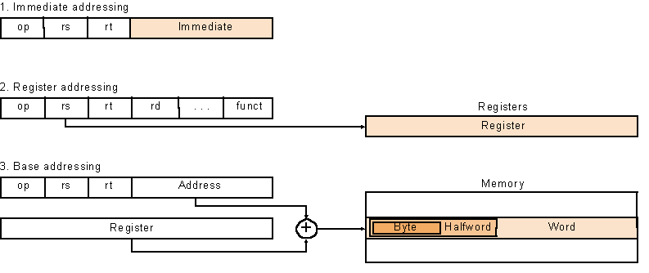
MIPS Addressing Mode
Instruction Set-<number>

Slide 108
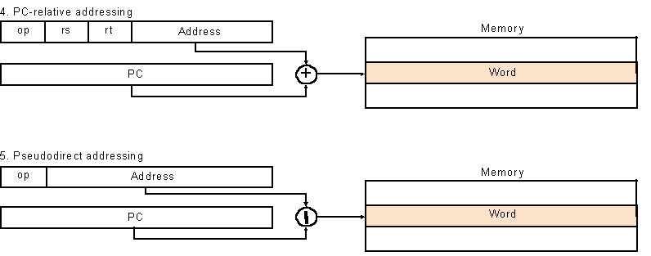
MPIS Addressing Modes
Instruction Set-<number>

Slide 109
Outline
Instruction set architecture (using MIPS ISA as an example)
Operands
  Register operands and their organization
  Memory operands, data transfer
  Immediate operands
Signed and unsigned numbers
Representing instructions
Operations
  Logical
  Decision making and branches
Supporting procedures in hardware
Communicating with people
Addressing for 32-bit immediate and addresses
Translating and starting a program (Sec. 2.12)
A sort example
Arrays versus pointers
ARM and x86 instruction sets
Instruction Set-<number>

Slide 110

Translation and Startup
Many compilers produce object modules directly
Static linking
Instruction Set-<number>

Slide 111
Assembler Pseudoinstructions
Most assembler instructions represent machine instructions one-to-one
Pseudo instructions: figments of the assembler’s imagination
move $t0, $t1 → add $t0, $zero, $t1
blt $t0, $t1, L → slt $at, $t0, $t1
bne $at, $zero, L
  $at (register 1): assembler temporary
Instruction Set-<number>

Slide 112
Producing an Object Module
Assembler (or compiler) translates program into machine instructions
Provides information for building a complete program from the pieces
  Header: described contents of object module
  Text segment: translated instructions
  Static data segment: data allocated for the life of the program
  Relocation info: for contents that depend on absolute location of loaded program
  Symbol table: global definitions and external refs
  Debug info: for associating with source code
Instruction Set-<number>

Slide 113
Linking Object Modules
Produces an executable image
  1. Merges segments
  2. Resolve labels (determine their addresses)
  3. Patch location-dependent and external refs
Could leave location dependencies for fixing by a relocating loader
  But with virtual memory, no need to do this
  Program can be loaded into absolute location in virtual memory space
Instruction Set-<number>

Slide 114
Loading a Program
Load from image file on disk into memory
  1. Read header to determine segment sizes
  2. Create virtual address space
  3. Copy text and initialized data into memory
    Or set page table entries so they can be faulted in
  4. Set up arguments on stack
  5. Initialize registers (including $sp, $fp, $gp)
  6. Jump to startup routine
    Copies arguments to $a0, … and calls main
    When main returns, do exit syscall
Instruction Set-<number>

Slide 115
Outline
Instruction set architecture (using MIPS ISA as an example)
Operands
  Register operands and their organization
  Memory operands, data transfer
  Immediate operands
Signed and unsigned numbers
Representing instructions
Operations
  Logical
  Decision making and branches
Supporting procedures in hardware
Communicating with people
Addressing for 32-bit immediate and addresses
Translating and starting a program
A sort example (Sec. 2.13)
Arrays versus pointers
ARM and x86 instruction sets
Instruction Set-<number>

Slide 116
C Sort Example
Illustrates use of assembly instructions for a C bubble sort function
Swap procedure (leaf)
  void swap(int v[], int k)
  {
  int temp;
  temp = v[k];
  v[k] = v[k+1];
  v[k+1] = temp;
  }
  v in $a0, k in $a1, temp in $t0
Instruction Set-<number>

Slide 117
The Procedure Swap
swap: sll $t1, $a1, 2 # $t1 = k * 4
add $t1, $a0, $t1 # $t1 = v+(k*4)
# (address of v[k])
lw $t0, 0($t1) # $t0 (temp) = v[k]
lw $t2, 4($t1) # $t2 = v[k+1]
sw $t2, 0($t1) # v[k] = $t2 (v[k+1])
sw $t0, 4($t1) # v[k+1] = $t0 (temp)
jr $ra # return to calling routine
Instruction Set-<number>

Slide 118
The Sort Procedure in C
Non-leaf (calls swap)
  void sort (int v[], int n)
  {
  int i, j;
  for (i = 0; i < n; i += 1) {
  for (j = i – 1;
  j >= 0 && v[j] > v[j + 1];
  j -= 1) {
  swap(v,j);
  }
  }
  }
  v in $a0, k in $a1, i in $s0, j in $s1
Instruction Set-<number>

Slide 119
The Procedure Body
move $s2, $a0 # save $a0 into $s2
move $s3, $a1 # save $a1 into $s3
move $s0, $zero # i = 0
for1tst: slt $t0, $s0, $s3 # $t0 = 0 if $s0 ≥ $s3 (i ≥ n)
beq $t0, $zero, exit1 # go to exit1 if $s0 ≥ $s3 (i ≥ n)
addi $s1, $s0, –1 # j = i – 1
for2tst: slti $t0, $s1, 0 # $t0 = 1 if $s1 < 0 (j < 0)
bne $t0, $zero, exit2 # go to exit2 if $s1 < 0 (j < 0)
sll $t1, $s1, 2 # $t1 = j * 4
add $t2, $s2, $t1 # $t2 = v + (j * 4)
lw $t3, 0($t2) # $t3 = v[j]
lw $t4, 4($t2) # $t4 = v[j + 1]
slt $t0, $t4, $t3 # $t0 = 0 if $t4 ≥ $t3
beq $t0, $zero, exit2 # go to exit2 if $t4 ≥ $t3
move $a0, $s2 # 1st param of swap is v (old $a0)
move $a1, $s1 # 2nd param of swap is j
jal swap # call swap procedure
addi $s1, $s1, –1 # j –= 1
j for2tst # jump to test of inner loop
exit2: addi $s0, $s0, 1 # i += 1
j for1tst # jump to test of outer loop
Move
params
Outer loop
Inner loop
Pass
params
& call
Inner loop
Instruction Set-<number>
Outer loop

Slide 120
The Full Procedure
sort: addi $sp,$sp, –20 # make room on stack for 5 registers
sw $ra, 16($sp) # save $ra on stack
sw $s3,12($sp) # save $s3 on stack
sw $s2, 8($sp) # save $s2 on stack
sw $s1, 4($sp) # save $s1 on stack
sw $s0, 0($sp) # save $s0 on stack
… # procedure body
…
exit1: lw $s0, 0($sp) # restore $s0 from stack
lw $s1, 4($sp) # restore $s1 from stack
lw $s2, 8($sp) # restore $s2 from stack
lw $s3,12($sp) # restore $s3 from stack
lw $ra,16($sp) # restore $ra from stack
addi $sp,$sp, 20 # restore stack pointer
jr $ra # return to calling routine
Instruction Set-<number>

Slide 121
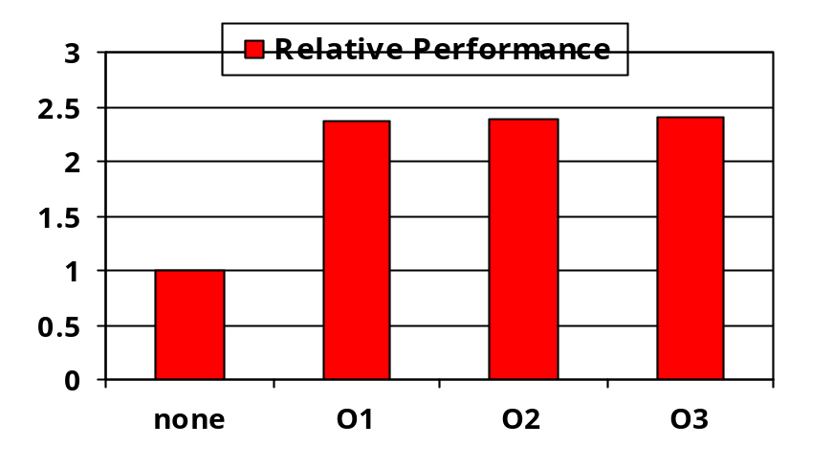
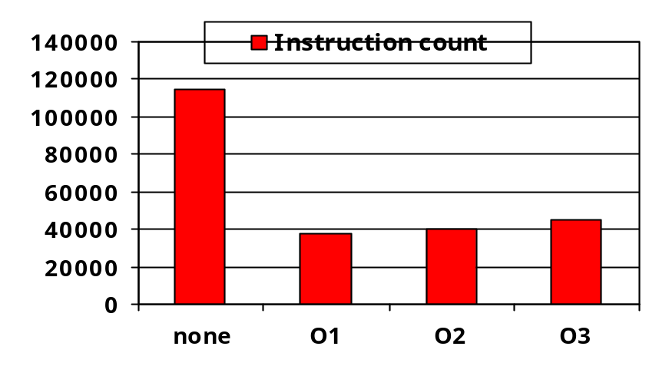
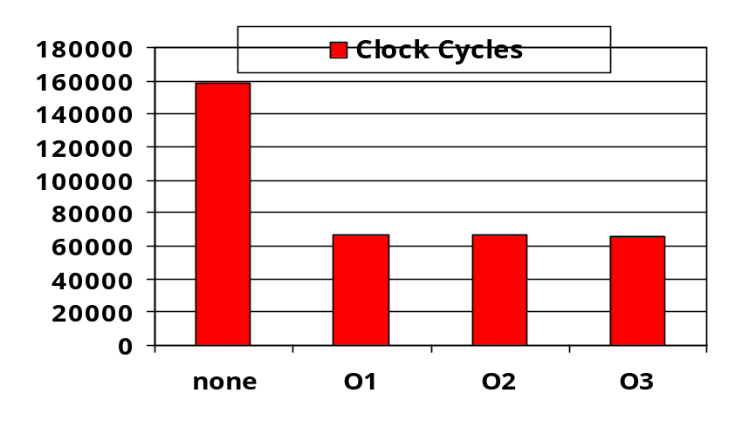
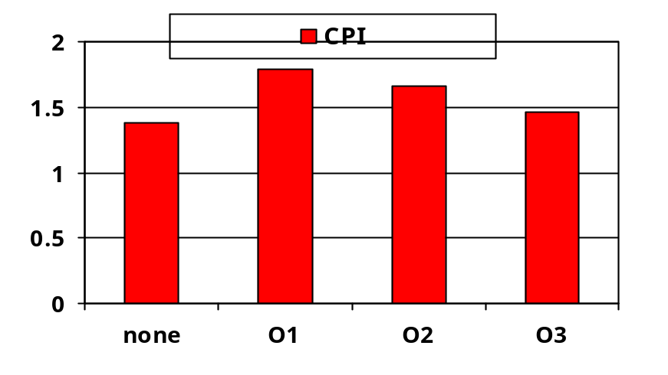
Effect of Compiler Optimization
Compiled with gcc for Pentium 4 under Linux
Instruction Set-<number>

Slide 122
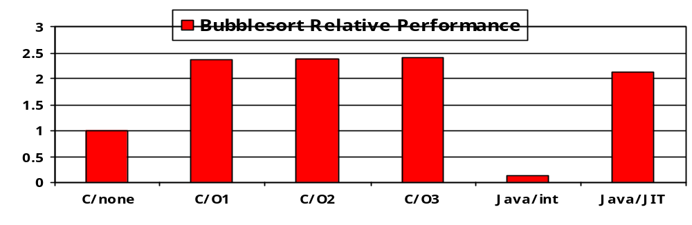
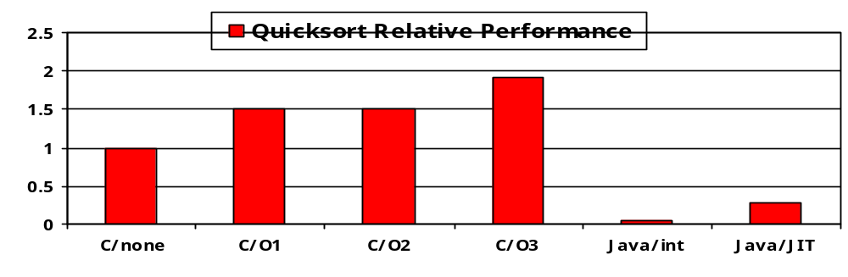
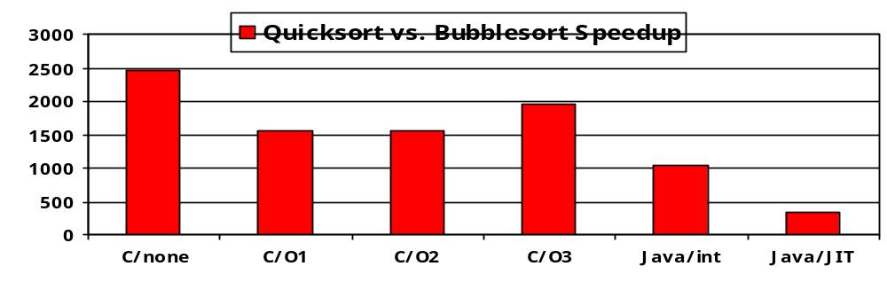
Effect of Language and Algorithm
Instruction Set-<number>

Slide 123
Lessons Learnt
Instruction count and CPI are not good performance indicators in isolation
Compiler optimizations are sensitive to the algorithm
Nothing can fix a dumb algorithm!
Instruction Set-<number>

Slide 124
Outline
Instruction set architecture (using MIPS ISA as an example)
Operands
  Register operands and their organization
  Memory operands, data transfer
  Immediate operands
Signed and unsigned numbers
Representing instructions
Operations
  Logical
  Decision making and branches
Supporting procedures in hardware
Communicating with people
Addressing for 32-bit immediate and addresses
Translating and starting a program (Sec. 2.12)
A sort example
Arrays versus pointers (Sec. 2.14)
ARM and x86 instruction sets
Instruction Set-<number>

Slide 125
Arrays vs. Pointers
Array indexing involves
  Multiplying index by element size
  Adding to array base address
Pointers correspond directly to memory addresses
  Can avoid indexing complexity
Instruction Set-<number>

Slide 126
Example: Clearing an Array
clear1(int array[], int size) { int i; for (i = 0; i < size; i += 1) array[i] = 0; } | clear2(int *array, int size) { int *p; for (p = &array[0]; p < &array[size]; p = p + 1) *p = 0; }
move $t0,$zero # i = 0 loop1: sll $t1,$t0,2 # $t1 = i * 4 add $t2,$a0,$t1 # $t2 = # &array[i] sw $zero, 0($t2) # array[i] = 0 addi $t0,$t0,1 # i = i + 1 slt $t3,$t0,$a1 # $t3 = # (i < size) bne $t3,$zero,loop1 # if (…) # goto loop1 | move $t0, $a0 # p = & array[0] sll $t1, $a1, 2 # $t1 = size * 4 add $t2,$a0,$t1 # $t2 = # &array[size] loop2: sw $zero,0($t0) # Memory[p] = 0 addi $t0,$t0,4 # p = p + 4 slt $t3,$t0,$t2 # $t3 = #(p<&array[size]) bne $t3,$zero,loop2 # if (…) # goto loop2
Instruction Set-<number>

Slide 127
Comparison of Array vs. Ptr
Multiply “strength reduced” to shift (strength reduction)
Array version requires shift to be inside loop
  Part of index calculation for incremented i
  c.f. incrementing pointer
Compiler can achieve same effect as manual use of pointers
  Eliminating array address calculations within loop (induction variable elimination): 6 instructions reduced to 4 in loop
  Better to make program clearer and safer
Instruction Set-<number>

Slide 128
Outline
Instruction set architecture (using MIPS ISA as an example)
Operands
  Register operands and their organization
  Memory operands, data transfer
  Immediate operands
Signed and unsigned numbers
Representing instructions
Operations
  Logical
  Decision making and branches
Supporting procedures in hardware
Communicating with people
Addressing for 32-bit immediate and addresses
Translating and starting a program
A sort example
Arrays versus pointers
ARM and x86 instruction sets (Sec. 2.15, 2.16)
Instruction Set-<number>

Slide 129
ARM & MIPS Similarities
ARM: the most popular embedded core
Similar basic set of instructions to MIPS
 | ARM | MIPS
Date announced | 1985 | 1985
Instruction size | 32 bits | 32 bits
Address space | 32-bit flat | 32-bit flat
Data alignment | Aligned | Aligned
Data addressing modes | 9 | 3
Registers | 15 × 32-bit | 31 × 32-bit
Input/output | Memory mapped | Memory mapped
Instruction Set-<number>

Slide 130
Compare and Branch in ARM
Uses condition codes for result of an arithmetic/logical instruction
  Negative, zero, carry, overflow
  Compare instructions to set condition codes without keeping the result
Each instruction can be conditional
  Top 4 bits of instruction word: condition value
  Can avoid branches over single instructions
Instruction Set-<number>

Slide 131

Instruction Encoding
Instruction Set-<number>

Slide 132
The Intel x86 ISA
Evolution with backward compatibility
  8080 (1974): 8-bit microprocessor
    Accumulator, plus 3 index-register pairs
  8086 (1978): 16-bit extension to 8080
    Complex instruction set (CISC)
  8087 (1980): floating-point coprocessor
    Adds FP instructions and register stack
  80286 (1982): 24-bit addresses, MMU
    Segmented memory mapping and protection
  80386 (1985): 32-bit extension (now IA-32)
    Additional addressing modes and operations
    Paged memory mapping as well as segments
Instruction Set-<number>

Slide 133
The Intel x86 ISA
Further evolution…
  i486 (1989): pipelined, on-chip caches and FPU
    Compatible competitors: AMD, Cyrix, …
  Pentium (1993): superscalar, 64-bit datapath
    Later versions added MMX (Multi-Media eXtension) instructions
    The infamous FDIV bug
  Pentium Pro (1995), Pentium II (1997)
    New microarchitecture (see Colwell, The Pentium Chronicles)
  Pentium III (1999)
    Added SSE (Streaming SIMD Extensions) and associated registers
  Pentium 4 (2001)
    New microarchitecture
    Added SSE2 instructions
Instruction Set-<number>

Slide 134
The Intel x86 ISA
And further…
  AMD64 (2003): extended architecture to 64 bits
  EM64T – Extended Memory 64 Technology (2004)
    AMD64 adopted by Intel (with refinements)
    Added SSE3 instructions
  Intel Core (2006)
    Added SSE4 instructions, virtual machine support
  AMD64 (announced 2007): SSE5 instructions
    Intel declined to follow, instead…
  Advanced Vector Extension (announced 2008)
    Longer SSE registers, more instructions
If Intel didn’t extend with compatibility, its competitors would!
  Technical elegance ≠ market success
Instruction Set-<number>

Slide 135

Basic x86 Registers
Instruction Set-<number>

Slide 136
Basic x86 Addressing Modes
Two operands per instruction
Source/dest operand | Second source operand
Register | Register
Register | Immediate
Register | Memory
Memory | Register
Memory | Immediate
Memory addressing modes
  Address in register
  Address = R_{base} + displacement
  Address = R_{base} + 2^{scale} × R_{index} (scale = 0, 1, 2, or 3)
  Address = R_{base} + 2^{scale} × R_{index} + displacement
Instruction Set-<number>

Slide 137
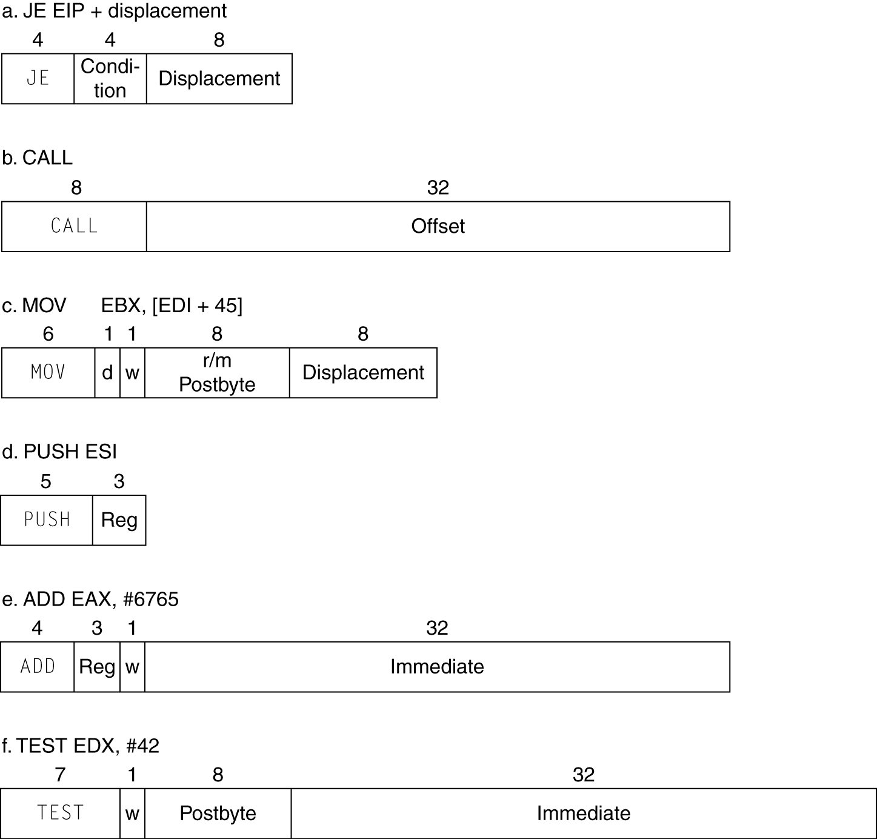
x86 Instruction Encoding
Variable length encoding
  Postfix bytes specify addressing mode
  Prefix bytes modify operation
    Operand length, repetition, locking, …
Instruction Set-<number>

Slide 138
Implementing IA-32
Complex instruction set makes implementation difficult
  Hardware translates instructions to simpler microoperations
    Simple instructions: 1–1
    Complex instructions: 1–many
  Microengine similar to RISC
  Market share makes this economically viable
Comparable performance to RISC
  Compilers avoid complex instructions
Instruction Set-<number>

Slide 139
Fallacies
Powerful instruction ⇒ higher performance
  Fewer instructions required
  But complex instructions are hard to implement
    May slow down all instructions, including simple ones
  Compilers are good at making fast code from simple instructions
Use assembly code for high performance
  But modern compilers are better at dealing with modern processors
  More lines of code ⇒ more errors and less productivity
§2.18 Fallacies and Pitfalls
Instruction Set-<number>

Slide 140
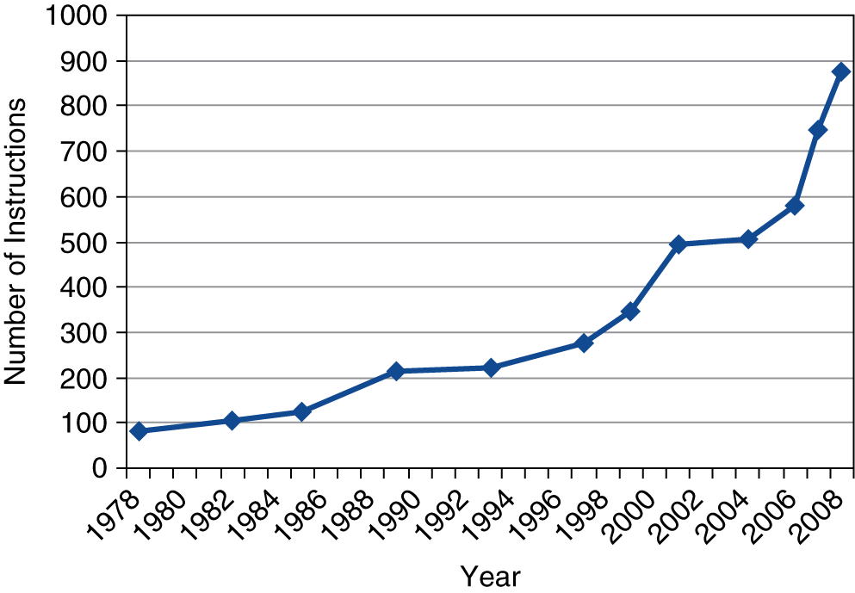
Fallacies
Backward compatibility ⇒ instruction set doesn’t change
  But they do accrete more instructions
x86 instruction set
Instruction Set-<number>

Slide 141
Pitfalls
Sequential words are not at sequential addresses
  Increment by 4, not by 1!
Keeping a pointer to an automatic variable after procedure returns
  e.g., passing pointer back via an argument
  Pointer becomes invalid when stack popped
Instruction Set-<number>

Slide 142
Concluding Remarks
Design principles
  1. Simplicity favors regularity
  2. Smaller is faster
  3. Make the common case fast
  4. Good design demands good compromises
Layers of software/hardware
  Compiler, assembler, hardware
MIPS: typical of RISC ISAs
  c.f. x86
Instruction Set-<number>

Slide 143
Concluding Remarks
Measure MIPS instruction executions in benchmark programs
  Consider making the common case fast
  Consider compromises
Instruction class | MIPS examples | SPEC2006 Int | SPEC2006 FP
Arithmetic | add, sub, addi | 16% | 48%
Data transfer | lw, sw, lb, lbu, lh, lhu, sb, lui | 35% | 36%
Logical | and, or, nor, andi, ori, sll, srl | 12% | 4%
Cond. Branch | beq, bne, slt, slti, sltiu | 34% | 8%
Jump | j, jr, jal | 2% | 0%
Instruction Set-<number>

