Slide 1
Intro to Git and GitHub* part 1
STC Workshop

Slide 2
Get Started with Git and GitHub
What is git?
History
  CVS
  SVN
  git

Slide 3
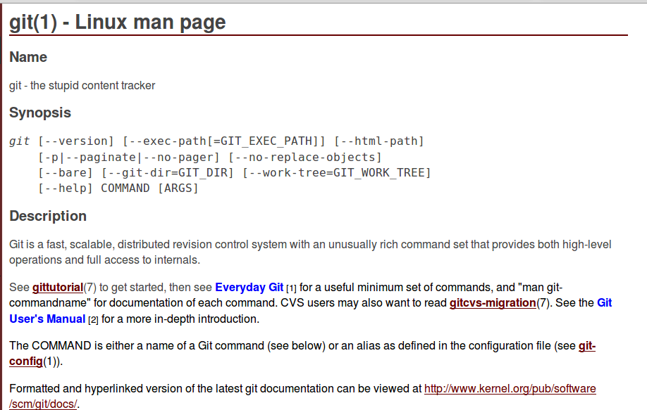
Man page

Slide 4
How Technical Writers Use git
Content collaboration
content updates based on pulls
Update Readme pages

