Slide 1


HCMC UNIVERSITY OF TECHNOLOGY AND EDUCATION
Analysis of external factors affecting students' scores
GROUP 3
Trần Văn Duy
19133016
Trần Công Trường
19133062
Cao Anh Văn
19133067
Lê Phương Nam
19133036

Slide 2
Introduce
In the 4.0 era, the application of technology in all areas of life plays a very important role, especially the application of technologies in data analysis to help us predict the results that will occur in the future. future, find a solution to give the best outcome. Therefore, in this analysis, we will apply the R language to analyze the student's academic achievement through the exams, apply the knowledge learned about data analysis in the R language. R. From these analyzes can be made predictions about students' future test performance.

Slide 3
Data sources
The group's data source is taken from a few high schools in the US and compiled by the website kaggle : https://www.kaggle.com/spscientist/studentsperformance-in-exams

Slide 4
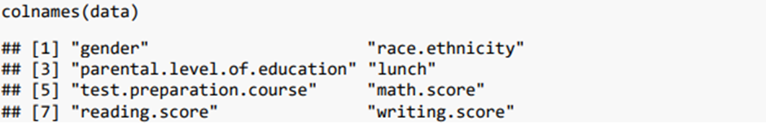
2. Information about datasets
Attributes

Slide 5
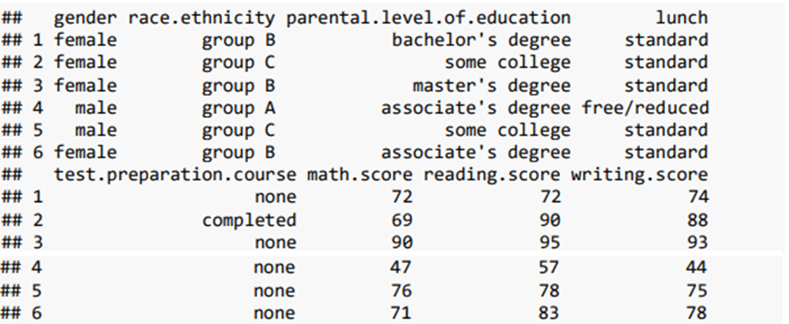
This dataset includes 8 colums: This dataset includes scores from three exams and a variety of personal, social, and economic factors that interact with them.

Slide 6
3. Research questions
1.What factors influence the score the most ?
2. Predict the mean score.
Outcome : mean score
Input : gender, parental level education ,race.ethnicity, lunch and test preparation course.

Slide 7
Check data

Slide 8
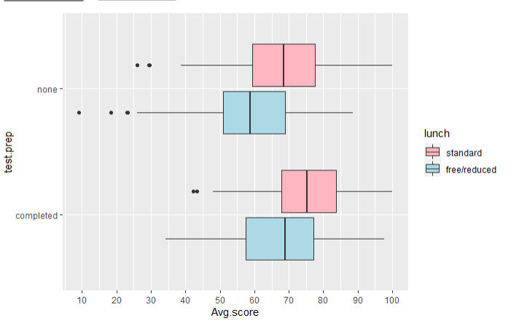
Analysis EDA
The graph of students' mean score distribution by lunch and test.prep
Comment: when lunch is standard and test preparation course is completed, the mean score is higher than the rest.

Slide 9
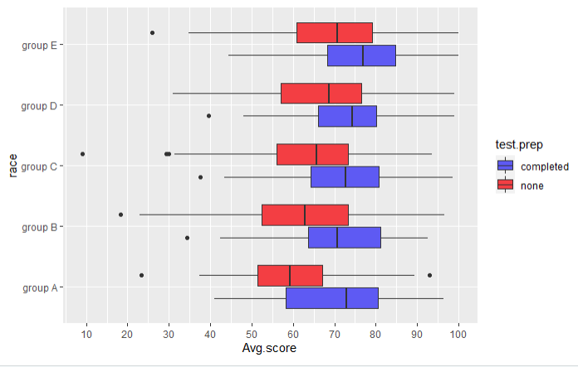
Analysis EDA
The graph of students' mean score distribution by race và test.prep
Comment: The average of the mean score of group E students when the test preparation course is completed is as high as 76.7. The lowest is group A students when the test preparation course is none equal to 59.2.

Slide 10
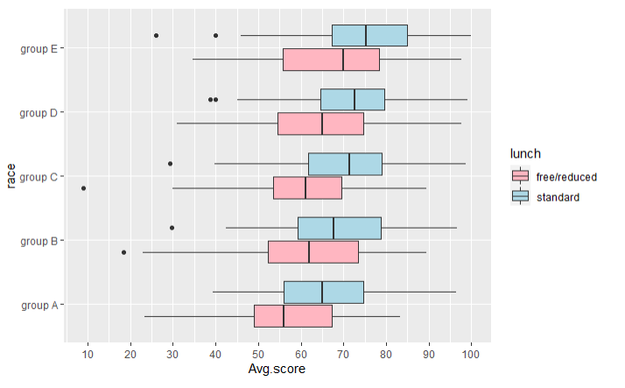
Analysis EDA
The graph of students' mean score distribution by lunch and race.
Comment: The average of the mean score of students in group E when lunch is standard is the highest with 74.9. The lowest student group A when lunch is free/reduced is 57.7.

Slide 11
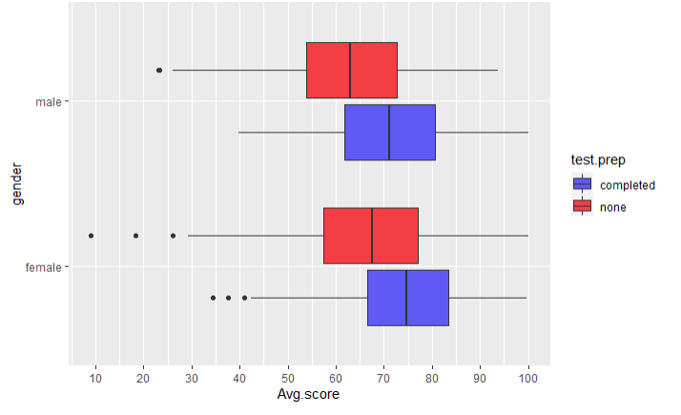
Analysis EDA
The graph of students' mean score distribution by gender and test.prep
Comment: The average of female's mean score with test.prep as complete is as high as 74.5. The lowest is male with test.prep of none equal to 63.

Slide 12
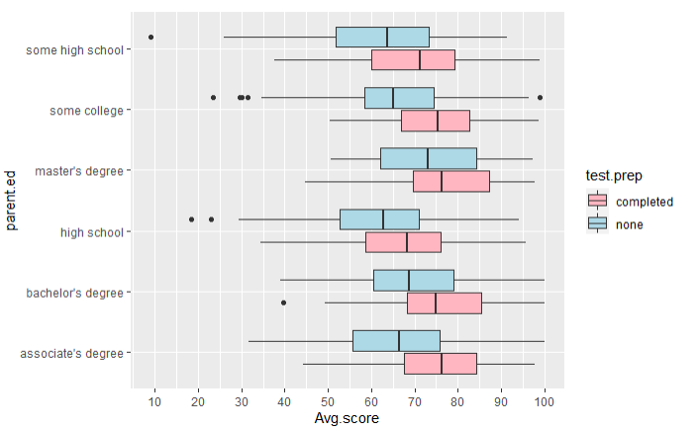
Analysis EDA
The graph of students' mean score distribution by parent.ed and test.prep
Comment: Students whose parental level of education is master's degree and test.prep is completed have the highest average of the mean score as 76.3. The lowest parental level of education students was high school and test.prep was none with an average of the mean score as 61.6.

Slide 13
Summary
Females have higher mean scores than males.
Students with lunch as standard have higher scores.
When completing the exam preparation course, the higher score does not complete the exam preparation course.
The higher the education level of parents, the higher the average score of their children.
There isn’t much difference in mean scores between students of different ethnicities.

Slide 14
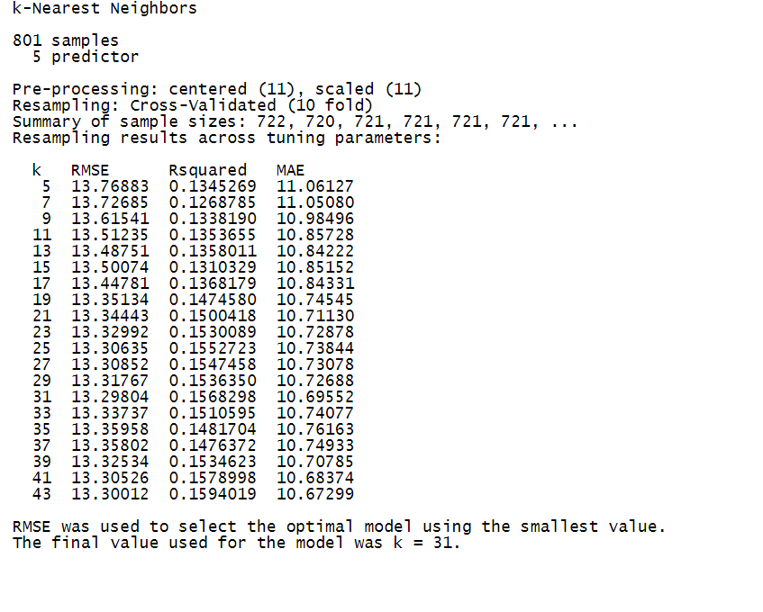
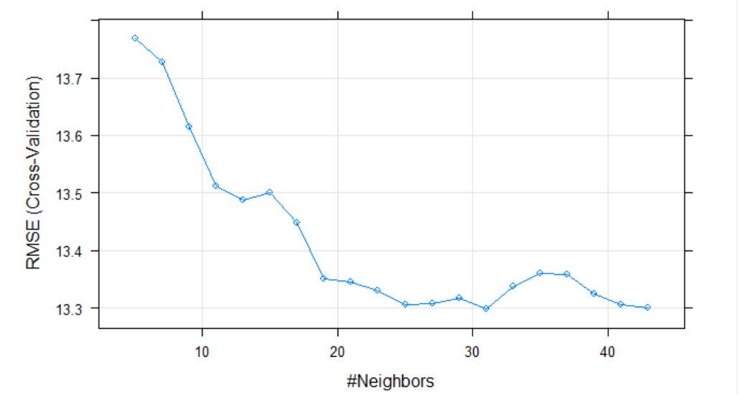
Predict the mean score using the KNN algorithm
Building a KNN model on the training set
Comment: we see that with K=31, the model is the best. Minimum RMSE is 13.29804

Slide 15
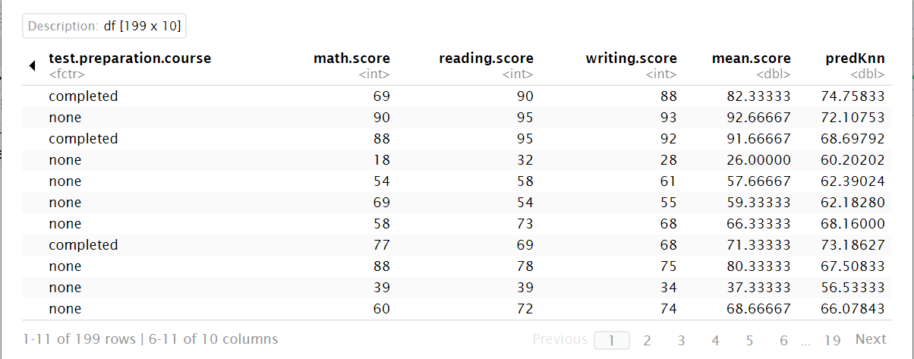
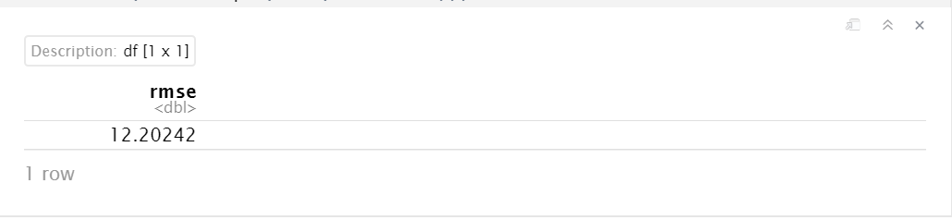
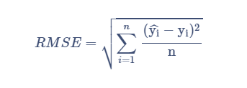
Predict the mean score using the KNN algorithm
Prediction on test set

Slide 16
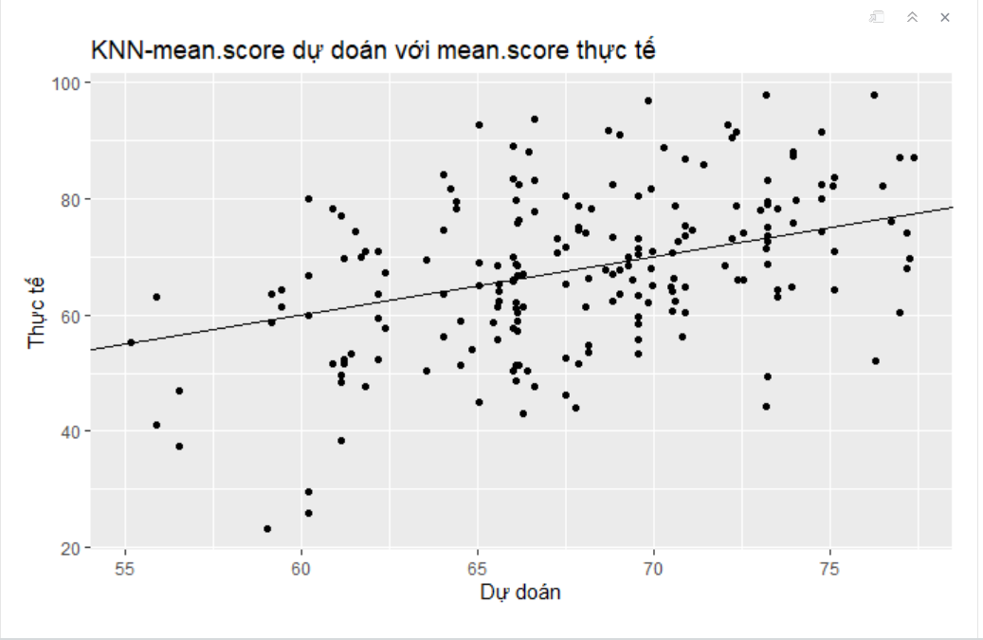
The graph shows the correlation between the actual mean score and the predicted score
Comment :
- RMSE of KNN model is still high.
- The model is not really good.

Slide 17
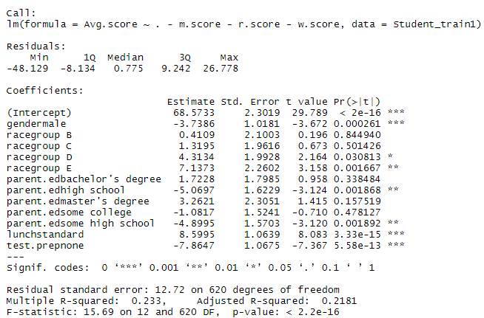

Predict the mean score using the linear regression

Slide 18
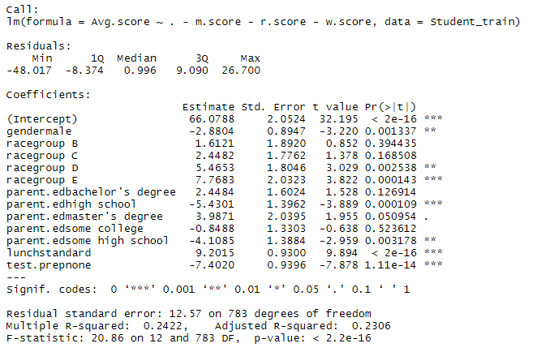
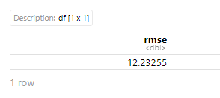
Predict the mean score using the linear regression

Slide 19
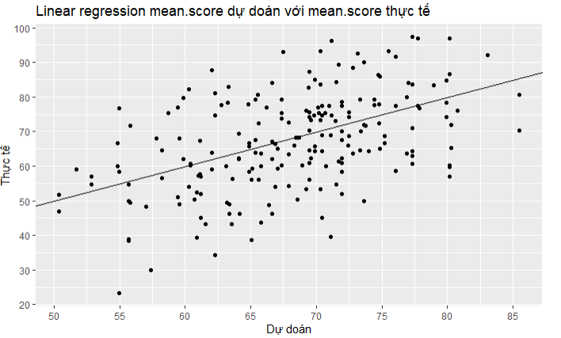
Predict the mean score using the linear regression

Slide 20
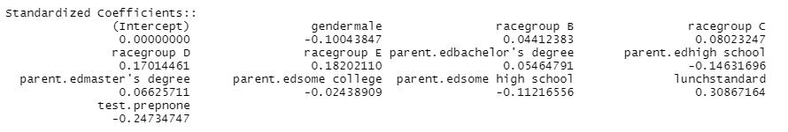
Summary
1.What factors influence the score the most ?
2. Predict the mean score.
- KNN model gives better results
- The accuracy of the 2 models is still low

Slide 21
Thank you for watching <3
Q&A

