Slide 1


Artificial Intelligence and Data Science
Data Science and Visualization
24ADI204
DATA-VIZ HACK-A-BIT (2026-2027)
PROJECT REVIEW (October 2026)
Team Number: 17
"The Heat Is On: A Visual Timeline of Global Warming"
Preview of the final “warming stripes” visualization style

Slide 2
Problem Statement
Why this project matters:
Rising global temperatures are reshaping weather, sea levels and ecosystems, but the scale of this change is hard to grasp from raw numbers alone.
This project uses 124 years of country-level climate data (1900-2023) to examine, in a clear visual way, how temperature anomalies have changed over time and across countries.
1900–2023
Years of climate data
195
Countries covered
100,000
Records analyzed

Slide 3
Project Objectives
  We explore historical temperature anomaly data from 1900 to 2023 across 195 countries.
  We look for long-term trends and patterns across countries and decades.
  We clean the dataset thoroughly, handling missing values and outliers so the analysis stays reliable.
  We aim to build a clear, animated "warming stripes" visualization that communicates climate change simply.
  We document our process clearly each week so our GitHub repo tells the full story of the project.

Slide 4
Dataset Description
Here are the key details of our dataset:
  The dataset is a structured CSV file from Kaggle: Global Warming Dataset, 195 Countries (1900-2023).
  The variable we study most closely throughout the project is Temperature_Anomaly.
  The data is structured and almost entirely numeric, with Country as the only categorical field.
100,000
Records
195
Countries
26
Columns
1900–2023
Years covered

Slide 5
Project Workflow (Weeks 1 to 7)
What we did each week:
  Week 1: selected the Kaggle Global Warming dataset and set up the GitHub repository.
  Week 2: data quality report covering structure, data types, missing values and duplicates.
  Week 3: cleaning with median imputation, plus IQR and Z-score outlier checks.
  Week 4: exploratory data analysis with 30 visualizations.
  Week 6: feature engineering: skewness check, scaling and encoding.
  Week 7: correlation analysis and PCA.

Slide 6
Week 1: Dataset Selection
What we did:
  Chose the topic: global temperature anomalies, told as a visual timeline of global warming.
  Selected the Kaggle dataset 'Global Warming Dataset: 195 Countries (1900-2023)'.
  Defined the problem statement, the objectives and the scope of the project.
  Set up the GitHub repository, with one folder for each week's work.
  Chose the tools: Python with Pandas, NumPy, Matplotlib, Seaborn and Scikit-learn in Google Colab.

Slide 7
Week 2: Know Your Data
What we did:
  Loaded the CSV file into a Pandas DataFrame and checked its shape, column names and data types.
  Counted missing values in every column and worked out the percentage missing.
  Checked for exact duplicate rows and for repeated Country-Year pairs.
  Produced summary statistics for every numeric column: mean, standard deviation, minimum, quartiles, maximum.
  Validated value ranges: no negative values where impossible, percentages between 0 and 100, years 1900 to 2023.
  Put the results together as the data quality report used to plan the cleaning.

Slide 8
Week 2: Data Quality Report
What the first check of the raw data showed:
  100,000 rows and 26 columns: 25 numeric and 1 categorical (Country).
  12,000 missing cells: 2,000 (2%) in each of six columns.
  0 exact duplicate rows.
  No negative values where they are impossible, and no percentage outside 0 to 100.
  195 countries, and every year from 1900 to 2023 is present.
  Some Country-Year pairs repeat with different values; we kept them.

Slide 9
Week 3: Cleaning Sprint
How we cleaned the data:
  Missing values were filled with the column median: 12,000 missing cells before, 0 after.
  We chose the median because it is not affected by extreme values.
  Every numeric column was tested for outliers with IQR and Z-score (threshold 3): 0 found.
  Negative average temperatures were kept, because they are valid in degrees Celsius.
  No rows were removed: 100,000 records before and after cleaning.

Slide 10
Week 3: Outlier Detection Methods
The two methods we used:
  IQR method: IQR = Q3 − Q1, where Q1 and Q3 are the 25th and 75th percentiles.
  A value is an outlier if it is below Q1 − 1.5 × IQR or above Q3 + 1.5 × IQR.
  Z-score method: Z = (value − mean) ÷ standard deviation.
  A value is an outlier if its Z-score is above 3 or below −3.
  We used both methods so that one confirms the other; both gave 0 outliers.
  Boxplots were drawn for six key columns as a visual check.

Slide 11
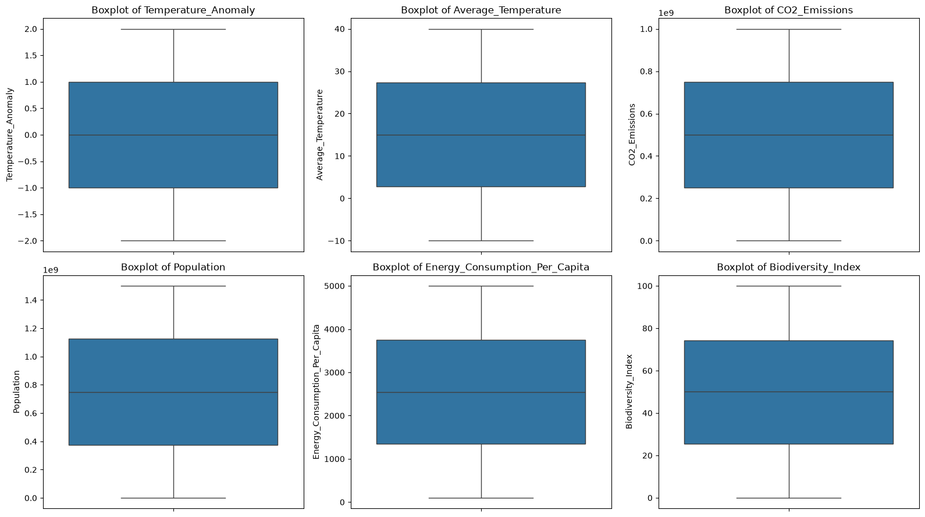
Week 3: Outlier Check
Boxplots: no points fall outside the whiskers, so there are no outliers.

Slide 12
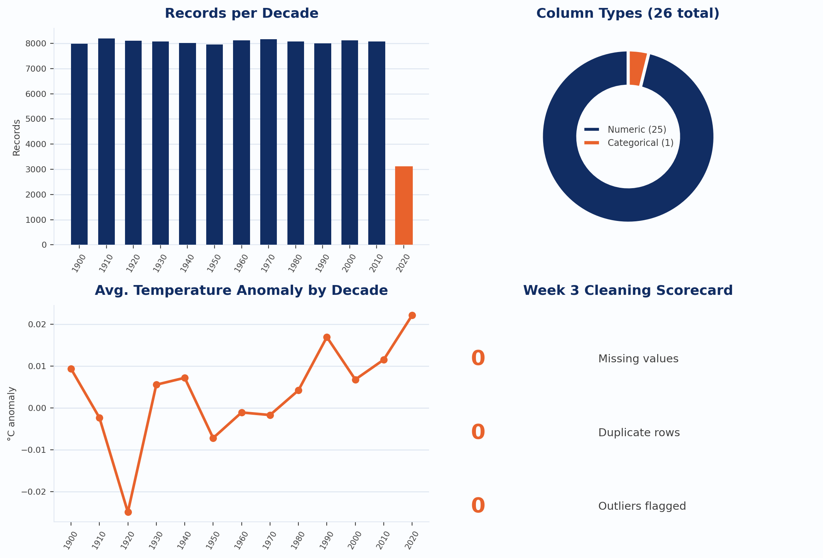
Data Quality & EDA Dashboard (Weeks 1–4)
A quick snapshot of the dataset we cleaned and explored in Weeks 1–4:

Slide 13
Week 4: Exploratory Data Analysis
What we did:
  Loaded the cleaned dataset (100,000 rows, 26 columns, 0 missing values).
  Built 30 visualizations with Matplotlib and Seaborn, each of a different chart type.
  Univariate analysis: histogram, KDE, boxplot, violin and ECDF to see how single variables are distributed.
  Bivariate analysis: scatter, regression, hexbin and joint plots to see how two variables relate.
  Time analysis: line, step and area charts of yearly averages from 1900 to 2023.
  Multivariate analysis: correlation heatmaps, pair plot and parallel coordinates.
  For large scatter plots we used random samples so that the pattern stays readable.

Slide 14
Week 4: Questions the EDA Answers
Each group of plots answers one question:
  How are temperature anomalies distributed?
  Has the average anomaly changed over time?
  Do some countries show higher anomalies than others?
  Do CO2, methane or average temperature move with the anomaly?
  How are the other indicators spread, and do they change over the century?
  Is energy use different at different anomaly levels?
  Which variables are correlated with each other?

Slide 15
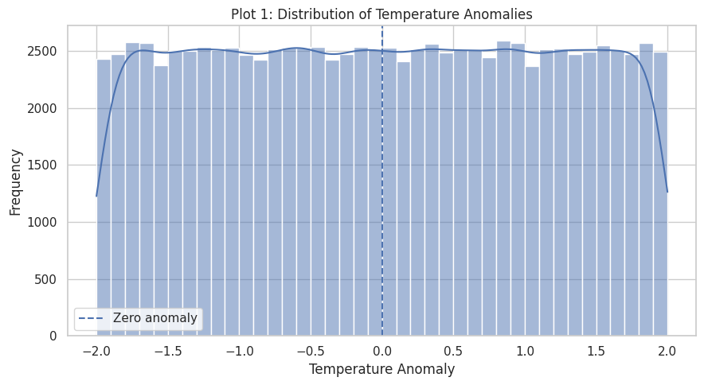
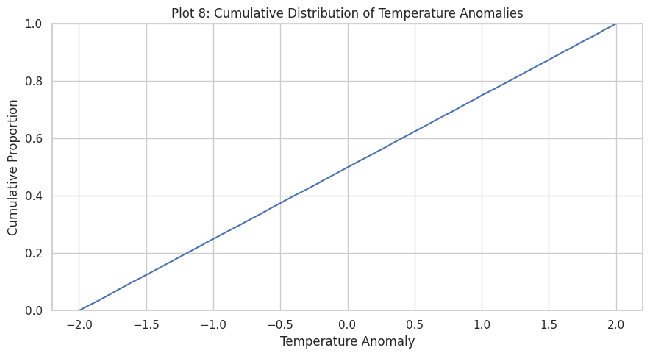
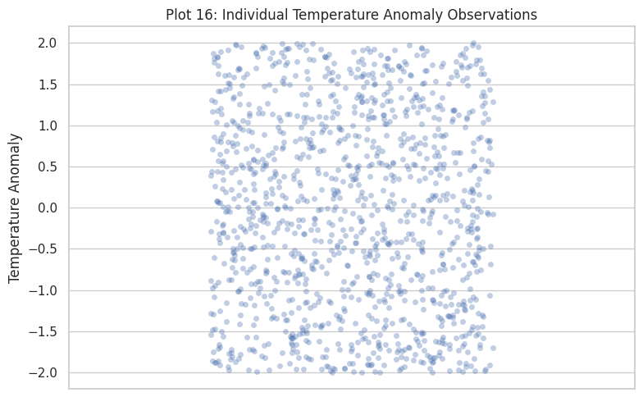
EDA: Temperature Anomaly Distribution
Anomalies are spread evenly from −2 to +2; warm and cool records are balanced.

Slide 16
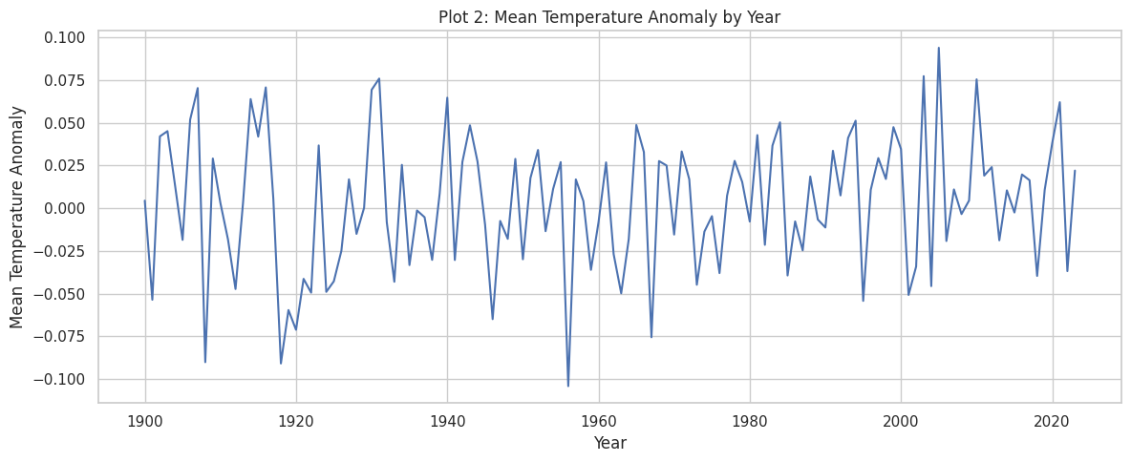
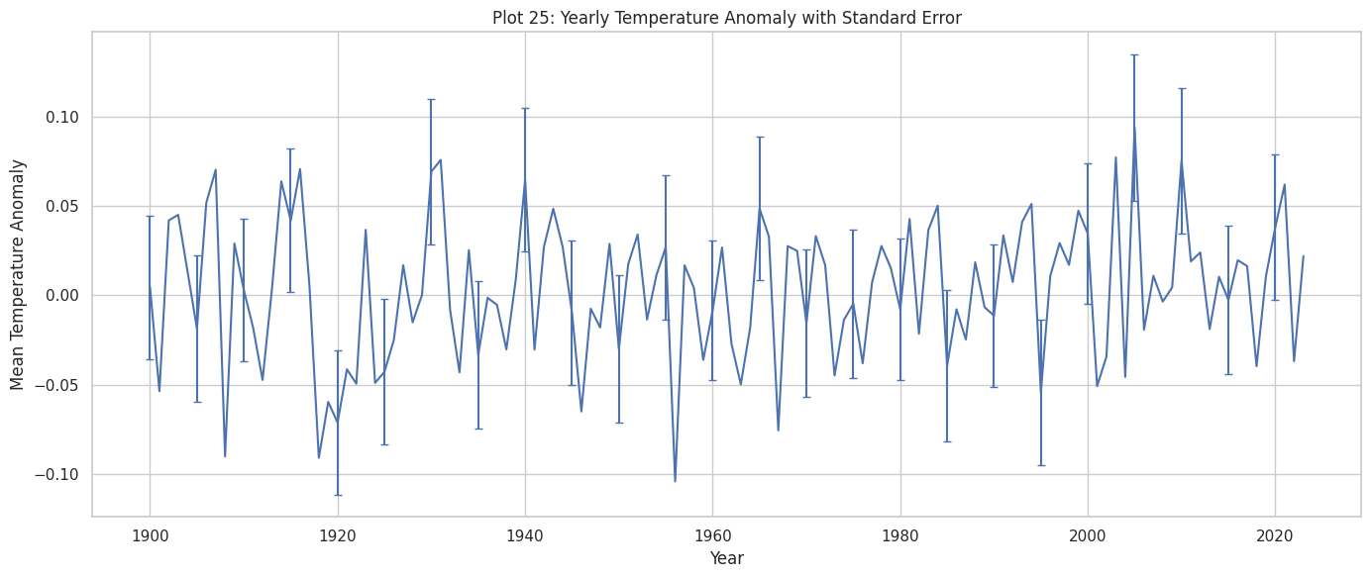
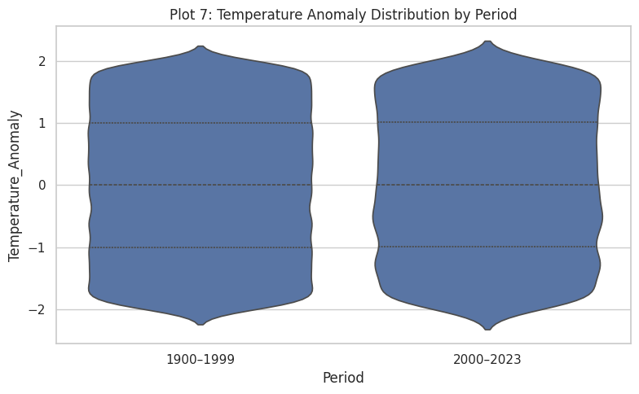
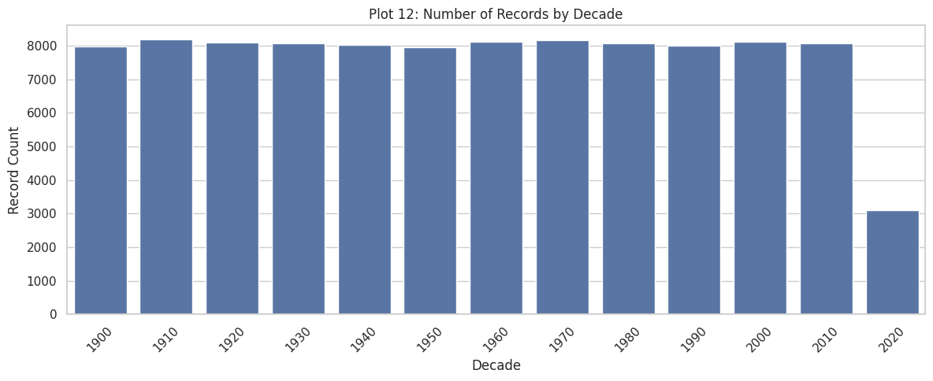
EDA: Trend Over Time
The yearly mean stays within about ±0.1 and both periods look the same: no warming trend.

Slide 17
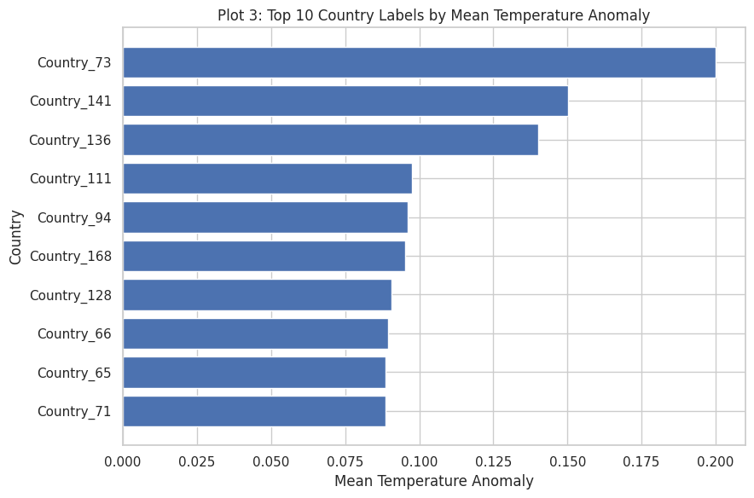
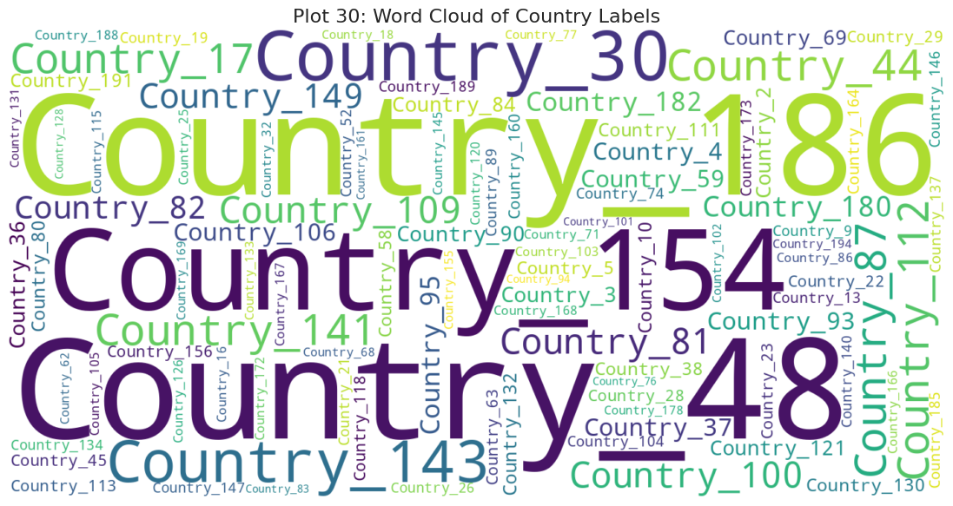
EDA: Across Countries
The highest country average is only 0.2, and every country has a similar number of records.

Slide 18
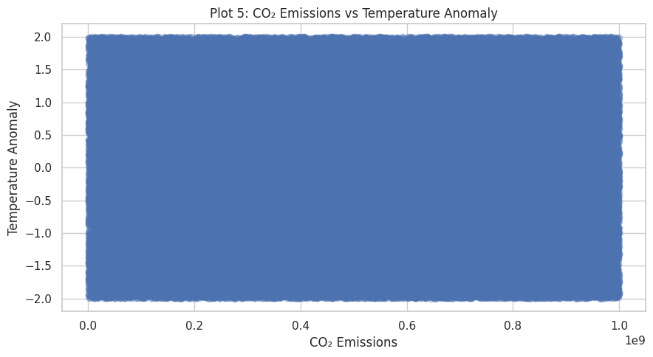
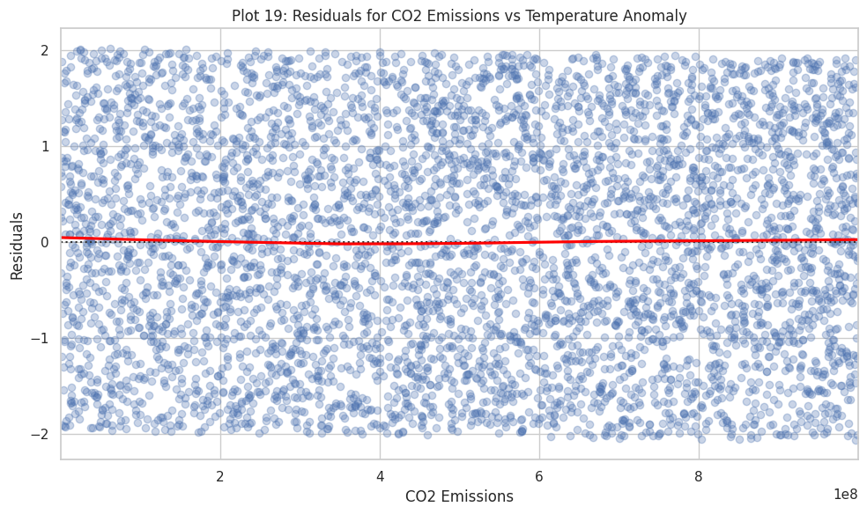
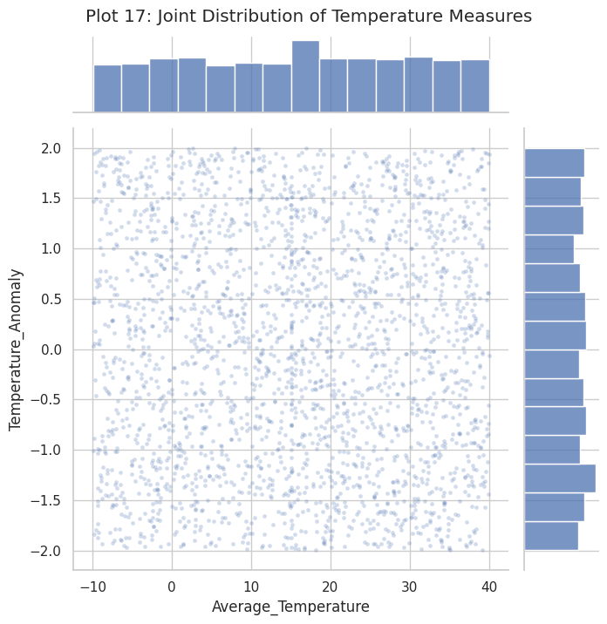
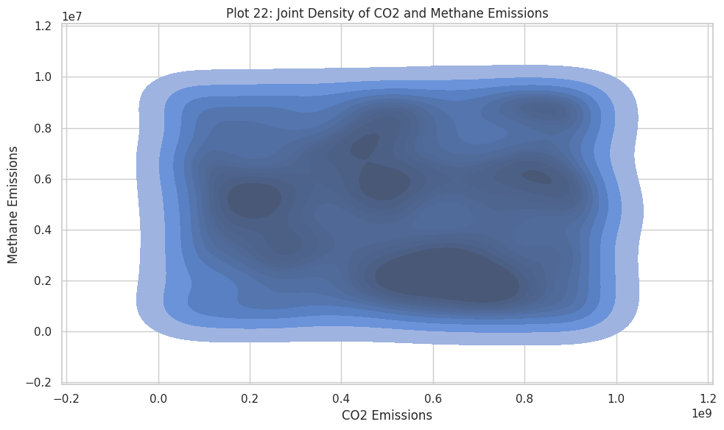
EDA: What Moves With Temperature?
CO2 and average temperature show no link with the anomaly; CO2 and methane are not linked either.

Slide 19
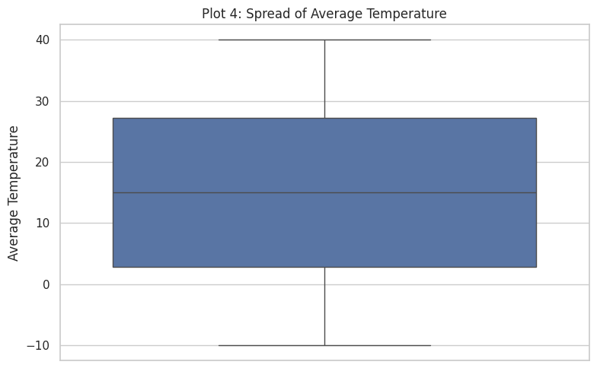
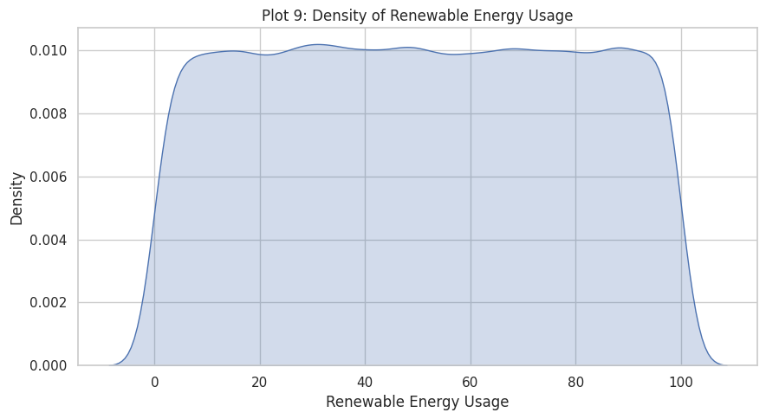
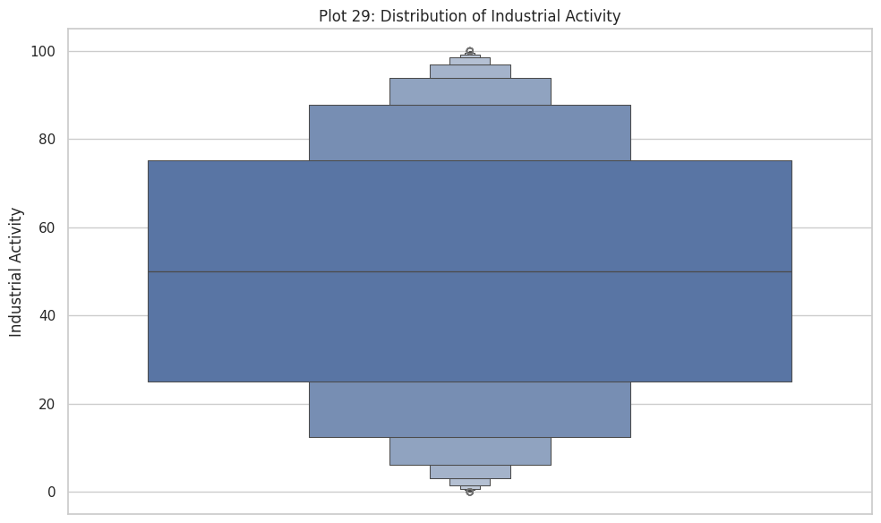
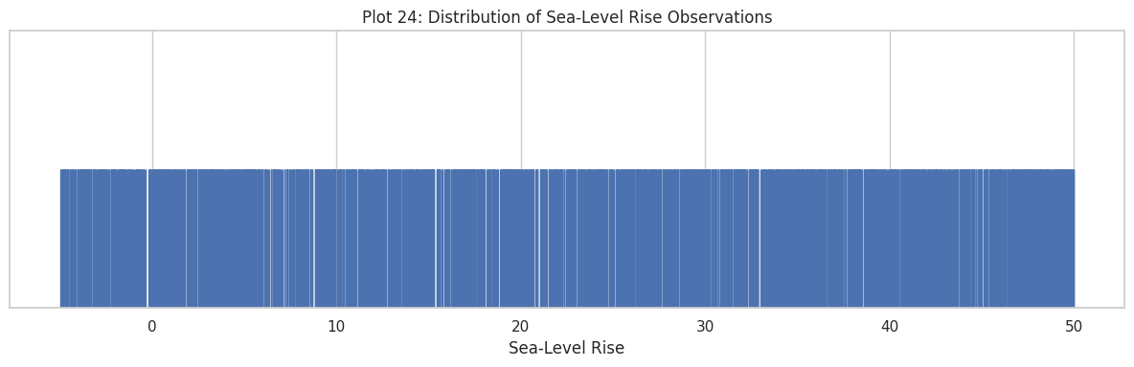
EDA: Other Indicators
Average temperature, renewable use, industrial activity and sea-level rise are each evenly spread.

Slide 20
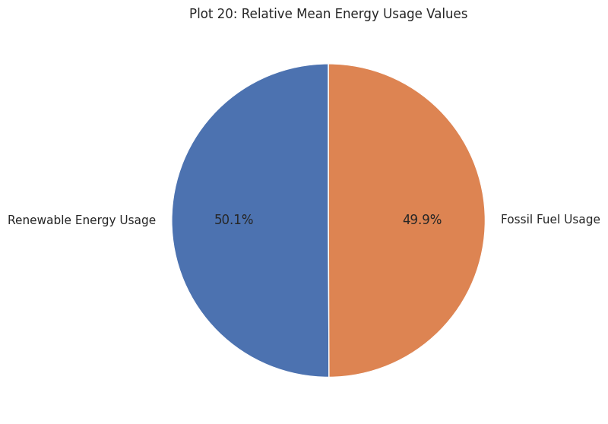
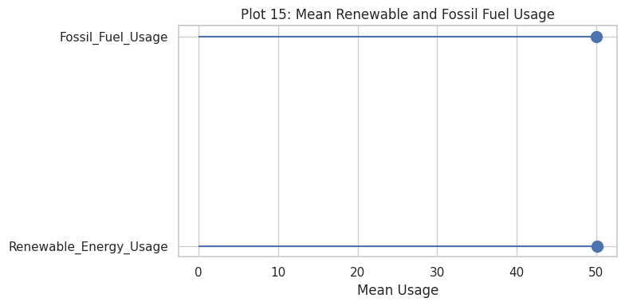
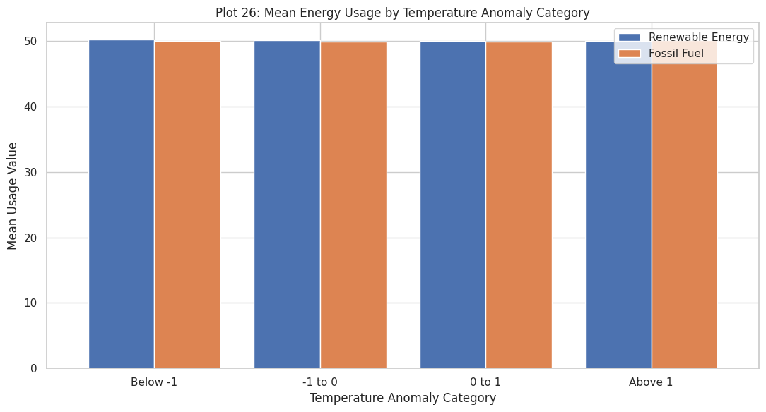
EDA: Energy Use
Renewable and fossil fuel use both average about 50, at every anomaly level.

Slide 21
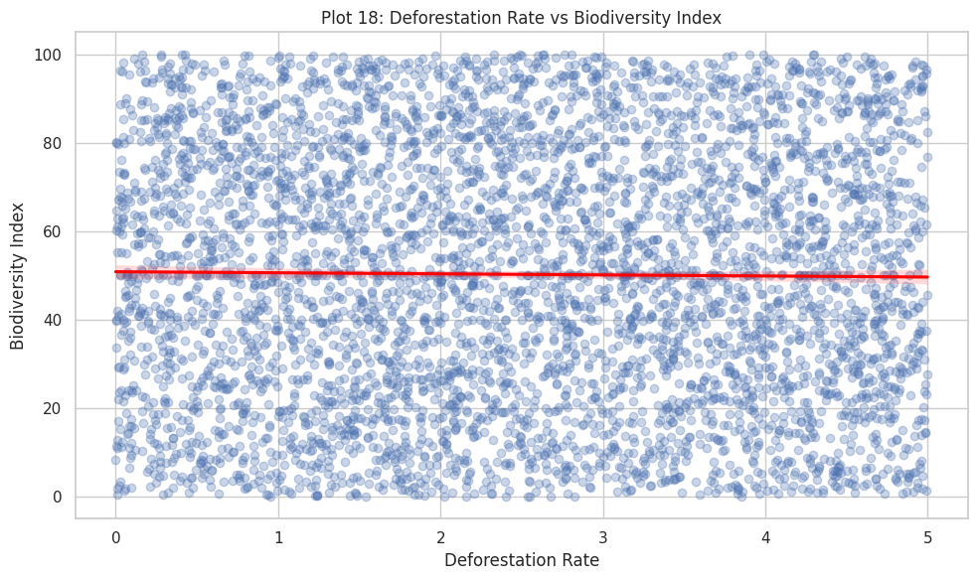
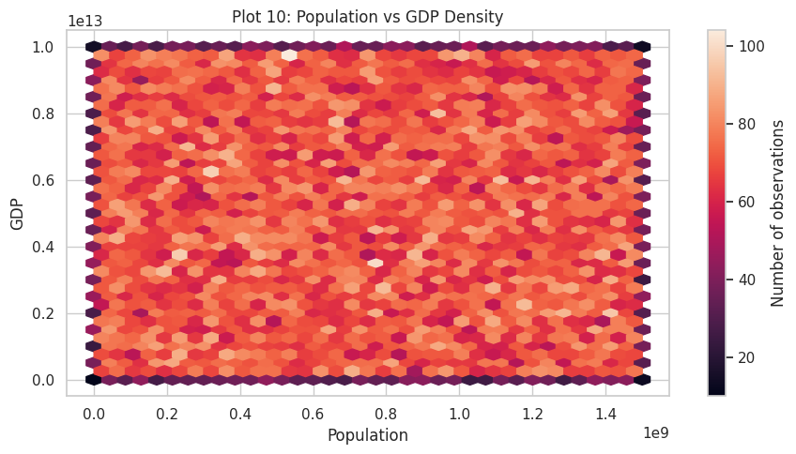
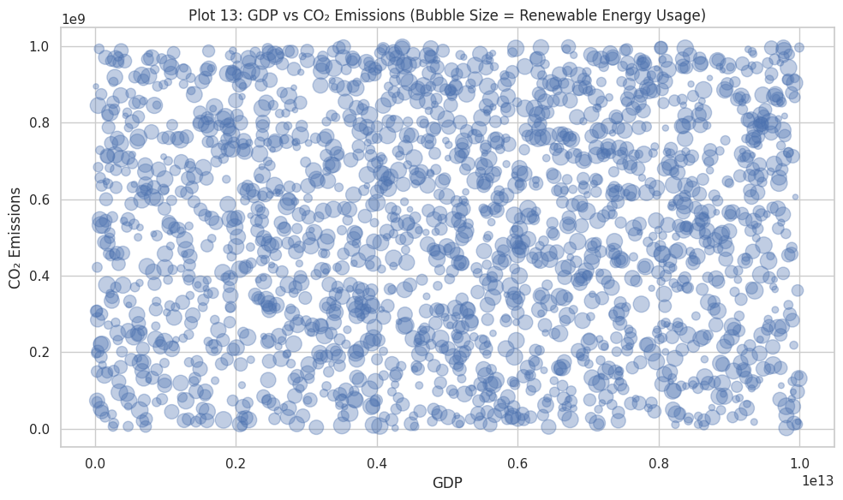
EDA: Environment and Economy
Deforestation, biodiversity, population, GDP and CO2 show no relationships.

Slide 22
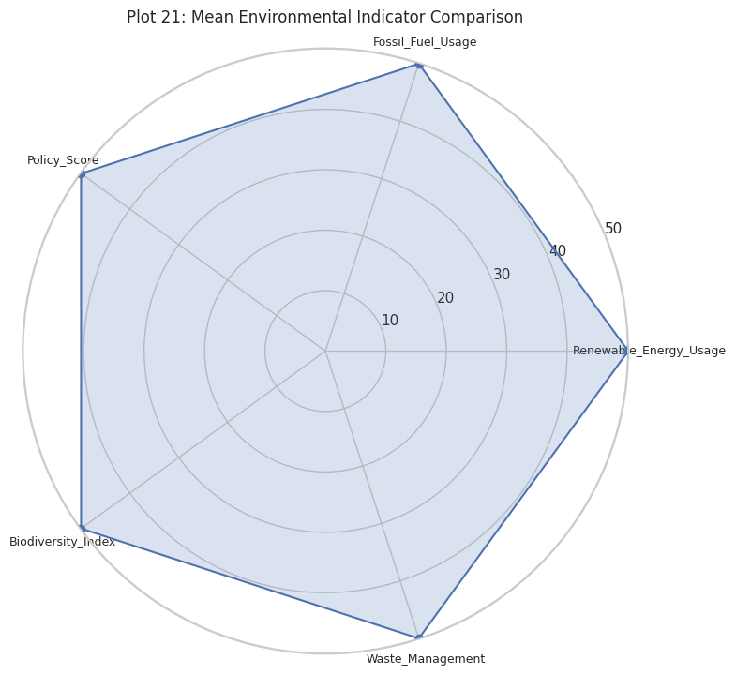
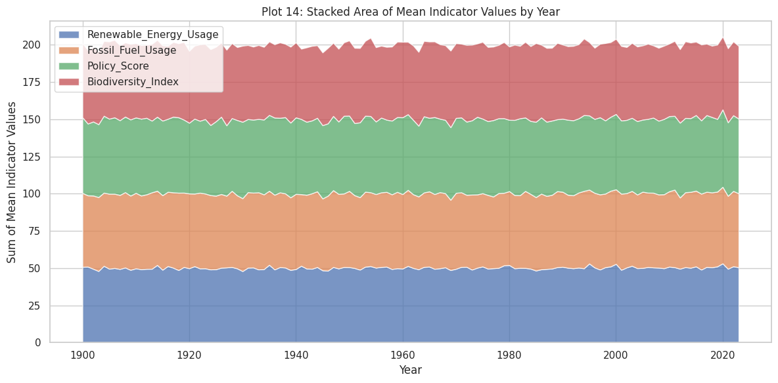
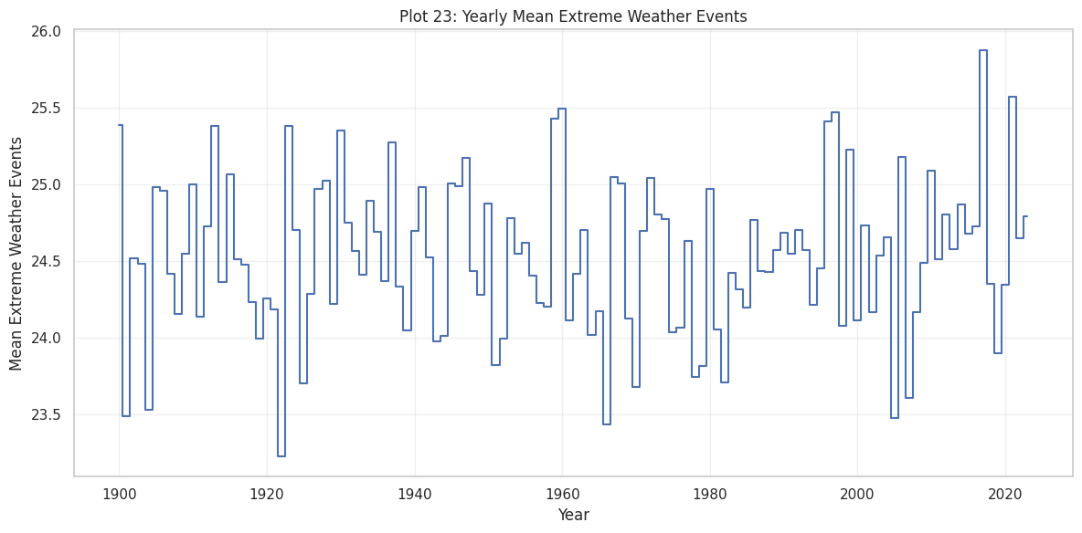
EDA: Indicators Over the Century
The indicator averages stay flat from 1900 to 2023.

Slide 23
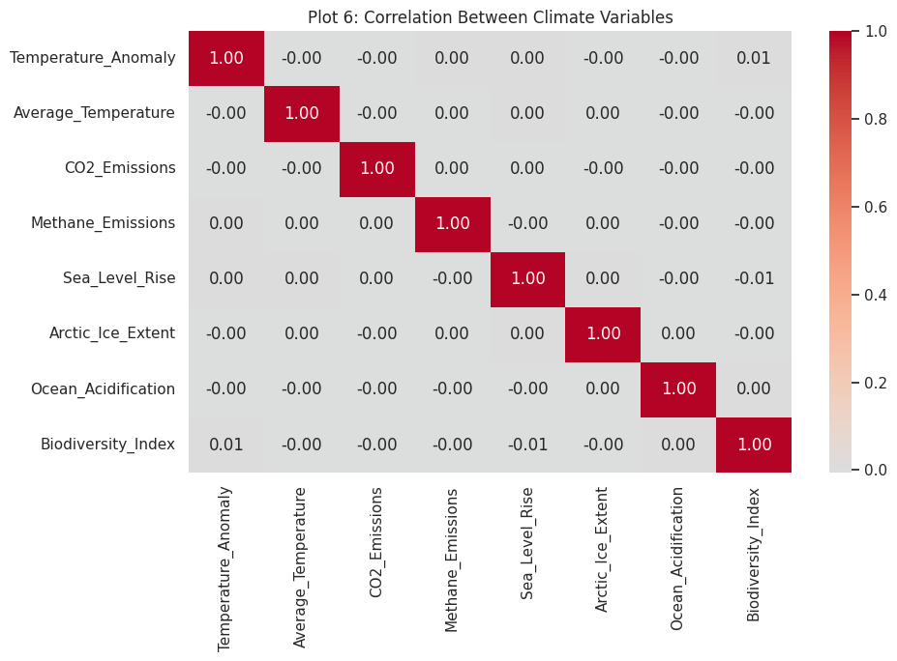
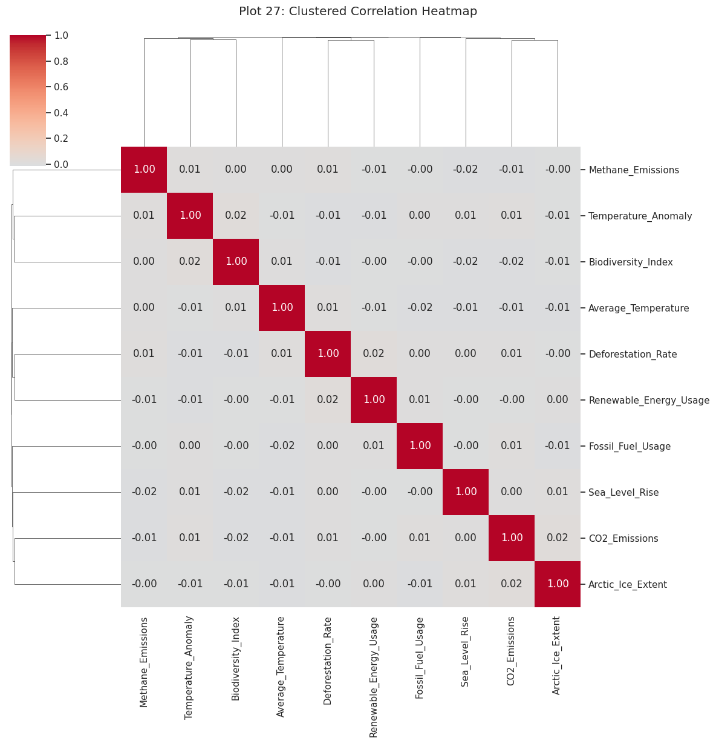
EDA: Correlations
Every correlation is close to zero: the variables are independent of each other.

Slide 24
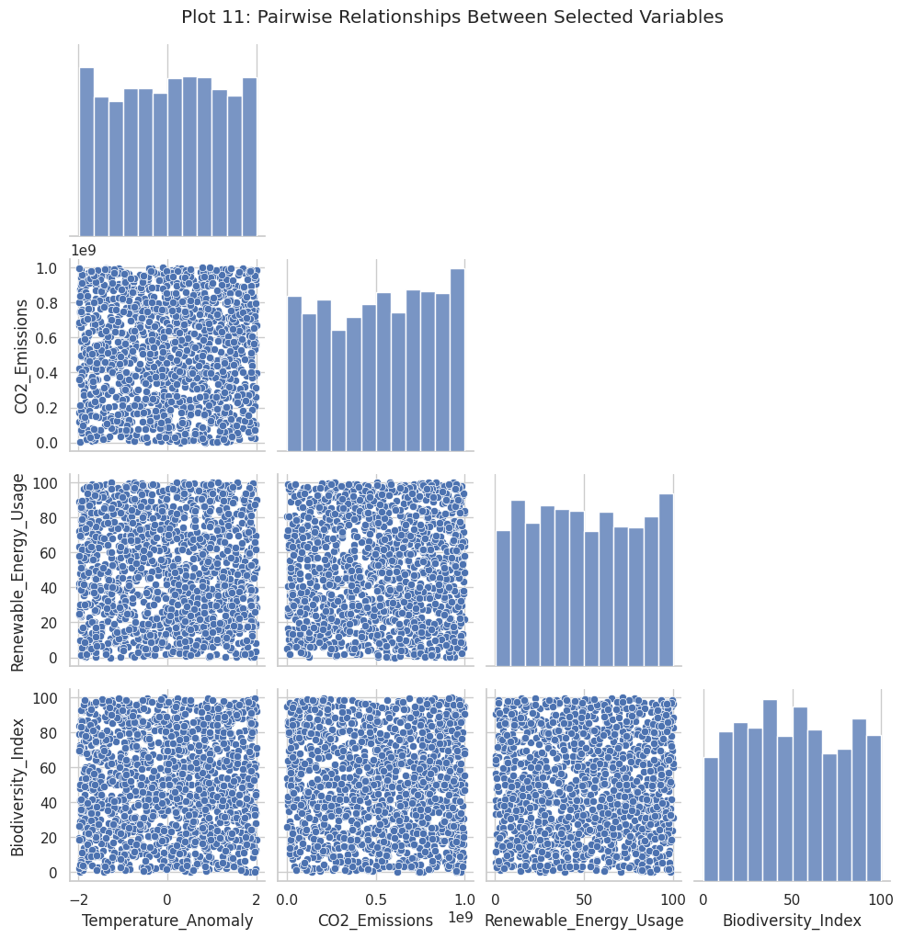
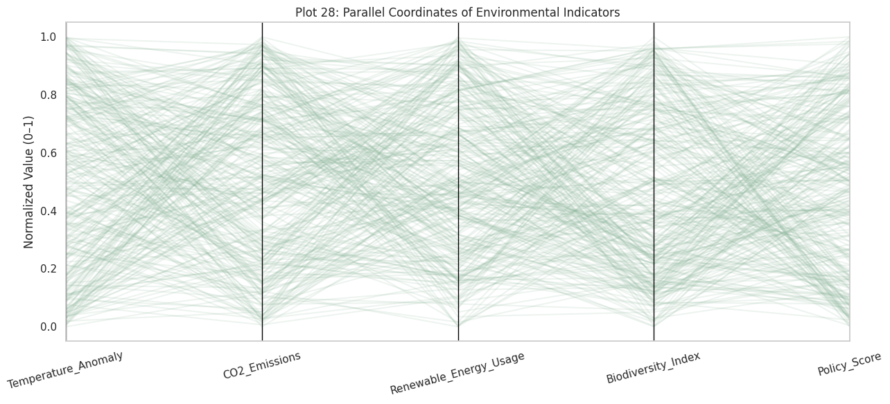
EDA: All Pairs Together
Pair plot and parallel coordinates: no pair of variables forms a pattern.

Slide 25
Week 6: Feature Engineering
What we did and why:
  Calculated mean, standard deviation, skewness and kurtosis for the 24 numeric features.
  Checked skewness to decide whether any column needed a transformation to make it symmetric.
  Applied StandardScaler: (value − mean) ÷ standard deviation, so every feature is on the same scale.
  Applied MinMaxScaler: (value − min) ÷ (max − min), which puts every feature between 0 and 1.
  Scaling is needed because the columns differ hugely: GDP is in trillions, the anomaly is between −2 and 2.
  One-hot encoded Country, because countries are labels with no order.
  Kept the original cleaned data and saved each transformed dataset separately.

Slide 26
Week 6: Results
What the feature engineering produced:
  Skewness is about 0 in every column, so the data is symmetric and no skewness correction was needed.
  Kurtosis is about −1.2 in every column, which means flat distributions with no heavy tails.
  After StandardScaler, each numeric feature has mean 0 and standard deviation 1.
  After MinMaxScaler, each numeric feature runs from 0 to 1.
  After one-hot encoding, 26 columns became 220 (25 other columns plus 195 country columns).
  Year was left unscaled because it is a time label, not a measurement.

Slide 27
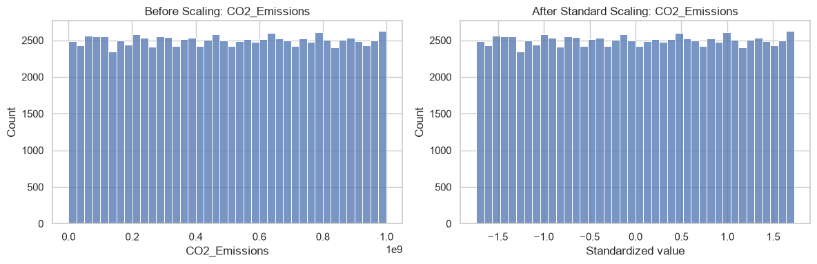
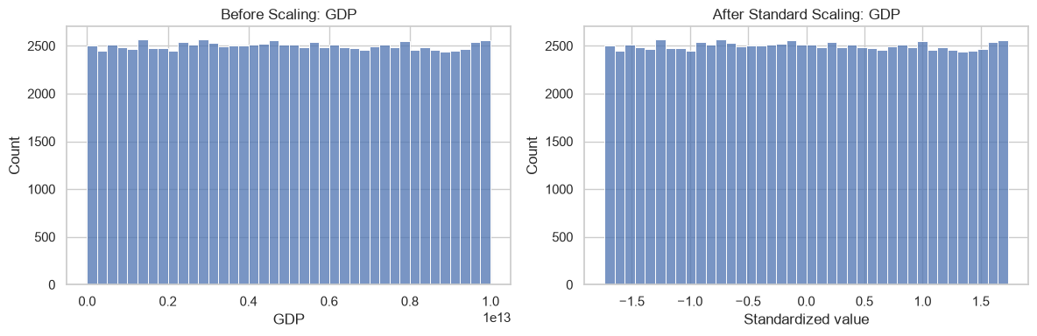
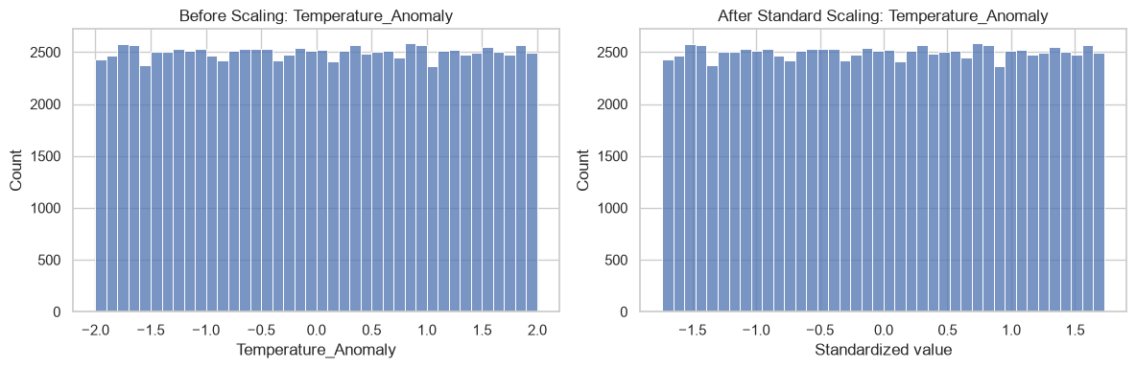
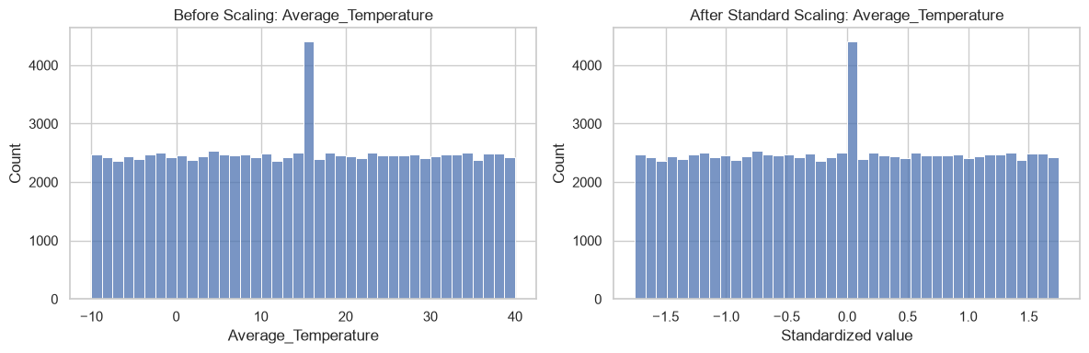
Week 6: Before vs After Scaling
Scaling changes the scale of each feature, not the shape of its distribution.

Slide 28
Week 7: Feature Selection and PCA
What we did:
  Started from the standard-scaled dataset and took the 24 numeric features (Year and Country left out).
  Feature selection: built the correlation matrix and looked for pairs with correlation of 0.90 or more.
  Such pairs would carry the same information twice (multicollinearity), so one could be dropped.
  PCA: combined the 24 features into new, uncorrelated components ordered by how much variance they capture.
  Plotted the cumulative explained variance to find how many components keep at least 90%.
  Plotted the first two components as a 2D scatter to look for groups in the data.
  Saved the PCA-reduced dataset and the explained-variance table.

Slide 29
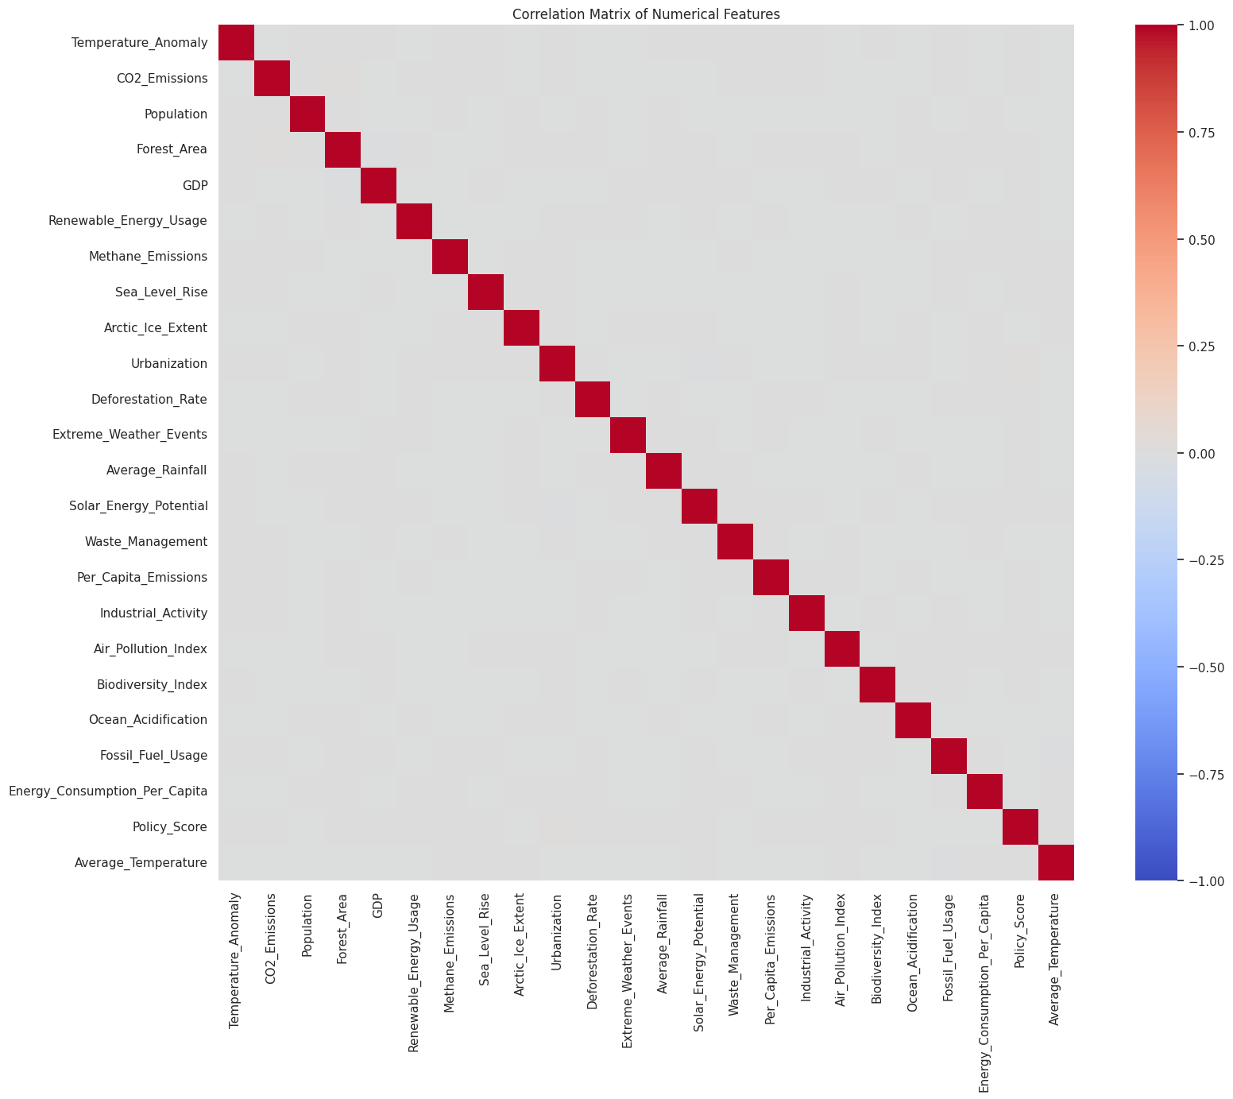
Week 7: Feature Selection
No pair of features reaches a correlation of 0.90, so no feature was removed.

Slide 30
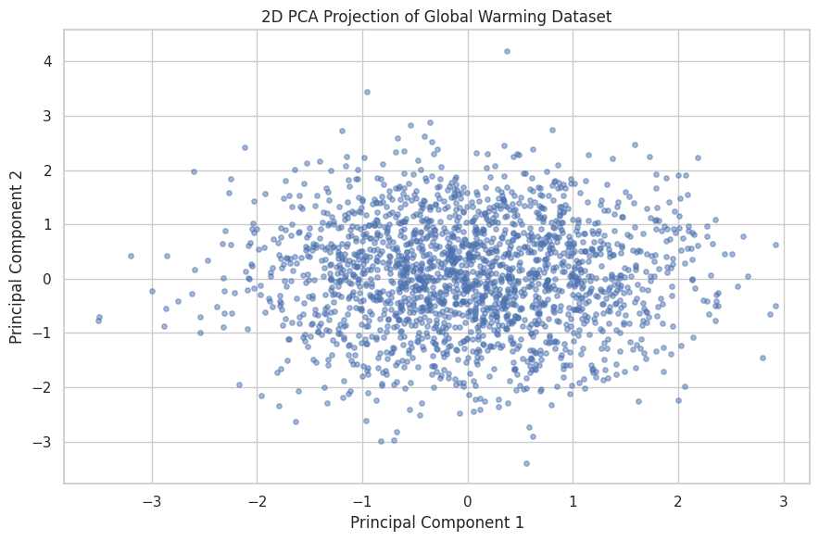
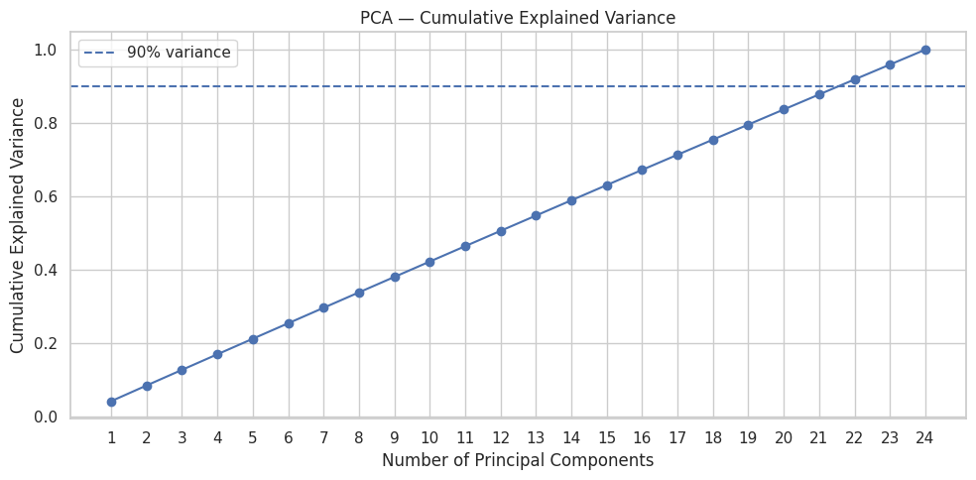
Week 7: PCA
22 of 24 components keep 91.88% of the variance; PC1 and PC2 together explain 8.57%.

Slide 31
Week 7: What PCA Told Us
Reading the results:
  No feature pair is highly correlated, so every feature carries its own information.
  Each principal component explains about 4% of the variance, roughly 1 part in 24.
  That is why the cumulative variance line is straight, and 22 components are needed to reach 90%.
  The 2D scatter is one round cloud: the records do not form separate groups.
  Conclusion: the features are independent, so this dataset cannot be reduced much further.

Slide 32
Key Findings
What the data shows:
  The cleaned dataset is complete: 100,000 records, 0 missing values, 0 duplicates, 0 outliers.
  Temperature anomalies are spread evenly from −2 to +2, with no trend from 1900 to 2023.
  No country or period stands out with a clearly higher average anomaly.
  The indicators show almost no correlation with each other.
  Because the features are independent, PCA can reduce them only from 24 to 22.

Slide 33
Next Steps
What is left to do:
  Week 8: build the interactive dashboard with Streamlit and Plotly, using at least five plot types.
  Tell the story as context, conflict and resolution, based on what the data shows.
  Week 9: final report (8 to 10 pages), final presentation and viva.

Slide 34
Roles & Responsibilities
Team Member | Roles & Responsibilities
V Jayavanadhi | Data Analyst
Joyce Laetitia Malenou Weudji | Data Analyst & Storyteller
Gurupriya | Data Engineer
Manoj SS | Visualization Expert

Slide 35
References
Global Warming Dataset: 195 Countries (1900-2023), Kaggle, by ankushpanday1
Pandas Documentation: pandas.pydata.org
Matplotlib Documentation: matplotlib.org
Seaborn Documentation: seaborn.pydata.org
SciPy Documentation (stats.zscore): scipy.org

