Slide 1


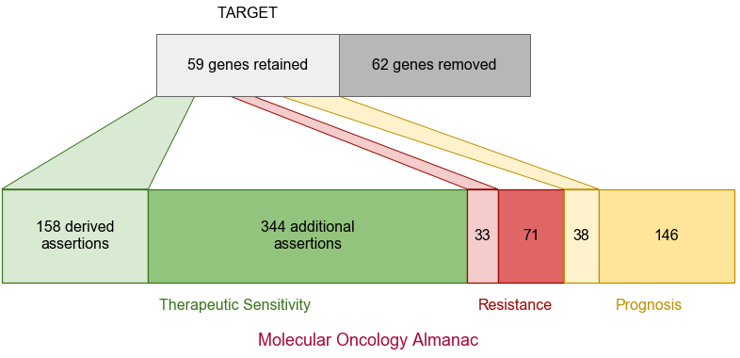
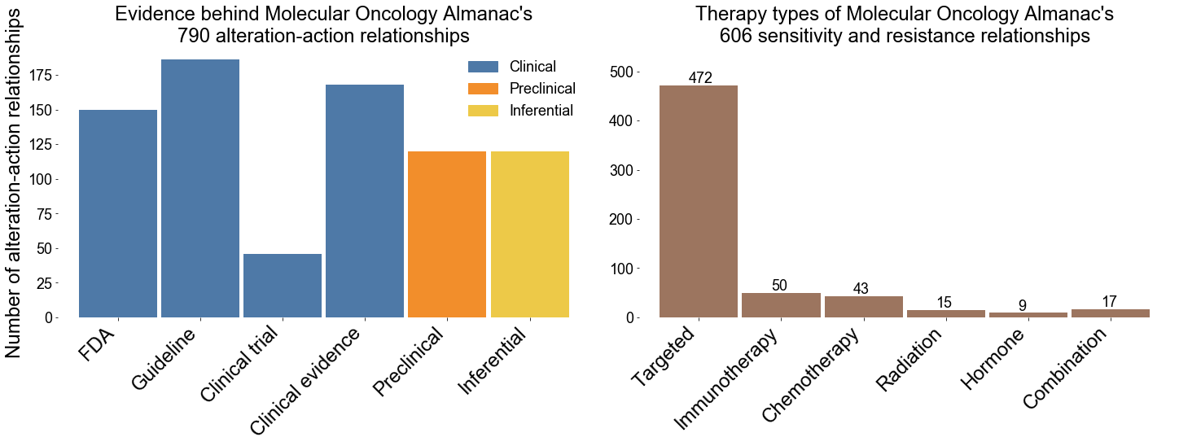
a
b
Patient DNA
Patient RNA
Somatic and germline mutations
Copy number alterations
Somatic mutations
Fusions
9 Established Databases
Molecular Oncology Almanac
790 action-alteration relationships asserting sensitivity, resistance, and prognostic claims
Annotate & evaluate first-order genomic relationships
502
184
c
104
Annotate & evaluate second-order genomic relationships
Perform patient-cell line similarity
with first-order genomic features
Integrated
Genome wide
Inferred
Sequencing
concordance
Microsatellite stability
Mutational burden
Somatic & germline overlap
Aneuploidy
Mutational signatures
Produce patient actionability report

