Slide 1
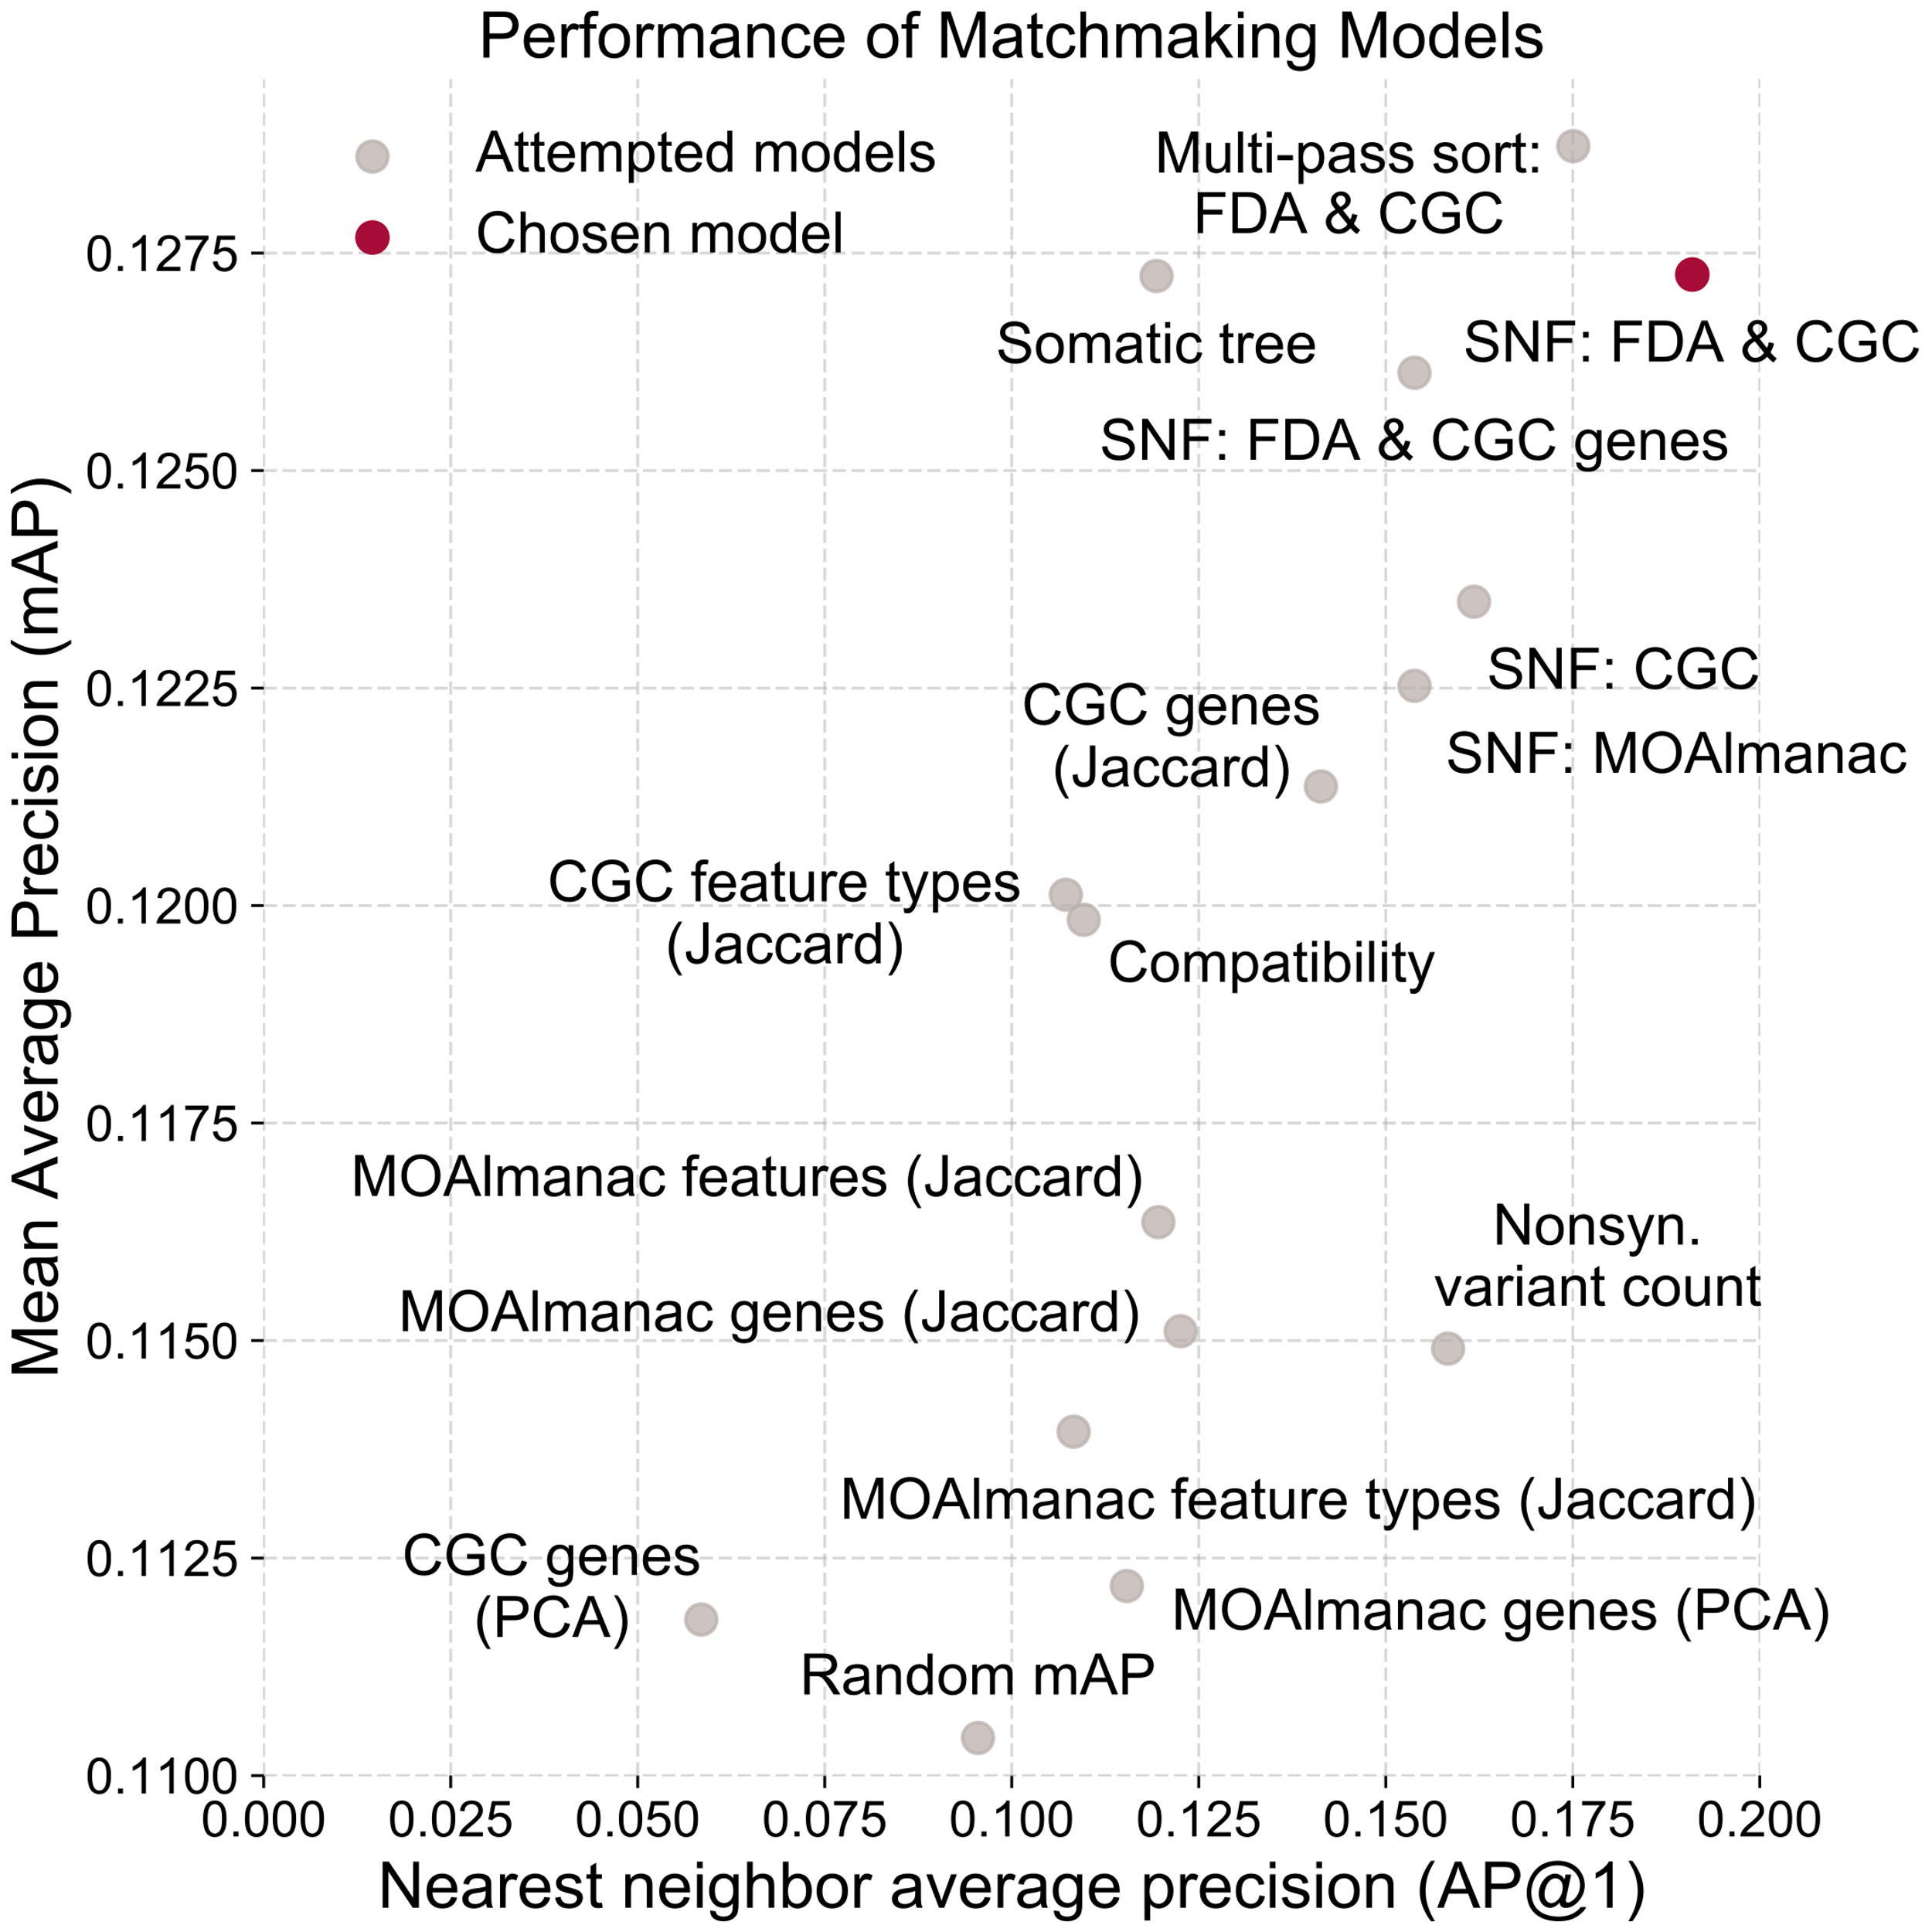
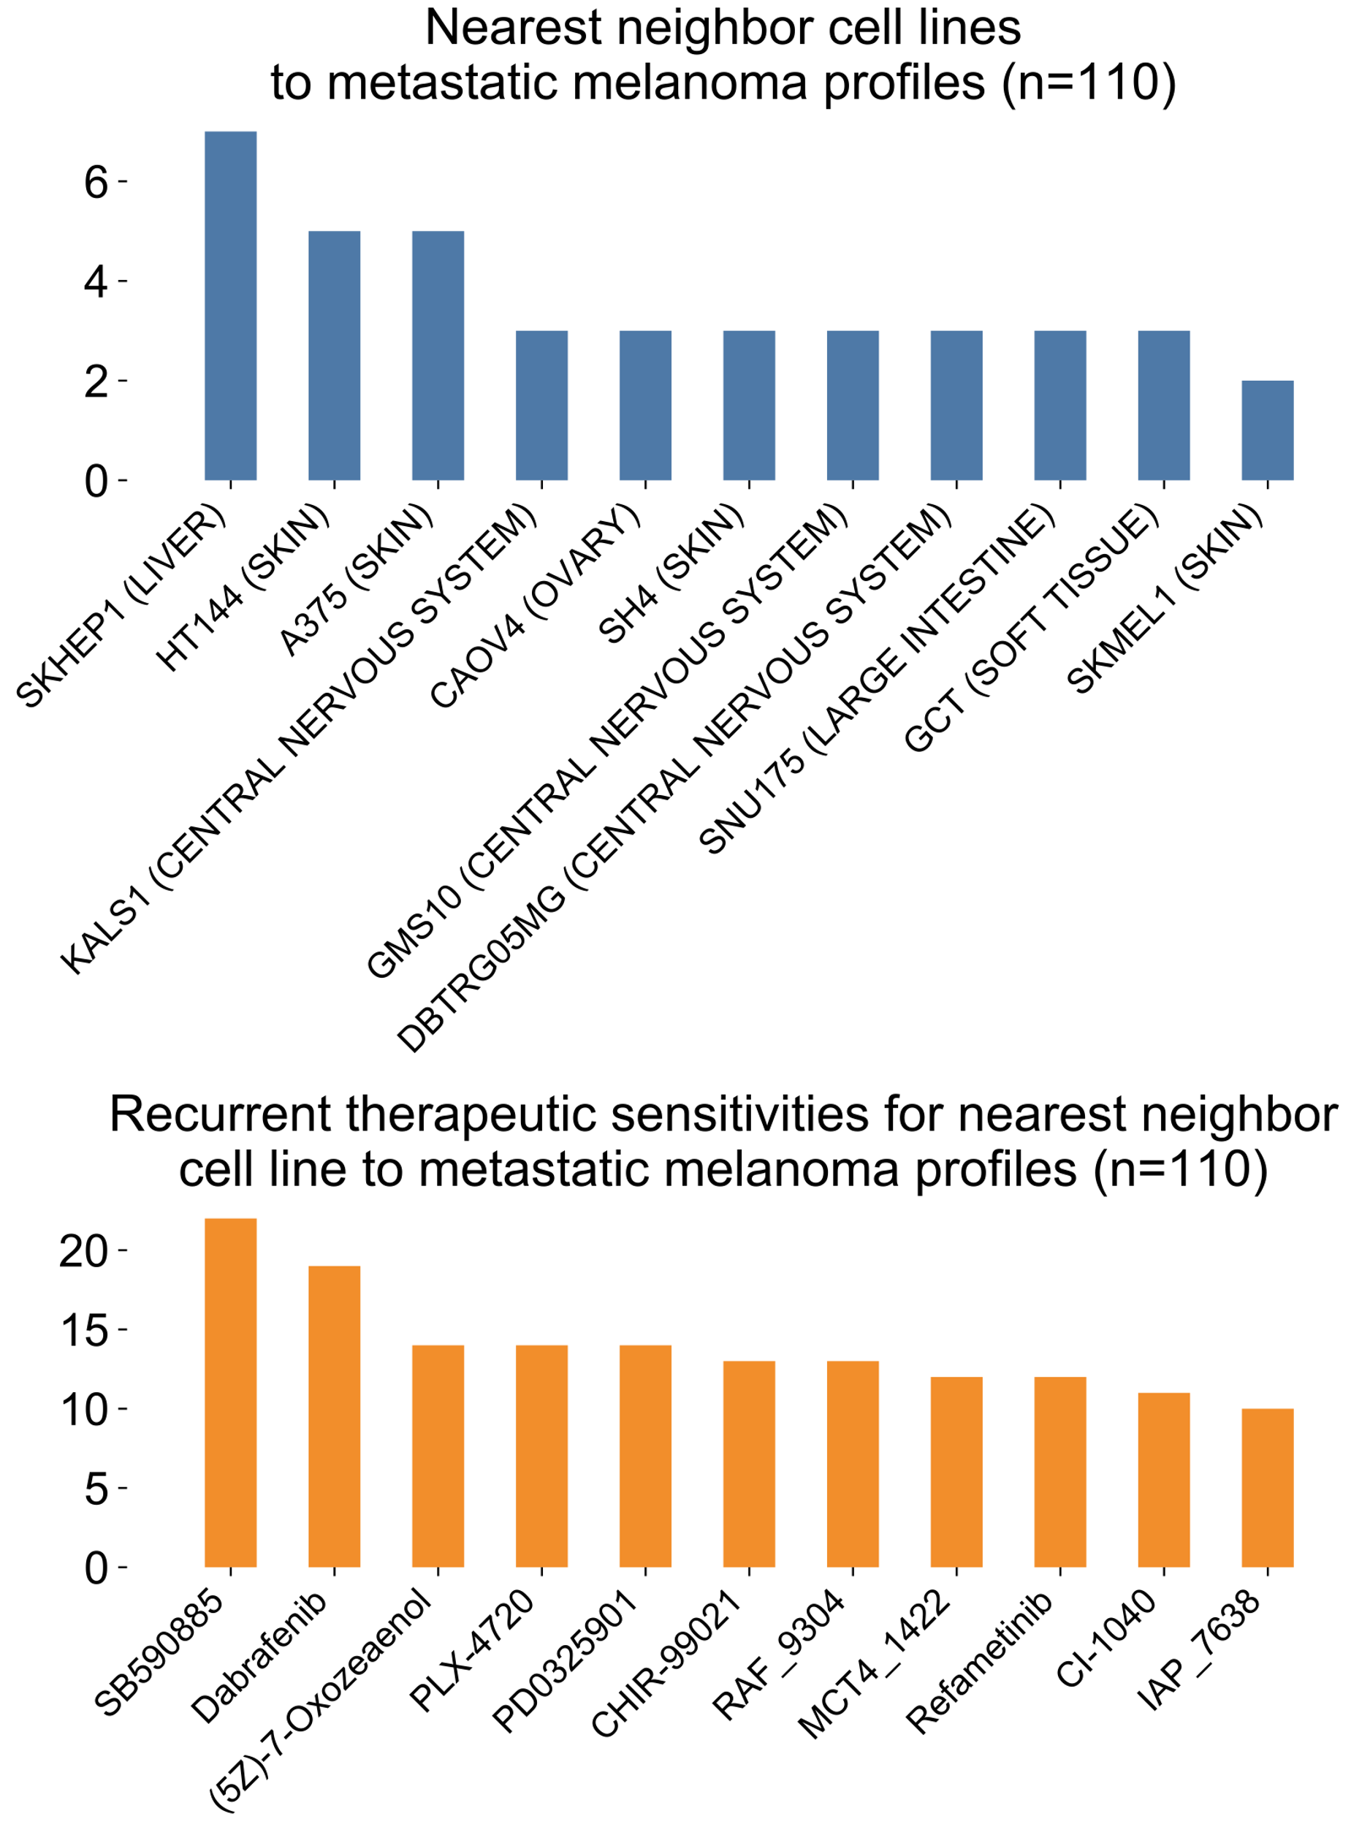
a
Evaluating matchmaking
CGC
Molecular Oncology Almanac
719 genes
139 genes
Fusions
Copy Number
Precision @ rank
Somatic Variants
Vectorize molecular features
rank
1
1.00
2
0.50
Cancer cell lines
&
Less similar
3
0.66
Apply matchmaking model for genomic similarity
Therapeutic sensitivity
4
0.50
Shared drug sensitivity with case
No shared drug sensitivity
b
c

