Slide 1


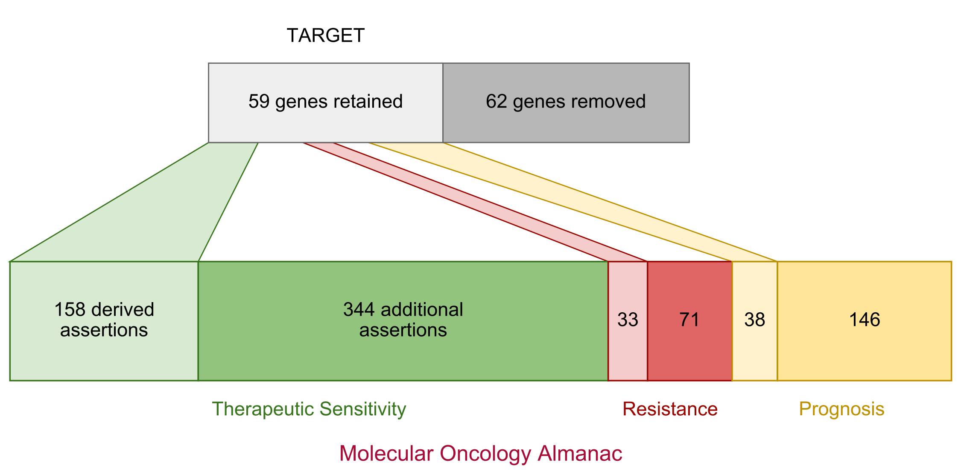
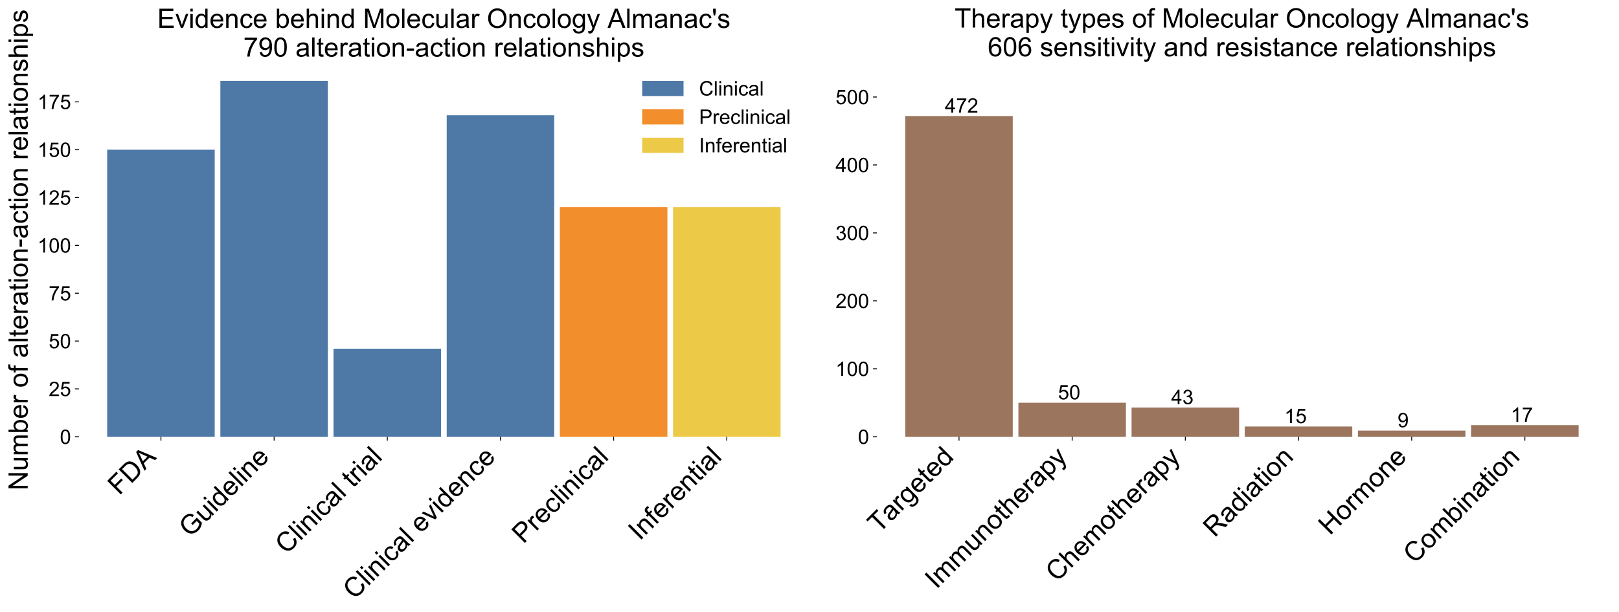
a
b
Patient DNA
Patient RNA
Somatic and germline variants
Copy number alterations
Somatic variants
Fusions
9 Established Databases
Molecular Oncology Almanac
790 alteration-action relationships asserting sensitivity, resistance, and prognostic claims
Annotate and evaluate first-order genomic relationships
502
184
104
c
Annotate and evaluate second-order genomic relationships
Perform patient-cell line similarity with first-order genomic features
Integrated
Genome wide
Inferred
Sequencing concordance
Microsatellite stability
Mutational burden
Somatic & germline
Aneuploidy
Mutational signatures
Produce patient actionability report
d
Somatic Analysis – heuristically prioritize features if in…
e
Germline analysis – annotate with ExAC and ClinVar and report…
Incidental findings from ACMG v2
Molecular Oncology Almanac
Variants in genes related to hereditary cancers
Variants in genes related to somatic cancers
3D Cancer Hotspots
Cancer Hotspots
Cancer Gene Census
GSEA Cancer Pathway
GSEA Cancer Module
COSMIC
Decrease priority if common in ExAC
VUS
Increase priority if observed in orthogonal sequencing or gene mutated in germline

