Slide 1
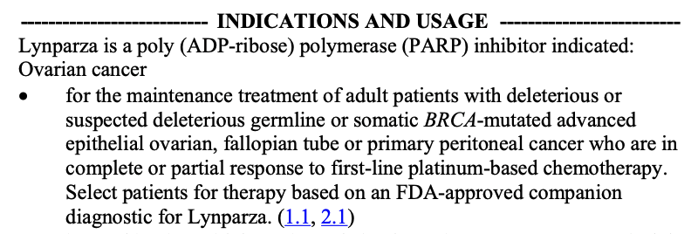


PDF
PDF
PDF
biomarkers
cancer types
therapies
Gather citable documents
Derive concepts and clinical implication relationships
Curate into a knowledge base
non-small cell lung cancer
ICD10:C34.90
oncotree:nsclc
Extract regulatory approvals
Align with representation ontologies and standards
Enable programmatic and interactive access

