Slide 1




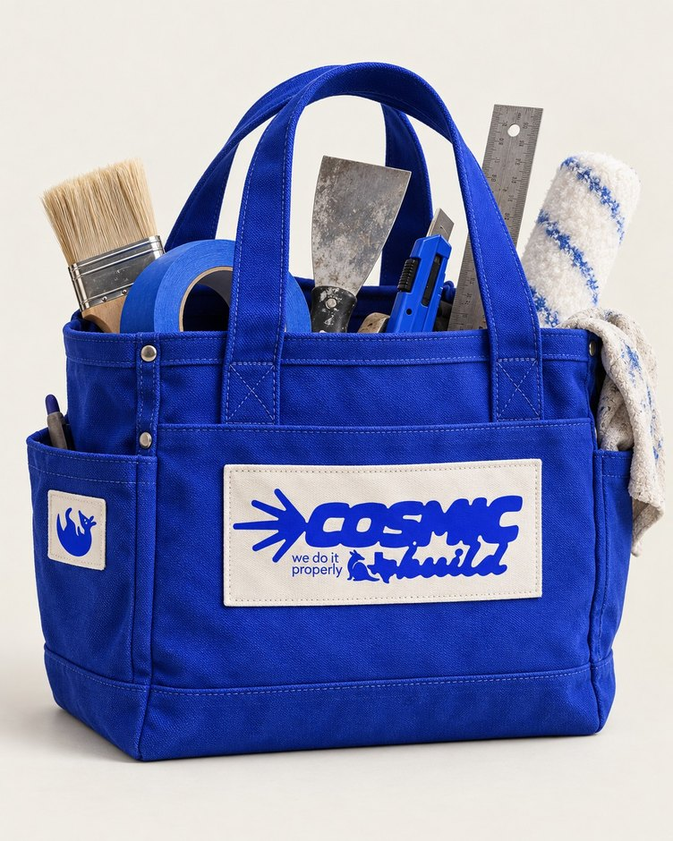
DIY
01 / 06
Do it yourself. Do it properly.
Notes:
diy/01-cover

Slide 2




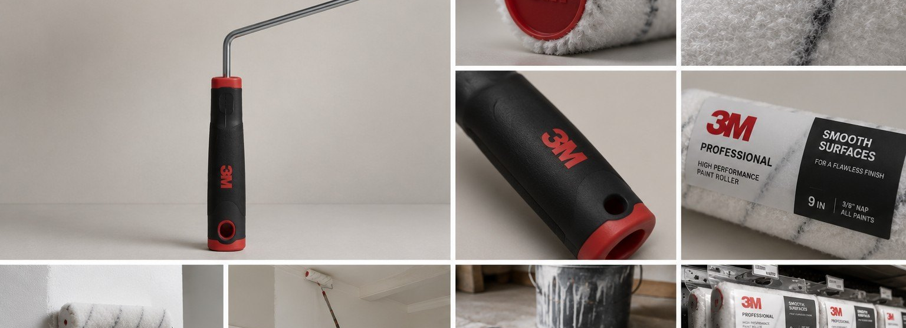
DIY
02 / 06
Practical guides, checklists, calculators and project plans to help you get the work right.
Notes:
diy/02-use-the-stuff

Slide 3
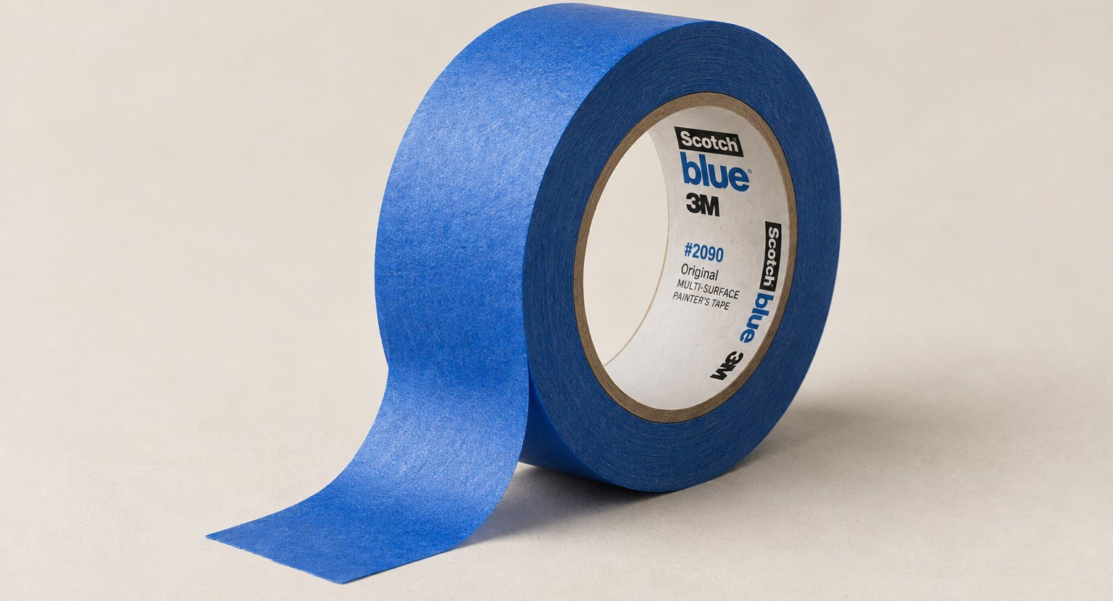
DIY
03 / 06
PREP TIP 01
CLEAN IT.
DRY IT.
THEN TAPE.
Tape holds best on a clean, dry surface. Wipe off dust and grease, then let it dry fully before you stick anything down.
Notes:
diy/03-clean-dry

Slide 4
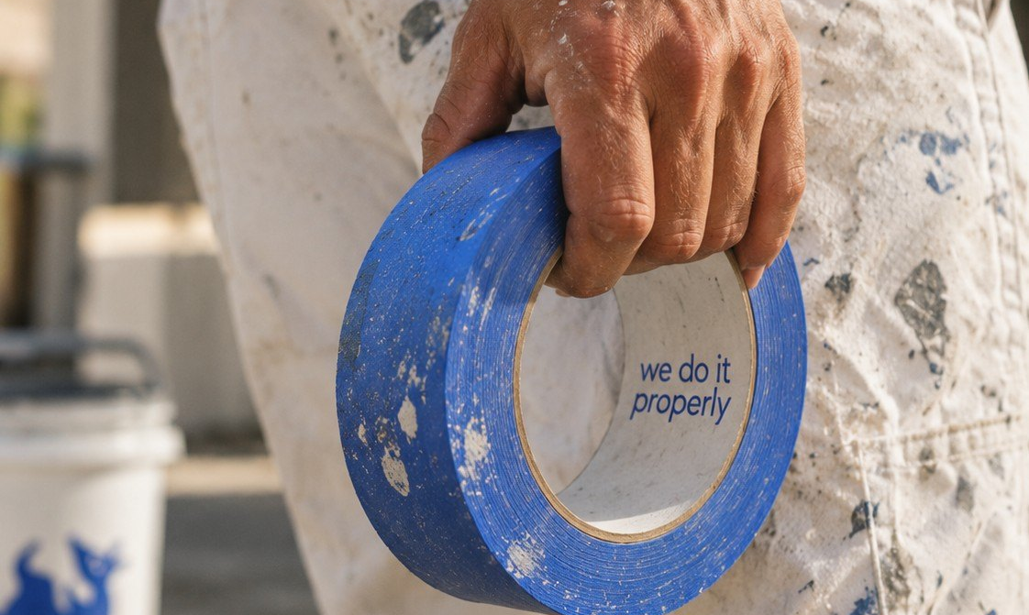
DIY
04 / 06
PREP TIP 02
PRESS THE
EDGES DOWN.
Run your thumb or a putty knife along the tape edge. A firm seal helps keep paint from creeping underneath.
Notes:
diy/04-press-edges

Slide 5
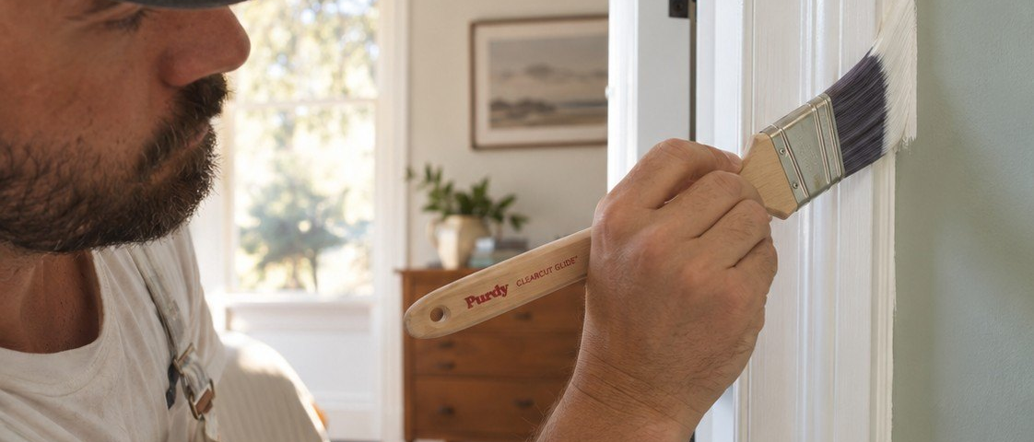
DIY
05 / 06
PREP TIP 03
PULL TAPE
WHILE THE
PAINT IS
SLIGHTLY WET.
Take it off while the paint is slightly wet. Pull slowly, at a low angle, for a clean line.
Notes:
diy/05-pull-early

Slide 6




DIY
06 / 06
EXPLORE
DIY.
Guides, checklists, calculators and project plans.
Explore DIY
[TBC: URL]
Notes:
diy/06-explore

