Slide 1


01 / 07
FEATURED
WORK
Real places, real people.
Notes:
featured-work/01-cover

Slide 2

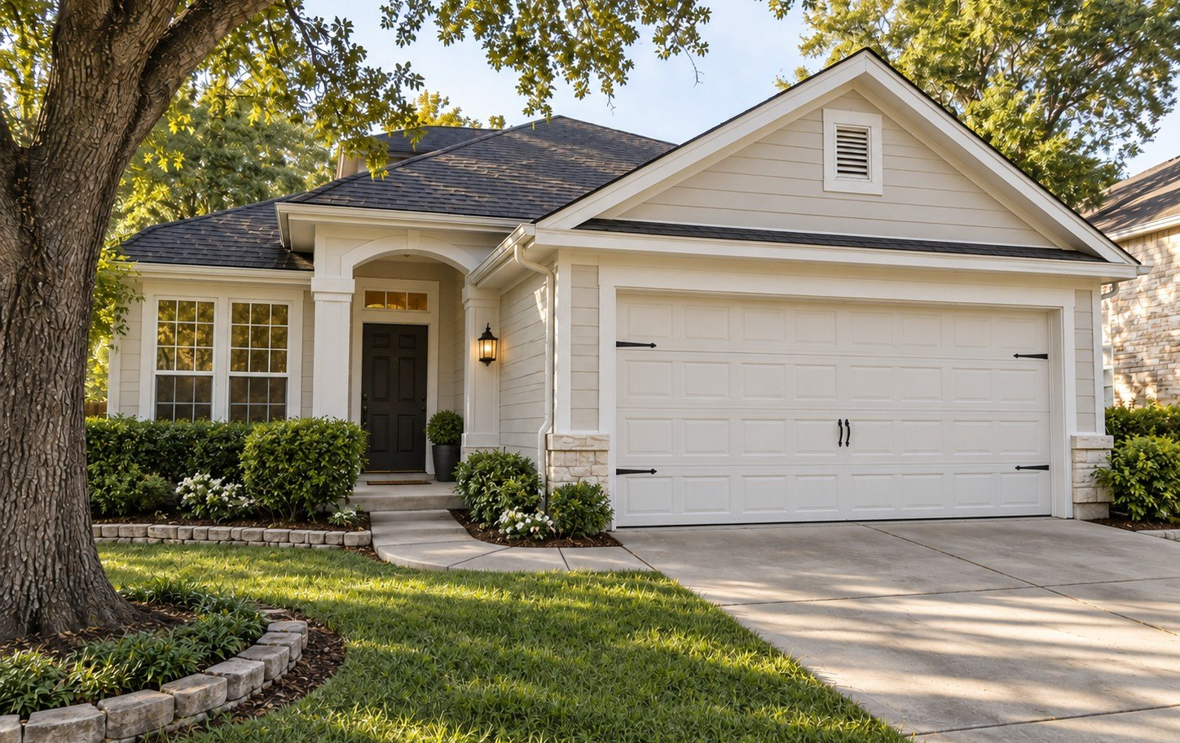
02 / 07
CASE STUDY
THE ZILKER
FAMILY HOME
Exterior refresh with lasting results.
Notes:
featured-work/02-zilker

Slide 3
03 / 07
THE JOB,
IN NUMBERS
2,850
6
sq ft
working days
4
ZILKER
Austin · single-family home
crew members
ZILKER, AUSTIN
Notes:
featured-work/03-the-facts

Slide 4

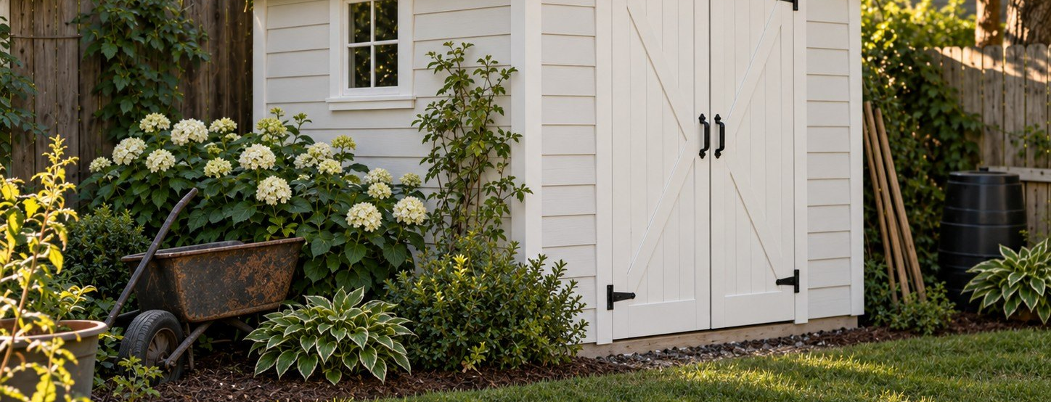
04 / 07
THE SCOPE
WHAT WE
DID
FULL EXTERIOR REPAINT (SIDING + TRIM)
PRESSURE WASHING
WOOD REPAIRS AND CAULKING
FRONT PORCH REFRESH
Notes:
featured-work/04-scope

Slide 5
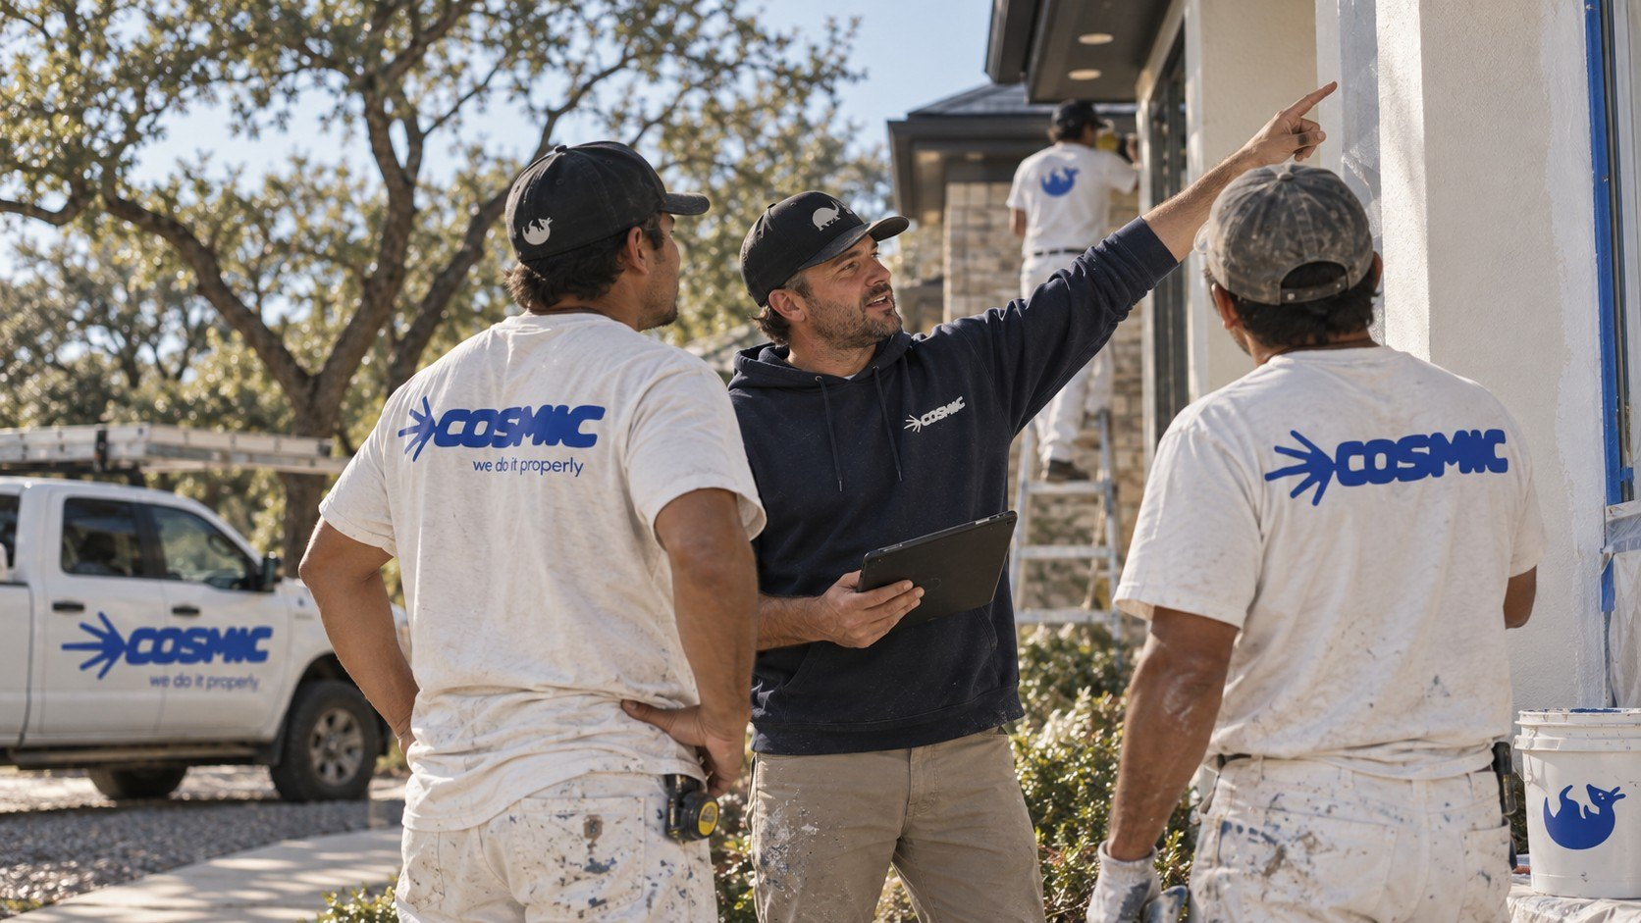
05 / 07
AND TO FINISH
GARAGE DOOR REPAINT
TWO-COAT EXTERIOR PAINT SYSTEM
CLEANUP AND FINAL WALKTHROUGH
Notes:
featured-work/05-scope-finish

Slide 6



06 / 07
CLIENT REVIEW
BETH REDIX
“After heavily vetting about 10 contractors to do interior painting for the entirety of our house, I could not be more pleased to have chosen Cosmic...”
Notes:
featured-work/06-review

Slide 7

07 / 07
YOUR PLACE
NEXT?
A few quick details are enough to get started.
Get a clear estimate
[TBC: URL]
Notes:
featured-work/07-cta

