Slide 1

MEET THE CREW
01 / 06
MEET
ARLO.
The newest member of the Cosmic crew.
Notes:
meet-arlo/01-cover

Slide 2



MEET ARLO
02 / 06
BORN IN
TEXAS.
Arlo brings the Texas side of Cosmic to life. Curious, resilient and easy to get along with.
Notes:
meet-arlo/02-texas

Slide 3

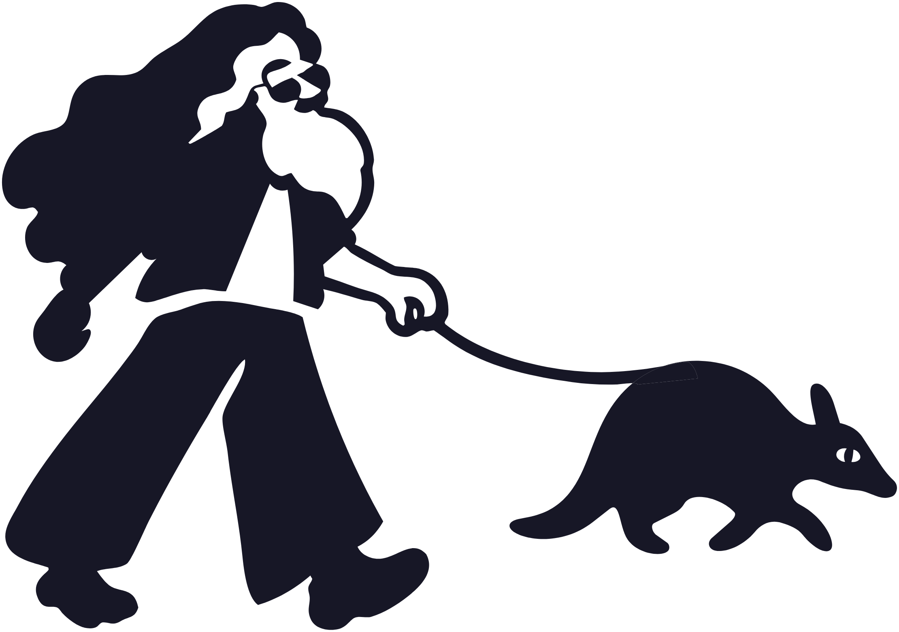
MEET ARLO
03 / 06
ALWAYS
SOMEWHERE
AROUND THE
JOBSITE.
Notes:
meet-arlo/03-jobsite

Slide 4

MEET ARLO
04 / 06
TOUGH SHELL.
SOFT SPOT
FOR GOOD
WORK.
Notes:
meet-arlo/04-tough-shell

Slide 5


MEET ARLO
05 / 06
WHAT HE STANDS FOR
CARE.
CURIOUS
RESILIENT
APPROACHABLE
Notes:
meet-arlo/05-stands-for

Slide 6
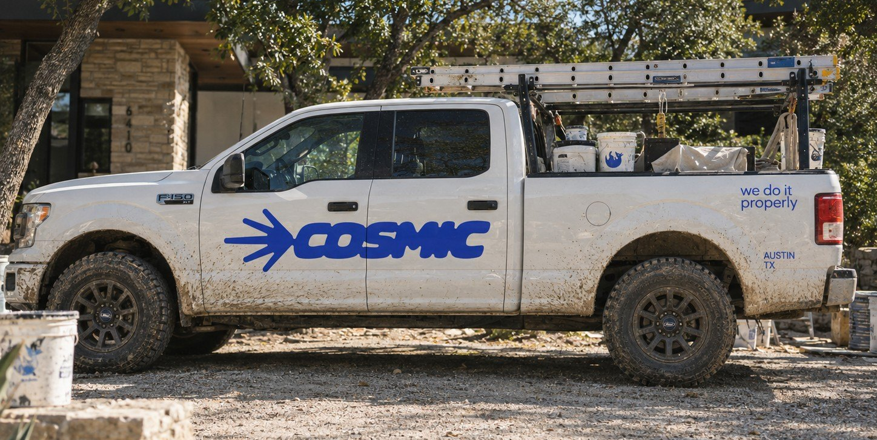

MEET ARLO
06 / 06
SAY HI WHEN
YOU SEE
THE TRUCK.
Follow
[TBC: HANDLE]
Notes:
meet-arlo/06-say-hi

