Slide 1

A GUEST ON THE CREW
01 / 05
MEET
COSMO.
Part craftsman, part inspector, part cosmic oddball.
Notes:
meet-cosmo/01-cover

Slide 2
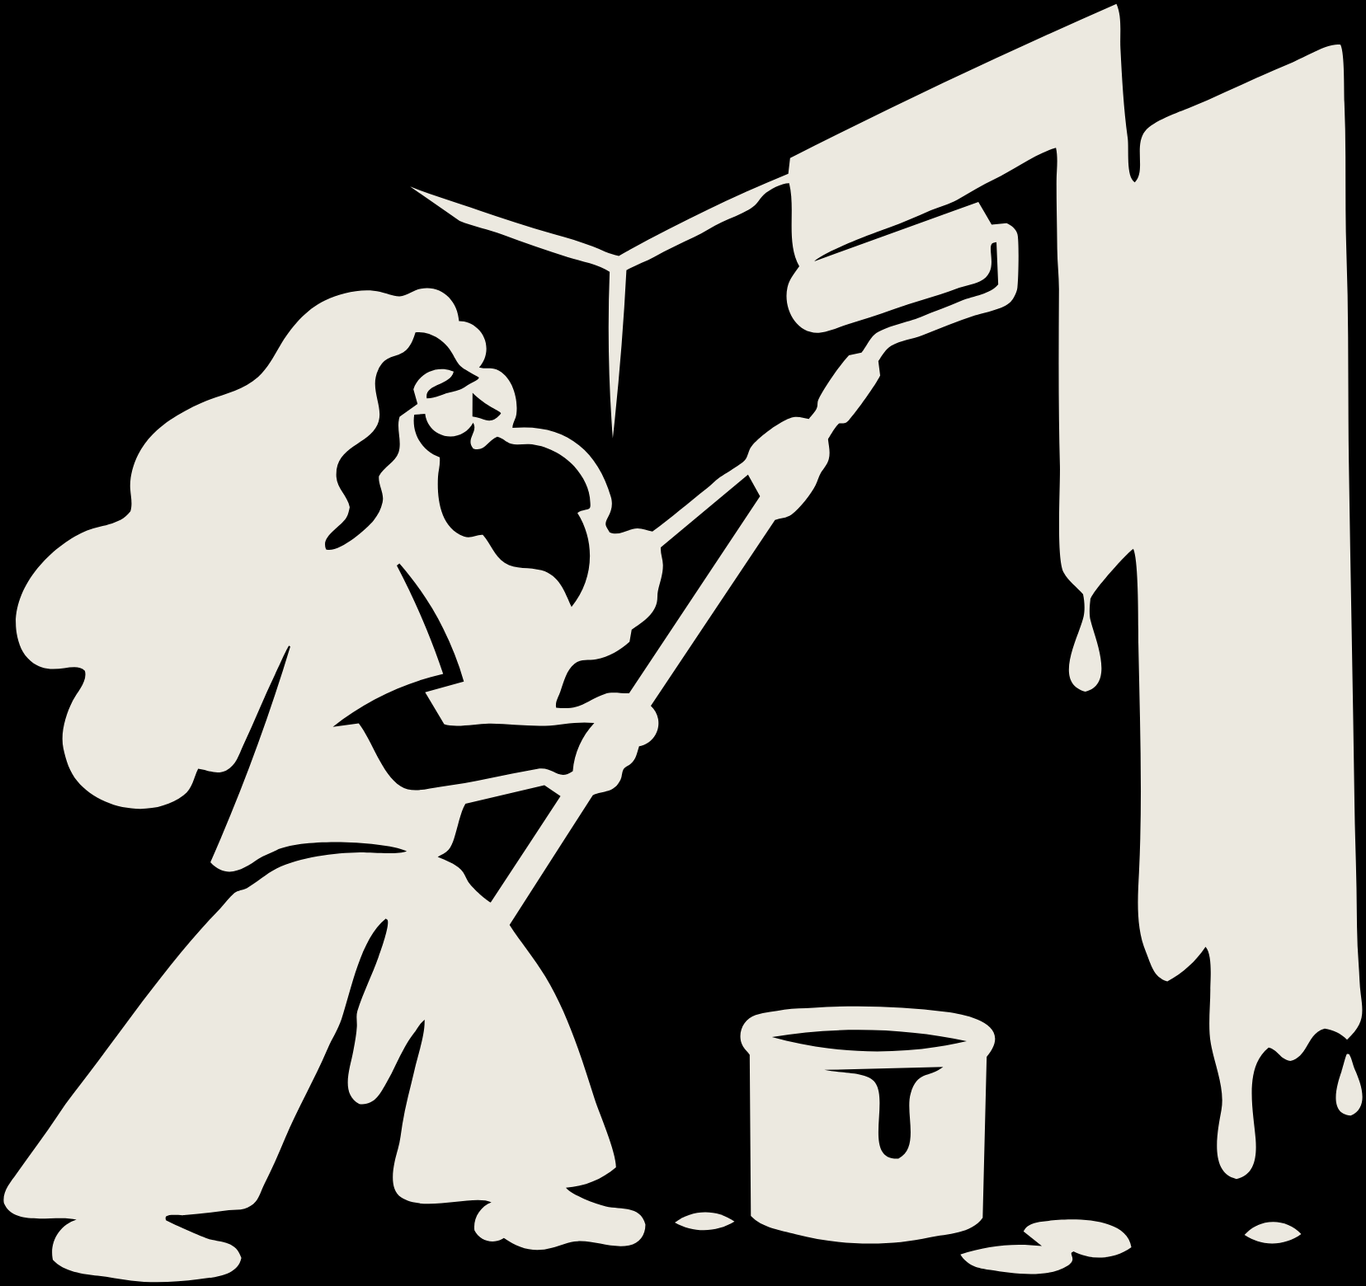
MEET COSMO
02 / 05
PART
CRAFTSMAN.
Hands that know the job, and the patience to do it properly.
Notes:
meet-cosmo/02-craftsman

Slide 3

MEET COSMO
03 / 05
PART
INSPECTOR.
He checks the details so nothing gets missed.
Notes:
meet-cosmo/03-inspector

Slide 4

MEET COSMO
04 / 05
PART COSMIC
ODDBALL.
Yes, that is a tub of paint.
Notes:
meet-cosmo/04-oddball

Slide 5
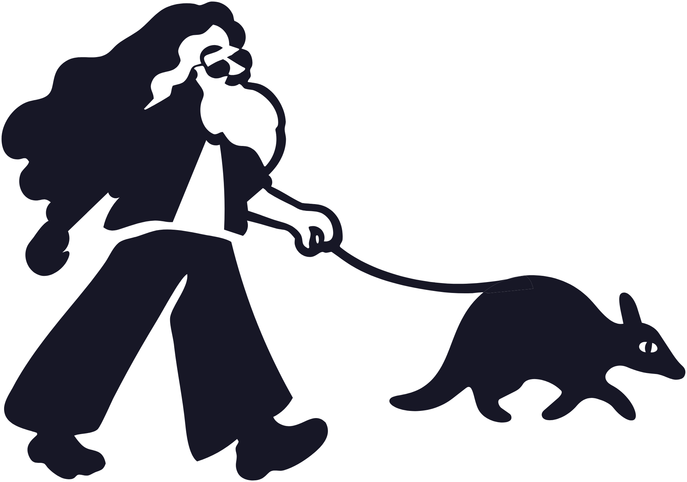
MEET COSMO
05 / 05
KNOW-HOW FROM DOING THE WORK FOR A LONG TIME.
We care, it shows.
Notes:
meet-cosmo/05-know-how

