Slide 1

























UNIFORMS & MERCH · 01 / 08
THE PATCH SET
Twelve patches from Cosmic's own marks, lettering and stickers. Blue first; every one also comes in navy.
MARKS
Comet wordmark
Arlo mark
Arlo curl
Arlo, sitting
Arlo, leaping
3.5 x 1.5 in
3.0 x 3.0 in
2.0 x 2.0 in
2.2 x 2.5 in
3.4 x 1.8 in
WORDS
Leave it better
Show up
Top notch
Will book again
Three tapes
2.8 x 2.8 in
3.6 x 1.4 in
3.0 x 2.3 in
2.8 x 2.5 in
3.75 / 4.5 x 0.6 in
NAVY
Twill body, merrow edge in the body colour, a thin cream keyline inside it, art in cream thread. Blue #362cff on canvas and white; navy #171726 on blue fabric. Die-cut patches follow each sticker's own outline. Finished sizes, edge included.
Notes:
merch/01-patch-sheet

Slide 2
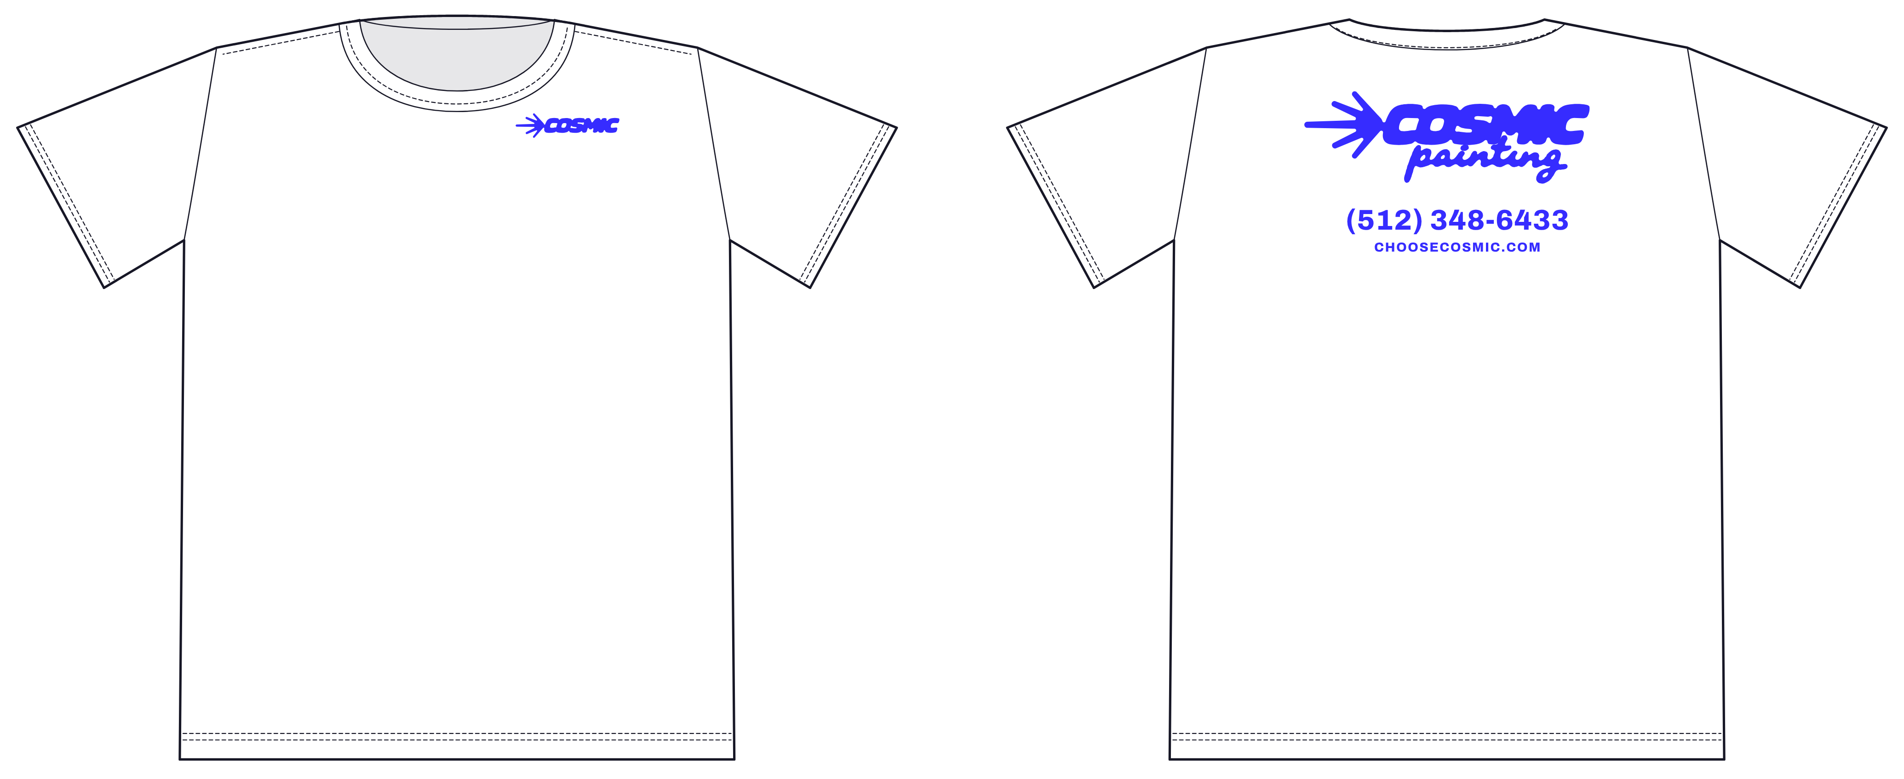
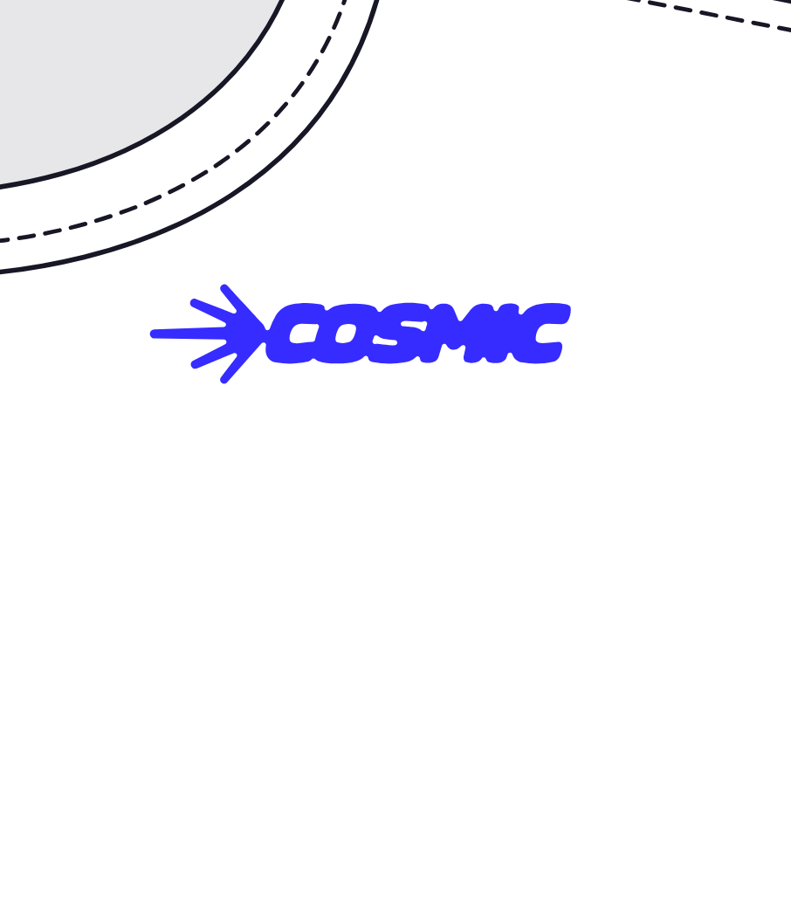
UNIFORMS & MERCH · 02 / 08
T-SHIRT A, WHITE
Left-chest comet up front. On the back: COSMIC painting, the phone and the site.
CHEST DETAIL
FRONT
BACK
Left chest · comet wordmark · 4 in wide · screen print, blue
COSMIC painting lockup 11 in wide, 3 in below the collar · (512) 348-6433 and CHOOSECOSMIC.COM in Archivo caps
White 100% cotton jersey, 6 oz. One ink: blue #362cff.
Notes:
merch/02-tee-white

Slide 3
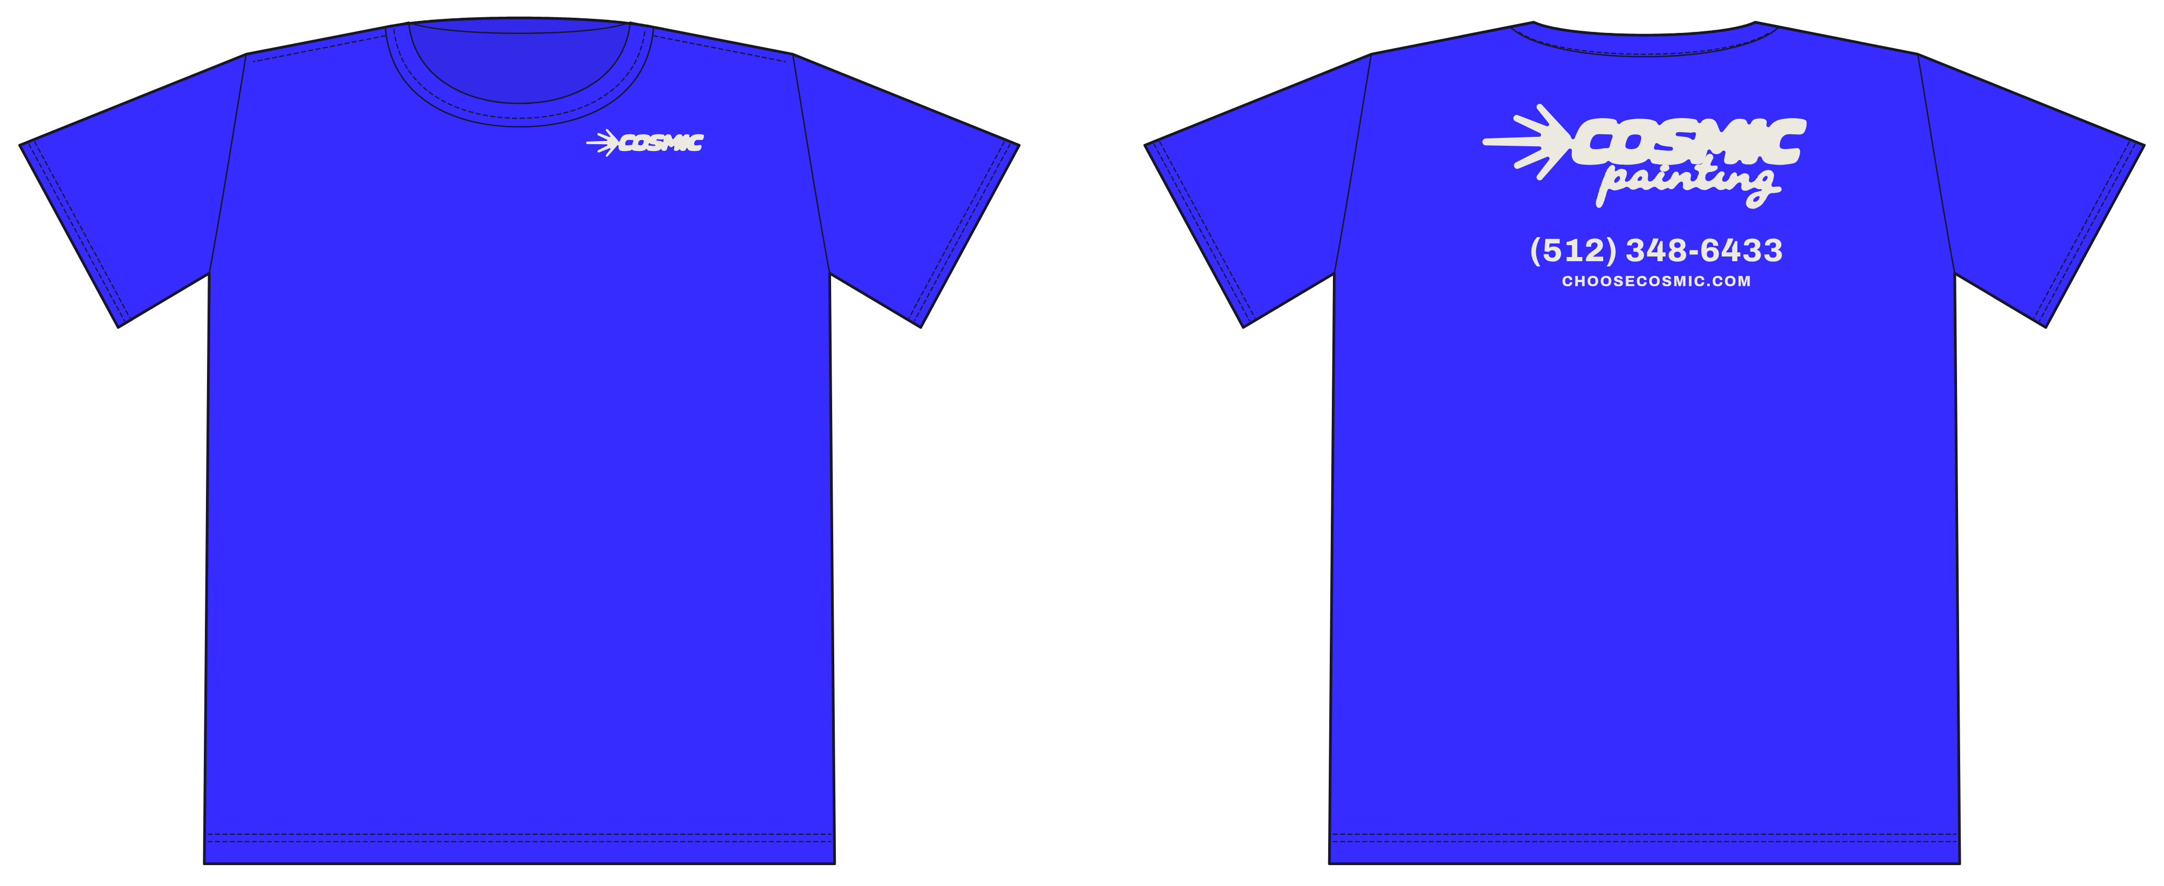
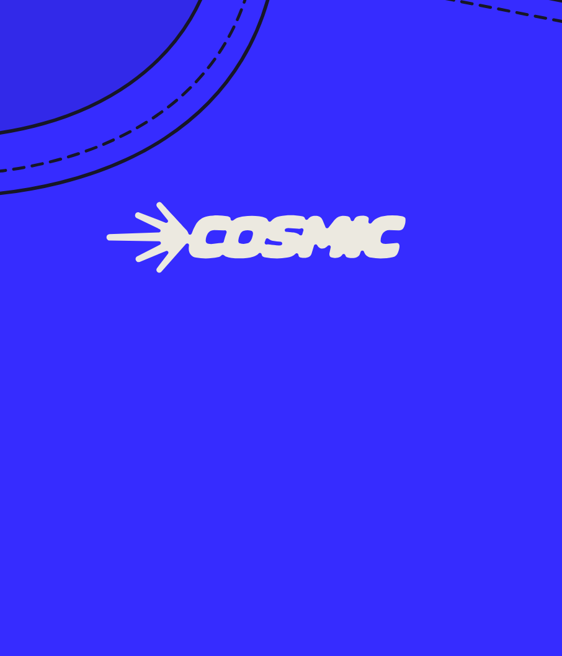
UNIFORMS & MERCH · 03 / 08
T-SHIRT B, BLUE
The same tee in Cosmic blue, art in cream.
CHEST DETAIL
FRONT
BACK
Left chest · comet wordmark · 4 in wide · screen print, cream
COSMIC painting lockup 11 in wide · phone and site in Archivo caps, cream
Cosmic blue jersey (match #362cff). One ink: cream #ece9e0, printed over an underbase.
Notes:
merch/03-tee-blue

Slide 4
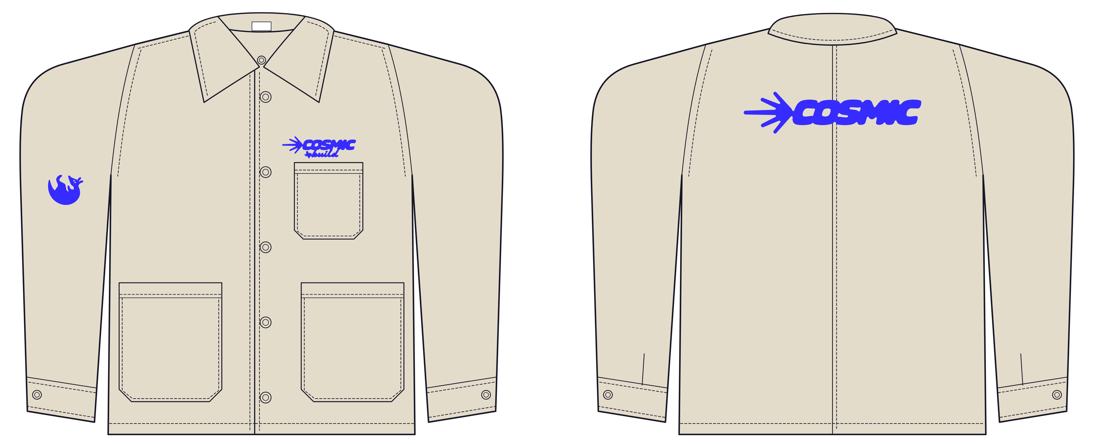
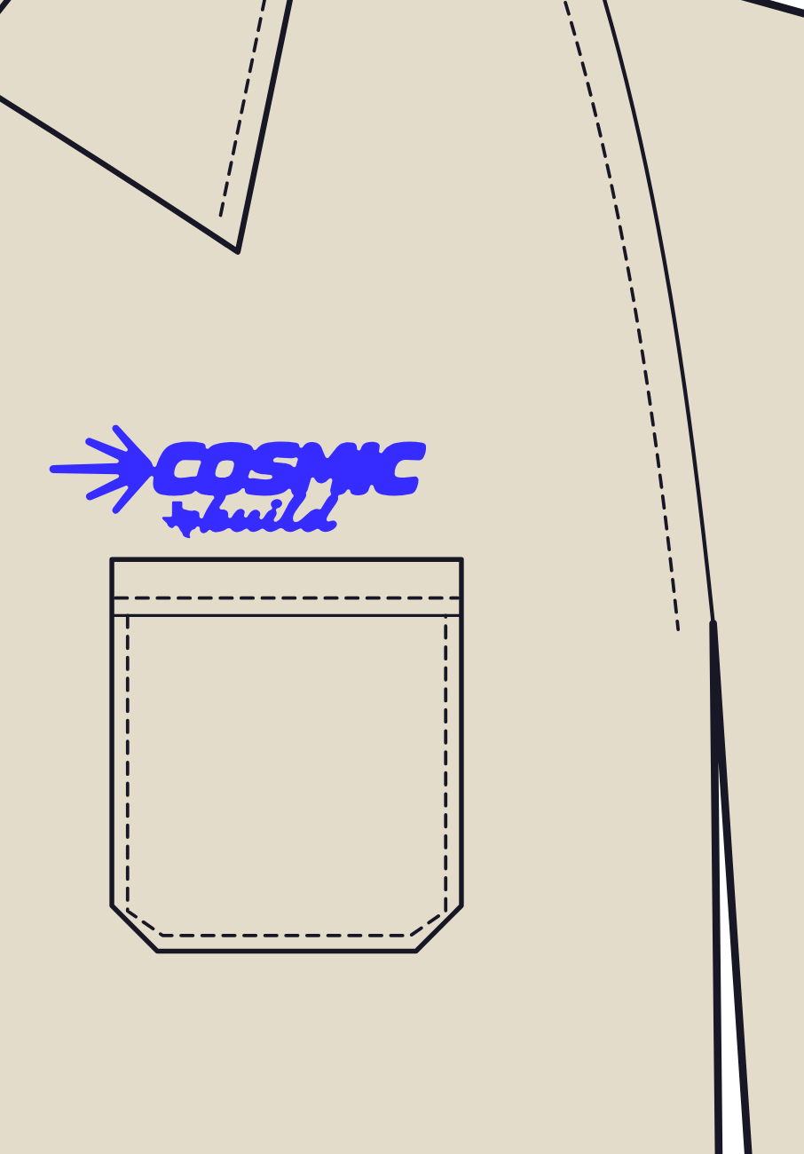
UNIFORMS & MERCH · 04 / 08
JACKET 1, CURRENT
The chore coat the crew already wears, finished with a back.
CHEST DETAIL
FRONT
BACK
As today: COSMIC build above the chest pocket, 5.4 in · Arlo curl on the right sleeve, 2.6 in · direct embroidery, blue
One thing: the comet wordmark, 13 in wide across the upper back · embroidery, blue
Natural canvas chore coat: point collar, five shank buttons, chest pocket, two lower patch pockets, button cuffs.
Notes:
merch/04-jacket-current

Slide 5
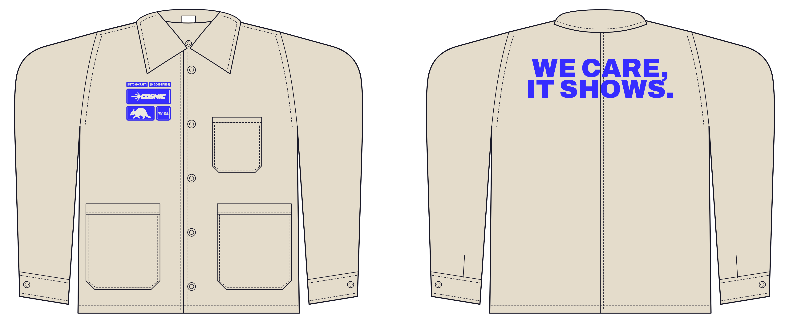
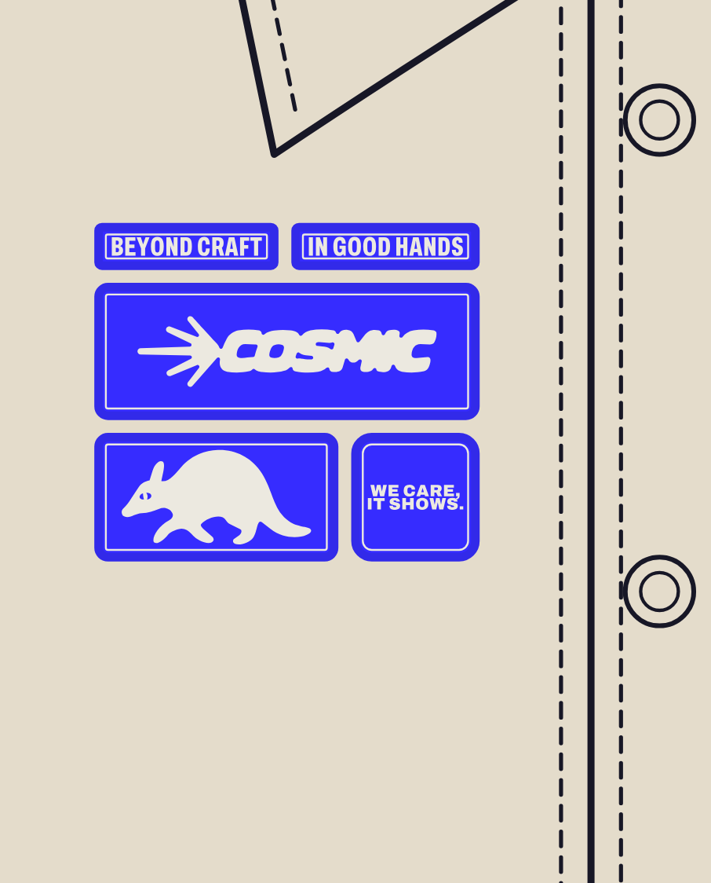
UNIFORMS & MERCH · 05 / 08
JACKET 2, PATCH CLUSTER
The blue patch block on the chest. One big phrase on the back.
CHEST DETAIL
FRONT
BACK
Blue patch block 4.5 x 4 in on the right chest, under the collar point, 1.2 in from the placket · close-up on board 08
One thing: WE CARE, IT SHOWS. in Archivo Black caps, 15 in wide, one blue · embroidery or print
Same natural canvas jacket. The chest pocket stays clear; the block sits on the opposite chest.
Notes:
merch/05-jacket-patch-cluster

Slide 6
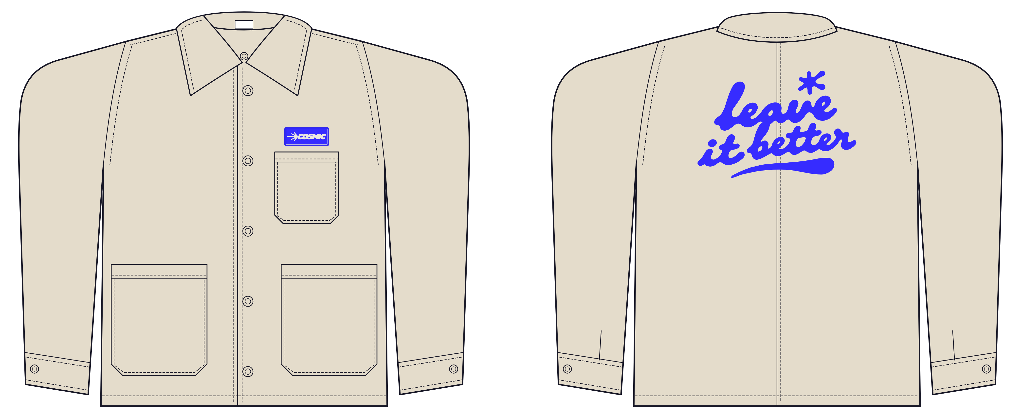
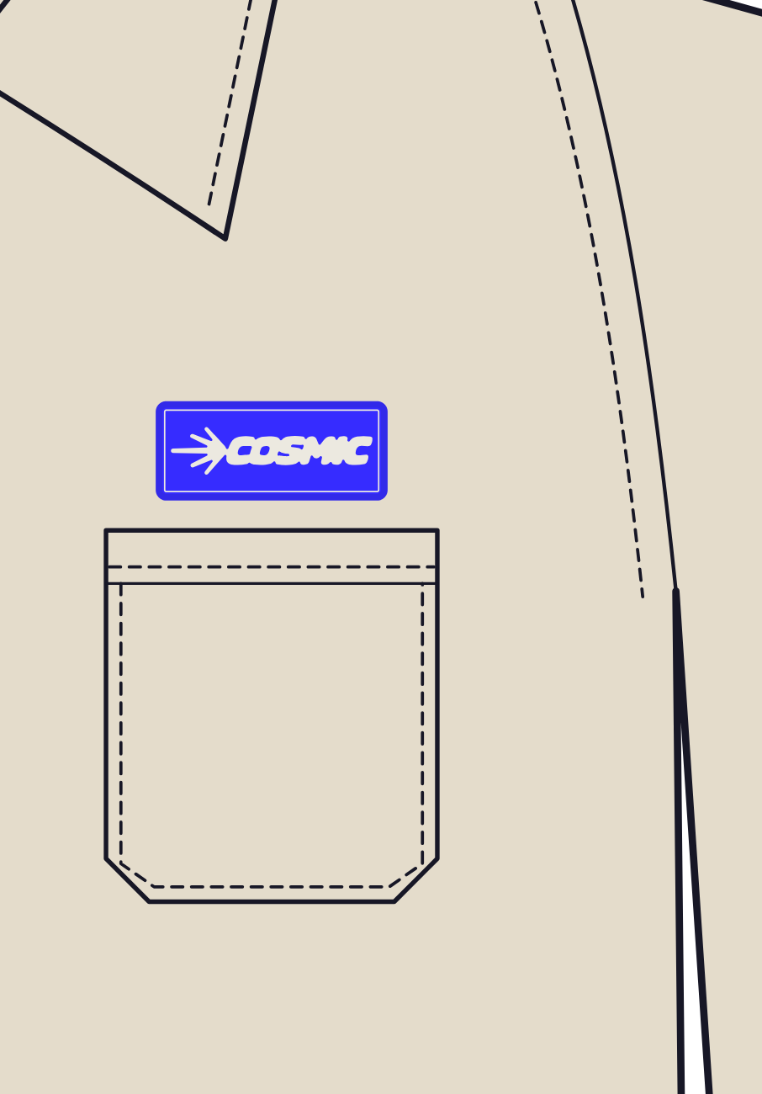
UNIFORMS & MERCH · 06 / 08
JACKET 3, LEAVE IT BETTER
A single wordmark patch up front. The value, big, on the back.
CHEST DETAIL
FRONT
BACK
Blue wordmark patch above the chest pocket, 3.5 x 1.5 in · nothing else
One thing: the leave it better lettering, 12.5 in wide, one blue · embroidery or print
Same natural canvas jacket.
Notes:
merch/06-jacket-leave-it-better

Slide 7
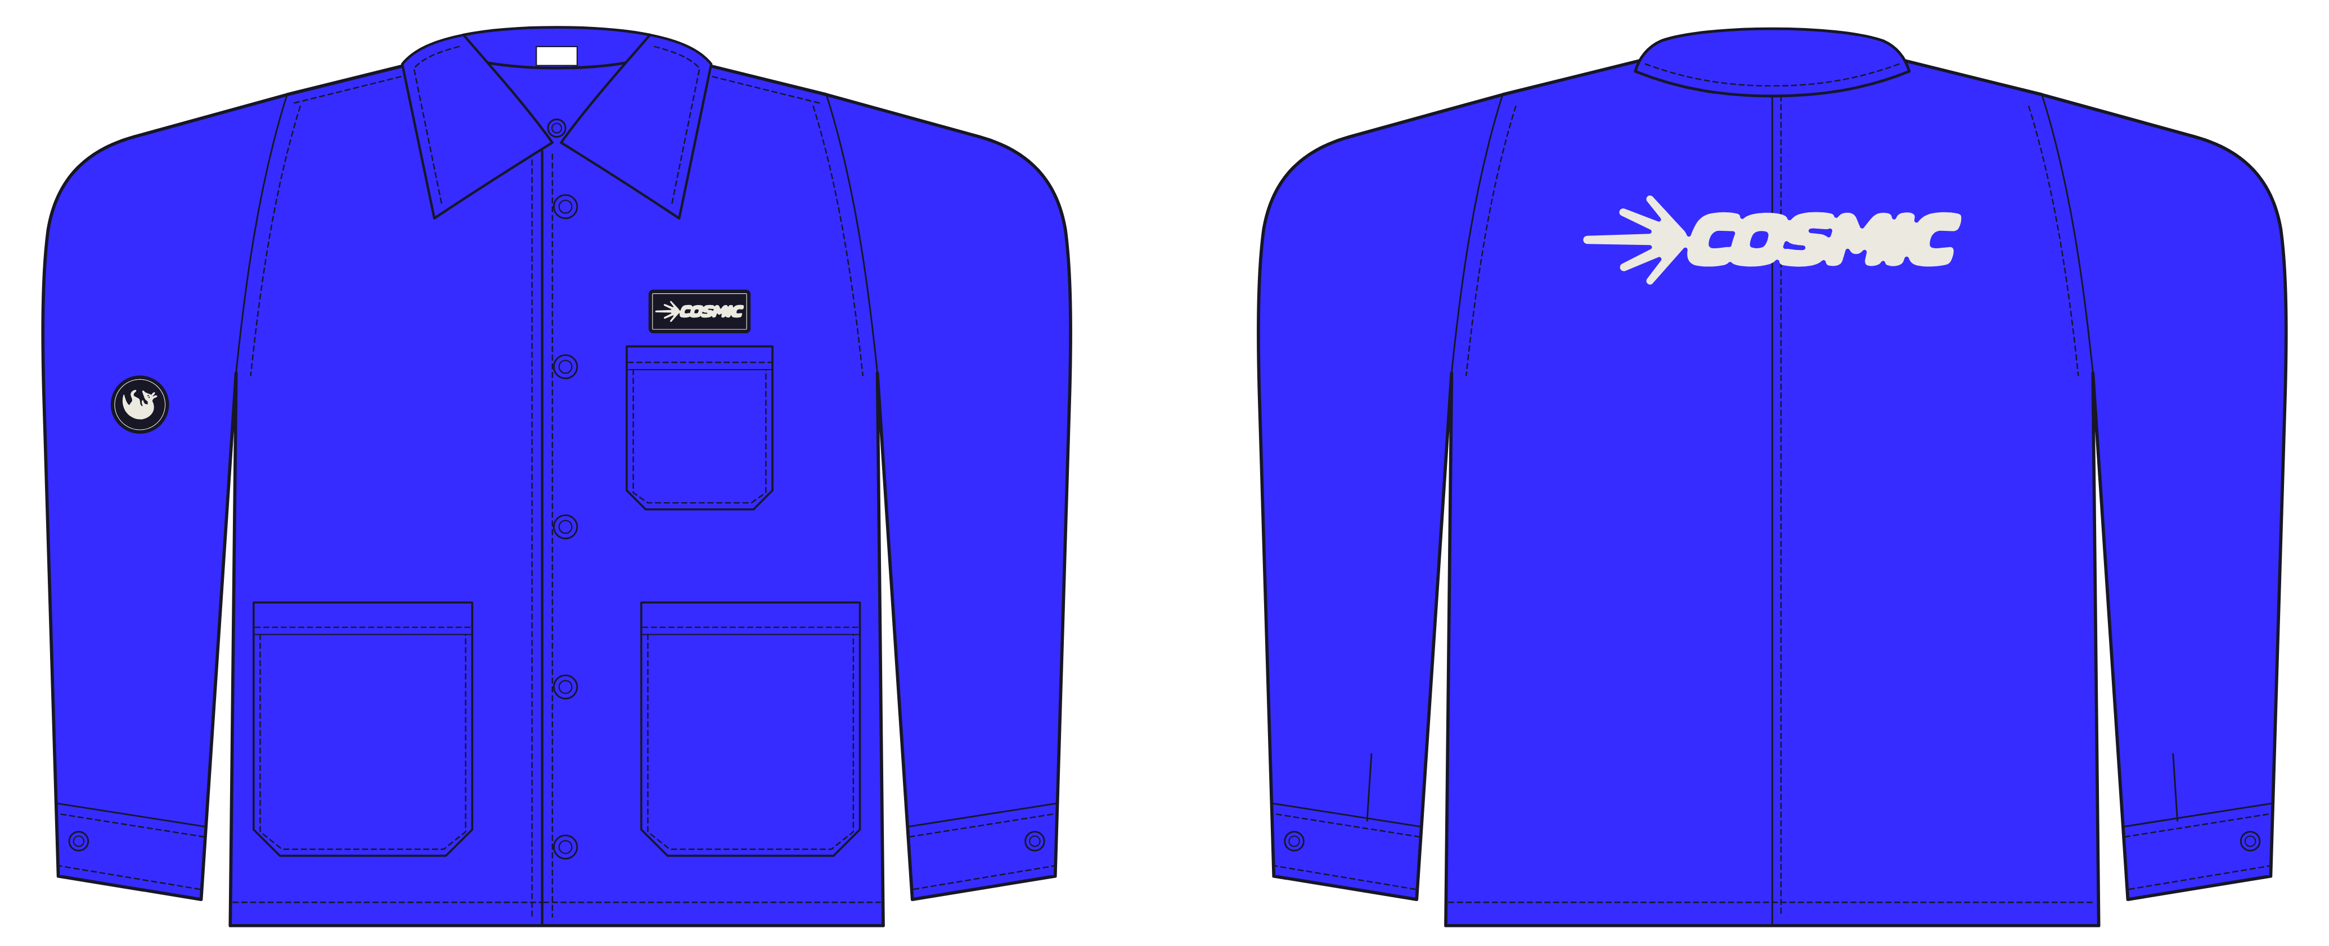
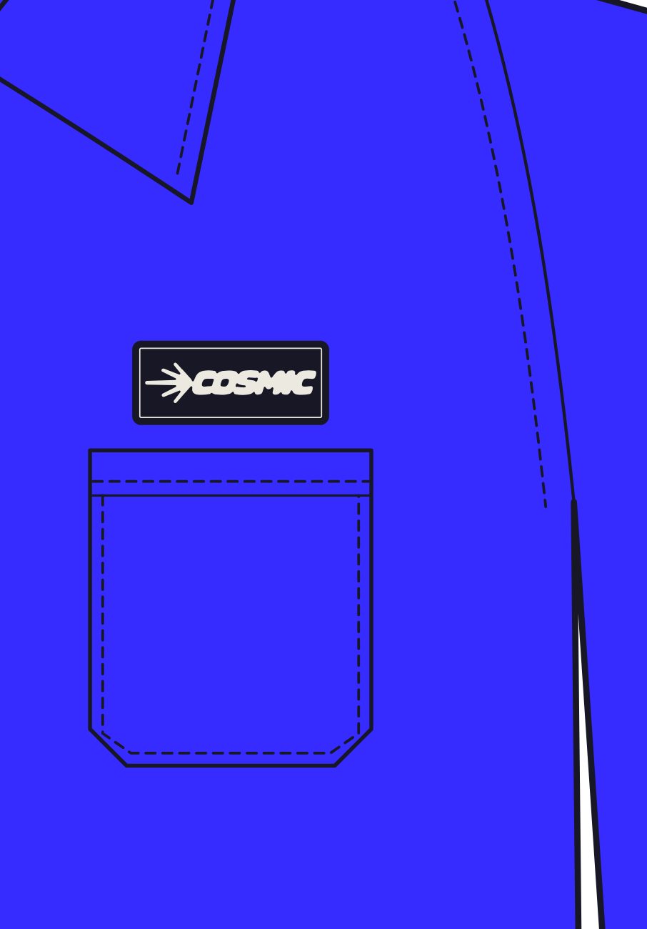
UNIFORMS & MERCH · 07 / 08
JACKET 4, BLUE CREW
Cosmic blue canvas, navy patches, the comet in cream on the back.
CHEST DETAIL
FRONT
BACK
Navy wordmark patch above the pocket, 3.5 in · navy Arlo curl patch on the right sleeve, 2 in
One thing: the comet wordmark, 13 in wide, cream
Cosmic blue canvas (match #362cff), same cut. Navy patches on blue fabric: blue patches would vanish into it.
Notes:
merch/07-jacket-blue

Slide 8
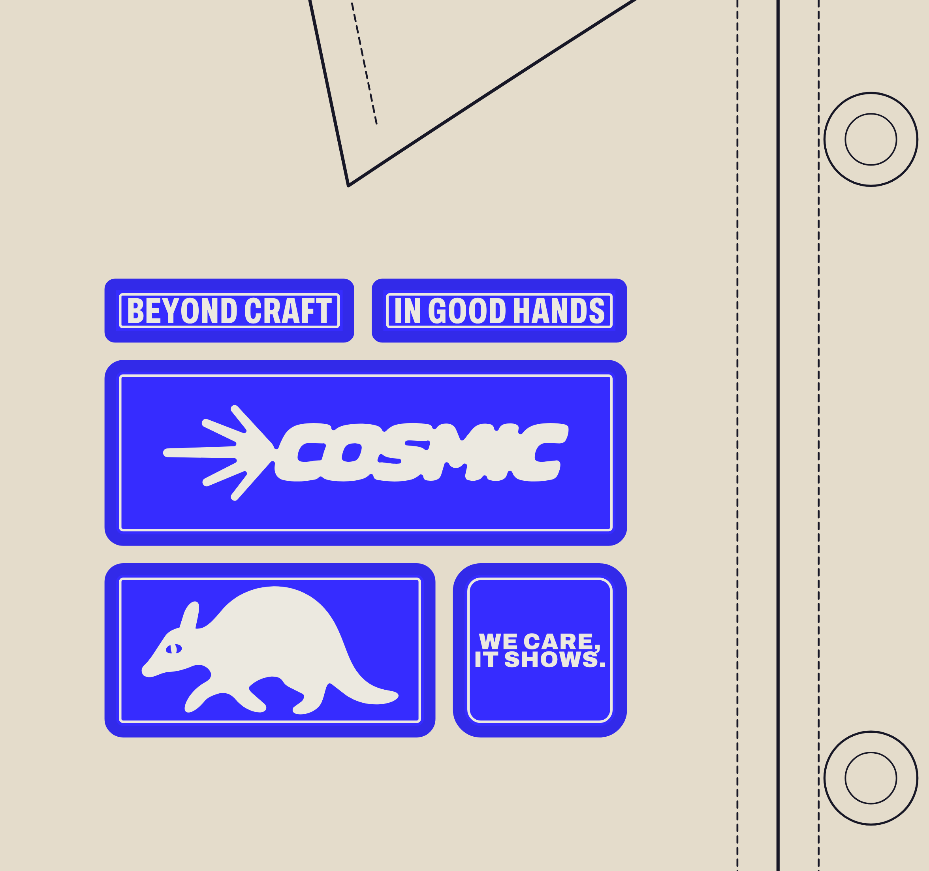
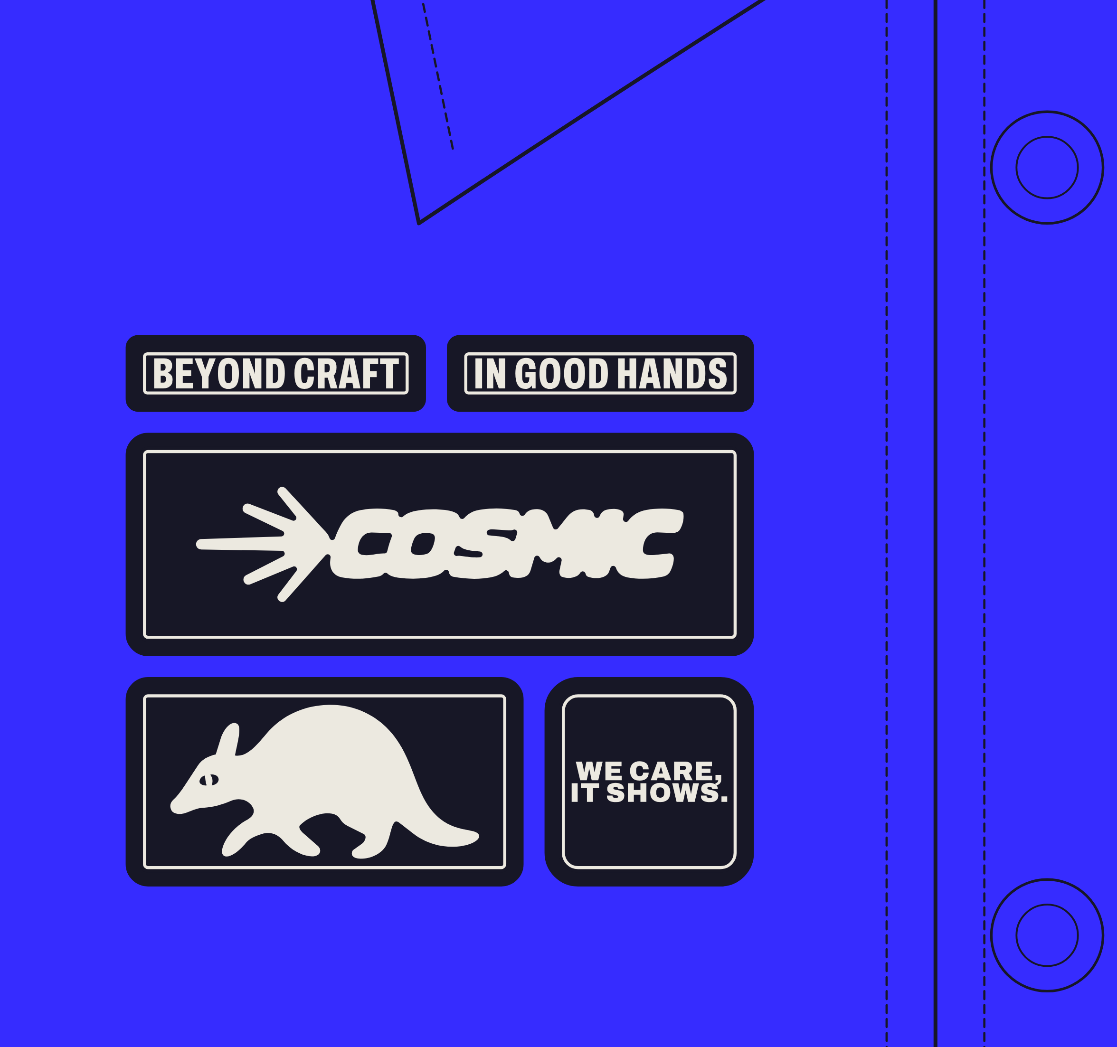
UNIFORMS & MERCH · 08 / 08
CHEST PATCHES
Five patches in one tight column. Blue on canvas, navy on blue.
Block 4.5 x 3.95 in · tapes 2.15 and 2.20 x 0.55 in · wordmark 4.5 x 1.6 in · Arlo 2.85 x 1.5 in · We care, it shows. 1.5 in square · gutters 0.15 in · body-colour merrow, cream keyline
BLUE BLOCK, NATURAL CANVAS JACKET
NAVY BLOCK, BLUE JACKET
Notes:
merch/08-chest-patches

