Slide 1

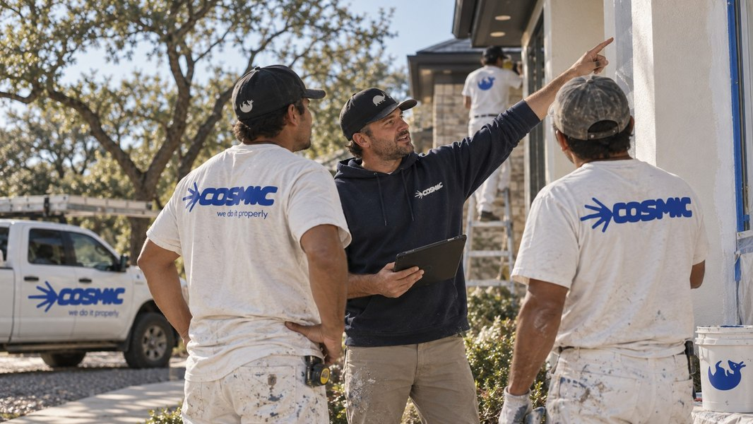

AUSTIN, TX
A NOTE FROM ROBERTO AND CARLOS
SAME PLACES.
DIFFERENT STANDARD.
Painting is the visible part. Trust is the real work. Hiring a contractor shouldn't mean chasing a quote, wondering who's showing up, or finding out about problems after the work has started.
So we built Cosmic around it. New name on the truck, same crew behind it, and a higher standard for every space.
WE CARE,
IT SHOWS.
500+
98%
5.0
spaces improved
on-time completion
average rating
MEET ARLO.
You'll start seeing him around the jobsite. He's the newest member of the crew.
HAVE A PROJECT IN MIND?
Get a clear estimate
[TBC: URL]
· ·
[TBC: HANDLE]
[TBC: PHONE]
Notes:
newsletter/01-launch

