Slide 1


THE COSMIC STANDARD
WE CARE,
IT SHOWS.
Property services. Done properly.
Notes:
posts/01-promise

Slide 2
WHY COSMIC
A HIGHER STANDARD FOR EVERY SPACE
SPACES IMPROVED
500+
Homes. Business. Everything in between.
ON-TIME COMPLETION
98%
Projects get finished when we say they will be.
AVERAGE RATING
5.0
We make sure you will be satisfied.
Same places. Different standard.
Notes:
posts/02-stats

Slide 3


WHAT AUSTIN SAYS
“After heavily vetting about 10 contractors to do interior painting for the entirety of our house, I could not be more pleased to have chosen Cosmic.”
BETH REDIX
5 STARS
We care, it shows.
Get a clear estimate
Notes:
posts/03-review

Slide 4
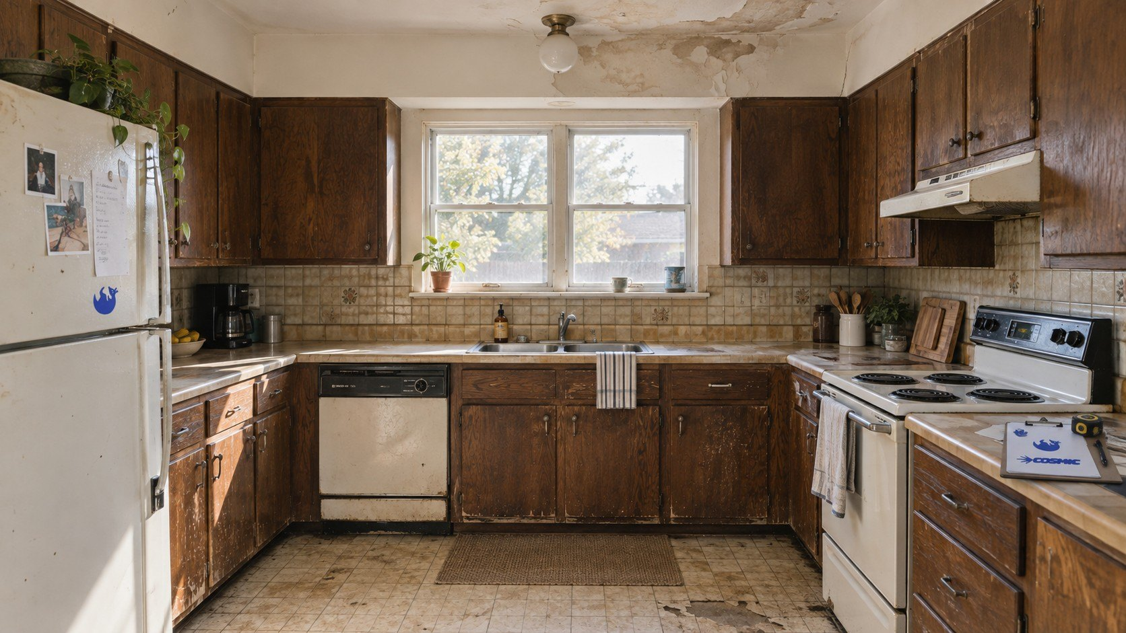
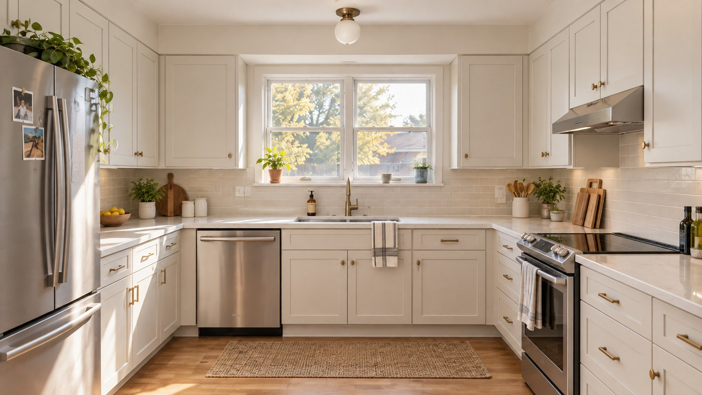

Before
After
CARE.
LEAVE IT BETTER.
Get a clear estimate
Notes:
posts/04-kitchen

Slide 5



OWNER-LED
BUILT
Property services. Done properly.
Notes:
posts/05-built-for-austin

Slide 6








GREATER AUSTIN
WE WORK ALL OVER AUSTIN
Same places. Different standard.
Notes:
posts/06-all-over-austin

Slide 7



GOOD
DESERVES A GOOD WORD
If we’ve worked together, tell Austin how it went.
Leave a review
[TBC: REVIEW LINK]
Notes:
posts/07-good-word

Slide 8



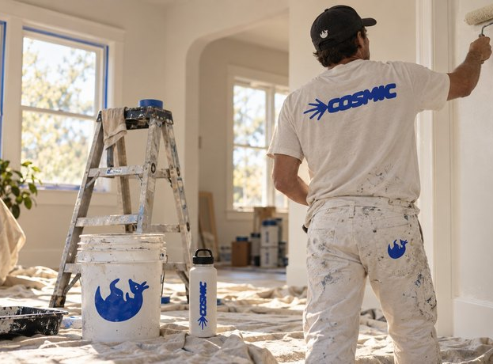
WHAT WE DO
Property services. Done properly.
Get a clear estimate
Notes:
posts/08-services

