Slide 1


WE CARE,
IT SHOWS.
A few quick details are enough to get started. We'll take it from there.
Get a clear estimate
[TBC: LINK STICKER URL]
Notes:
stories/01-estimate

Slide 2



GOOD
DESERVES A GOOD WORD
If we’ve worked together, tell Austin how it went.
Leave a review
[TBC: REVIEW LINK]
Notes:
stories/02-leave-a-review

Slide 3

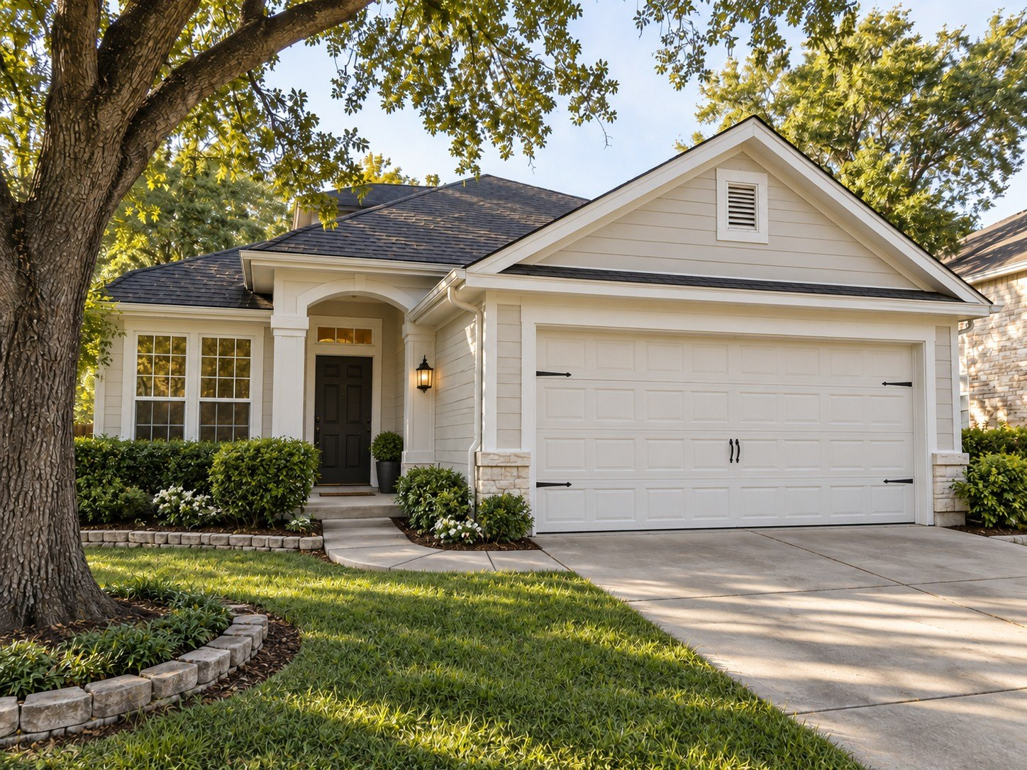
FEATURED WORK
ZILKER HOUSE
Full exterior repaint.
6
4
2,850
WORKING DAYS
CREW
SQ FT
Notes:
stories/03-featured-work

Slide 4
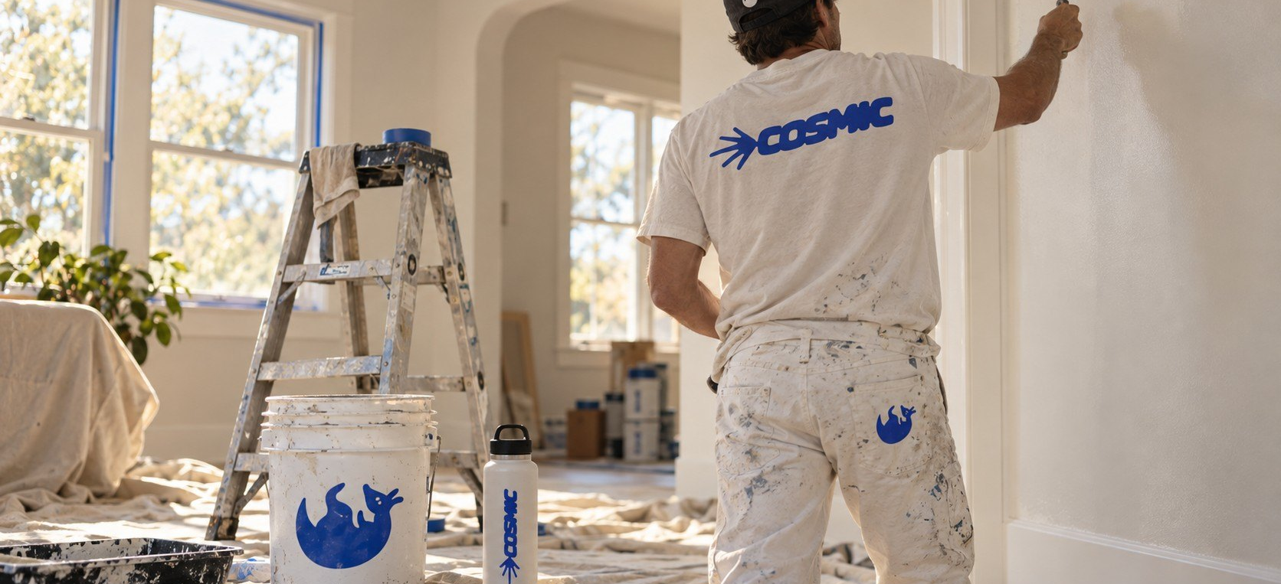
THIS OR THAT
INTERIOR REFRESH OR EXTERIOR REPAINT?
Interior refresh
Exterior repaint
Notes:
stories/04-this-or-that

Slide 5



REFERRAL PROGRAM
GOOD WORK SHOULD KEEP WORKING FOR YOU
Refer good people, earn Cosmic Credit, get member perks, and keep your property looked after.
Join now
[TBC: OFFER]
Notes:
stories/05-join-the-circle

Slide 6
QUESTIONS
ASK US ANYTHING ABOUT YOUR PROJECT
Owner-led. We answer.
Type your question...
Notes:
stories/06-question-box

