Slide 1




01 / 06
WHAT
Painting, landscaping, property work and more. We take care of the details so you can enjoy the bigger picture.
Notes:
what-we-do/01-cover

Slide 2
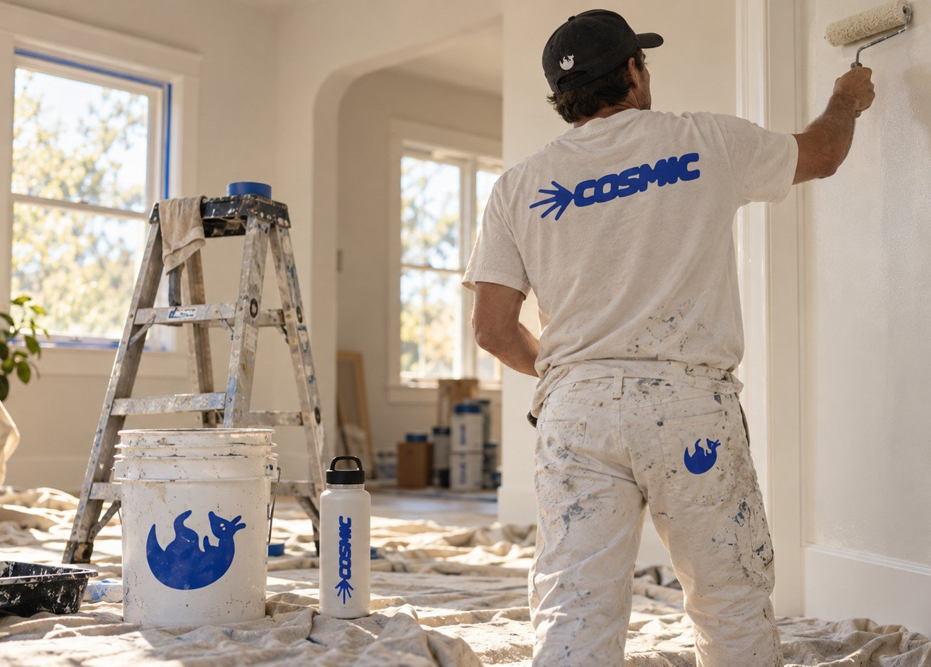

PAINTING
Interiors and exteriors, homes and commercial spaces. Prepped right, finished clean, walked through with you at the end.
INTERIORS · EXTERIORS
02 / 06
Notes:
what-we-do/02-painting

Slide 3





03 / 06
LANDSCAPING
GREENER
SPACES.
HAPPIER
PLACES.
Outdoor spaces cared for with the same attention as the inside.
Notes:
what-we-do/03-landscaping

Slide 4




04 / 06
PROPERTY
WORK
The repairs and upkeep that keep a place in good shape.
WOOD REPAIRS
CAULKING
PRESSURE WASHING
AND MORE
Notes:
what-we-do/04-property-work

Slide 5


05 / 06
HOMES AND
BUSINESSES
01
RESIDENTIAL
Keep the house in good shape.
02
COMMERCIAL
For spaces that keep business moving.
Notes:
what-we-do/05-residential-commercial

Slide 6


06 / 06
LET’S GET
TO
A few quick details are enough to get started. We’ll take it from there.
Get a clear estimate
[TBC: URL]
Notes:
what-we-do/06-cta

