Slide 1

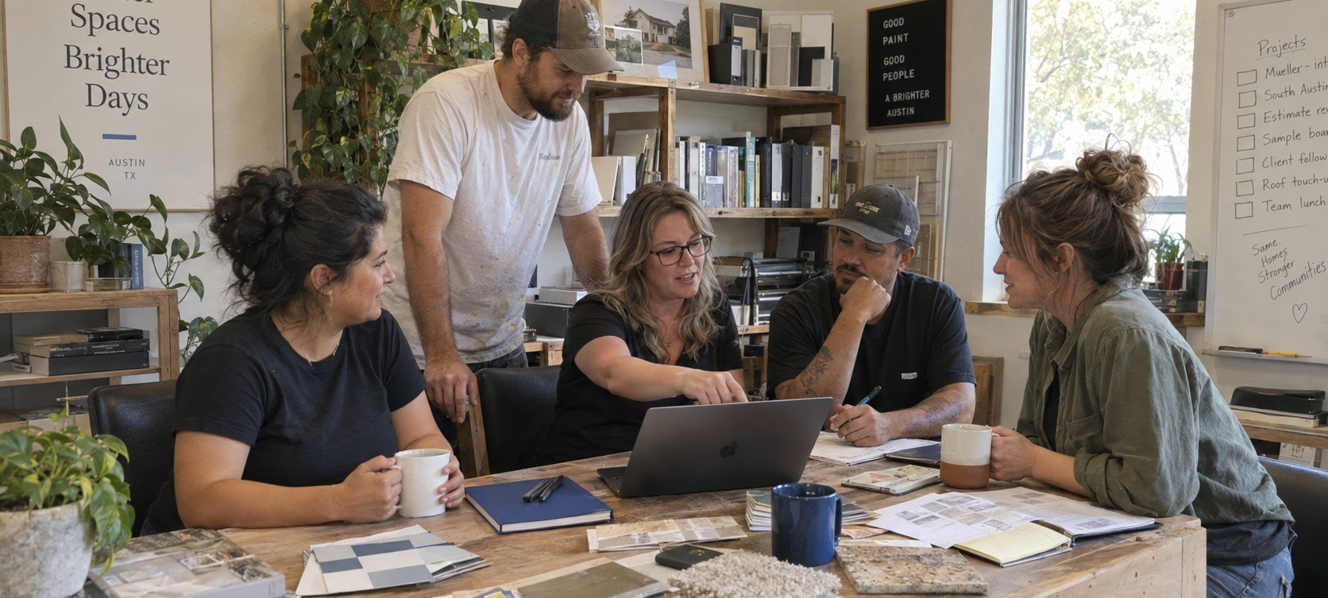
WHO WE ARE
01 / 06
WHO
WE ARE.
A hands-on Austin crew.
Notes:
who-we-are/01-cover

Slide 2
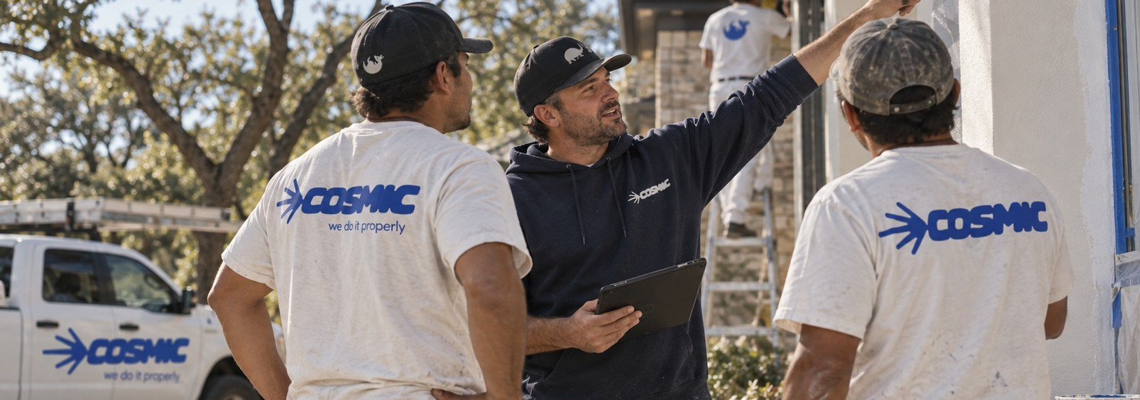
WHO WE ARE
02 / 06
COSMIC,
FROM THE
GROUND UP.
OWNER-LED / AUSTIN-BUILT.
HERE FOR THE LONG HAUL.
Cosmic is a hands-on Austin crew built around clear communication, proper work, and taking responsibility for the spaces we touch.
Notes:
who-we-are/02-ground-up

Slide 3
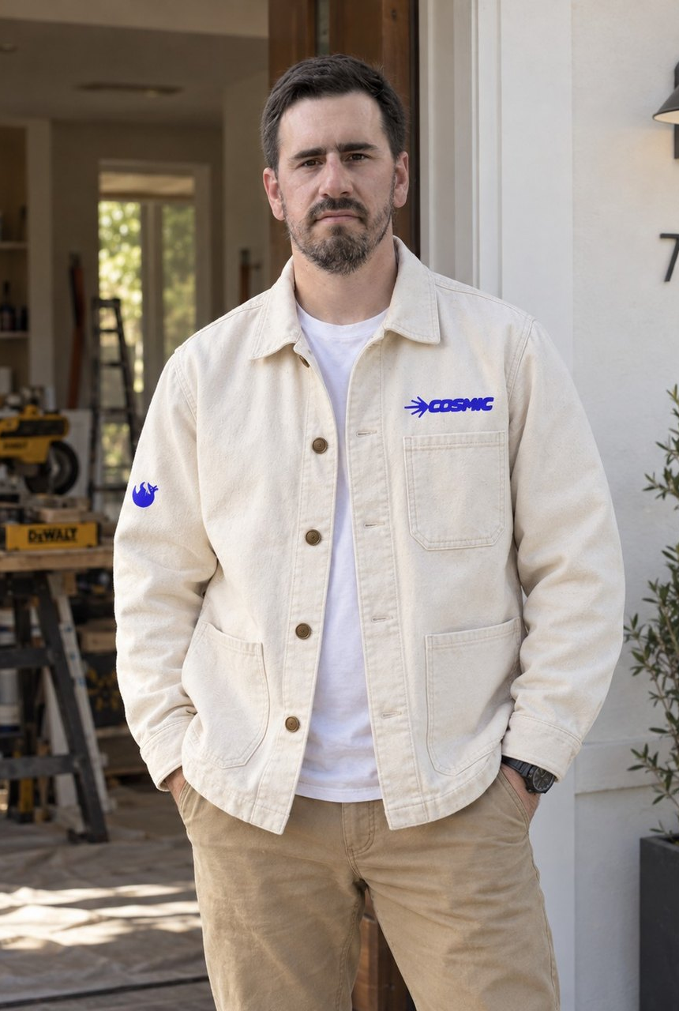

WHO WE ARE
03 / 06
ROBERTO
An architect's eye. A builder's discipline.
Roberto blends an architect's eye with a builder's discipline. He started in commercial construction, moved into single-family spec homes while completing a Master of Architecture at UT, then managed large residential projects and later served as an owner's representative for Austin ISD, delivering and renovating K–12 schools. He also holds bachelor's degrees in Mechanical Engineering and Industrial Engineering, which shape his process-driven approach and attention to detail.
Notes:
who-we-are/03-roberto

Slide 4

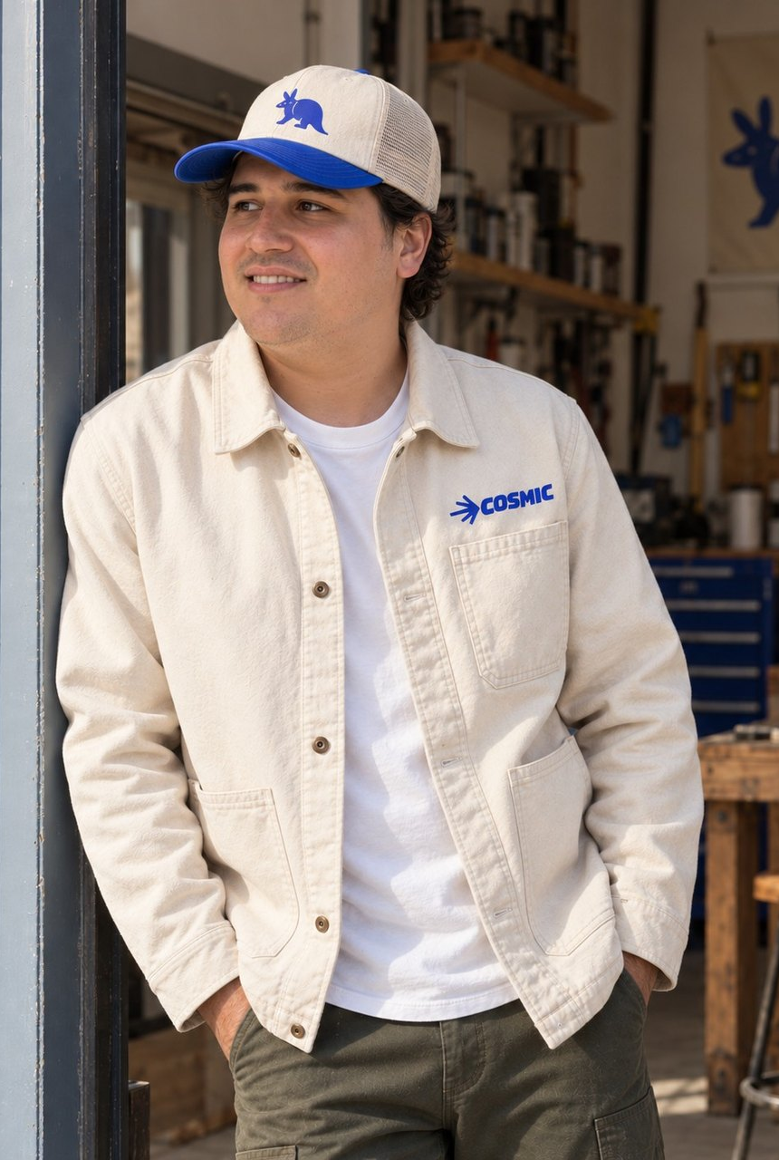

WHO WE ARE
04 / 06
ESTRADA
Customer experience first, every time.
Carlos pairs a strong business foundation with a personal touch. He earned a B.B.A. and an MBA, then built deep experience in home services as a top-performing Senior Project Manager and sales leader. After seeing too many companies put profits before people, he co-founded Cosmic to do it differently — customer experience first, every time.
Notes:
who-we-are/04-carlos

Slide 5



WHO WE ARE
05 / 06
BUILT
Notes:
who-we-are/05-built-for-austin

Slide 6

WHO WE ARE
06 / 06
HERE FOR
THE LONG
HAUL.
Owner-led. Austin-built. We care, it shows.
Get a clear estimate
FOLLOW
[TBC: HANDLE]
Notes:
who-we-are/06-long-haul

