Slide 1


01 / 06
WHY COSMIC
A HIGHER STANDARD FOR EVERY SPACE
Same places. Different standard.
Notes:
why-cosmic/01-cover

Slide 2



02 / 06
01
CLEAR
COMMUNICATION
You’ll always know what’s happening. We provide clear updates, realistic timelines and quick responses, so there are no surprises.
Notes:
why-cosmic/02-clear-communication

Slide 3
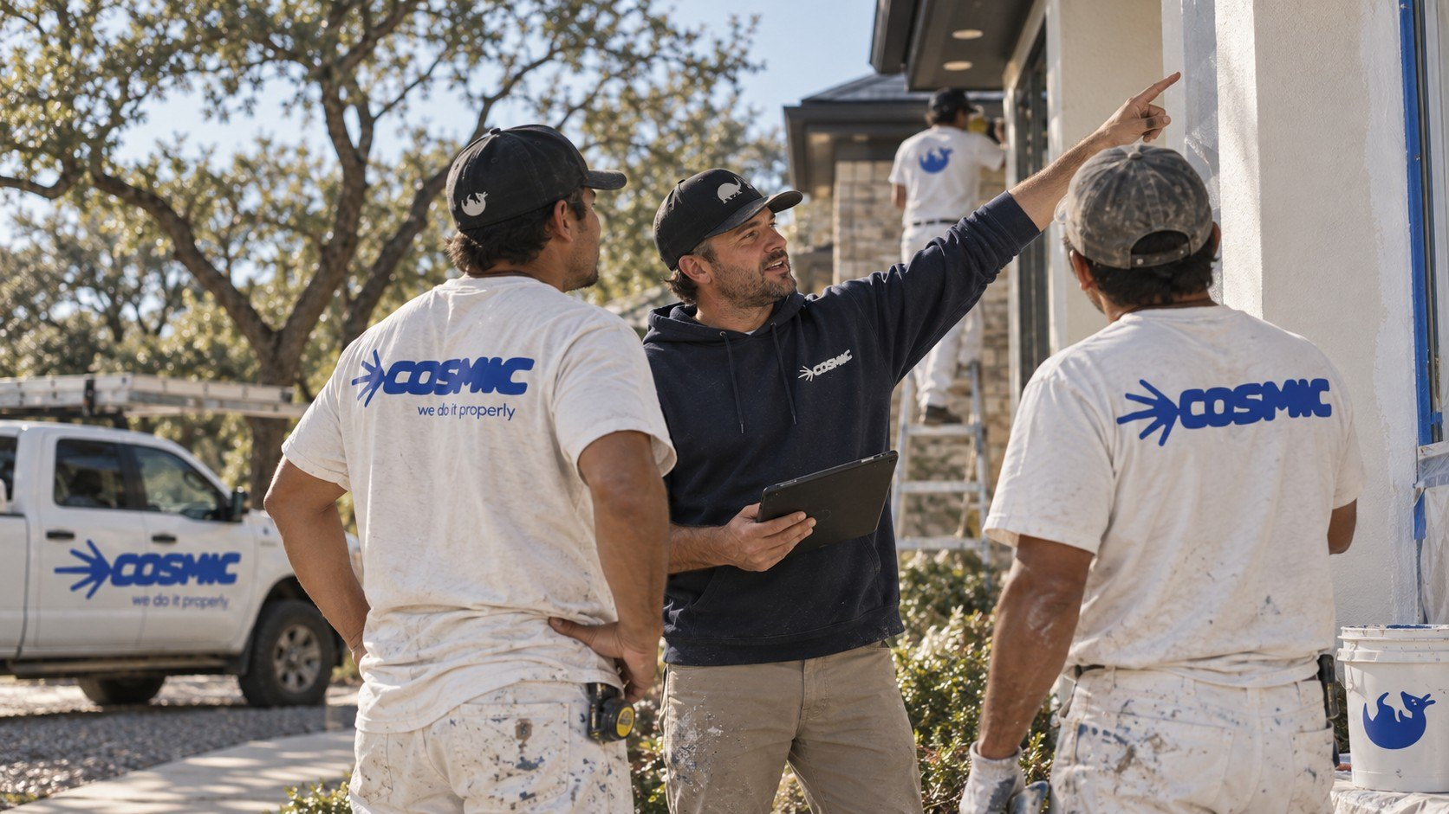
03 / 06
02
BOOTS ON
THE GROUND
A local crew on your site, doing the work in person.
Notes:
why-cosmic/03-boots-on-the-ground

Slide 4


04 / 06
03
ON-TIME
DELIVERY
Projects get finished when we say they will be.
Notes:
why-cosmic/04-on-time

Slide 5
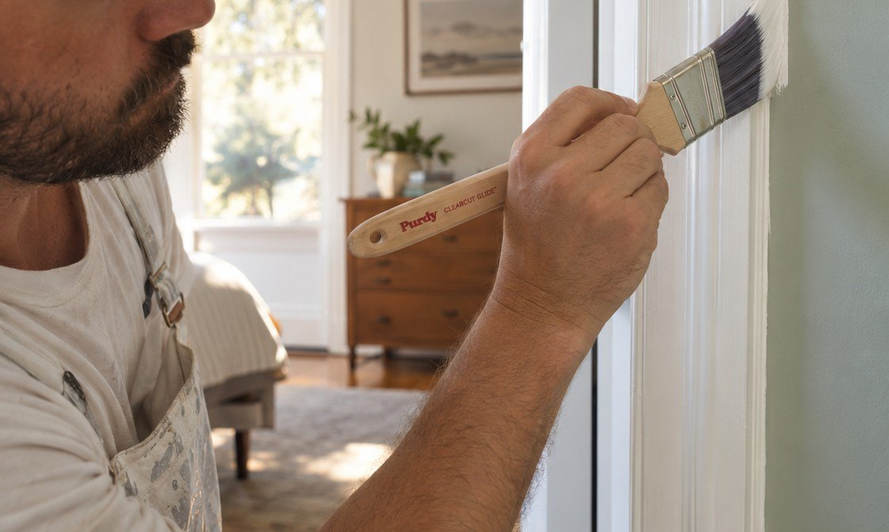
05 / 06
04
CARE FOR
YOUR SPACE
We treat every home and workplace like it matters.
Notes:
why-cosmic/05-care

Slide 6



06 / 06
SAME PLACES.
DIFFERENT
STANDARD.
500+
spaces improved
98%
on-time completion
5.0
average rating
Get a clear estimate
[TBC: URL]
Notes:
why-cosmic/06-the-numbers

