Slide 1

Online Courier Service System

Slide 2
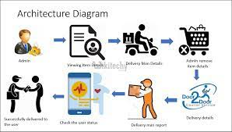
Mini Project on Courier Service SystemNowadays its very important to receive and send many things like important furniture, electronic items, gifts and many more.Courier service system is very easy and allows many users to perform the job simultaneously.The courier service system is all about delivering a product to its destination with the help of their personal details like the address of the receiver and other details.The cost is decided depending on the product and the weight of the product.We also provide an option of quick delivery but it costs a little more.The user will always receive a message whenever his/her order is dispatched or delivered or canceled.It makes the user work easier.

Slide 3
Modules:
Admin module
Delivery module
User module
Admin module: In the Admin module, Admin has all the control over the Websites.The admin plays a major role in this application and only admin can add, view and remove item details.Additionally, the admin has the possibility to add or remove the delivery person.Before doing the above-mentioned process, at first, the admin has to create a separate login in that Web application.

Slide 4
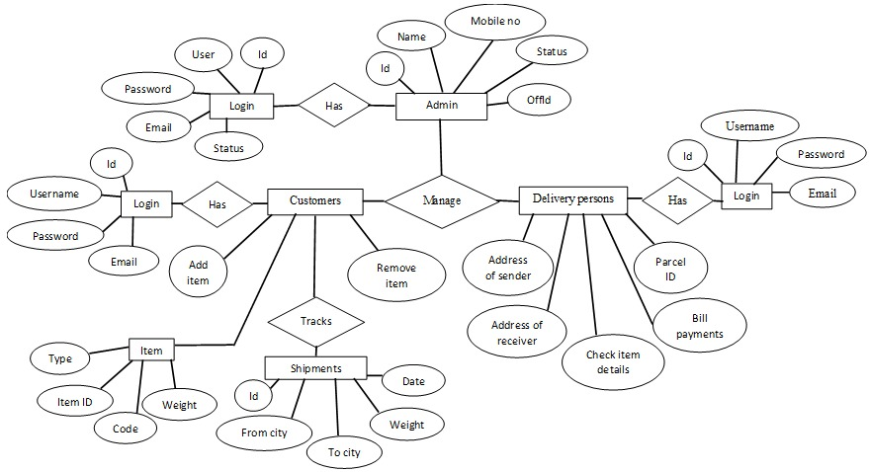
Delivery module
In this module, the details of the delivery man are notifiedA delivery person gets a notification whenever admin matches the delivery person with some order.Here the delivery person goes to the user/sender, takes the item and checks the weight of the item.After all this process the delivery person delivers the item to the receiver.Delivery person’s job is done when the order got delivered.
User module
Here in this module user has to enter the personal details like name, mobile number, the address of the user as well as the receiver, Aadhaar number.The user should also enter the details of the item like the weight of the item and name.And the order gets placed.ER Diagram:

Slide 5






Technologies Used:

Slide 6
THANK YOU

