Slide 1


Entity Linking WPI GQP
Project Updates
Team members
Kratika Agrawal, Vandana Anand, Xinlu He,
Min Huang, Soumya Joshi, Jing Yu
Week 11 - Nov.9th

Slide 2
Latent Relations paper updates
Done
Implementating Latent Relations Github Training Model
Debugging the code to load the output file
Importing BT dataset into model
Testing the Latent Relations Model
In Progress
Improving the bt dataset processing work
Next Step
Finding Optimal value of k for the training model
Improving the test results

Slide 3
Latent Relations paper updates
Input BTdataset Format:
{‘mention’, ‘context’:[leftctx,rightctx], ‘candidates’:[entityname, priorprob], ‘gold’, ‘conll_doc’:{ ‘sentences’: splitted lists of sentences in the article, ‘mentions’: the position of all the mentions in the list}, ‘conll_m’: the position of each mention in the list}
e.g. {"1.json": [{"mention": "United States", "context": ["A ", " federal air marshal shot dead on Wednesday an American Airlines passenger named Rigoberto Alpizar on American Airlines Flight 924 a Boeing 757 at Miami International Airport in Miami Florida USA …. three shots"], "gold": ["United States of America", 1e-05, -1], "candidates": [["United States", "0.944"], ["United States men's national soccer team", "0.009"], ["United States of America", "0.007"], ["United States women's national soccer team", "0.004"], ["United States national rugby union team", "0.002"], ["United States men's national ice hockey team", "0.002"], ["Secondary education in the United States", "0.002"], ["United States national rugby league team", "0.001"], ["United States men's national basketball team", "0.001"], ["United States national cricket team", "0.001"], ….."conll_doc": {"sentences": [["A", "United", "States", "federal", "air", "marshal", "shot", "dead", "on", "Wednesday", "an", "American", "Airlines", "passenger", "named", "Rigoberto", "Alpizar", "on", "American", "Airlines", "Flight", "924", "a", "Boeing", "757", "at", "Miami", "International", "Airport", "in", "Miami", "Florida", "USA"], ["The", "44yearold", "passenger", "ran", "out", "of", "the", "door", "of", "the", "airplane", "after", "he", "reboarded", "the", "plane", "following", "a", "customs", "check", "in", "Miami"], ["He", "was", "intercepted", "by", "the", "marshals", "before", "reaching", "the", "jetway", "and", "told", "to", "get", "on", "the", "ground"], ["According", "to", "Air", "Marshal", "Service", "spokesman", "Dave", "Adams", "the", "passenger", "did", "so", "but", "then", "reached", "for", "a", "bag", "at", "which", "point", "a", "marshal", "fired", "two", "or", "three", "shots", "and", "killed", "the", "passenger"], ["The", "passengers", "recall", "that", "they", "heard", "up", "to", "six", "shots"],......], "mentions": [{"sent_id": 0, "start": 1, "end": 2}, {"sent_id": 0, "start": 11, "end": 12}, {"sent_id": 0, "start": 15, "end": 16}, {"sent_id": 0, "start": 11, "end": 12}, {"sent_id": 0, "start": 23, "end": 24}, {"sent_id": 0, "start": 26, "end": 28}, ……….]}, "conll_m": {"sent_id": 0, "start": 1, "end": 2}},

Slide 4
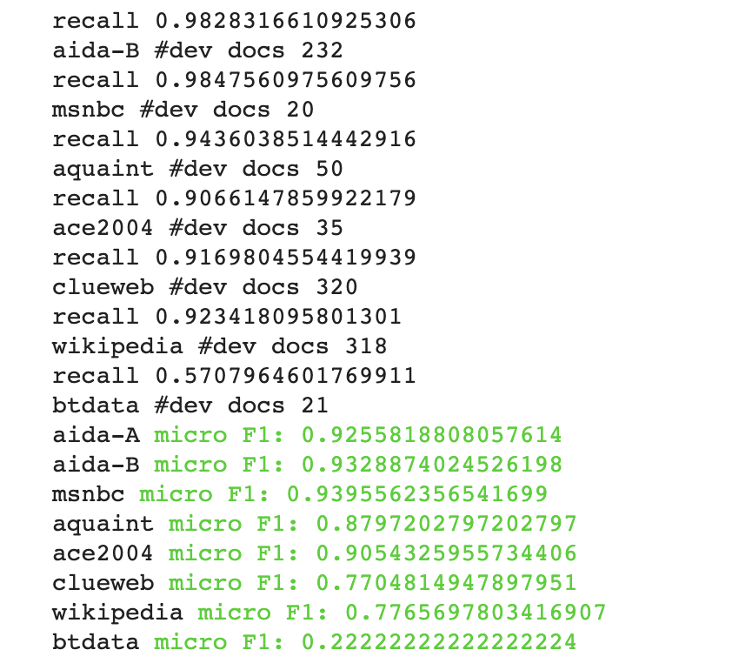
Latent Relations paper updates
Reasons might be:
Transformed mentions when selecting candidates and calculating their frequency
Neglect some errors when processing the bt dataset
Other reasons related to the model

Slide 5
End2End paper updates
Done
Preprocessing AIDA dataset and understanding the steps required for the BT data
Training/Testing AIDA dataset as well as training other datasets (ex. Wikipedia)
Comparing scores among other models
In Progress
Transforming BT Dataset
Testing
Next Step
Improve accuracy scores and BT’s model

Slide 6
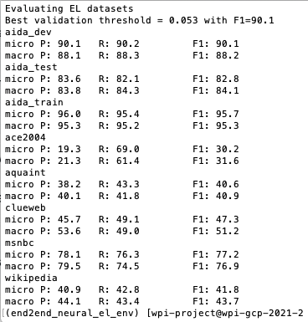
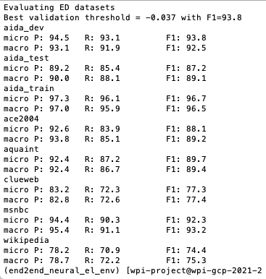
End2End - Training
Entity Linking Training
Entity Disambiguation Training
Model
Performance
Notes:
ED performed a lot better than EL especially for the Wikipedia dataset
The training model on different datasets for both EL and ED performed a bit worse overall than the latent model whose wiki training was the lowest performing dataset at 77%. However here, the Wiki dataset is at 74-75% which is lower.
Micro/Macro - For EL, these metrics are computed both in the strong matching and weak matching settings. Micro requires exactly predicting the gold mention boundaries and their entity annotations, whereas Macro gives a perfect score to spans that just overlap with the gold mentions and are linked to the correct gold entities.

Slide 7
End2End - Training/Testing AIDA
Entity Disambiguation | Train Score | Test Score | Test Precision | Test Recall
Best Scores | 92.2% | 85.7% | 88.5% | 83%
Entity Linking | Train Score | Test Score | Test Precision | Test Recall
Best Scores | 62.9% | 56.8% | 57.5% | 56.1%
Using all Spans Best Score | 89.1% | 80.1% | 83.5% | 76.9%
Notes:
While processing the BT dataset, we trained and tested the AIDA data to see what we could expect. We used the base model for EL and ED training/testing on the AIDA dataset which ran overnight and obtained these scores. We expect to see similar or lower scores for the BT dataset because it will be smaller. The AIDA dataset has more than 502K data points.

Slide 8
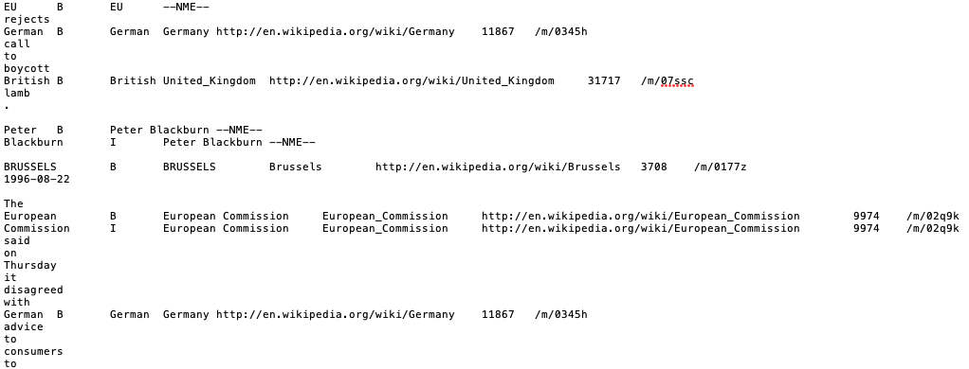
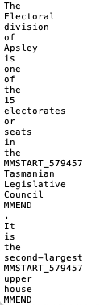
End2End - BT data processing
AIDA Dataset Processing
Wikipedia Processing

Slide 9
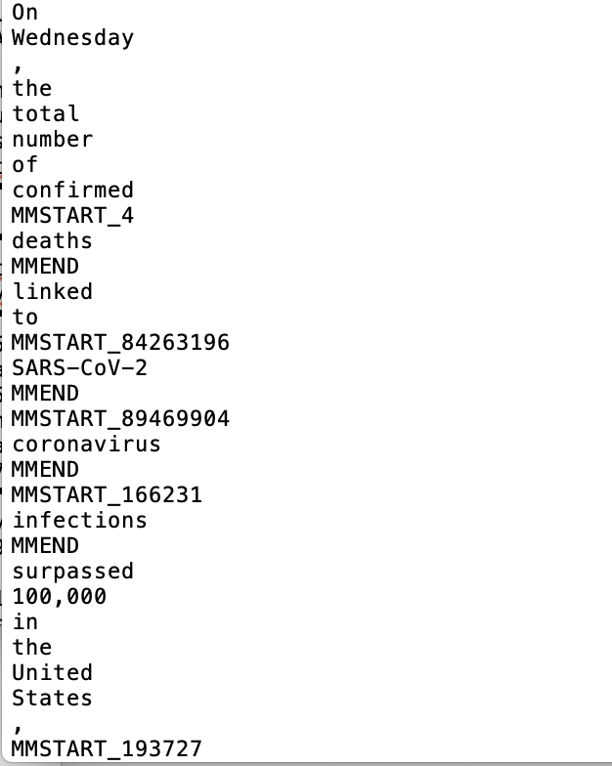
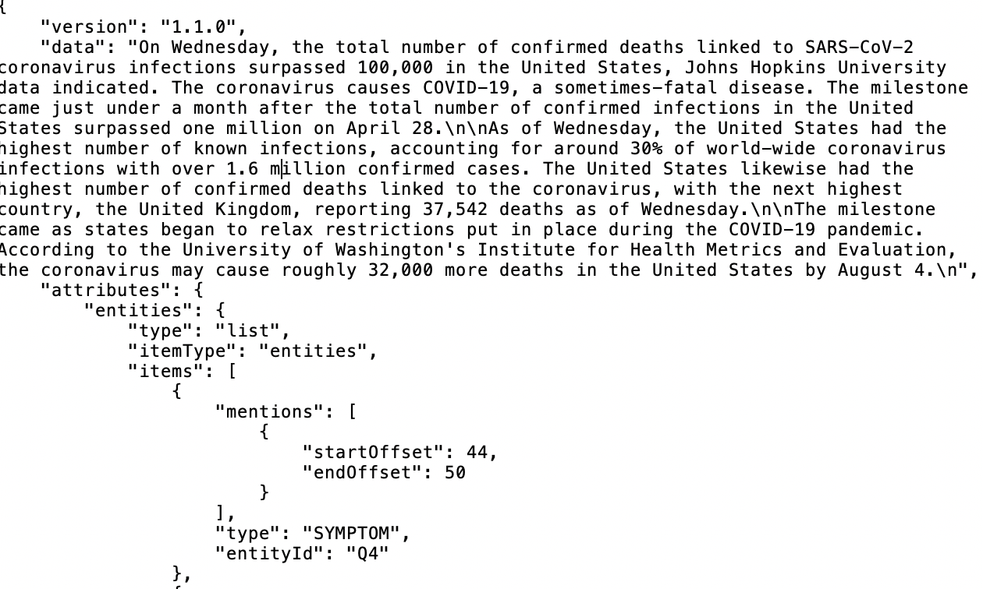
End2End - BT data processing

Slide 10
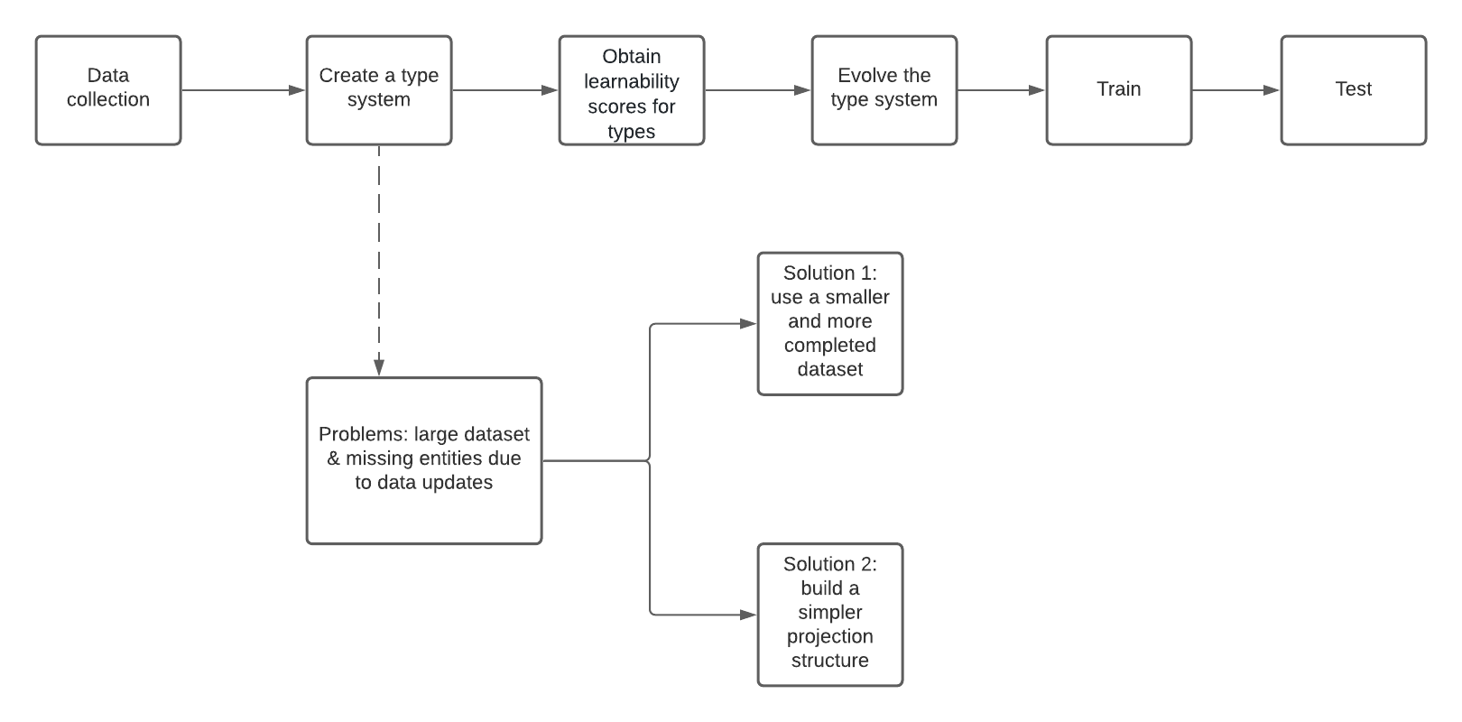
DeepType Implementation Workflow

Slide 11
DeepType Implementation Updates
Approach 1
Problems
Getting categories for each article from AIDA dataset
AIDA articles do not include categories information
tried to extract categories using topic model (LDA) but not getting meaningful results
Building the graph between AIDA entities and AIDA articles
some entities just appear in one article, makes it hard to build a complete graph
Two possible ways for future work
returning to wikidata + wiki articles with more dedicated preprocessing (still need to deal with the large dataset)
building a graph between AIDA articles & AIDA entities similar to wikidata & wiki articles

Slide 12
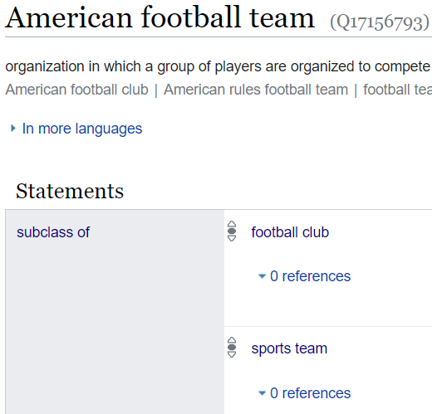
DeepType Implementation Updates
Approach 2
Obstacles:
created one big knowledge graph using Candidate Entities for each mention in all train text document
simplified type_classifier dataframe to consider few scenarios
Issue in prioritizing relations among all

Slide 13
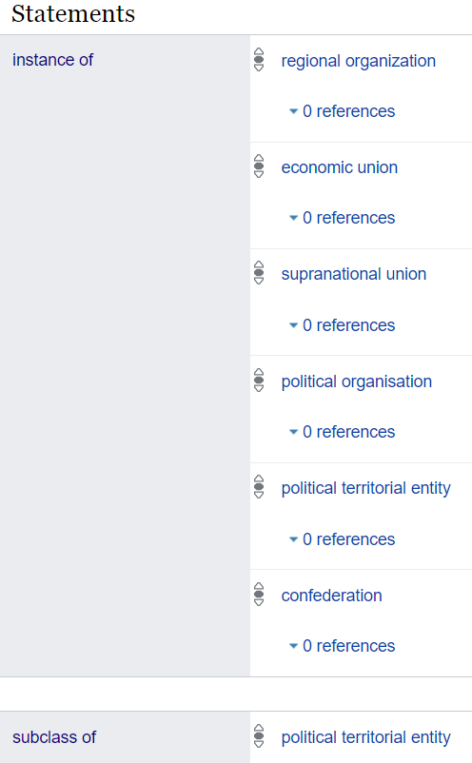

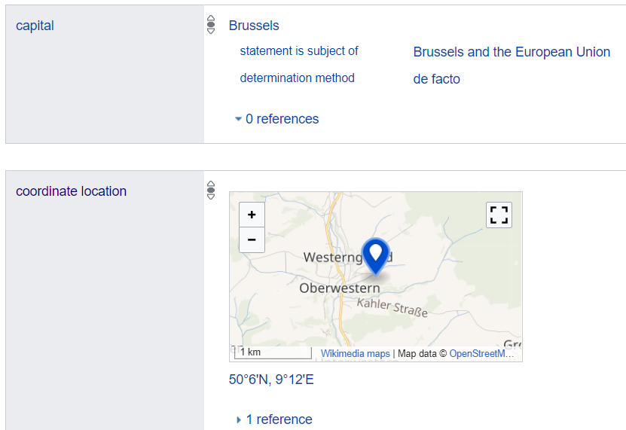
DeepType Implementation Updates

Slide 14
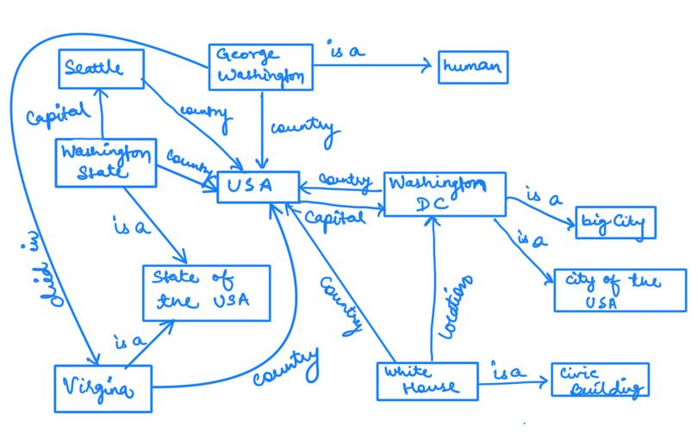
DeepType Implementation Updates
S1: Washington died in Virginia
S2: Washington has city Seattle
S3: The White House office in Washington

Slide 15
Graph Neural Entity Disambiguation
Embed Entities using pre-trained Embeddings
Global Semantic Relations:
Build heterogeneous knowledge graph for candidate entities of all mentions in each document using the knowledge base (build n graphs for n train documents)
Apply Graph Convolution Network(GCN) to generate new set of entities
Apply Conditional Random Fields (CRF) to combine global and local information.
https://www.sciencedirect.com/science/article/pii/S0950705120300861?casa_token=0idD_JcfthQAAAAA:XonjVr3nhPRqcOm3U9_d4tE25dBecv4X-x7lZtw47HkDkXjvWKe0qARlw3g40IFkyvNlPICXqw#!

