Slide 1


Entity Linking WPI GQP
Project Updates
Team members
Kratika Agrawal, Vandana Anand, Xinlu He, Min Huang, Soumya Joshi, Jing Yu
Week 12 - Nov.16th

Slide 2
Latent Relations paper updates
Done & In Progress
Finding Optimal value of k for the training model Improvement
Github Code review completed
Some doubts regarding multiple variables handling the mention entity relations
Training model improvement is in progress
Improving the bt dataset processing work
Improving the test results

Slide 3
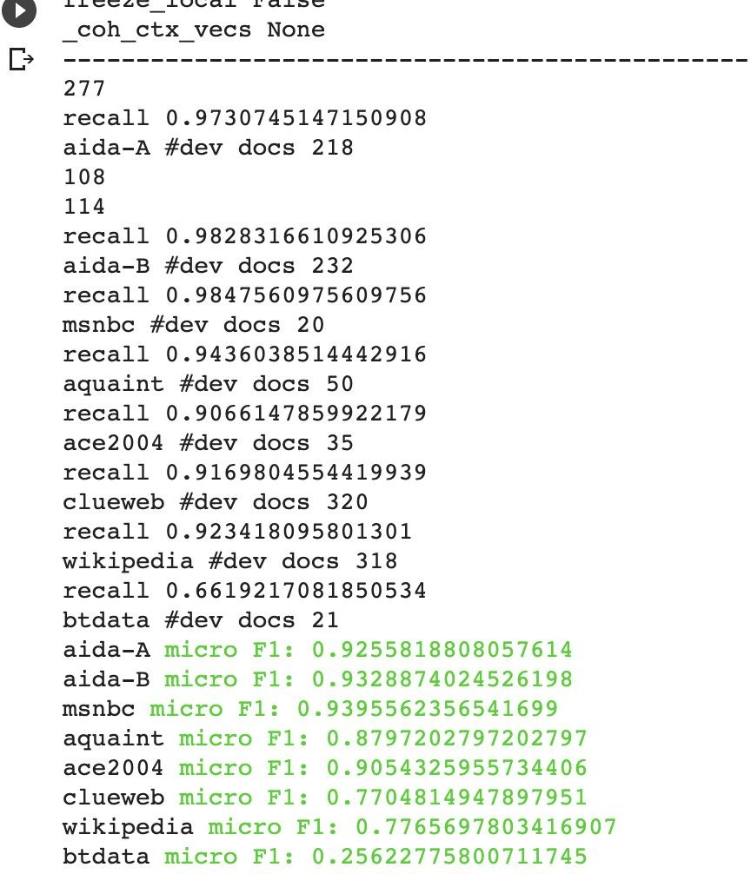
Latent Relations paper updates
Poor testing result might be caused by
Processing error
Candidates selection( to get at least 10 candidates)
Basic processing (lower(), Remove the special symbol)
Transfromed Mentions
Loop: e.g. air marshal service - air marshal - marshal service - air - marshal -service (break when got 10 candidates)
Might bring errors
Approach:
Only keep basic processing work
Total Mentions : 452
Mentions with more than 10 candidates: 273
Testing result : F1: 0.256
improved little

Slide 4
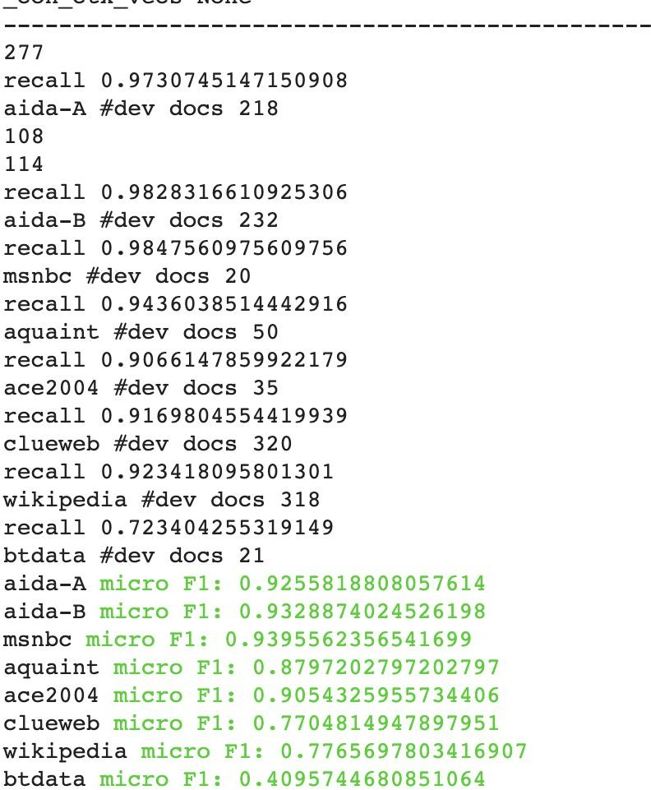
Latent Relations paper updates
Poor testing result might be caused by
Other reasons related to model
Training data: original data from the paper
Model:
used pretrained context and entity embeddings baed on wiki2014textfile
local context Approaches:
Using new version wikipedia text file to train model
too large - not feasible
Using old version wikipedia text file to select candidates and calculate frequency
Total Mentions : 452
Mentions with more than 10 candidates: 188
Testing result : F1: 0.409

Slide 5
Latent Relations paper updates
Hard to improve the testing result
Used old version data to train the model while using new version data to test the model
local context
Secondary context (the sentence where the mention from)
latent relations of mentions
The dataset is small
could not be used to train

Slide 6
End2End paper updates
Done
Preprocessing AIDA dataset and understanding the steps required for the BT data
Training/Testing AIDA dataset as well as training other datasets (ex. Wikipedia)
Comparing scores among other models
In Progress
Testing with BT Dataset
Impoving the methods to transform the BT Data set as the input
Next Step
Improve accuracy scores and BT’s model

Slide 7
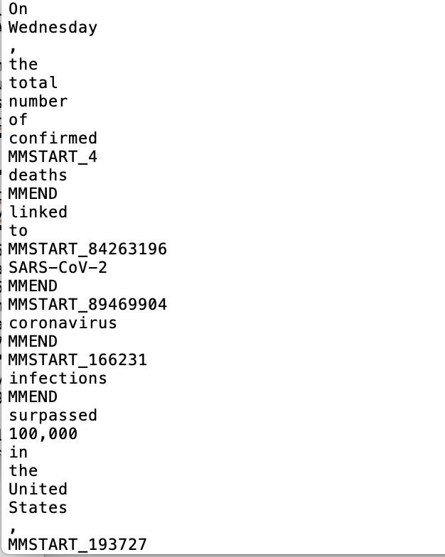
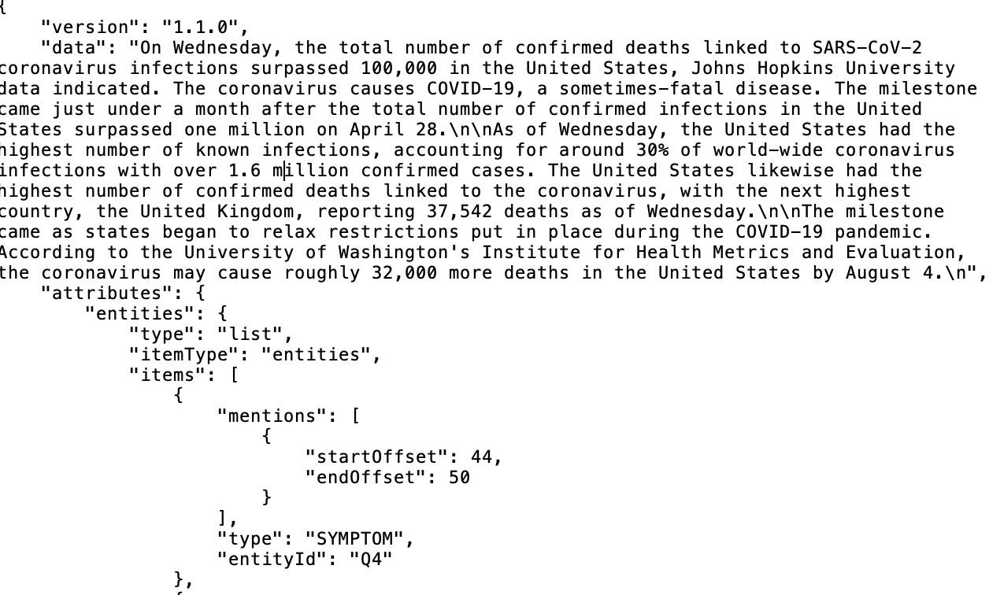
End2End - BT data processing

Slide 8
End2End - Training
Preprocessed the BT Dataset and did Word2Vec conversion, but facing some errors when trying to put it in the testing model -> Invalid Argument Error
Trying to see if there is another way to preprocess BT dataset by converting documents to an XML format file or train from the entity vectors
Tried with small sample size, need to process more of the BT documents

Slide 9
Robust Disambiguation
Disambiguation Technique that combines three measures:
Prior probability of a mentioned entity
Similarity between the context of the mention to candidate entities
Coherence among candidate entities for all mentions together
These steps will build a weighted graph of mention and candidate entities.
Compute a dense sub-graph that approximates the best joint mention-entity mapping

Slide 10
Prior Probability:
Identify all mentions in a text document
List all candidate entities for each mention using WikiSearchAPI
Prior Probability: a measure of popularity of an entity
Defines the “frequencies” based on Wikipedia link anchor text referring to specific entities.
For each surface form that constitutes an anchor text, count how often it refers to a particular entity: it is an estimate of probability distribution over candidate entities.
Eg: “Kashmir” refers to
Kashmir (the region) in 90.91% of all occurrences, Kashmir (Song) in 5.45%.

Slide 11




Context Similarity:
Two approaches:
For each mention, construct a context from all words in the input text.
It represents mention as set of weighted words or phrases
For each candidate entity, KP(e) => keyphrase set
For each word w in keyphrase: compute specificity weight => the MI (Mutual Information) between entity e and keywork w
Also allows partial matches of entities’ keyphrases in the text. The score for partially matching phrase q in a text set is:
where,
= MI weight or IDF weight of keyphrase word w
Aggregated Similarity Score for all keyphrase words:

Slide 12
Context Similarity:
Two approaches:
Consider similarity score based on syntactically-parsed context
Associate each entity with characteristic key phrases or words.
Eg: “Page”
Larry Page: keyphrases like “Stanford”, “search engine”, etc. Jimmy Page: keyphrases like “Gibson guitar”, “hard rock”, etc.
Compute similarity measure between a mention and entity candidates.
Train using large corpus to collect statistics to rank candidate entities as per their compatibility with the verb
Consider a set of substitutes for each possible entity e, which is taken as its context cxt(e)
Syntax-based similarity between cxt(e) and cxt(m) => sum of the scalar-product similarity between two vectors for each substitute.

Slide 13
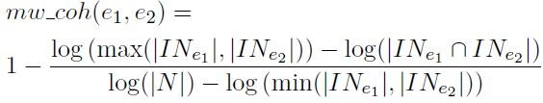
Coherence among Entities:
Coherence among two entities => the number of incoming links that their Wikipedia articles share
where, IN = Incoming links
N = Total number of entities
It’s based on the notion that entities that co-occur in a text document have some semantic relationship or have the same semantic type
Eg: Most texts deal with a single or few semantically related topics, like, rock
music, internet technology or global warming and not all together
Distance between two entities => type and subclassOf edges

Slide 14
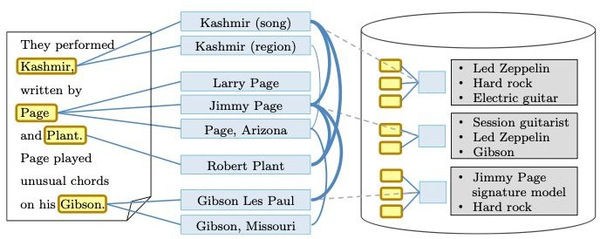
Graph Modelling:
based on coherence score
based on popularity prior & similarity score

Slide 15
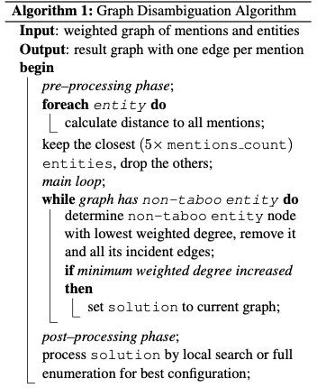
Graph Algorithm:
An entity is taboo if it is the last candidate for a mention it is connected to

Slide 16
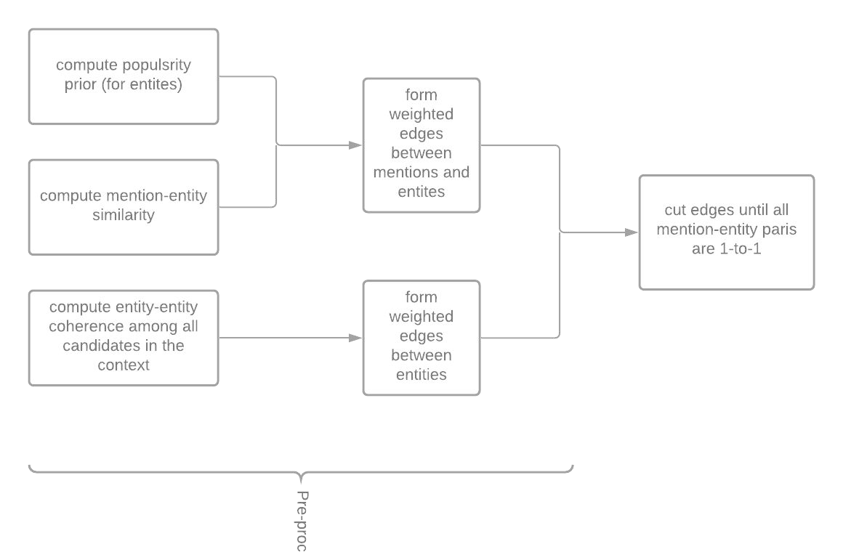
Flow Chart

Slide 17

Robustness Tests:
Prior Test:
For each mention, if probability prior is above some threshold, eg. 90%, use priors, otherwise disregard in computing mention-entity edge weights.
Coherence Test:
Compute L1 distance between prior probability and similarity-only measure
If the difference is more than a threshold, then Coherence test might fix it
Else, if the difference is less than the threshold, then Coherence test might add risk for thematically heterogeneous text

Slide 18
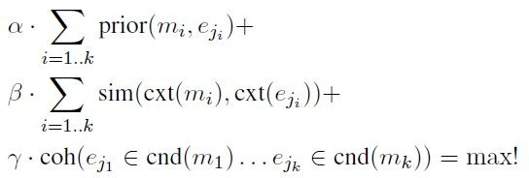
Overall Objective:
For each mention m_{i}, i=1...k, select entity candidates e_{ji}:

Slide 19
Parameter Tuning
Using SVM classifier on CoNLL training set to find optimal values of parameters in the objective function
Turn to CNN to do the tuning job?

Slide 20
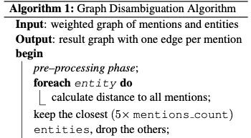
Queries:
1. In the preprocessing part of the algorithm, why it starts from an entity node instead of a mention node?
2. How the SVM classifier works in parameter tuning? Are classes defined as True (linking to the right entity) & False (not linking to the right entity) ?

Slide 21
References:
Research Paper Reference: https://www.aclweb.org/anthology/D11-1072.pdf
AIDA System usage guide: https://github.com/codepie/aida

