Slide 1


Entity Linking WPI GQP
Project Updates
Team members
Kratika Agrawal, Vandana Anand, Xinlu He,
Min Huang, Soumya Joshi, Jing Yu
Week 14 - Nov.30th

Slide 2
Latent Relations paper updates
Done
Completed training work with different sizes of bt docs
Completed testing work
In Progress
Organizing the code and preparing for final presentation
Next Step
Preparing the 5 min Slides and Video for the GRIE event

Slide 3
Latent Relations paper updates
Testing results:
Training docs | Original | Original+ 10docs | Original+ 20docs | Original+ 30docs | Original+ 40docs | Original+ 50docs | Original+ 60docs
Testing1 Results | 0.444 | 0.426 | 0.479 | 0.489 | 0.546 | 0.482 | 0.584
Testing 2 Results | 0.440 | 0.507 | 0.482 | 0.461 | 0.553 | 0.542 | 0.528
Testing 3 Results | 0.465 | 0.454 | 0.419 | 0.486 | 0.465 | 0.493 | 0.542
Avg Testing Results | 0.449 | 0.462 | 0.460 | 0.479 | 0.521 | 0.506 | 0.551

Slide 4
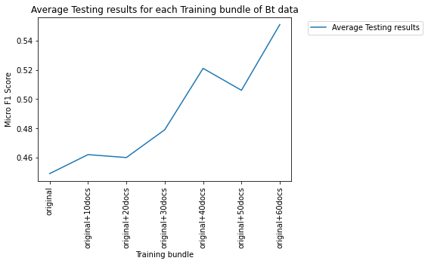
Latent Relations paper updates
Learning curve for the model including Bt data:

Slide 5
End2End paper updates
Done
Completed training model
Completed testing model with AIDA/other datasets
Preprocessed entire BT dataset to be compatible with End2End
In Progress
Work on testing BT data
Work on Final paper and presentation
Next Step
Prepare Final Presentation Materials
Notes:
Testing BT -> We tried converting the BT dataset into an XML format but got errors there. Also tried to process the entire BT dataset and the model gave invalid error argument which was the same as last time. Xinlu will talk about it in more detail

Slide 6
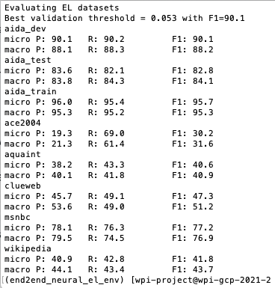
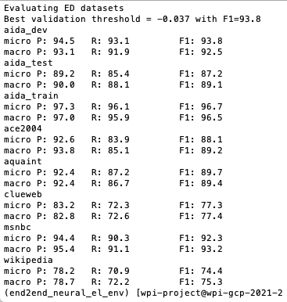
End2End - Training
Entity Linking Training
Entity Disambiguation Training
Model
Performance
Notes:
ED performed a lot better than EL especially for the Wikipedia dataset
The training model on different datasets for both EL and ED performed a bit worse overall than the latent model whose wiki training was the lowest performing dataset at 77%. However here, the Wiki dataset is at 74-75% which is lower.
Micro/Macro - For EL, these metrics are computed both in the strong matching and weak matching settings. Micro requires exactly predicting the gold mention boundaries and their entity annotations, whereas Macro gives a perfect score to spans that just overlap with the gold mentions and are linked to the correct gold entities.

Slide 7
End2End - Training/Testing AIDA
Entity Disambiguation | Train Score | Test Score | Test Precision | Test Recall
Best Scores | 92.2% | 85.7% | 88.5% | 83%
Entity Linking | Train Score | Test Score | Test Precision | Test Recall
Best Scores | 62.9% | 56.8% | 57.5% | 56.1%
Using all Spans Best Score | 89.1% | 80.1% | 83.5% | 76.9%
Notes:
While processing the BT dataset, we trained and tested the AIDA data to see what we could expect. We used the base model for EL and ED training/testing on the AIDA dataset which ran overnight and obtained these scores. We expect to see similar or lower scores for the BT dataset because it will be smaller. The AIDA dataset has more than 502K data points.

Slide 8
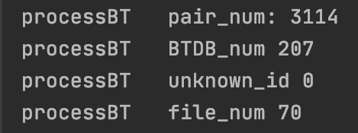
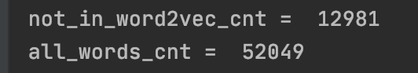
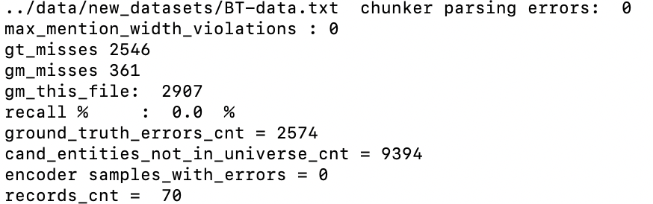
End2End--implement with BT’s data
Steps:
transform BT’s data into input format ✅
choose candidates, create the universe as the wiki id of all the mentions and entity candidates, in all training and testing datasets❌
use the pre-trained Word2Vec files to find the relevant embeddings for the universe (using googlenews vectors file) ✓
transfer the files into the tfrecords file for the model (tf.train.SequenceExample) ✓
use the model trained with Aida dataset to test the model
problem:
using candidate group chosen by ourselves(probabilistic mention - entity map p(e|m),wikipedia 2014)
plug it into the process
Gt_misses: the ground truth entity is not in the entity candidate
Gm -> check if the gold mentions are not inside the candidates span
Notes:
Tfrecords folder contains the format to use tensorflow
None of the entities are being counted in the candidate list, thus yielding the 0% rate

Slide 9
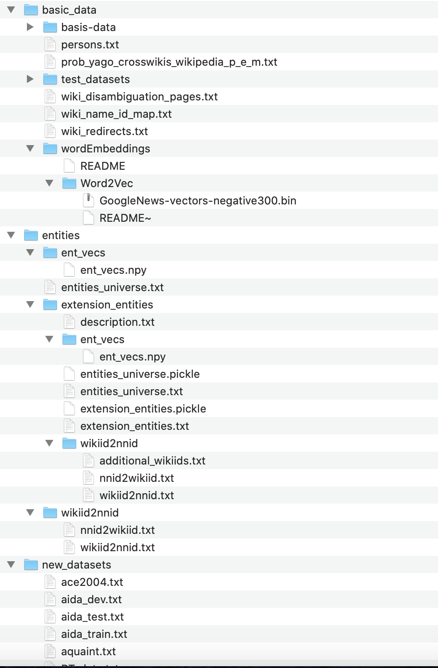
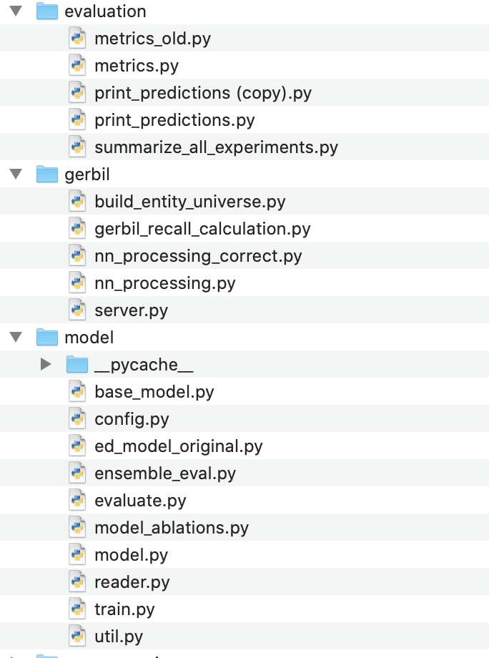
End2End-problem
This code:
targeting the purpose of the paper for the available datasets, with wikipedia concepts
was not designed with a plug and play mentality
data dictionary:
where to put candidate file
googlenews
Notes:
In general, the code has implementation details that are targeting the purpose of the paper i.e. NER and ED for the available datasets, with wikipedia concepts, also evaluation with Gerbil, and optimizations in training with tfrecords and was not designed with a plug and play mentality

Slide 10
Novel Disambiguation: Development Phases
Get nodes and edges from generated Graph
Translate Graph Information to build Adjacency matrices
Generate embeddings for Mentions & Candidate Entities
Disambiguate entities multi-output classification
Build CNN architecture to learn various features
Combine Adjacency Matrices & Embeddings to input to CNN

Slide 11
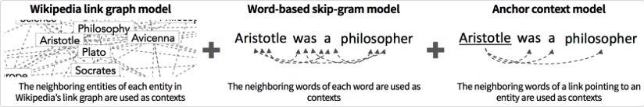
Wikipedia2Vec Embedding Model
A tool for learning embeddings of words and entities from wikipedia
for each mention: get the word embedding
for each candidate entity: get the entity embedding
by jointly optimizing the following three submodels
Usage: Entity linking/ Named entity recognition/ Question answering/ Relation classification, etc.

Slide 12
Developing graphs
Done:
Use Robust Disambiguation technique code to produce graph
https://github.com/codepie/aida
Extract Mention Nodes, Entity Nodes and edge information from the generated graph
Downloaded Yago dumps in tsv format
Installed Postgres
In Progress:
Running Script to load Yago dumps in Postgres to create data tables
Command:
D:\Postgres\bin\psql.exe -a -d postgres -h localhost -U postgres -f D:\Kratika\Semester3\GQP_BasisTechnology\RobustDisambiguation\yago_postgres_infofoxes.sql

Slide 13
CNN Model:
CNN Input generation Steps:
Create Mention-Entity Adjacency Matrix (adj_me) & Entity-Entity Adjacency Matrix (adj_ee) for few documents, save as npy
Download Wikipedia2Vec embeddings, load & get embeddings for all mentions (emb_m) & entities (emb_e)
Create Input for the model as follows:
emb_m * adj_me * emb_e
emb_e * adj_ee * emb_e
CNN Architecture:
Working on developing the CNN model using keras and tensorflow libraries.

