Slide 1


Entity Linking WPI GQP
Project Updates
Research Paper Presentations
Team members
Kratika Agrawal, Vandana Anand, Xinlu He,
Min Huang, Soumya Joshi, Jing Yu
Week 3 - September 17th

Slide 2

Datasets

Slide 3
Aida CoNLL
Size(Estimated):
A training set of 18,448 linked mentions in 946 documents.
A validation set of 4,791 mentions in 216 documents.
A test set of 4,485 mentions in 231 documents.
Website:
https://www.mpi-inf.mpg.de/departments/databases-and-information-systems/research/ambiverse-nlu/aida/downloads
use READ_ME to create the final data file

Slide 4
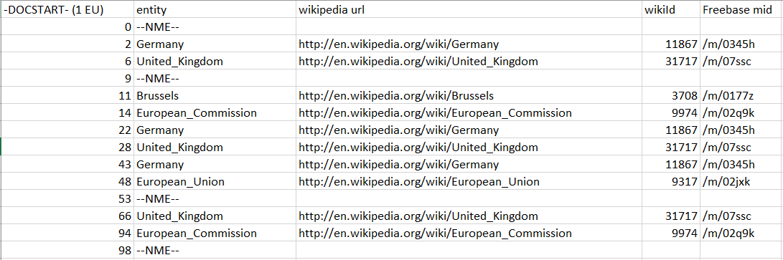
Aida CoNLL
- column 1 is the token - column 2 is the corresponding YAGO2 entity - column 3 is the corresponding Wikipedia URL of the entity - column 4 is the corresponding Wikipedia ID of the entity - column 5 is the corresponding Freebase mid --NME-- No Matching Entity
2 more Columns: either B (beginning of a mention) or I (continuation of a mention), the full mention used to find entity candidates

Slide 5
TAC KBP --2010
The 2010 competition has been over, and the dataset cannot be fetched from the official pages
Still one: LDC2016T26 TAC KBP Spanish Cross-lingual Entity Linking - Comprehensive Training and Evaluation Data 2012-2014
Need more exploration

Slide 6
End-to-End Entity Linking Research Paper
Kratika Agrawal, Xinlu He, Jing Yu

Slide 7
Motivation and Background
Entity Linking: include Mention Detection(MD) and Entity Disambiguation(ED)
Other research: dependency between the 2 steps is ignored.
Errors caused by MD/NER will propagate to ED without possibility of recovery
This research: emphasize the importance of the mutual dependency between MD and ED.
MD influence ED: numerous and more informative linkable spans found by MD obviously offer more contextual cues for ED.
ED influence MD: finding the true entities appearing in a specific context encourages better mention boundaries, especially for multi-word mentions.
address the end-to-end EL task

Slide 8
Research Problems Addressed
Generates all possible spans (mentions) that have at least 1 possible entity candidate.
Each mention - candidate pair receives a context-aware compatibility score based on word and entity embeddings ,a neural attention and a global voting mechanisms.
During training, we enforce the scores of gold entity - mention pairs to be higher than all possible scores of incorrect candidates or invalid mentions, thus jointly taking the ED and MD decisions.

Slide 9
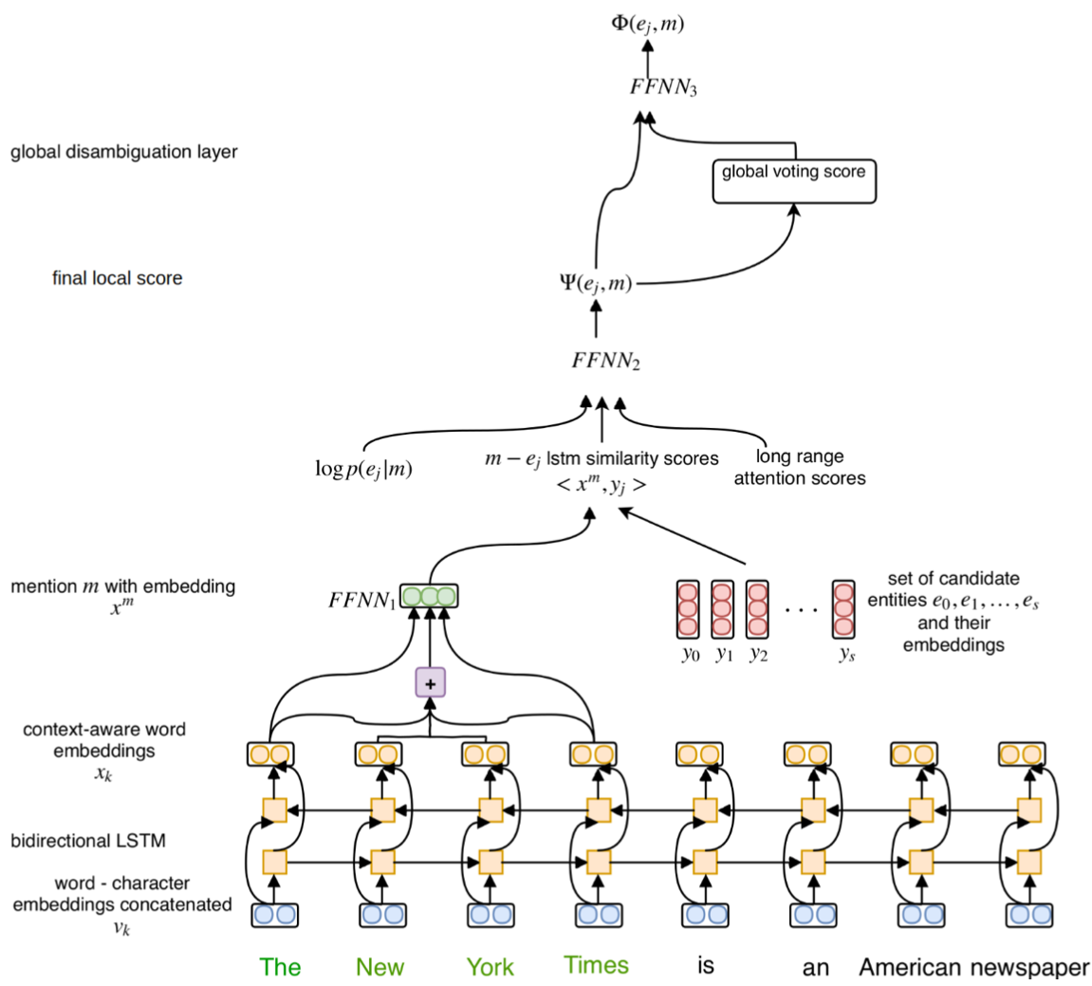
Final Score
➔ local score:
analysis focus on
mention and relationship between
mention and entity candidates
➔ global score:
analysis focus on
the relationship among
entity candidates in KB

Slide 10
Methodology - Mention Detection
Inside a word:(blue)
Word Embeddings
Character Embeddings: lexical information
bidirectional LSTM
Concatenate
On a potential mention:
context- aware (yellow): biLSTM
fixed size representation (purple): concatenate the first(x1), last(xn),softhead
FFNN (green): feed forward neural network

Slide 11
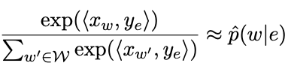
Methodology - Entity Disambiguation
➔ Candidate Selection and Entity Embeddings (red part)
entity embeddings: pre-trained
candidate selection:
the empirical conditional word-entity distribution pˆ(w|e)
conditional probability entity - map p(e|m) for each span we select up to s entity candidates
➔ Final Local Score (FFNN2)
similarity score: lstm
log prior probability:log p(ej |m)
Long Range Context Attention: context
FFNN using (a)(b)(c)

Slide 12
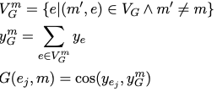
Methodology - Global Disambiguation
cosine similarity between the entity embedding and the normalized average of all other voting entities’ embeddings

Slide 13
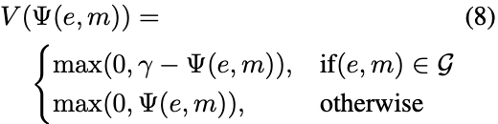

Methodology - Training
(a) Data:documents and gold entity - mention pairs
(b) Loss Function:
Violation Term:separate the scores gold pairs from negative pairs
Loss function
(c) Gold span and all span
Gold span/ mention-entity pairs: Mention Detection is already been down
All span：all pairs
(d) Inference:
ED—training with gold span data
EL-training with all span data

Slide 14
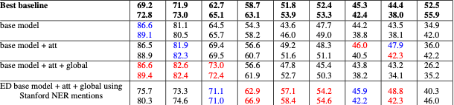
Experimental Results
KB(Knowledge Base): Wikipedia 2014
Data: AIDA/CoNLL
Training: 18,448 linked mentions in 946 documents
Validation: 4,791 mentions in 216 documents
Testing: 4,485 mentions in 231 documents
Performance
Notes:
Baseline: Gerbil Platform

Slide 15
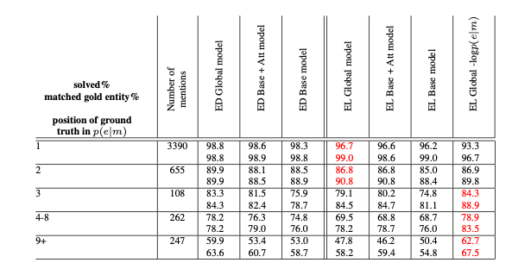
Implementation Plan
Feasibility: how can we make use of ED module of this paper along with the existing implementation of Rosette for MD
Gold span vs All span:
Gold span: Mention Detection is already been down
All span：all pairs
ED - training with gold span data
EL - training with all span data
Try to follow: https://github.com/dalab/end2end_neural_el

Slide 16
DeepType:
Multilingual Entity Linking by Neural Type System Evolution
Kratika Agrawal, Xinlu He, Jing Yu

Slide 17
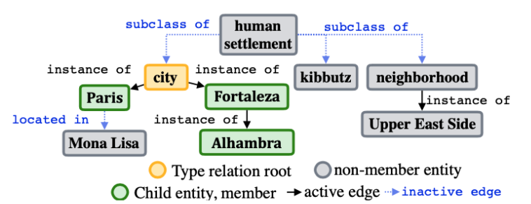
Motivation and Background
Symbolic Representations(SR): Something visible that by association or convention represents something else that is invisible
Knowledge Base provides some Symbolic Representations:
Difficulties of current SR approaches : • Symbolic information Selection. • Design of the representation. • Need Hand-labelling
DeepType : • Select Type information. • Design DeepType method. • automatically without human effort for a target task.
Used DeepType to solve the Disambiguation Problem in Entity Linking

Slide 18
Research Problems Addressed --Disambiguation
Disambiguation in Entity Linking:
Example: “Washington”could mean Washington, D.C. or George Washington
General criteria for disambugation:
how often does a mention point to an entity, LinkCount(m, e).-- This method take this.
how often does entity e1 co-occur with entity e2, an O(N2) process, often named coherence.-- Used in other methods: global score
Disambiguation with DeepType:
Use Type information (get from DeepType model) to rule out invalid answers, produce a constrained set
eg. If the type is Washington: {Person, Politics}, rule out the Washington, D.C
In the constrained set, use LinkCount to choose the final entity (Entity Prediction Model)
eg. “bass”:a type of fish, tones of low frequency, a type of instrument

Slide 19
Research Problems Addressed --Type
Two steps before predicting the entity:
Construct a Type System: define the type
Build a Type Classifier
Relationship between 2 steps:
use the type system to constrain the output of the Type Classifier
It’s hard to build them separately
Build it together
regard as mixed integer problem: discrete variables are in Type System Construction, and continuous variables control a classifier fit to the type system
Firstly fix the Type Classifier(2 classifier) to construct the Type Sysment. Then use SoftMax to build the real Type Classifier

Slide 20
Terminology
Relation：A set of rule that is inherited by entire group belonging to a particular member or entity.
Type：A label for a relation. e.g. IsHuman is the type applied to all children of Human connected by instance of
Type Axis: A branch for a unique type with a root node and edge type. e.g. IsHuman
Type System: A group of Type Axes for any entity. e.g. George Washington: {Person, Politics}

Slide 21

Methodology
Create a type system and its classifier using entity prediction model and Wikipedia/Wikidata text snippets containing entity mention.
Use LinkCount(e,m) as an entity prediction model.
Mixed Integer Problem: discrete variables control A which roots r₁,.....,r_{k} and edge types g₁,.....,g_{k} among all roots R and edge types G will define type axes. And continuous variables ϴ parametrize a classifier fit to the type system. S_{model}(A, ϴ) as the disambiguation accuracy given a test corpus containing mentions M = {(m₀, e₀^{GT}, E_{m0} ),.....,(m_{n}, e_{n}^{GT} ; E_{mn})}
EntityScore(e,m,D,A, ϴ): This model produces score for each proposed entity e given a mention m in the document D.
Predicted entity for a given mention => e* = argmax_{eϵEm} EntityScore(e,m,D,A, ϴ)
e* = e^{GT} shows that the mention is disambiguated; e^{GT} => Ground Truth entity

Slide 22


Algorithm Step 1: Discrete Optimization of Type System
Extend the EL task to associate with each entity a series of types (e.g. Person, Place, etc.)
Heuristic search or stochastic optimization to find A.
Use proxy objective J for the discrete optimization
J(A) =(S_{oracle} - S_{greedy}) . Learnability(A) + S_{greedy} - |A| . 𝞴
S_{oracle}: disambiguation accuracy S_{greedy}: the accuracy of a system that predicts only according to the entity prediction model 𝞴 : per type axis penalty to avoid degenerate solutions.
Oracle operates on a test corpus with a set of mentions, entities, and proposal sets: m_{i}, e_{i}^{GT}, E_{mi}
If Oracle(m) = e^{GT}, the mention is disambiguated
Notes:
Avoid training an entire type classifier and entity prediction model for each evaluation of the objective function

Slide 23

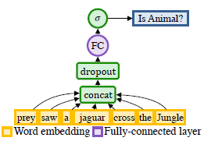
Learnability
To ensure that the types selected are easy to predict.
Measures the average performance of classifiers in predicting type.
Parallelize the training of simpler classifiers for each type axis
Measure (AUC) for each classifier:
Notes:
Avoid training an entire type classifier and entity prediction model for each evaluation of the objective function
To ensure that the types selected are easy to predict while training the type classifier.
The Learnability heuristic empirically measures the average performance of classifiers at predicting the presence of a type within some Learnability-specific training set.
To efficiently estimate Learnability for a full type system we make an independence assumption and model it as the mean of the Learnability for each individual axis, ignoring positive or negative transfer effects between different type axes. This assumption lets us parallelize training of simpler classifiers for each type axis.
Measure the area under its receiver operating characteristics curve (AUC) for each classifier and compute the type system’s learnability:

Slide 24

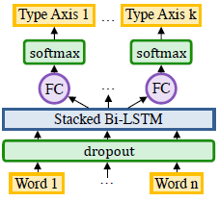
Algorithm Step 2: Type Classifier
Discover long-term dependencies in the input data
Bidirectional-LSTM (Lample et al. 2016) with word, prefix, and suffix embeddings
Train to minimize the negative log likelihood of the per-token types for each type axis in the document D with L tokens:
Notes:
The goal for this classifier is to discover long-term dependencies in the input data that let it reliably predict types across many contexts and languages.
use Softmax as the output activation

Slide 25

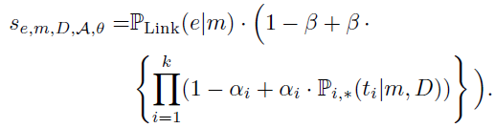
Inference
Obtain confidence over each type axis for each word by running classifier over full context.
For each mention, obtain the type conditional probability for all type axes, i:
Max-over time for i-th type axes: P_{i,*}(.|m, D)
EntityScore of an entity for given conditional probabilities and type axis, can be combined to rank entities, according to how predicted they were by both the entity prediction model and the type system.
P_{Link}(e|m) =
𝛼_{i} : per type axis smoothing parameter,
𝛽 : smoothing parameter over all types

Slide 26
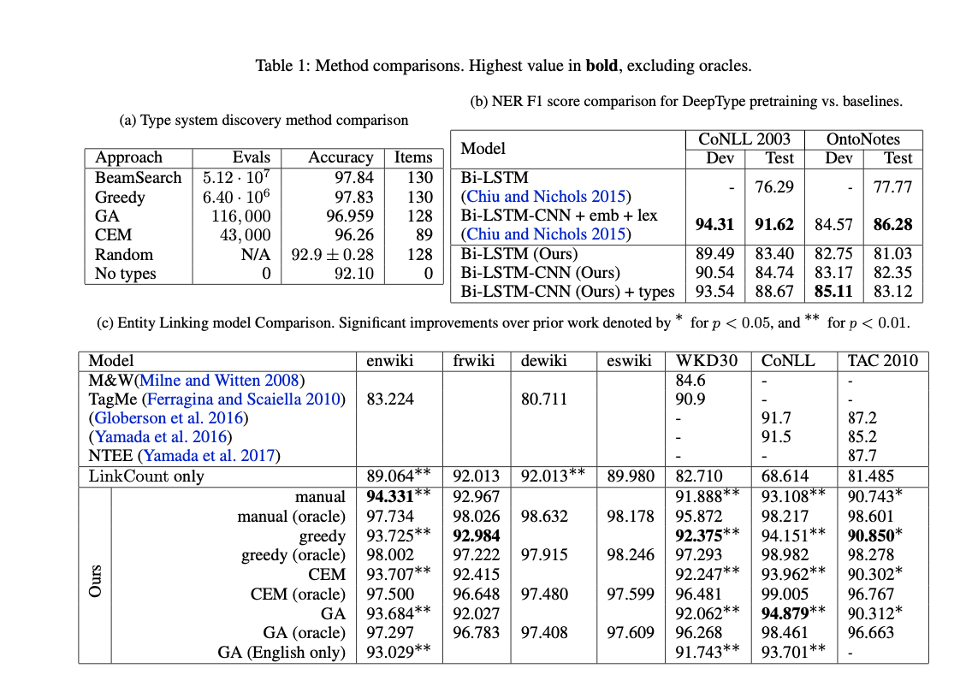
Experimental Results

Slide 27
Implementation Plan
➔ Look for the feasibility of implementation along with the current Rosette MD implementation.
➔ Try to go through: https://github.com/openai/deeptype

Slide 28
Improving Entity Linking by Modeling Latent Relations between Mentions
Vandana Anand, Min Huang, Soumya Joshi

Slide 29
Motivation and Background
Entity linking systems often exploit relations between mentions in a document to decide if the linking decisions are compatible.
Previous Research
Rely either on supervised systems or heuristics to predict the relations between mentions, considering only coreference(Lazic et al., 2015; Cheng and Roth (2013); Ren et al. (2017))
Use representation learning which rely on pretrained embeddings of words and entities instead of feature engineering (Ganea and Hofmann (2017)
This research
Many other relations besides coreference should take into account
Treat relations as latent variables in their neural entity-linking model instead of supervised systems
Apply representation learning but considering relation embeddings
Notes:
This slide is based on the abstract of the paper
Entity disambiguation(ED): the task of linking mentions of ambiguous entities to their referent entities in a knowledge base such as Wikipedia
Features:
Context- Independent Features
LinkCount: the numbers of mentions linking to entities #(m->e)
Entity Attributes: Type, Popularity
Context- Dependent Features
Textual Context
Coherence Between Entities
Relations between mentions
Methods:
Manually designed features
Representation learning(Ganea and Hofmann, 2017 )

Slide 30
Research Problems Addressed
Tackled candidate selection problem which is to choose best entity from a list of candidates by
local and global modeling (Ganea and Hofmann, 2017 )
including latent relations into global models
Eliminated the need for extensive feature engineering by using representation learning to learn relation embeddings
Notes:
Written from abstract as well the contribution part of the paper

Slide 31

Methodology - Local Model
To select best candidate from Ci = (ei1, … , eili):
Local model
ci is the local context of mention mi
rely only on local contexts of mentions
ignore interdependencies between linking decisions in the document
Local score function

Slide 32
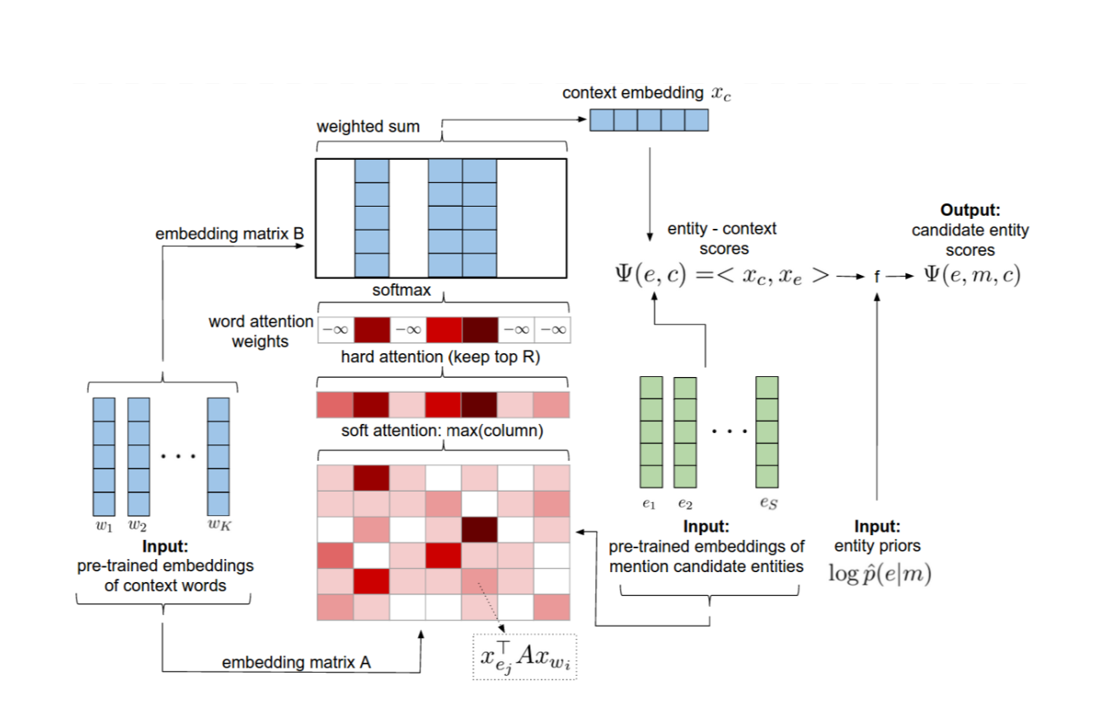
Methodology
Apply a neural attention mechanism
Assume we have computed a mention-entity prior p(e|m)
Compute a score for each e based on local context surrounding m as well as on the prior

Slide 33
Methodology
5
Input pre-trained embeddings of context and candidate entities
Key: embeddings of entities
Value: embeddings of context
Get the score matrix
Get max(column) : words have high relativity with entities
Keep top R words: remove uninformative words
Apply Softmax function: to calculate the weighted sum of entity- context score
Integrate the score with entity priors: to get the final local score
6
4
3
1、2

Slide 34
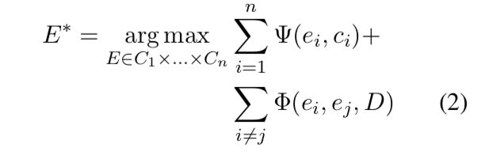
Methodology
To select best candidate from Ci = (ei1, … , eili):
Global model
Take into account entity coherency
Coherence score function
the sum of pairwise score function

Slide 35
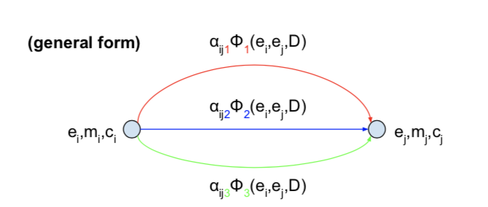
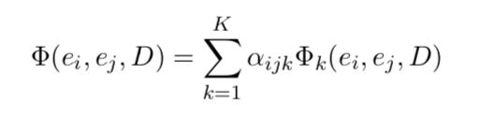
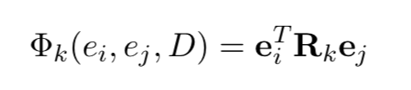
Multi-relational Models
Assume there are K latent relations:
Each K is assigned to a mention pair (mi,mj) with a weight aijk
= Weighted sum of relation-specific pairwise scores

Slide 36
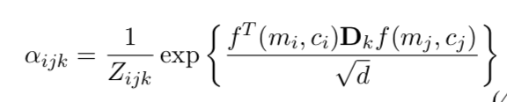
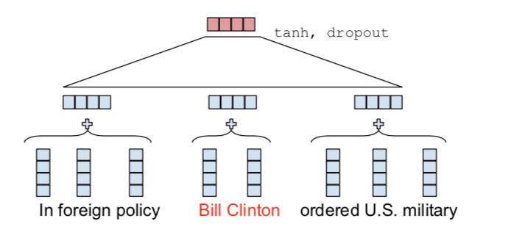
Multi-relational Models
Ci is the concatenation of the average embedding of words in the left context with the average embedding of words in the right context of the mention

Slide 37
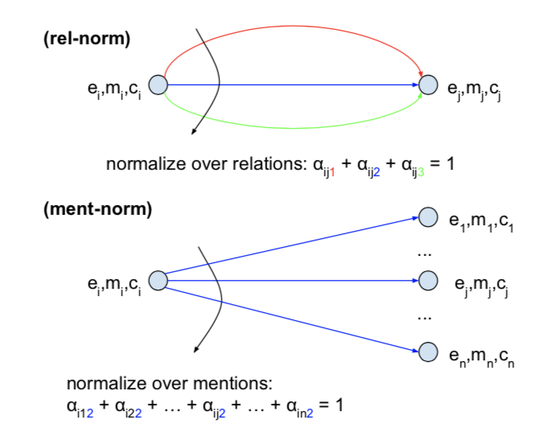
Multi-relational Models
Relation -wise normalization
Mention -wise normalization

Slide 38
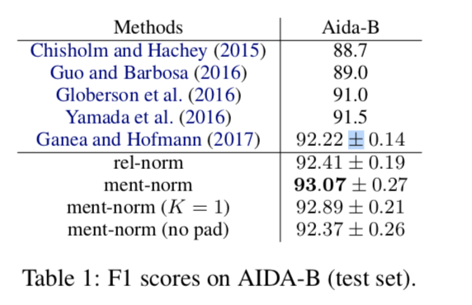
Experimental Results
F1-score:

Slide 39
Improving Entity Liking by Modeling Latent Entity Type Information
Vandana Anand, Min Huang, Soumya Joshi
Notes:
Differences between two papers - newest version which shows the improvement of methods from previous paper by taking entity type information into account using the BERT model

Slide 40
Motivation and Background
The current state of the art neural entity linking model (Ganea and Hofmann 2017) employ
attention-based bag-of-words context model,
pre-trained entity embeddings for topic level similarity
However, the latent entity type information in direct relation with the mention is not included which causes incorrect entity linking.
Therefore, the research paper aims to include latent entity type information through the pre trained BERT model in order to minimise incorrect entity linking issue.
BERT is a NLP technology from Google which generates “contextualized” word embeddings/vectors.
“CMA can easily hydrolyze into free acetic acid.”
Referring to H2O/ water
Notes:
This slide is based on the abstract of the paper
Context compatibility
BERT has a bi- directional approach which allows google users to search without writing in a proper sentence formation

Slide 41
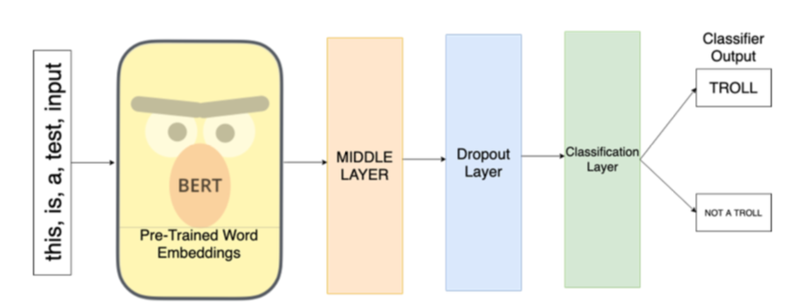
Research Problems Addressed
Current Issues with the SOTA model (Ganea and Hofmann, 2017)
It adopts a bag-of-words encoding scheme which cannot take predictive cues such as “In” which refers to a location entity rather than a name
It is not sensitive to entity types, for example the entity ”Steve Jobs” will return “Apple.Inc” when asked for similar entity whereas “Steve Jobs” is a name and similar entities would “Steve Wozniak” or “Tim Cook”
To address the above problem, the research paper proposes to integrate a BERT-based entity similarity into the local model of the SOTA model
Image Source: https://towardsdatascience.com/using-bert-and-cnns-for-russian-troll-detection-on-reddit-8ae59066b1c
Notes:
Written from abstract as well the contribution part of the paper
“Bert is a natural language processing pre-training approach that can be used on a large body of text. It handles tasks such as entity recognition, part of speech tagging, and question-answering among other natural language processes. Bert helps Google understand natural language text from the Web. Google has open sourced this technology, and others have created variations of BERT.”

Slide 42


Methodology
The model consists of two phases:
(1) Build entity embeddings from BERT
(2) Add a BERT-based entity similarity component to the local model
Local Model - An attention model based on pre-trained word and entity embeddings. Two layer feed forward neural nets.
Global Model - Used max product loopy belief propagation (LBP) to estimate the max marginal probability for each mention. Two layer neural nets.
Notes:
Local models rely only on local contexts of mentions and completely ignore interdependencies between the linking decisions in the document. Ganea and Hofmann used neural nets to combine the long and log
Global models take interdependencies into account
pˆ(e|m) is computed by mixing mention-entity hyperlink count statistics from Wikipedia
BERT-based entity similarity score into the local context model of a state-of-the-art model to better capture latent entity type information.

Slide 43



(1) Build entity embeddings from BERT
Given lists of mention context (ie. the surrounding text of a mention) in Wikipedia for every entity, build the entity embedding map with entity -> embedding (vector of real numbers representing the entity). We look at the immediate left and right context of the mention.
Anchor context:
Next we randomly sample N anchor contexts from Wikipedia. Entity representation is computed by aggregating all the context representation via average pooling:
The entity embeddings from BERT better capture entity type information.
Notes:
the mention’s immediate context is a sequence of tokens where the mention mij is replaced with a single [MASK] token. Then, we represent the immediate entity context by [extracting the upper most layer representation of] the pre-trained BERT corresponding to the [MASK] token.
Mask some words and ask to identify that word. Masking to pretrain the BERT model

Slide 44





(2) Add a BERT-based entity similarity component to the local model
Capture latent entity type information by designing a BERT-based entity similarity score: where e = entity and c = context
Given a short range (the immediate context where the mention m lies) context c = (lctx, m,rctx), encode
Then define the BERT-based entity similarity as the cosine similarity:
Local:
Global:
Integrate BERT based entity similarity with local context score (long/log expressions)
Combine BERT and long to define local context score Then adopt the same global model as Ganea and Hofmann. We use two layer neural nets to get the final score

Slide 45
Experimental Results
Proposed Model: a BERT-based entity similarity model to capture latent entity type information which is supplementary to existing SOTA local context model (Ganea and Hofmann 2017).
Step 1: Performance comparison when the proposed model integrated with the SOTA model
Results: The proposed model achieves a 1.31 improvement in terms of F1 over the SOTA model, producing a very competitive local model with an average 90.06 F1 score
Step 2: Evaluation of the proposed model with the global modeling method of SOTA model.
Results: the performance of the proposed model further increase to 93.54 F1 Score with an average 1.32 improvement over SOTA model
Step 3: further comparison with other SOTA models (Yamada et al. 2016; Le and Titov 2018)
Results:The proposed method achieves an improvement of 0.47 in terms of F1 than the SOTA model (Le and Titov 2018)
Notes:
The model of Le and Titov (2018) is a multi-relational extension of Ganea and Hofmann (2017)’s global modeling method while keeps exactly the same local context model.

Slide 46
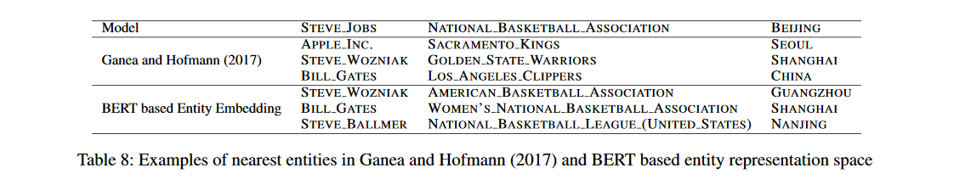
Difference between the models
Source: https://arxiv.org/pdf/2001.01447.pdf
Context Matching
Entity type Matching

Slide 47
Github Sources for the Paper Implementation
For pre trained BERT model: https://github.com/huggingface/pytorch-pretrained-BERT
Resources for training entity embeddings:
https://github.com/dalab/deep-ed/
Previous Models implementation:
https://github.com/izuna385/Entity-Linking-Recent-Trends

Slide 48
Thank You
Any questions?

