Slide 1


Entity Linking WPI GQP
Project Updates
Team members
Kratika Agrawal, Vandana Anand, Xinlu He,
Min Huang, Soumya Joshi, Jing Yu
Week 6 - Oct.12th

Slide 2
Latent Relations paper updates
AIDA-CoNLL dataset
Preprocess the original dataset
Generate additional dataset based on the original one

Slide 3
Original dataset Preprocessing
AIDA-CoNLL dataset
TRAIN: '1 EU' to '946 SOCCER'
TESTA: '947testa CRICKET' to '1162testa Dhaka'
TESTB: '1163testb SOCCER' to '1393testb SOCCER'
Split into two files: Train.txt and TestA_TestB_Aggregate.txt
The original dataset has too many null values hence it has to be preprocessed
The dictionary data structure is used to connect context and candidate for every sentence as well as connect each mention with the equivalent sentence id as well as the wikilink

Slide 4
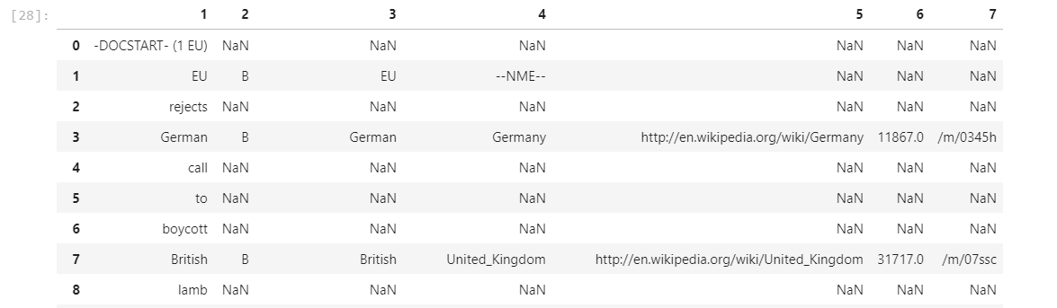
Original dataset Preprocessing
dict = {
'mention': mention,
'context': (lctx, rctx),
'candidates': cands,
'gold': gold}

Slide 5
Additional dataset generation
Format:-- doc_name \t doc_name \t mention \t left_ctxt \t right_ctxt \t CANDIDATES \t [ent_wikiid,p_e_m,ent_name]+ \t Gold: \t pos,ent_wikiid,p_e_m,ent_name
ent_wikiid: the wikiID of the entity
p_e_m: Prior Possibility P(m|e) = Counts of the mention points to the entity / Total Counts
ent_name: the name of the entity
Gold: the correct entity
p_e_m: based on textWithAnchorsFromAllWikipedia2014Feb.txt
e.g.: ‘CSF pressure, as measured by <a href="lumbar puncture">lumbar puncture</a> (LP), is 10-18 <a href="Pressure#H2O">'
mention: lumbar puncture, entity_name = lumbar puncture
<mention,ent_wikiid> pair
Calculate frequency
For each mention, store the corresponding wikiid and frequency
Choose candidates with higher prior possibility(at most 100)

Slide 6
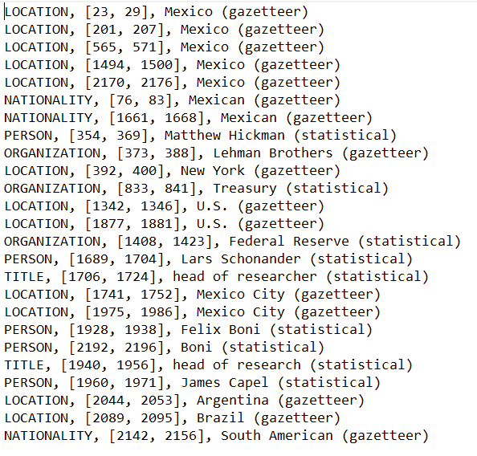
Rosette Entity Extractor
Setup the Basis Technology in-house Rosette Entity Extractor (REX).
Code is able to identify and extract entities in an AIDA-CoNLL dataset document:
Run Entity Extractor on all documents in AIDA-CoNLL dataset.

Slide 7
DeepType Model Implementation Status:
Current Step: Associate Type to each identified entity.
Links each entity type to Wikidata/Wikipedia record.
Entity Type: PERSON, MALE, FEMALE, ORGANIZATION, FOOD, etc.
Identify each Type as a category.
Eg: CHEMICAL_COMPOUND, DRUG, CHEMICAL_SUBSTANCE as is_chemical_compound
Start creating the Type System

Slide 8
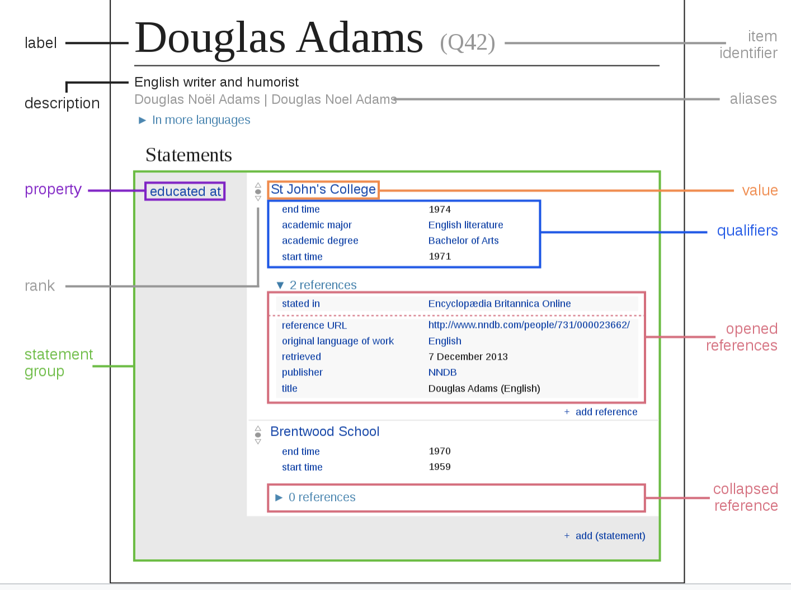
Wikibase
2 Impelemented Modules:
wbsearchentities
wbgetentities
Search Entity:
use parameter limit to limit the number of results -- size of candidate group
get a list of wiki id, url
Get Entity:
use the wiki id to get the information of certain entity
Current Tools:
Wiki Link
Type: Location, Organization
DBpedia Type

Slide 9
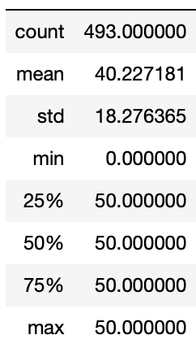
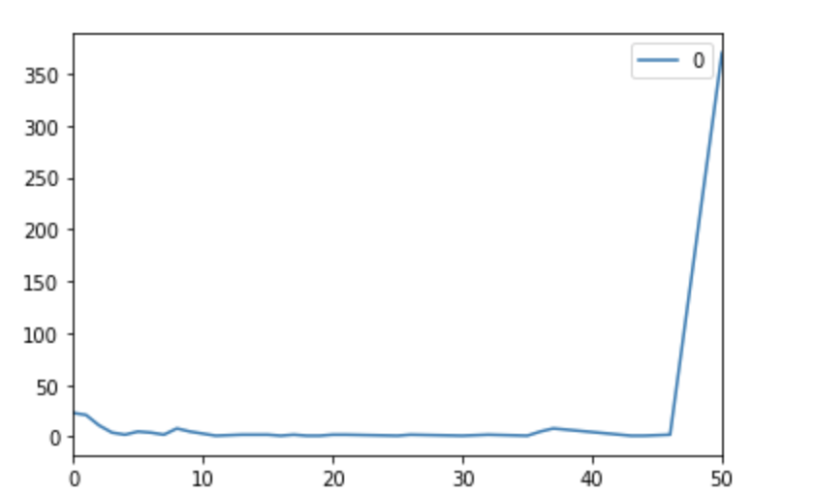
Choosing of k
The default limit is 7 in wbsearchentities,changed it to 100
run wiki query through all mentions and get the size of each candidate sets

