Slide 1


Entity Linking WPI GQP
Project Updates
Team members
Kratika Agrawal, Vandana Anand, Xinlu He,
Min Huang, Soumya Joshi, Jing Yu
Week 9 - Oct.26th

Slide 2
Latent Relations paper updates
Completed training the latent model (Colab)
Completed calculating the prior possibility
Next Steps:
Generate final BT dataset
Apply the BT dataset to test the model

Slide 3
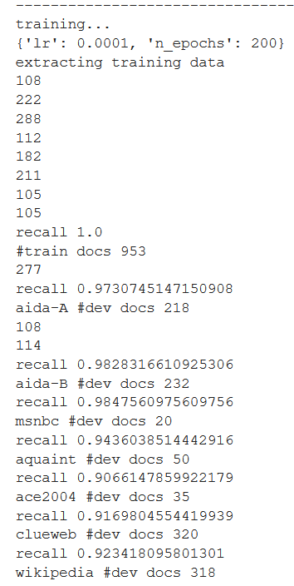
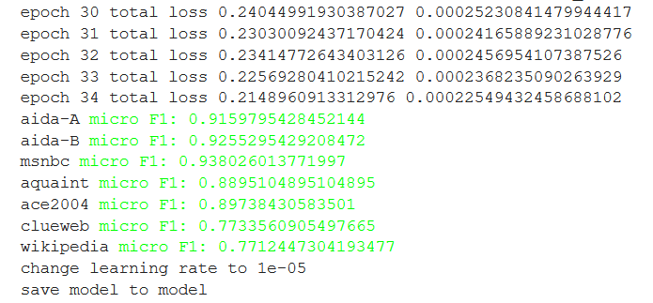
Latent Relations paper updates
Training results of the latent model

Slide 4
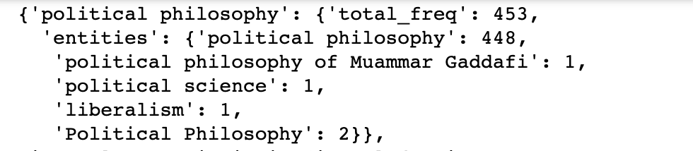
Latent Relations paper updates
Calculating prior probability - based on Wikipedia2014textfile
P(e|m) = count of [m,e] pair / Total counts of all the pairs
Format:
data[mention] = {‘total_freq’: counts, ‘entities’:{‘entity1’:counts,’entity2’:counts}}
e.g. data:

Slide 5
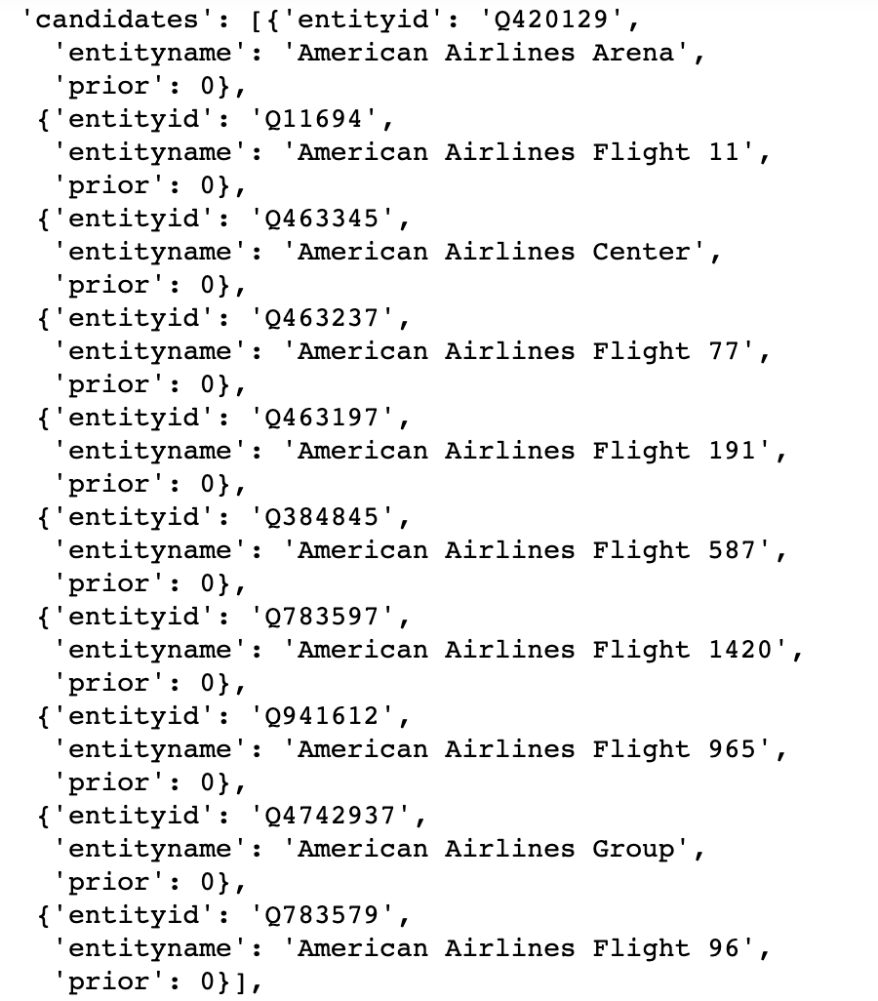
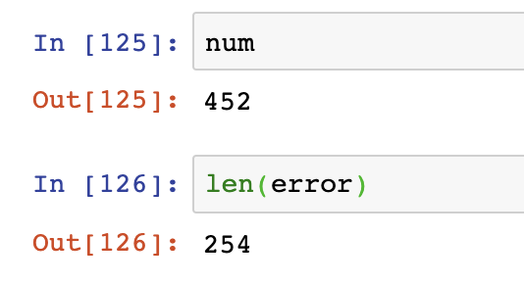
Latent Relations paper updates
Integrate with BT data
Many zero values
candidates selection- wiki API
Transformed mentions to get 10 candidates
frequency calculation- wikipedia2014textfile
Generate candidates using wikipedia2014textfile

Slide 6
End2End paper updates
In the process of training the End-to-End models with the AIDA dataset
too many pre-processing steps, used the data set End2End provided directly
candidate choosing could useWiki API: how it selects?
Encountered some challenges with the instructions as they were bit confusing
Executing commands in python, may be easier with the server
Large data file sizes to train the model

Slide 7
End2End paper updates
Next is to use the BT dataset to perform testing
the format of the input data for the entity disambiguition:
format of the input data for entity linking:
Need to transform the BT dataset/process

Slide 8
DeepType Implementation Updates
Wikidata entity dataset > 1.5 TB
Data is growing everyday
Using Pywikibot to query details for each entity
Write python script to convert all AIDA_YAGO2 dataset tokens for each doc into individual text documents for all

Slide 9
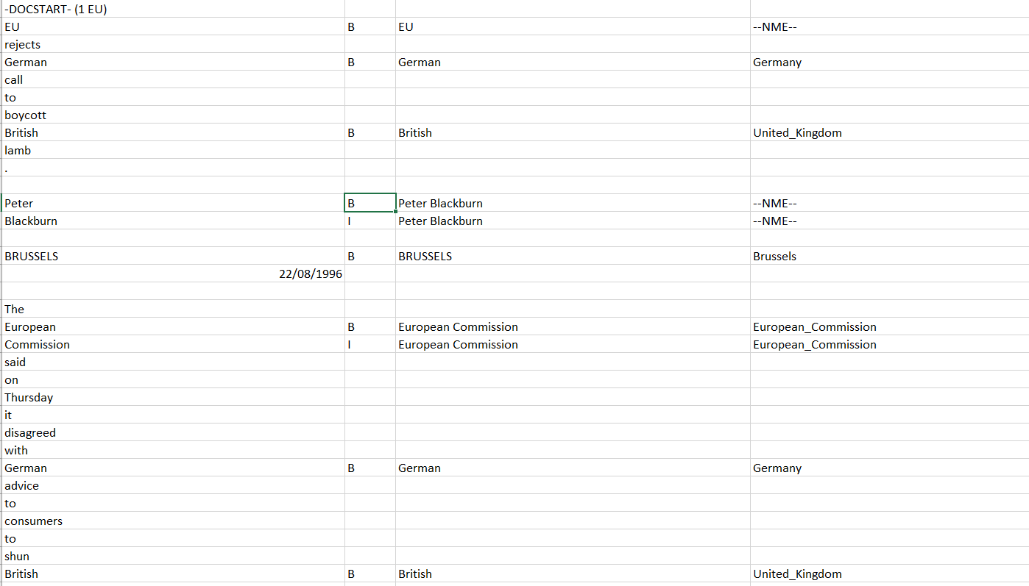
DeepType Implementation Updates

Slide 10
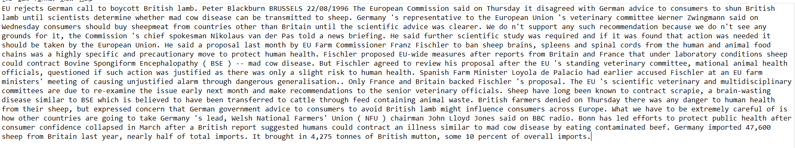
DeepType Implementation Updates

Slide 11
DeepType Implementation Updates
Updated REX script to annotate many documents in a folder
Extracted all unique entities from each document using REX and stored them in output file.
Create dictionary of Candidate Entities and Gold entity for all mentions.
Requested details for all entities using Pywikibot
Working with two approaches from here:
Use deeptype Github code (Jing):
Convert extracted entity list into the format of wikidata entity json
Convert all documents into the format of wiki article xml
Execute the code.
Use Claim details retrieved using pywikibot to build graph (Kratika):
Convert all details to DataFrame depicting a Graph
Restructure various types, eg: {human, person, people} as is_human
(create a supportive dataframe for this as well assigning one of the id to all and create lookup from here to main dataframe)
Train a classifier and evaluate

Slide 12
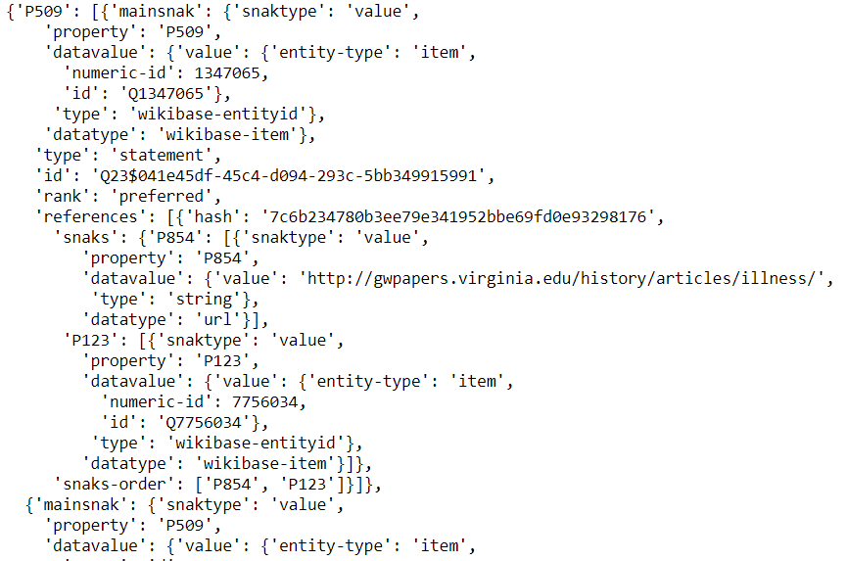
Creating dataframe using Entity Claim
Claim =>

Slide 13
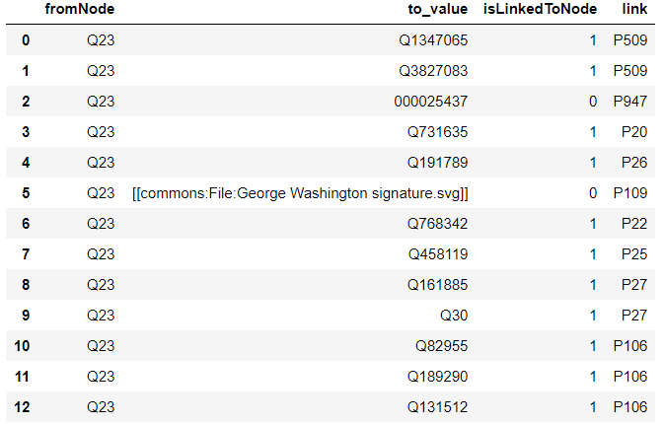
Continue..
DataFrame=>

