Slide 1


Entity Linking WPI GQP
Project Updates
Team members
Kratika Agrawal, Vandana Anand, Xinlu He,
Min Huang, Soumya Joshi, Jing Yu
Week 10 - Nov.2nd

Slide 2
Latent Relations paper updates
Done
Implementating Latent Relations Github Training Model
calculating Prior probability calculation for BT dataset
In Progress
Testing the BT dataset on the trained model
Next Step
Finding Optimal value of k for the training model
Training the Model on BT server

Slide 3
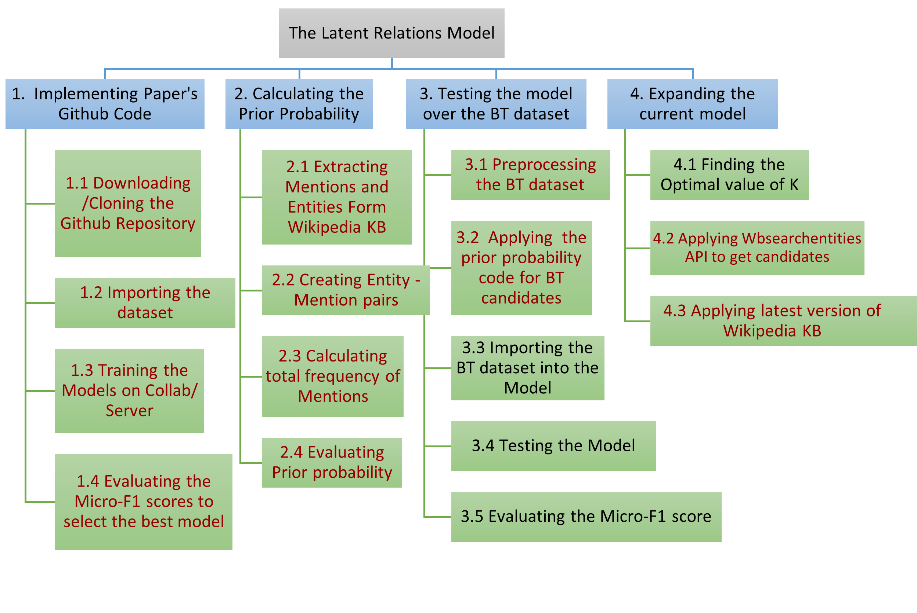
Work Breakdown Structure - Latent paper

Slide 4
Prior Probability
Get the latest version wikipedia KB
Download English Wikipedia xml dump
Applied wikiextractor to get articles
Applied unquote() to transform URL strings to normal strings
e.g. Séamus O\'Doherty (11 June 1882 - 23 August 1945) was an <a href="Irish republicanism">Irish republican</a>.\n\nSéamus O\'Doherty was born on 11 June 1882 in <a href="Derry">Derry</a>.

Slide 5
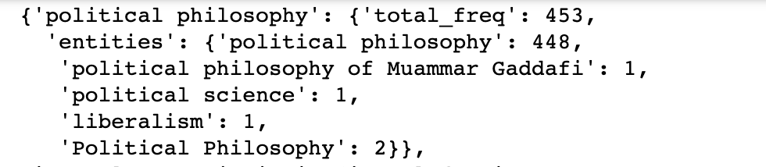
Prior Probability
Calculating prior probability for candidates
[mention,entity] Frequency: The times that the mention linked to the entity in Wikipedia KB
P(e|m) = [mention,entity] Frequency / All the [mention, entity] pairs Frequency for each mention
Format:
data[mention] = {‘total_freq’: counts, ‘entities’:{‘entity1’:counts,’entity2’:counts}}
e.g. data:

Slide 6
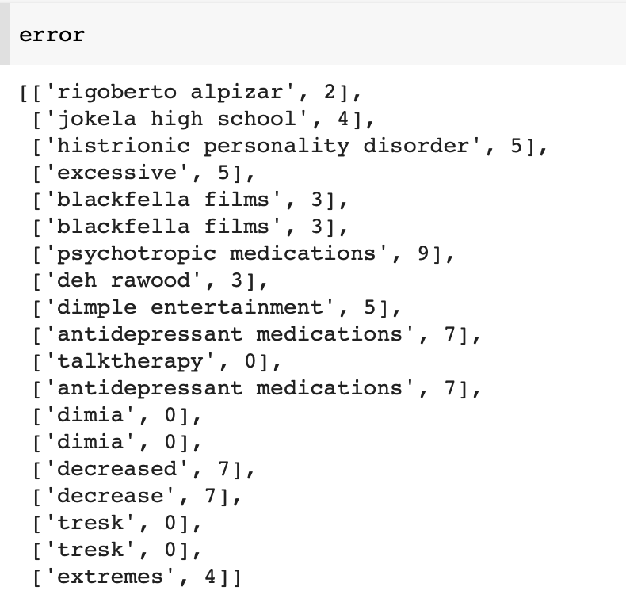
Prior Probability
Integrate with BT data
Entities selection is based on wiki KB API
Transformed mentions to get 10 candidates
Many[mention,entity] pairs are not exist in wiki KB
Solution:
Select candidates directly based on wikipediatextfile
Extract Entities from the frequency.json
Normalize the mention (lower(), re.sub)
Got 128 mentions have less than 10 candidates
Generate new mentions e.g. “air marshal service” to “air marshal”
Integrate frequency with the old mentions
Remove 19 mentions

Slide 7
BT final dataset
{"1.json": [{"mention": "United States", "leftctx": "A ", "rightctx": " federal air marshal shot dead on Wednesday an American Airlines passenger named Rigoberto Alpizar on American Airlines Flight 924 a Boeing 757 at Miami International Airport in Miami Florida USA The 44yearold passenger ran out of the door of the airplane after he reboarded the plane following a customs check in Miami He was intercepted by the marshals before reaching the jetway and told to get on the ground According to Air Marshal Service spokesman Dave Adams the passenger did so but then reached for a bag at which point a marshal fired two or three shots", "candidates": [{"entityid": "Q41700", "entityname": "United States", "prior": 0.972}, {"entityid": "Q232865", "entityname": "United States", "prior": 0.972}, {"entityid": "Q4917", "entityname": "United States dollar", "prior": 0.0}, {"entityid": "Q29552", "entityname": "Democratic Party", "prior": 0.0}, {"entityid": "Q29468", "entityname": "Republican Party", "prior": 0}, {"entityid": "Q8676", "entityname": "American Civil War", "prior": 0.0}, {"entityid": "Q11220", "entityname": "United States Navy", "prior": 0.0}, {"entityid": "Q11201", "entityname": "Supreme Court of the United States", "prior": 0.0}, {"entityid": "Q9212", "entityname": "United States Army", "prior": 0.0}, {"entityid": "Q11696", "entityname": "President of the United States", "prior": 0.0}], "gold": {"entityid": "Q30", "entityname": "United States of America"}},

Slide 8
BT final dataset
Considering the relations among the mentions: seceondary context
Dict[‘sentences’] : lists of splitted sentences in the whole document
Dict[‘m’]: sentid : index of the sentence lists, start/end: Index of the mentions in this sentence
e.g. Mention: {"sentences": [["On", "Wednesday,", "the", "total", "number", "of", "confirmed", "deaths", "linked", "to", "SARS-CoV-2", "coronavirus", "infections", "surpassed", "100,000", "in", "the", "United", "States,", "Johns", "Hopkins", "University", "data", "indicated."], ["On", "Wednesday,", "the", "total", "number", "of", "confirmed", "deaths", "linked", "to", "SARS-CoV-2", "coronavirus", "infections", "surpassed", "100,000", "in", "the", "United", "States,", "Johns", "Hopkins", "University", "data", "indicated."], ...........], "m": [{"sentid": 0, "start": 7, "end": 7}]}

Slide 9
End2End paper updates
Done
Preprocessing AIDA dataset and understanding the steps required for the BT data
In Progress
Transforming BT Dataset
Training/Testing
Next Step
Run the model on BT server

Slide 10
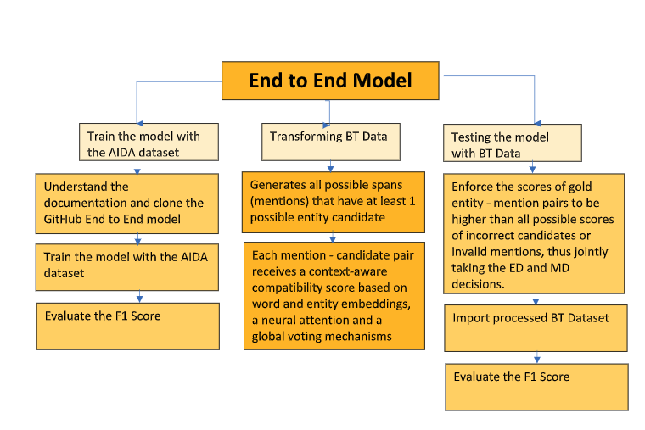
End2End - workflow
Notes:
Using word2vec to transform all the words to a number so that we can use the model for testing

Slide 11
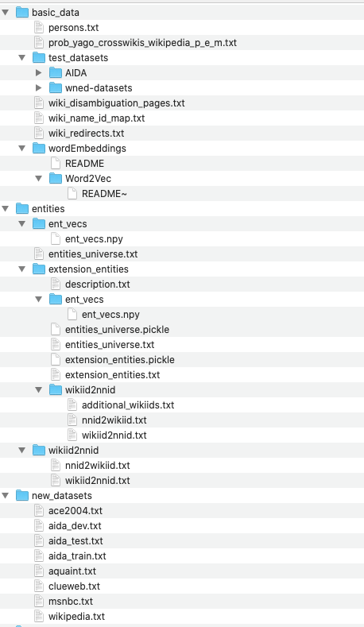
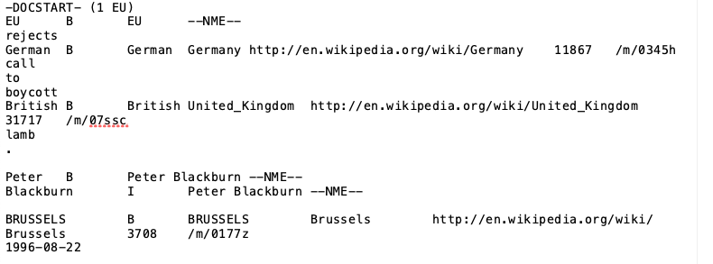
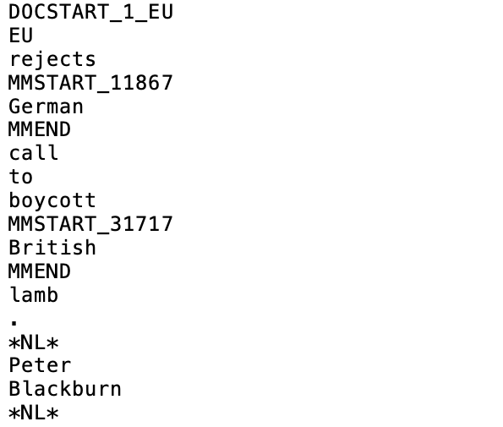
End2End - data preprocessing
Data End2End provided:
new dataset: what they used directly for training and testing
traning data:
entities:
chose candidate group for Aida dataset
all these candidate group formed entities-universe
(only consist of wiki id and entities)
wiki id for generating vectors in the model part

Slide 12
End2End - BT data
Candidate group -- wiki API
entity & wiki id
Word2Vec
trained AIDA as well as other datasets to convert words -> vector
used the pre-trained directly
based on Aida
BT data

Slide 13
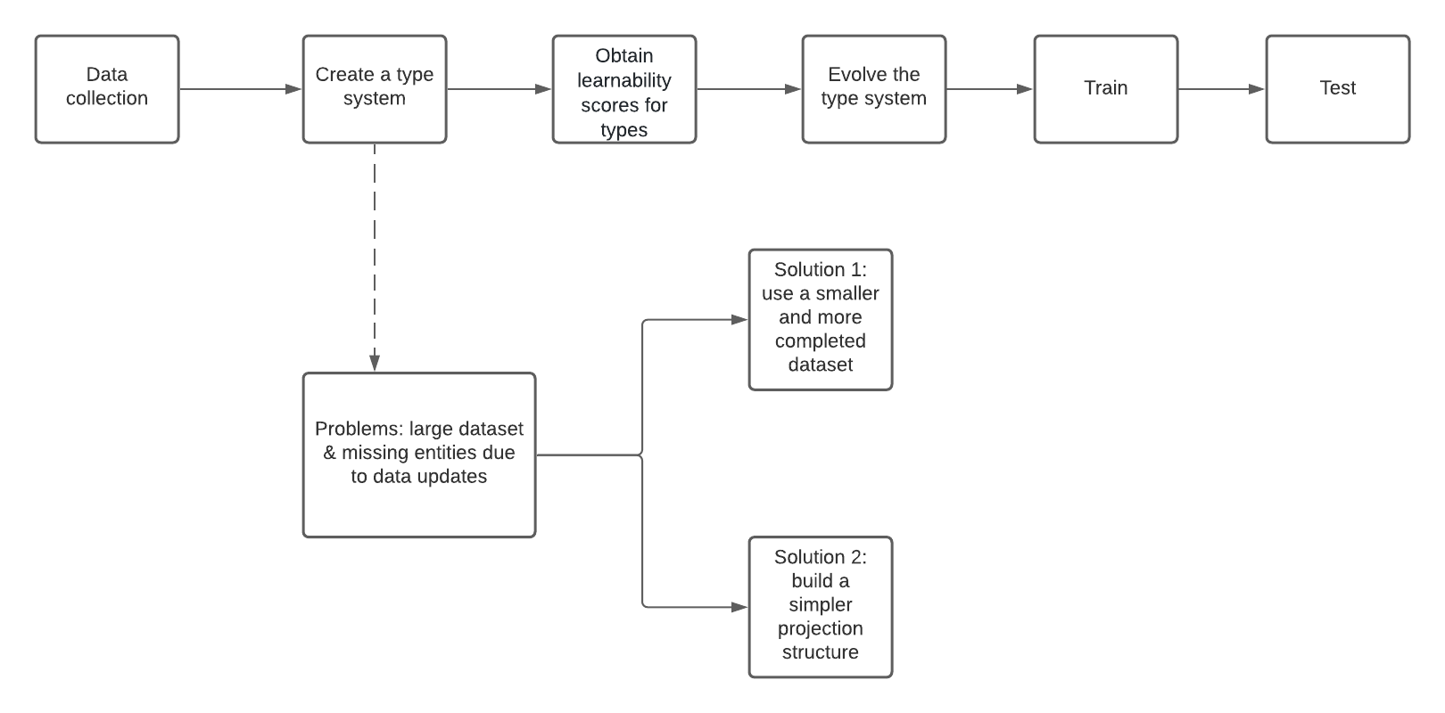
DeepType Implementation Workflow

Slide 14
DeepType Implementation Updates
Approach 1
Done
Formatting converted documents to wiki-article format supported by deepType github implementation
Extracting wikidata details for each mention using Pywikibot
Generating candidate lists for each mention
In Progress
Refactoring pywikibot response to json format that deepType github implementation support
Next Step
Plan to train using github code on transformed data and calculate F1 score

Slide 15
DeepType Implementation Updates
Approach 2
Done
Created type system knowledge graph for all candidate entities for mention in the AIDA dataset
Produced type_classifier dataframe to standardize all related entities
Tried to use deeptype code to evaluate type system & evaluate learnability, getting various issue because of difference in the dataset format.
In Progress
Exploring Graph Neural Network to train the graph
Next Step
Plan to train graph to be able to classify among various candidate entities and calculate F1 score.

