Slide 1


Entity Linking WPI GQP
Project Updates
Team members
Kratika Agrawal, Vandana Anand, Xinlu He,
Min Huang, Soumya Joshi, Jing Yu
Week 13 - Nov.23th

Slide 2
Latent Relations paper updates
Done
Completed training work with bt dataset
Completed testing work
In Progress
Organizing the code and preparing for final presentation
Next Step
Preparing the 5 min Slides and Video for the GRIE event

Slide 3
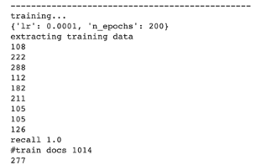
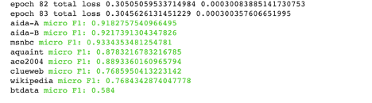
Latent Relations paper updates
BT: 60 docs for training, 10 docs for testing
Training docs: 1014
Total Mentions: 2404, Mentions(more than 5 candidates): 1551

Slide 4
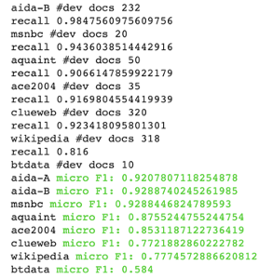
Latent Relations paper updates
Testing result:
BT docs: 10
Total mentions: 454
Mentions (more than 5 candidates): 284
F1 score: 0.584
Last result: 0.409

Slide 5
End2End paper updates
Done
Completed training model
Completed testing model with AIDA/other datasets
Preprocessed entire BT dataset to be compatible with End2End
In Progress
Work on testing BT data
Work on Final paper and presentation
Next Step
Prepare Final Presentation Materials
Notes:
Testing BT -> We tried converting the BT dataset into an XML format but got errors there. Also tried to process the entire BT dataset and the model gave invalid error argument which was the same as last time. Xinlu will talk about it in more detail

Slide 6
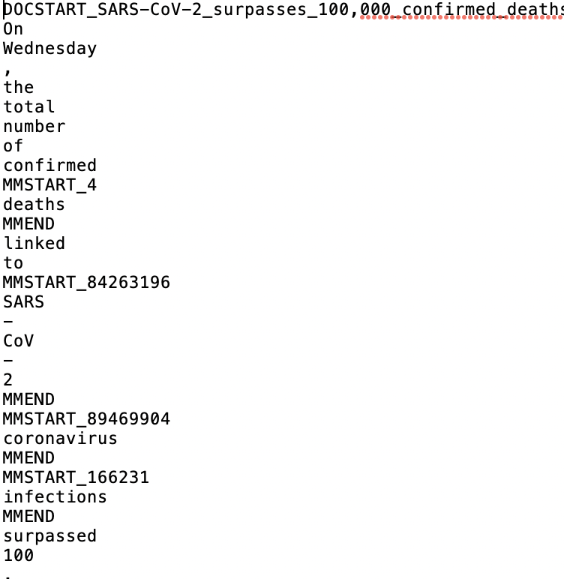
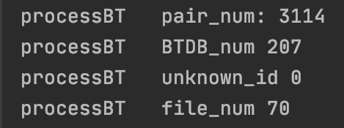
End2End-Transfer the input format
Doc start: DOCSTART_fileName
row: word or punc
mention: start with “MMSTART_Wikiid”
end with “MMEND”
between paragraph: *NL*

Slide 7
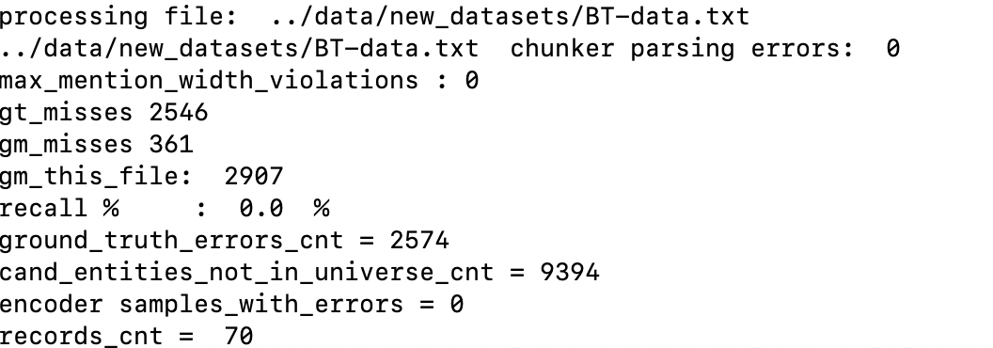
End2End-Word2Vec/Candidate/TFRecords

Slide 8
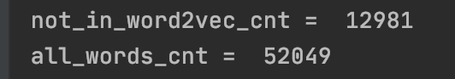
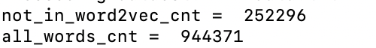
End2End Challenge--Word2Vec
BT’s data:
all data:

Slide 9
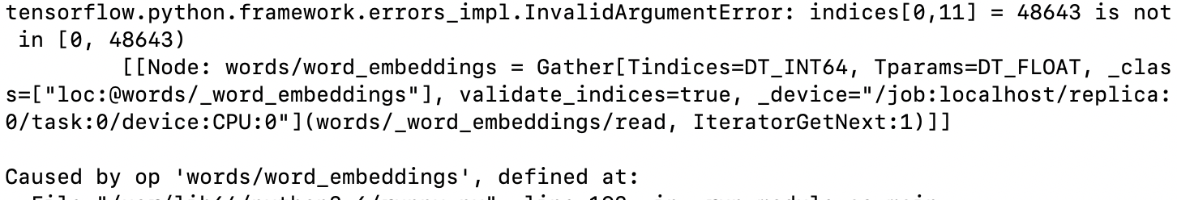
End2End--Test
Notes:
pretrained

Slide 10
Novel Disambiguation: Development Phases
Get nodes and edges from generated Graph
Translate Graph Information to build Adjacency matrices
Convert Adjacency matrix to build tensor to input to CNN model
Disambiguate entities multi-output classification
Build CNN architecture to learn various features

Slide 11
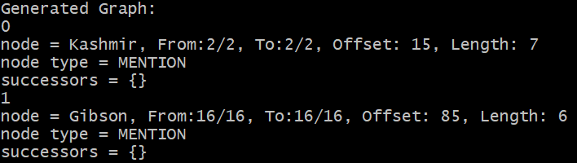
Developing graphs
Done:
Use Robust Disambiguation technique code to produce graph
https://github.com/codepie/aida
Extract Mention Nodes, Entity Nodes and edge information from the generated graph
In Progress:
Run recommended softwares to generate dataset to be used for generating graphs for training

Slide 12
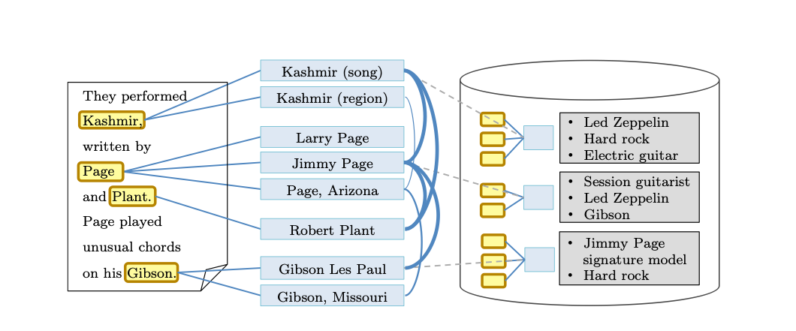
Adjacency Matrices:
Starting from a simplified version
e.g.

Slide 13
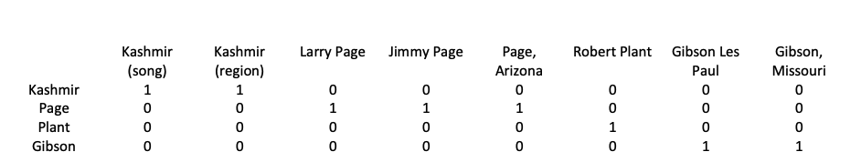
Adjacency Matrices:
Starting from a simplified version
e.g.
Mention-Entity Adjacency Matrix:

Slide 14
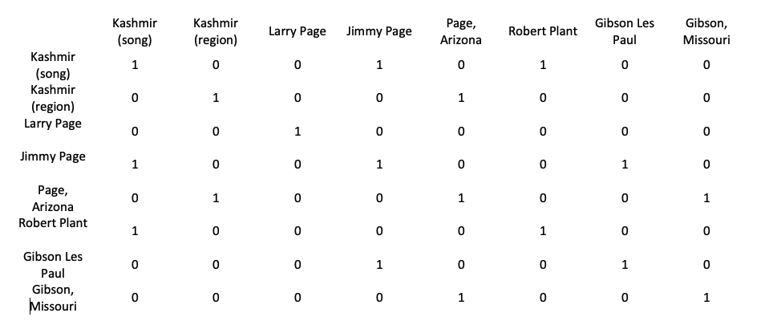
Adjacency Matrices:
Starting from a simplified version
e.g.
Entity-Entity Adjacency Matrix:

Slide 15
CNN Architecture:
Input: A tensor of shape 4x8x8
Output: A matrix of shape 4x(max_length_of_candidates_list)
Architecture:
Convolution a tensor of shape 4xmxm
ReLU same shape
Pooling a tensor of shape 4x(m’)x(m’)
…
Fully Connected Layer with softmax function and multi-class entropy as loss function

Slide 16
Multi-object Classification:
Consider multi-mention entity disambiguation as Multi-Object Classification problem
Let, m = number of mentions in a text document
e_{m} = number of candidate entities per mention (5 for Constrained graph development)
Split the CNN at the end to have m fully connected networks, each with e_{m} end nodes
Use Softmax to disambiguate among various entities for each mention

