Slide 1


Entity Linking WPI GQP
Project Updates
Team members
Kratika Agrawal, Vandana Anand, Xinlu He,
Min Huang, Soumya Joshi, Jing Yu
Week 4 - Oct.2nd

Slide 2
What we have done
Finished project proposal
3~6 weeks for implementation
Split into 3 groups and started studying the paper code
Created AIDA-YAGO2-Dataset based on provided CoNLL 2003 dataset
Digged deeper in evualation methods

Slide 3
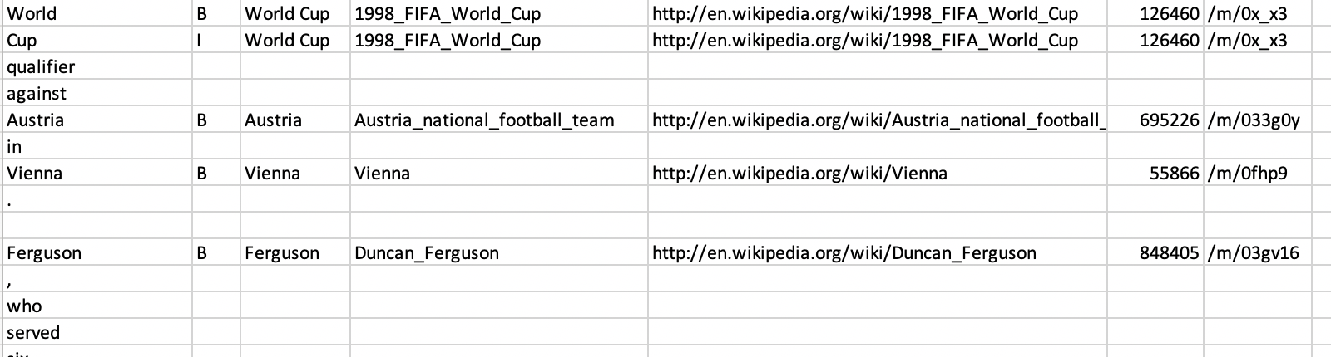
Aida CoNLL
Size: About 180,000 rows, 7 columns
column 1 is the token
column 2 is either B (beginning of a mention) or I (continuation of a mention)
column 3 is the full mention used to find entity candidates
column 4 is the corresponding YAGO2 entity (NME means no matching entity )
column 5 is the corresponding Wikipedia URL of the entity
column 6 is the corresponding Wikipedia ID of the entity
column 7 is the corresponding Freebase mid, if there is one

Slide 4
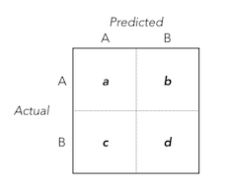

F1 score is a better choice in Entity Linking
F1 score vs Weighted F1 score
F1 = 2 * (precision * recall) / (precision + recall)
Weighted F1 score: find their average weighted by support (the number of true instances for each label)
Weighted F1 score approximately equals to accuracy when accuracy is high
The difference between the two statistics is
When b & c (false predictions) were small, the difference is relatively small.

