Slide 1


Entity Linking WPI GQP
Project Updates
Team members
Kratika Agrawal, Vandana Anand, Xinlu He,
Min Huang, Soumya Joshi, Jing Yu
Week 8 - Oct.19th

Slide 2
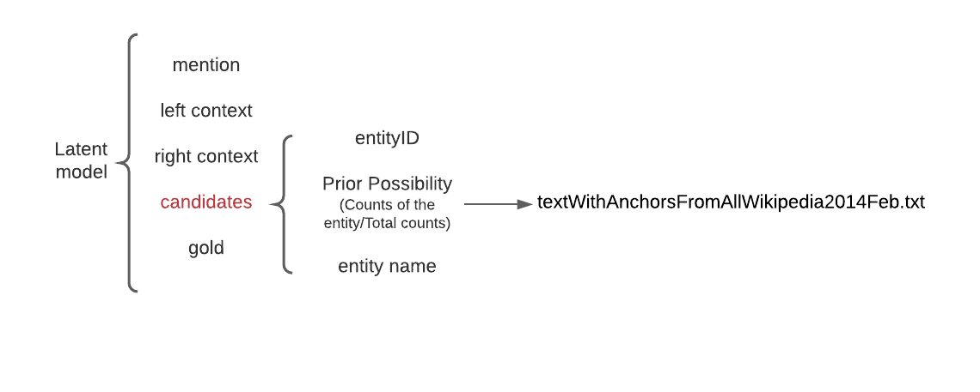
Latent Relations paper updates

Slide 3
Latent Relations paper updates
Process the BT dataset
Keep entity_id starts with Q
Mention
left context, right context
at most 100 words
raw text without punctuation
candidates
wbsearchentities API
‘entityid’, ‘entityname’
gold
wbgetentities API
Next steps
Calculate prior possibility for each entities
Run the model
e.g. {'mention': 'personality disorders', 'leftctx': 'Filmmakers know ', 'rightctx': ' make for compelling viewing Think of attention-seeking Scarlett OHara in Gone with the Wind 1939 Or the manipulation and callous disregard for others in Silence of the Lambs 1991 XXXXX', 'candidates': [{'entityid': 'Q56391664', 'entityname': 'Personality disorders'}, {'entityid': 'Q72048735', 'entityname': 'Personality disorders'}, {'entityid': 'Q69457737', 'entityname': 'Personality disorders'}, {'entityid': 'Q67340445', 'entityname': 'Personality disorders'}, {'entityid': 'Q60644282', 'entityname': 'Personality disorders'}, {'entityid': 'Q60645063', 'entityname': 'Personality Disorders'}, {'entityid': 'Q60641012', 'entityname': 'Personality Disorders'}], 'gold': {'entityid': 'Q270673', 'entityname': 'personality disorder'}}

Slide 4
End2End paper updates
Integrating github code with the research paper understanding
Working on extracting candidate pairs
Also need to perform prior possibility
Downloaded Wikibase which is very large and difficult to run locally

Slide 5
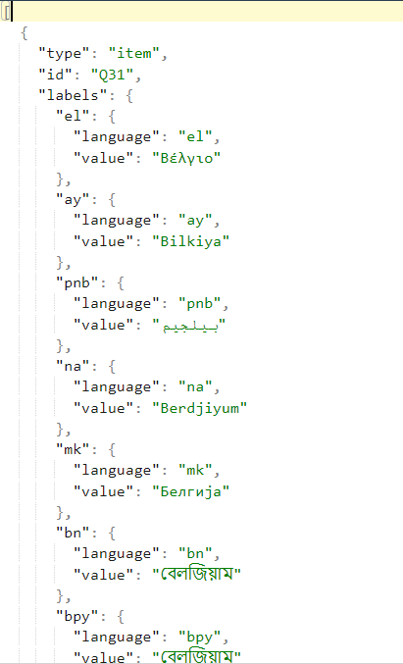
DeepType Implementation Updates
Downloaded entire Wikidata: https://dumps.wikimedia.org/wikidatawiki/entities/latest-all.json.bz2 (55.5 GB)
Size after unzipping (~160 GB)
Recorded few records (9)

Slide 6
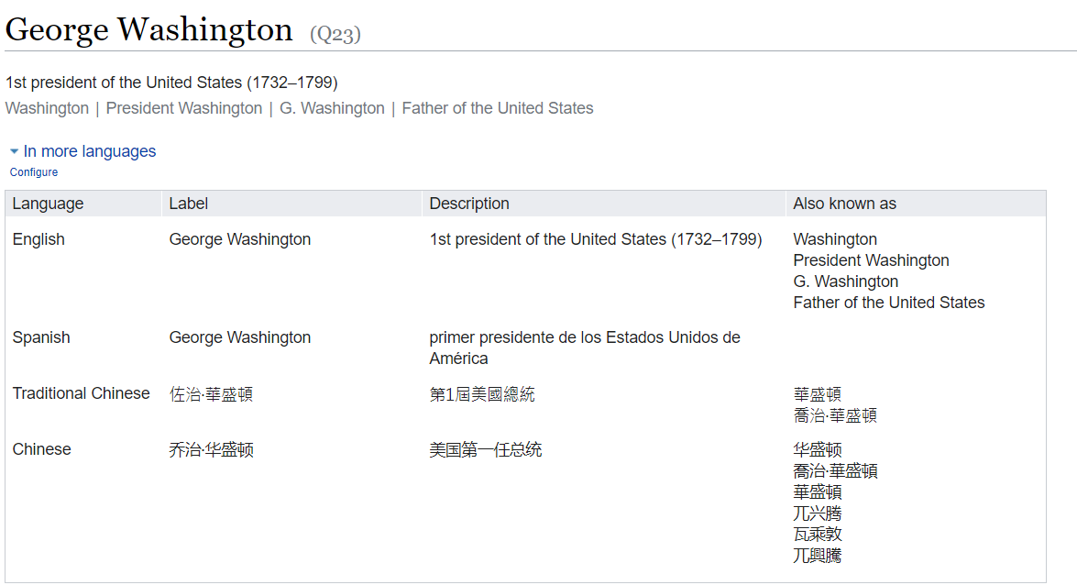
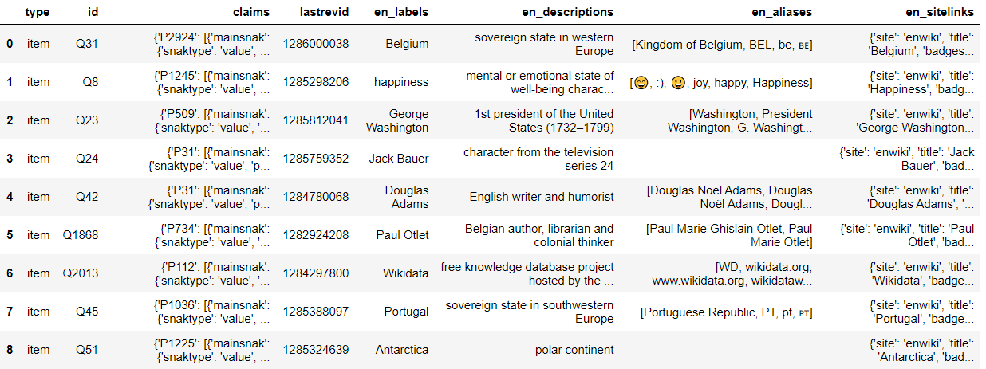
DeepType: Visualization in DataFrame Format
For only English language:

Slide 7
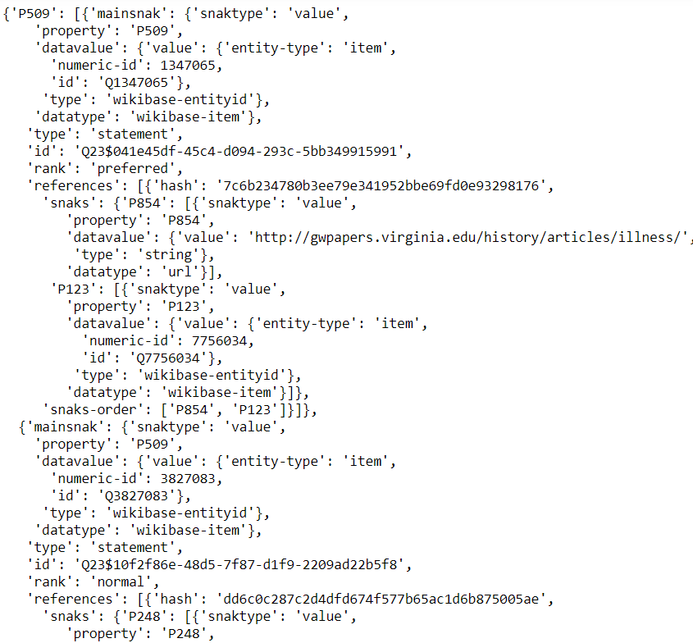




DeepType: Understanding Column “Claims”:

Slide 8
DeepType: WikiArticle Dataset:
Downloaded WikiArticle Dataset for English Language: https://dumps.wikimedia.org/enwiki/latest/enwiki-latest-pages-articles.xml.bz2 (16.5 GB)
Size after unzipping ~ 75 GB
A few lines of xml recorded (top 1000)
Used to build Graph of Wiki entities, define relation.

Slide 9
DeepType: Difficulties:
Very large amount of data.
Need more processing memory.
Need to load all entities and articles to build graph
Looking for saved Project Graph

