Slide 1


Novel Disambiguation Model
WPI-GQP

Slide 2
Document Pre-processing
Document pre-processing:
repository https://github.com/codepie/aida
From repository, Generate graph at step:
mpi.aida.graph.GraphGenerate.java function: run() get graph nodes and edge details at this step
Translate graph nodes and edges to adjacency matrices:
Mention-Entity Matrix (save as npy)
Entity-Entity Matrix (save as npy)

Slide 3
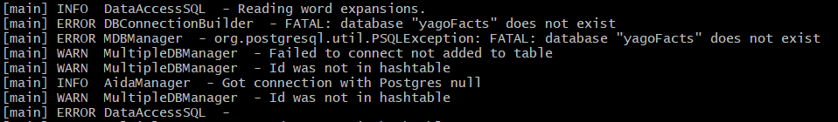
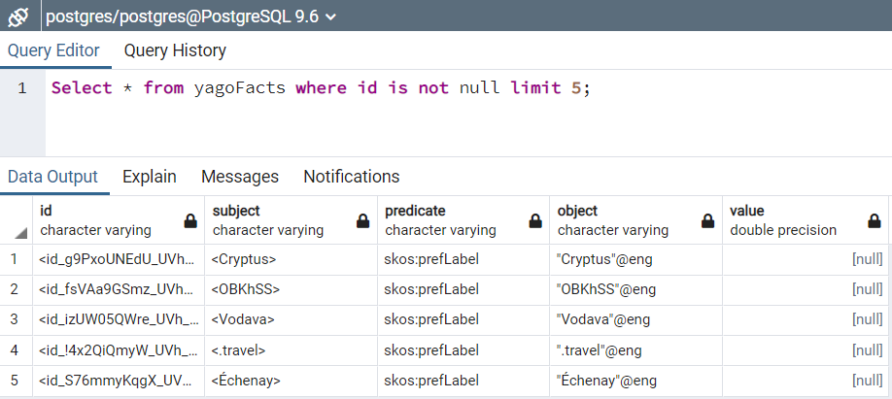
Graph Generation:
Failing to establish connection with Postgres:
Data in the Postgres:

Slide 4
Wikipedia2Vec Embeddings:
Download pre-trained Wikipedia2Vec embeddings:
https://wikipedia2vec.github.io/wikipedia2vec/pretrained/
enwiki_20180420 => 100d (txt)
Generate embeddings for all mentions, save them to csv
Generate embeddings for all candidate entities, save them to csv

Slide 5
CNN Input:
List of all mentions
List of list of all Candidate entities (max to 5 for each mention)
Input 1 => Multiply(mention_embeddings, mention-entity_adjacency, entity_embeddings)
Input 2 => Multiply(entity_embeddings, entity-entity_adjacency, entity_embeddings)

Slide 6
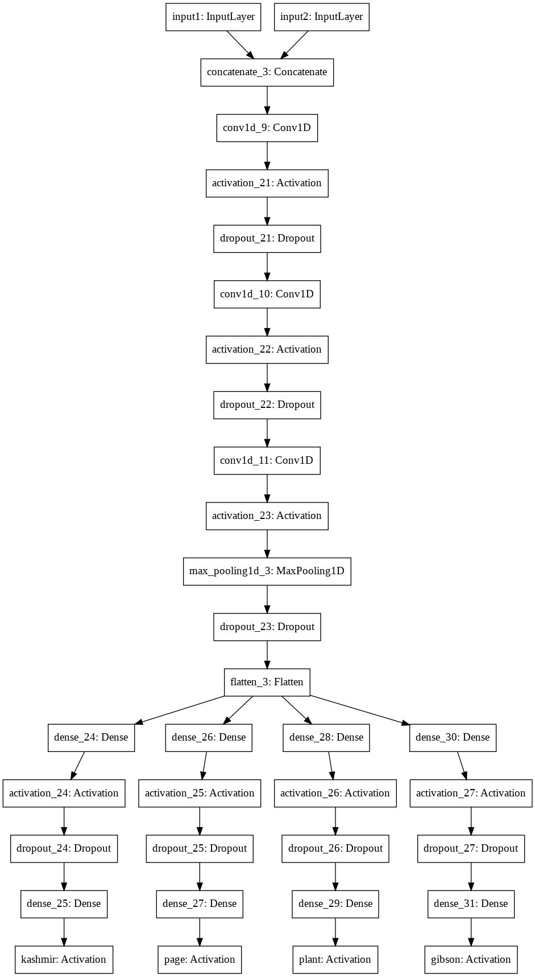

CNN Model:
Concatenate two inputs
Try to learn matrix features
Divide Flatten layer to be learnt for various mentions
Softmax Activation on last layer of each branch
Output => One-hot vector in each branch
Model Summary:

