Slide 1


Understanding Robust Disambiguation of Named Entities in Text
WPI-GQP

Slide 2
Robust Disambiguation
Disambiguation Technique that combines three measures:
Prior probability of a mentioned entity
Similarity between the context of the mention to candidate entities
Coherence among candidate entities for all mentions together
These steps will build a weighted graph of mention and candidate entities.
Compute a dense sub-graph that approximates the best joint mention-entity mapping

Slide 3
Prior Probability:
Identify all mentions in a text document
List all candidate entities for each mention using WikiSearchAPI
Prior Probability: a measure of popularity of an entity
Defines the “frequencies” based on Wikipedia link anchor text referring to specific entities.
For each surface form that constitutes an anchor text, count how often it refers to a particular entity: it is an estimate of probability distribution over candidate entities.
Eg: “Kashmir” refers to Kashmir (the region) in 90.91% of all occurrences, Kashmir (Song) in 5.45%.

Slide 4




Context Similarity:
Two approaches:
For each mention, construct a context from all words in the input text.
It represents mention as set of weighted words or phrases
For each candidate entity, KP(e) => keyphrase set
For each word w in keyphrase: compute specificity weight => the MI (Mutual Information) between entity e and keywork w
Also allows partial matches of entities’ keyphrases in the text.
The score for partially matching phrase q in a text set is:
where,
Aggregated Similarity Score for all keyphrase words:
= MI weight or IDF weight of keyphrase word w

Slide 5
Context Similarity:
Two approaches:
2. Consider similarity score based on syntactically-parsed context
Associate each entity with characteristic key phrases or words.
Eg: “Page”
Larry Page: keyphrases like “Stanford”, “search engine”, etc.
Jimmy Page: keyphrases like “Gibson guitar”, “hard rock”, etc.
Compute similarity measure between a mention and entity candidates.
Train using large corpus to collect statistics to rank candidate entities as per their compatibility with the verb
Consider a set of substitutes for each possible entity e, which is taken as its context cxt(e)
Syntax-based similarity between cxt(e) and cxt(m) => sum of the scalar-product similarity between two vectors for each substitute.

Slide 6
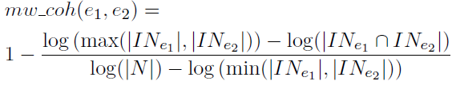
Coherence among Entities:
Coherence among two entities => the number of incoming links that their Wikipedia articles share
where, IN = Incoming links N = Total number of entities
It’s based on the notion that entities that co-occur in a text document have some semantic relationship or have the same semantic type
Eg: Most texts deal with a single or few semantically related topics, like, rock music, internet technology or global warming and not all together
Distance between two entities => type and subclassOf edges

Slide 7
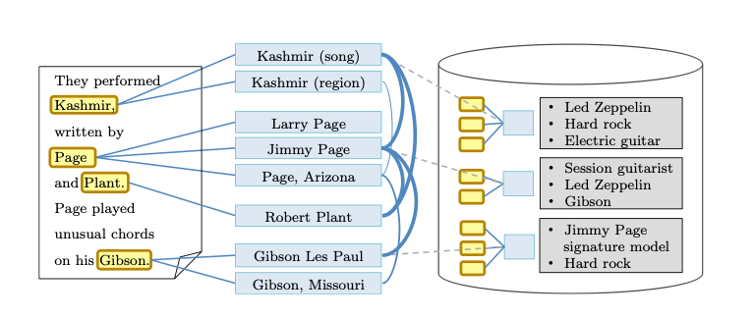
Graph Modelling:
based on coherence score
based on popularity prior & similarity score

Slide 8
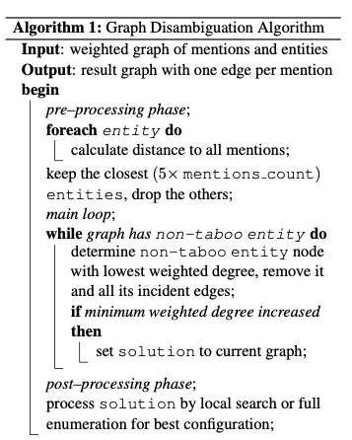
Graph Algorithm:
An entity is taboo if it is the last candidate for a mention it is connected to

Slide 9

Robustness Tests:
Prior Test:
For each mention, if probability prior is above some threshold, eg. 90%, use priors, otherwise disregard in computing mention-entity edge weights.
Coherence Test:
Compute L1 distance between prior probability and similarity-only measure
If the difference is more than a threshold, then Coherence test might fix it
Else, if the difference is less than the threshold, then Coherence test might add risk for thematically heterogeneous text

Slide 10
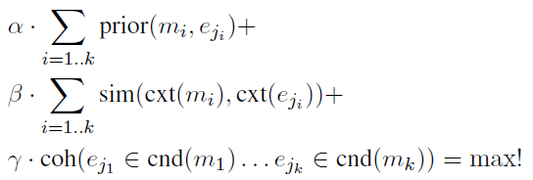
Overall Objective:
For each mention m_{i}, i=1...k, select entity candidates e_{ji}:

Slide 11
Parameter Tuning
Using SVM classifier on CoNLL training set to find optimal values of parameters in the objective function
Turn to CNN to do the tuning job?

Slide 12
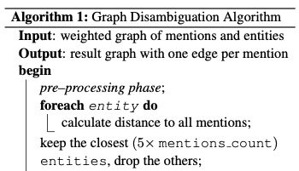
Queries:
In the preprocessing part of the algorithm, why it starts from an entity node instead of a mention node?
How the SVM classifier works in parameter tuning? Are classes defined as True (linking to the right entity) & False (not linking to the right entity) ?

Slide 13
Queries:
Research Paper Reference: https://www.aclweb.org/anthology/D11-1072.pdf

