Slide 1
Midterm Assignment Elevator Design MS585 UX Design
BY: Vandana anand

Slide 2

PART 1: Starting Point

Slide 3


User Rides the Elevator
User is in the lobby and pushes the up-arrow button to go to the top floor on the elevator
User reaches their destination on the top floor. The door opens and they exit
The elevator arrives and opens its doors, so the user enters
User tells someone else to push the button to their floor
User waits for a while without knowing where the elevator is stopped
There are a lot of people, so the user tries to find a spot to stand
The user tries to push the button to their floor but there’s too many buttons people in the way
User waits for everyone to leave the elevator and go to their floors
Notes:
This customer journey map shows my experience when entering an elevator at my workplace, a building with 14 floors. I pressed the up-arrow button to get to the top floor. I was waiting for the elevator for a long time not knowing which floor is has stopped on or an idea of how long I should be waiting there. Finally the elevator doors opened, and I saw a large amount of people in the compact shaft. I squeezed in and tried to push the floor number button, but I didn’t know which one to push because there were so many and too many people to see. I asked the person closest to the buttons to push the one for the top floor. It was intuitive in that I knew which buttons were for emergency and which ones were the floors, but the buttons were cluttered. I also had to wait for each person to get off on their floor before finally reaching the top at which point, I was running late for a meeting. Overall, the experience felt too long, confusing, and crowded. The good things about the experience were that the elevator itself was fast to get to the floors, but I spent time waiting for it to stop at each floor along the way. There was also a golden mirror background which looked modern. The limitations included there being no indication of which floor the elevator was currently stopped at when waiting to get into the elevator. There was no music that could’ve instigated a calm environment. The button interface was cluttered which could be condensed into an interactive screen format that the user can touch to interact and select the floor.

Slide 4
Two Interfaces in the Elevator Experience
1
2
3
4
5
6
7
8
9
10
11
12
13
14
STOP
CALL
First Interaction (Outside)
Second Interaction (inside elevator)

Slide 5
PART 2: Evolving

Slide 6
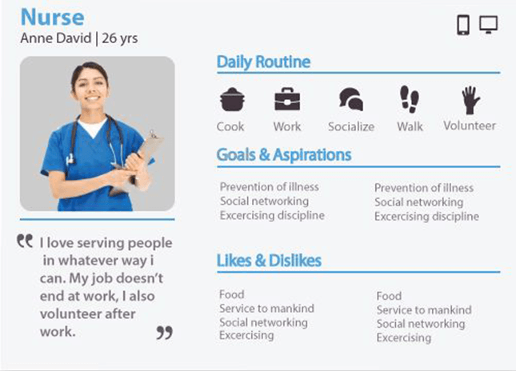
Engineer
Floor Indicator
Cassidy Lanor | 32 yrs
Floor 7
Walking into work at 8am, taking the elevator to the 21st floor, finishing the day at 5pm, taking the elevator back down to the lobby and leaving work
Getting to work as quickly as possible
Not being held up too long
Attend early morning meetings on time
My job is demanding so it’s important for me to get to work as quickly as possible
Elevator design
Functional
Crowded
Not time efficient
No floor indicators
Too many buttons
Music
Interactive Screen
Adding energetic music in the morning that gets people awake as well as soothing music in the evening
Floors
Emergency
Notes:
The innovation is to add music in the elevator depending on the time of day, adding a floor indicator to let people know which floor the elevator is currently at, and an interactive screen with floors and an emergency button. These innovations will help improve the existing design experience because the user would know which floor the elevator is at during its journey, allowing for them to know how long they may have to wait. Having music that suits different parts of the day could lift someone’s mood even if it’s for a few seconds. Energetic music in the morning could help people be enthusiastic about the res of the day and calming music in the evening could help create a peaceful mindset. In addition, the previous button interface could be condensed into an interactive screen format that the user can touch to interact and select the floor or call an emergency. Selecting the ‘floors’ button would have a list of floors with a scroll option. This would help reduce the clutter of buttons and make the interface easier to use.
The drawback is that a user could mistakenly click the emergency button when they didn’t mean to, which could trigger an alarm. There could be a confirmation to ask if this choice is really what the user wants to make. The design is not fully universal for larger buildings because if there are a lot of floors, the interactive screen wouldn’t help as it would have to feature all the floor numbers again. This would lead to the same problem as the buttons, making the whole interface confusing and difficult to use or understand.

Slide 7
PART 3: Extending

Slide 8
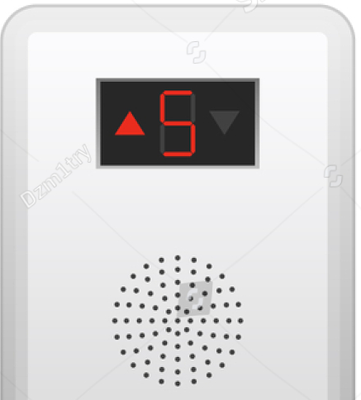
Voice Activation for Floors
Notes:
The design is not fully universal for larger buildings because if there are a lot of floors, the interactive screen wouldn’t help as it would have to feature all the floor numbers again. This would lead to the same problem as the buttons, making the whole interface confusing and difficult to use or understand. So, there could be a voice activation feature that would allow the user to say the floor they want instead of having to push any buttons. This would avoid the problem of having to find the floor button or asking others to push the floor button for you. The innovation could be managed by making a software that would allow user voice input and using that to select the floor.

