Slide 1

Determining a Business Closure
Team 6
Vandana Anand
Ye Hong
Weixiao Huang
Patrick Klaiber

Slide 2
Problem
Is there a correlation between [Businesses Closure] and their [Customer Reviews and Ratings]?

Slide 3
Importance and Interest
Sometimes your favorite store announces that they are closing down, but the issues causing them to close are not transparent.
There could be many issues causing a store to close. Which ones are the most consequential is questionable.
We want to figure out the relationship between some given factors that may impact a business to terminate and then communicate that reasoning to Yelp so that struggling businesses have a chance to survive in the market.
We will be investigating the restaurant business category because it the number one most occurring category out of the whole Yelp dataset.

Slide 4
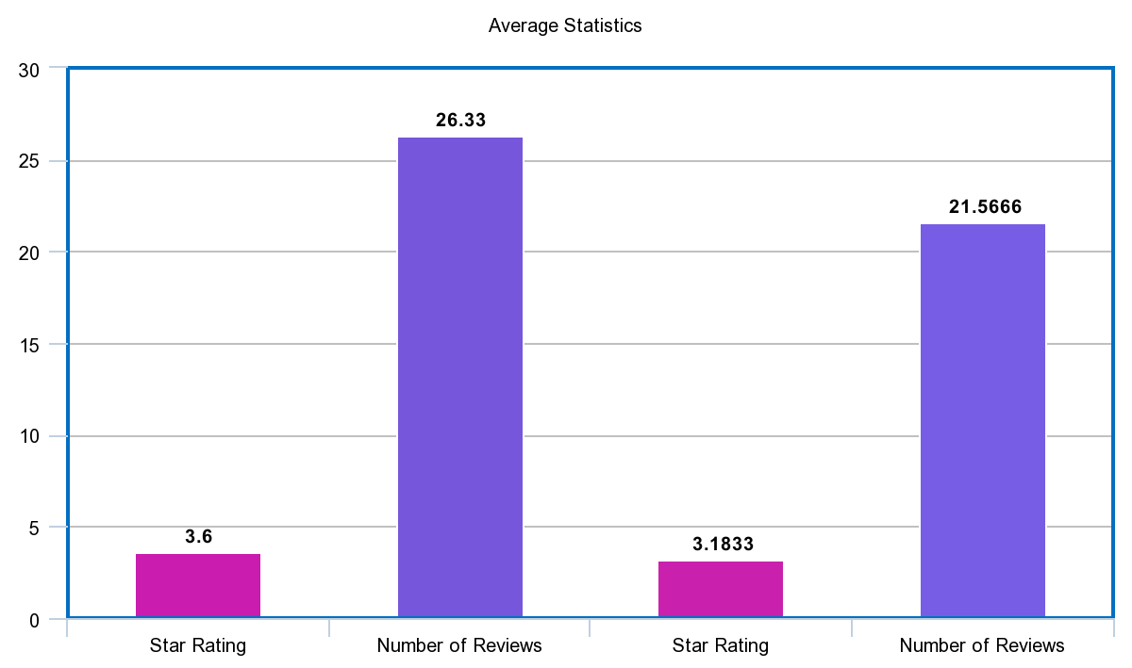
Star ratings/number of reviews of Closed Businesses
Star ratings/number of reviews of
Closed Restaurant Category Businesses

Slide 5

Solution
Collect data of the Closed Business regarding its ratings and customer reviews
Develop a Review Attitude Model and Rating Model to analyze how various factors (ratings and reviews in this case) impact the business closure
Future: Possibility of the Business Closure Prediction

Slide 6

Restaurant Closing Analysis
Rating and Other Attributes
Restaurant selection and review number threshold setting
Feature selection
Missing value handling
Modeling
Evaluation

Slide 7
Restaurant Closing Analysis
Rating and Other Attributes
Restaurant selection and rating number threshold setting
Over 17000 (17680) restaurants
Rating number must be >= 50
Few rating number – may high variance
Few rating number – unreliability

Slide 8
Restaurant Closing Analysis
Rating and Other Attributes
Feature Selection
From 90 features narrow down to 41 features
Rating number, rating star, food types, business time, parking availability and type, noise level, seat arrangement, decoration style, TV and WiFi availability, kids friendly, alcohol availability, food delivery, drive through, smoking allowing, disability friendly, pets friendly, music style, date of week operation, allergy identification, etc…

Slide 9
Restaurant Closing Analysis
Rating and Other Attributes
Missing value handling
Mean
Extreme value
XGBoost can automatically deal with sparse matrix

Slide 10
Restaurant Closing Analysis
Rating and Other Attributes
Modeling
Logistic regression
XGBoost
Evaluation
Confusion matrix

Slide 11

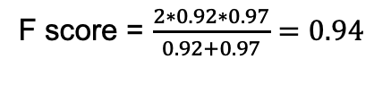
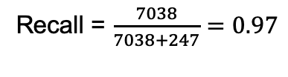
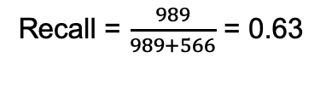
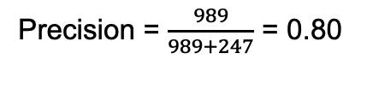
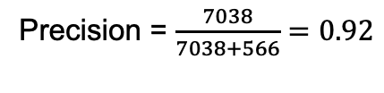
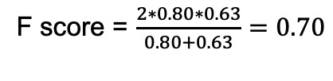
Result
 | Predict – open | Predict – close
True – open | 7038 | 247
True – close | 566 | 989
Precision = $\frac{7038}{7038+566}=0.92$
Recall = $\frac{7038}{7038+247}=0.97$
F score = $\frac{2∗0.92∗0.97}{0.92+0.97}=0.94$
Precision = $\frac{989}{989+247}$ = 0.80
Recall = $\frac{989}{989+566}$ = 0.63
F score = $\frac{2∗0.80∗0.63}{0.80+0.63}=0.70$

Slide 12
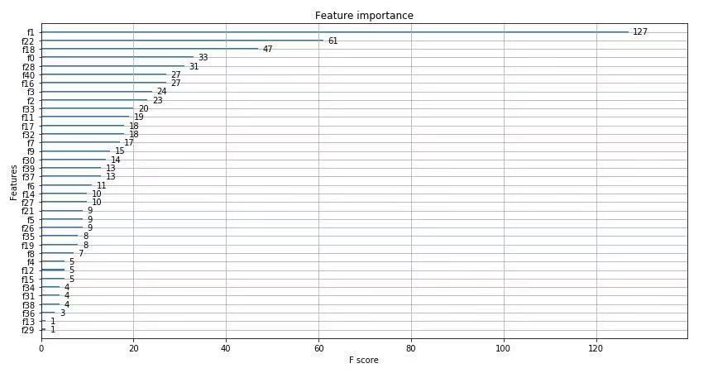
Result

Slide 13
Restaurant Closing Analysis
Key features which significantly affect restaurant closing
Review count
Bike parking
Restaurant table service (dine in)
Stars
Delivery
Credit card accepted
Caters
Good for meal
Restaurant reservation
TV availability

Slide 14
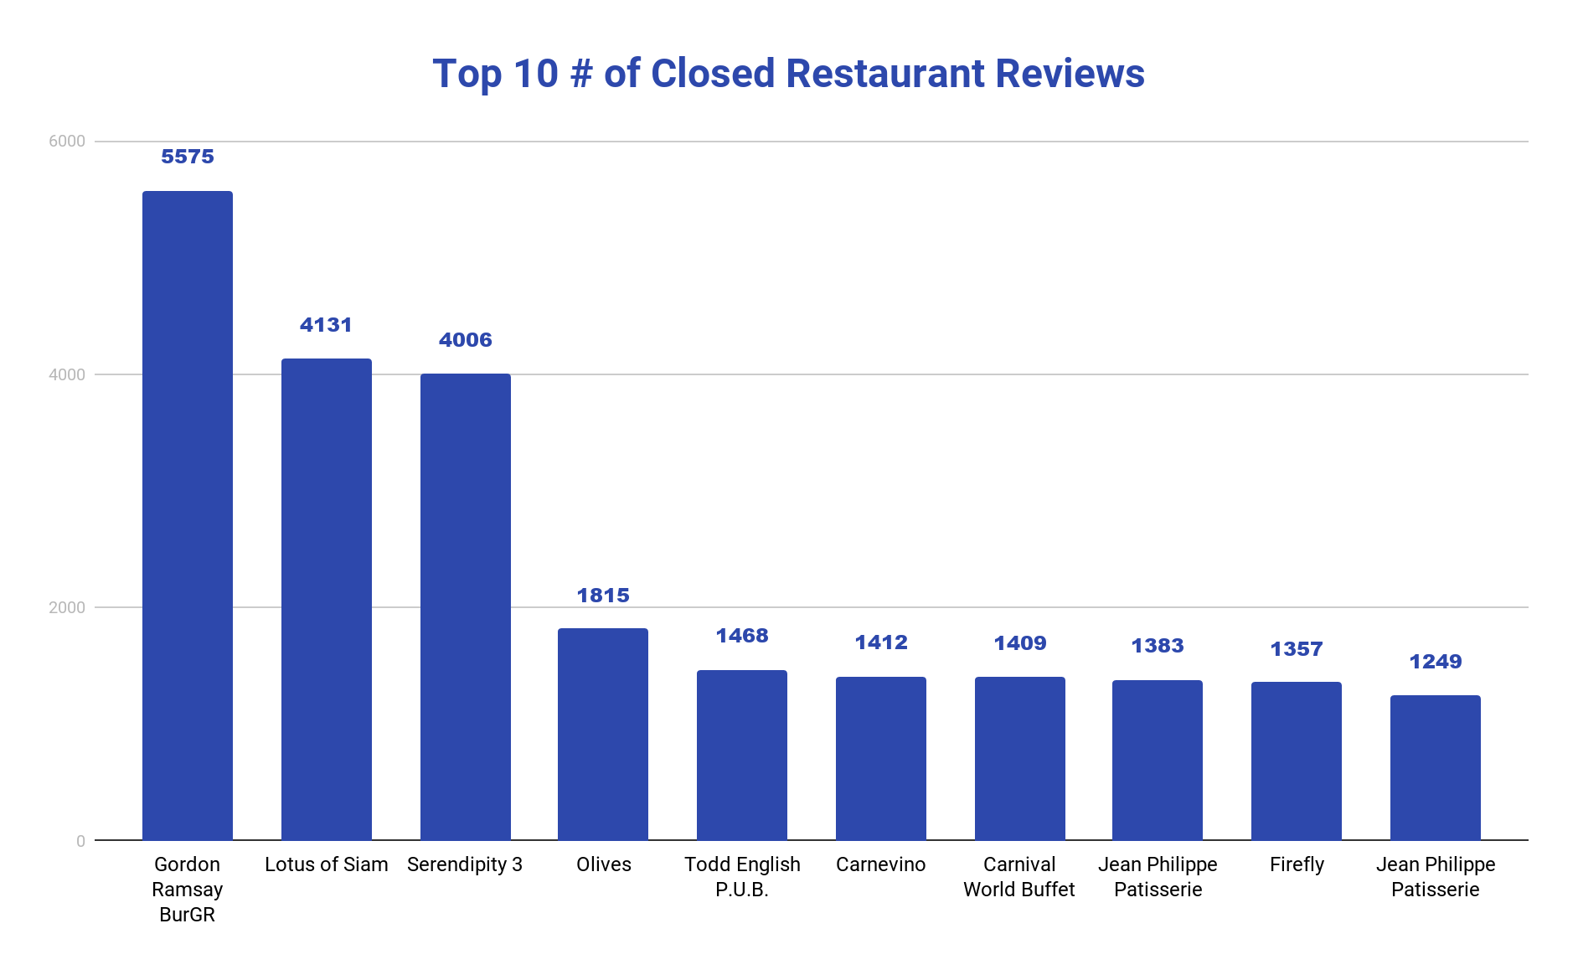

Slide 15
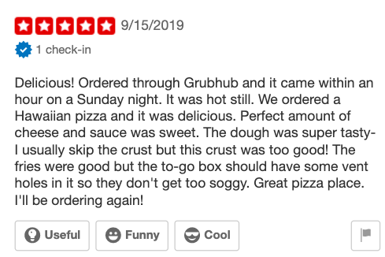
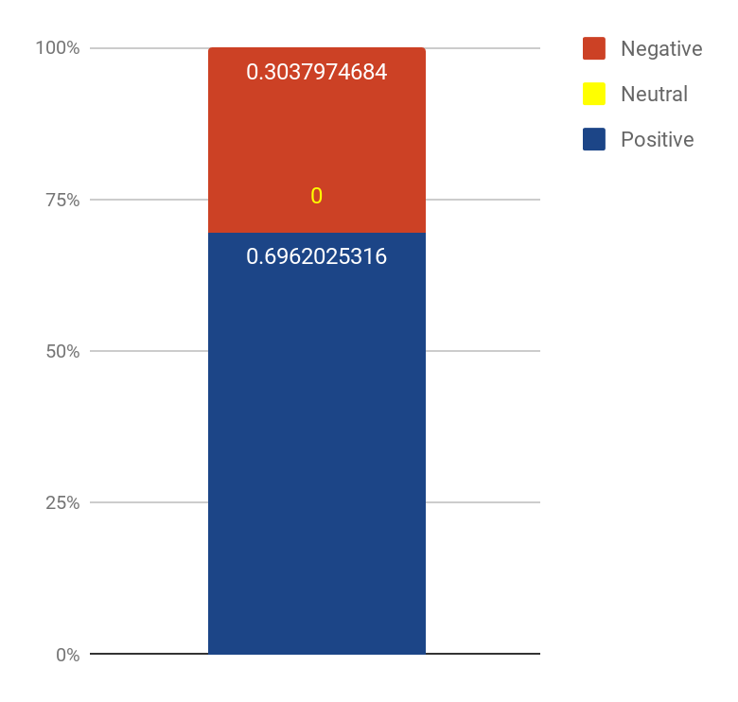
Review Attitude Model
Positive: 0.6962025316455697
Negative: 0.3037974683544304
Neutral: -5.551115123125783e-17

Slide 16
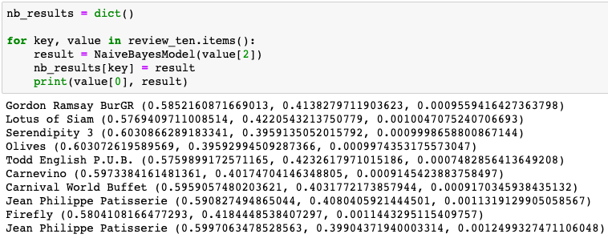
Testing Result

Slide 17
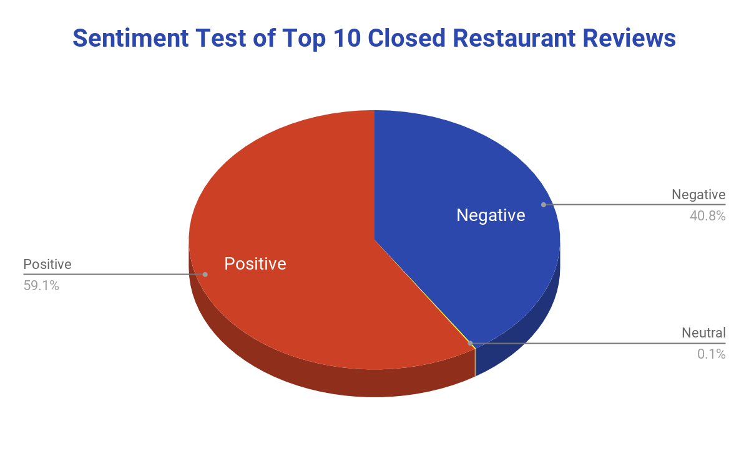

Slide 18
Conclusion
The closed restaurants in the Yelp dataset have around 3 star ratings, on average
Some of the interesting key features we found that can lead to a restaurant closing are: the business not having bike parking, TVs, or not accepting credit cards
The top 10 closed businesses only have about 60% positive reviews while the other 40% are negative reviews

Slide 19
Thank you!

