Slide 1


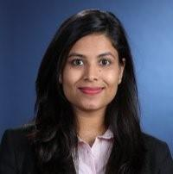

DS502/MA543
Statistical Methods for Data Science
Group 05: Final Project
Telecommunications Customer Churn Prediction
4/30/20
By:
Vandana Anand Kratika Agrawal Jiaju Shi

Slide 2

Project Overview & Goals
Fierce competition in the telecommunications industry
Understand customer churn characteristics to retain maximum amount of customers
Project Goals
Analyze which services cause customers to churn
Investigate which models provide the most accuracy
Notes:
With the increasingly fierce competition in the telecom industry, customer retention has become a key business indicator for the company's to achieve better operation and competitiveness.Our goal is to understand the characteristics of customers who stop using company's services, analyze the reasons behind it, predict whether customers will leave, calculate the retention rate of target users, and to provide the most accuracy and effective plans to retain those target users.

Slide 3


Telecom Churn Data is from Kaggle and provided by IBM
IBM is an American multinational technology and consulting company mainly producing and selling computer hardware and software products
Notes:
We used the data from Kaggle and provided by IBM which is an American multinational technology and consulting company mainly producing and selling computer hardwares and softwares.

Slide 4
Dataset
Data consists of 21 services or features that describe customers (both categorical and numerical)
Features are broken up into 4 groups:
Service that each customers has signed up for (ie. phone, internet, streaming)
Customer account information (ie. monthly/total charge, payment method, paperless billing)
Demographic information of each customer (ie. gender, age)
Whether a customer has churned or not
Notes:
The data set includes information from 7,043 users with 21 features (categorical and numerical) and the features can be divided into 4 groups

Slide 5
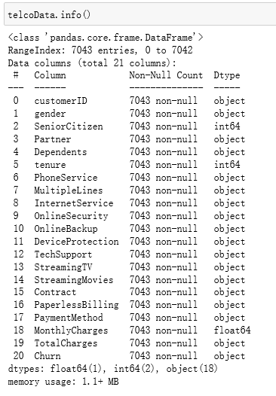
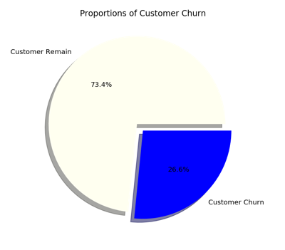
Data Exploration
The customer Churn is 26.6% of the total customers
Target: Churn
Features: Data #’s 1-19
Notes:
Because our purpose is to analyze the reasons of customer loss, first we will visualize the target value and analyze the characteristics of the basic data information. In order to facilitate the data operation in the future, we can see that the total number of customer loss is 26.6%

Slide 6
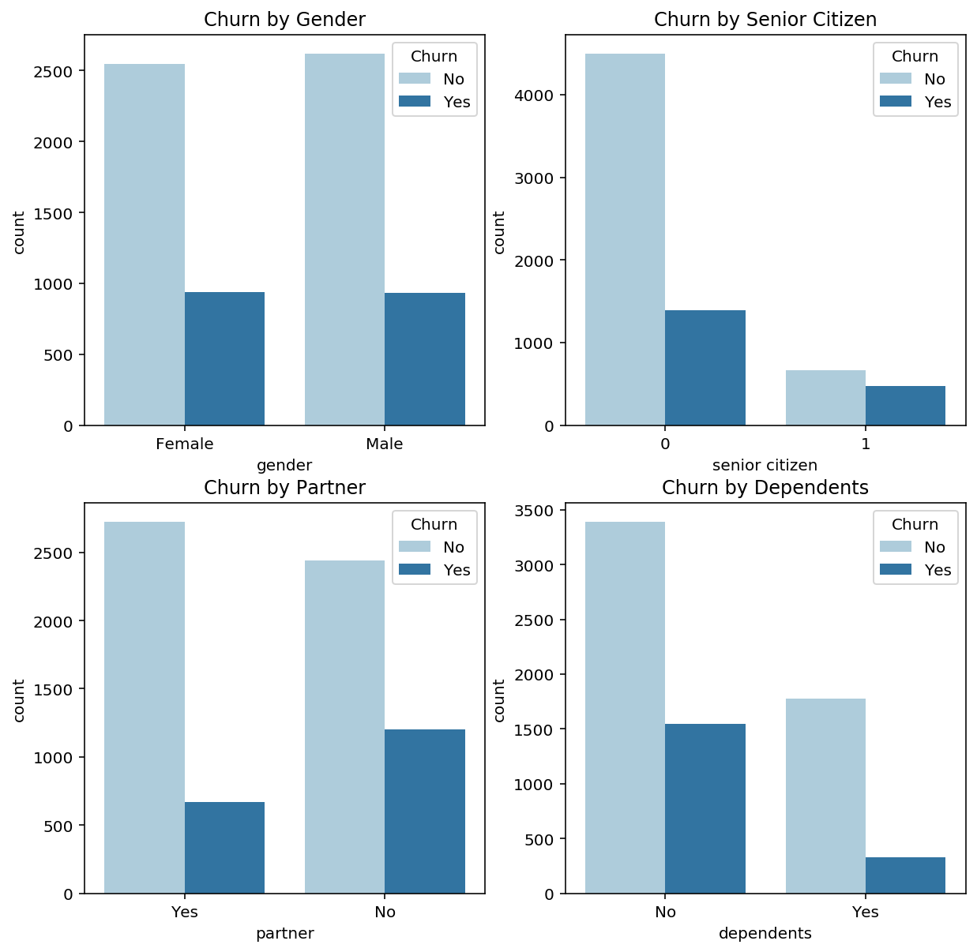
Categorical Data Churn
There was little difference in the loss of male and female users
The proportion of loss among elderly users is significantly higher than non-elderly users
The number of unmarried and married people in all the data was roughly the same, but the number of unmarried people loss was twice as fast as the number of married people loss
From the perspective of economic independence, the user turnover rate of economic independence is much higher than that of economic dependence.
Notes:
Then we also visualized all the categorical and numerical features.
There was little difference in the loss of male and female users
The proportion of loss among elderly users is significantly higher than that of non-elderly users which probably means the churn does not matter about the gender
The number of unmarried and married people in all the data was roughly the same, but the number of unmarried people lost was twice as fast as the number of married people lost
From the perspective of economic independence, the user turnover rate of economic independence is much higher than that of economic independence.

Slide 7
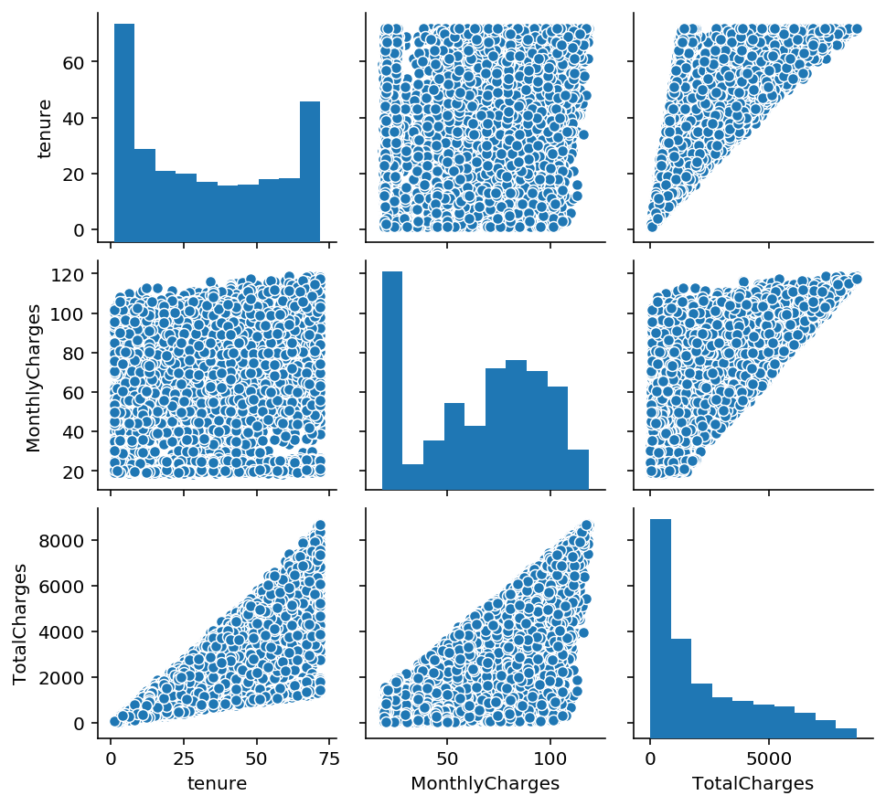
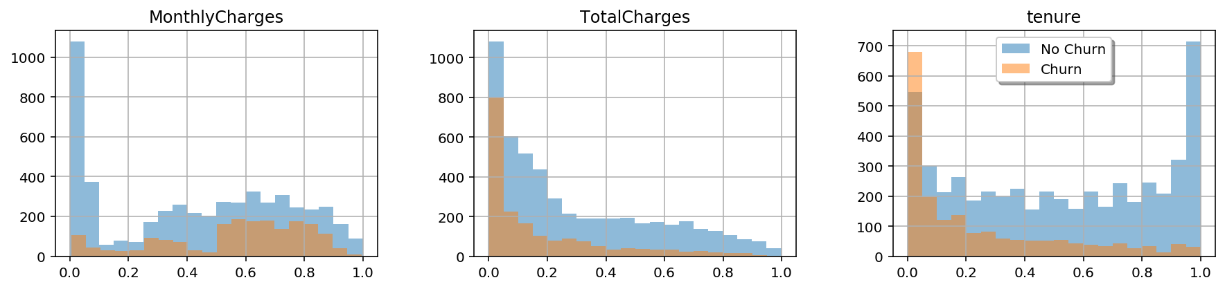
Numerical Data Set
We can observe that as Totalcharges and tenure increase, the probability of Churn also decreases.
Notes:
The figure at the left corner shows the numerical distribution between each features and the figure at bottom shows the bar plot of each numerical data, spread by churn and No Churn with different color.

Slide 8
Data Cleaning
Divided the dataframe into feature data and target data
Identified all categorical columns and created dummy variables
Removed unnecessary feature columns like ‘customerID’ and ‘const’
Notes:
When we finished the basic analysis of the data, we started to clean up the data, first …. second…. third….

Slide 9
Feature Extraction
Remove duplicate and missing data and outliers
Convert data to the proper data types
Normalized data by using Standard Scaler
Notes:
We did the feature extraction next, by …..

Slide 10
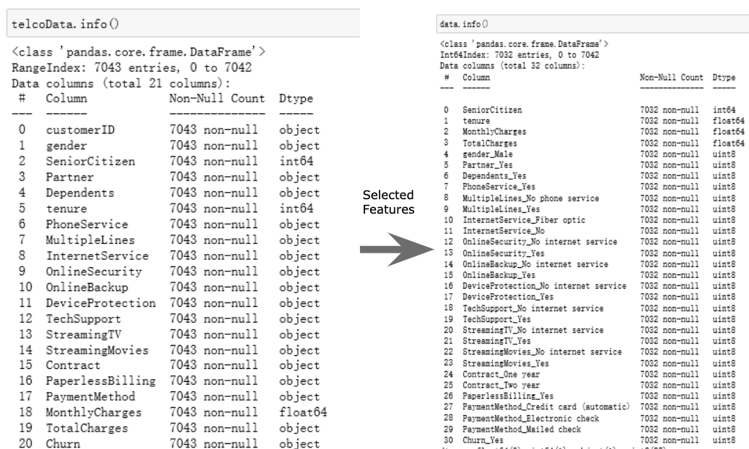
Feature Extraction
Notes:
Some of the selected features have the word Yes or No, because most of the columns are categorized.If the customer has this feature, the feature selection selects the feature with Yes, or No otherwise.Then, we can use this to see what features will affect the churn.

Slide 11
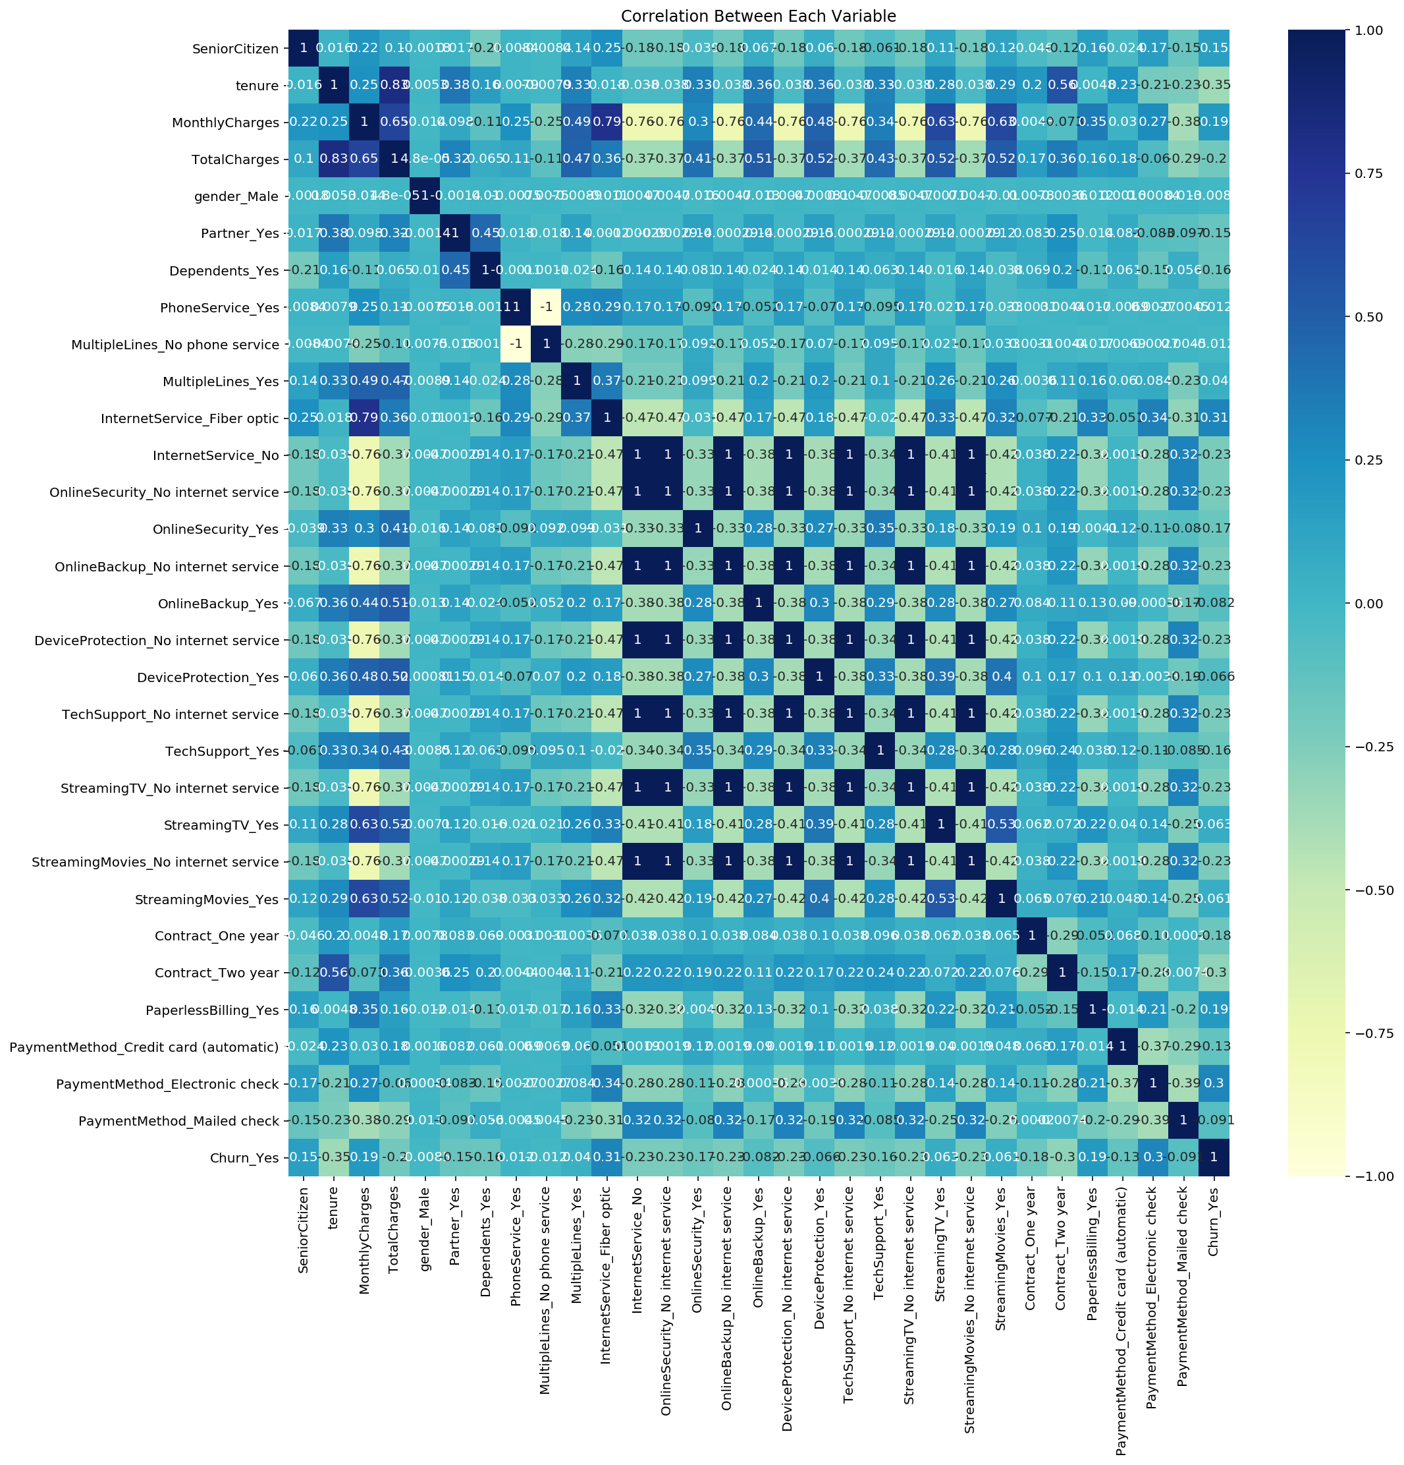
Correlation Heatmap
The darker the color on the heat map, the stronger the correlation between the 2 features
Dropped highly correlated variables:
OnlineSecurity_No internet service
OnlineBackup_No internet service
DeviceProtection_No internet service
TechSupport_No internet service
StreamingTV_No internet service
StreamingMovies_No internet service
Notes:
There is a strong correlation between some characteristics
Total Charges and Tenure
2-year contracts and Tenure
Internet Services with Fiber Optics and Monthly Charges
Streaming and Monthly Charges

Slide 12
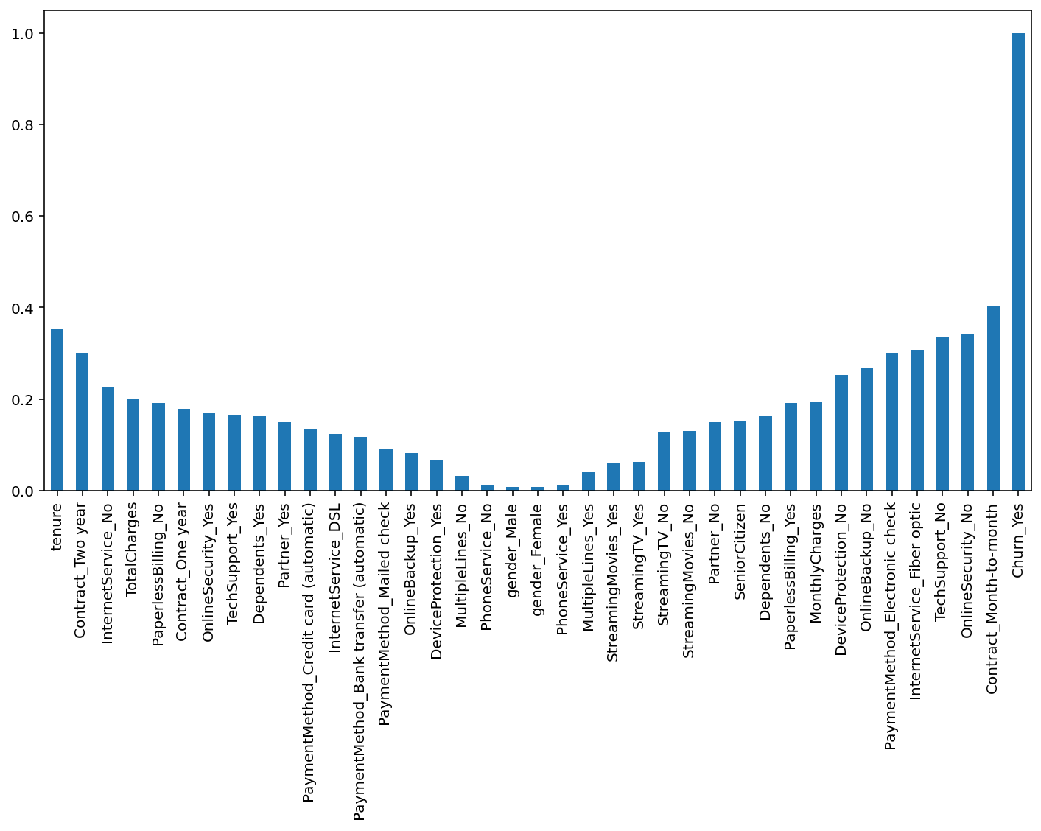
Correlation of Churn vs Features
Values of
Gender
Phoneservers
Mutipleline_no
phoneservices
are close to zero
Thus, these values have least impact on the forecast of telecom customer churn

Slide 13
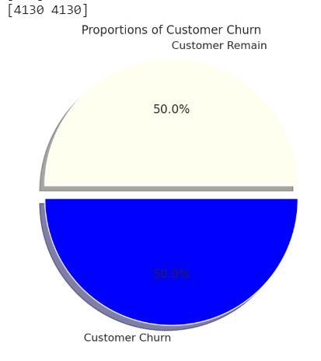
Sampling and Resampling
Original data for Churn was unbalanced with 73% of the data belonging to class 'No' and 27% of the data belonging to class 'Yes'
Over-Sample Minority Class (Churn_Yes):
SMOTE(Synthetic Minority Over-Sampling Technique)
Cross Validation:
Stratified k-Fold (k=10)
After resampling:
50% of data in each Yes or No Class
Notes:
Original Data distribution was unbalanced, so we thought of using oversampling method to oversample Minority classes and train various models on that and then predict the probability of Customer churn. We used SMOTE for it.
As we can, smote has created data points such that the distribution is symmetric now. We also used stratified k-fold cross validation with 10 folds to better train our model.

Slide 14
Prediction Models
Lasso Model
Support Vector Classifier
k-Nearest Neighbor
Naive Bayes
Logistic Regression
Linear Discriminant Analysis (LDA)
Quadratic Discriminant Analysis (QDA)
Random Forest Classifier
XGBoost
Notes:
One of the goals is to find out which model is best suited to the dataset and will provide the best accuracy.
We tried various algorithms on our model moving from simplest model to Bagging and Boosting approaches as well.
We also tried ensemble of all models however didn’t get any improved accuracy on it.
trained on two set of datasets separately and ran the model individually for both and noted their performance.

Slide 15
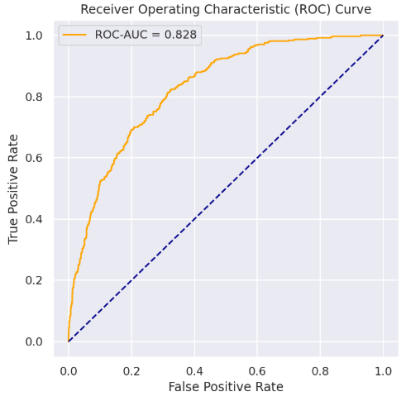
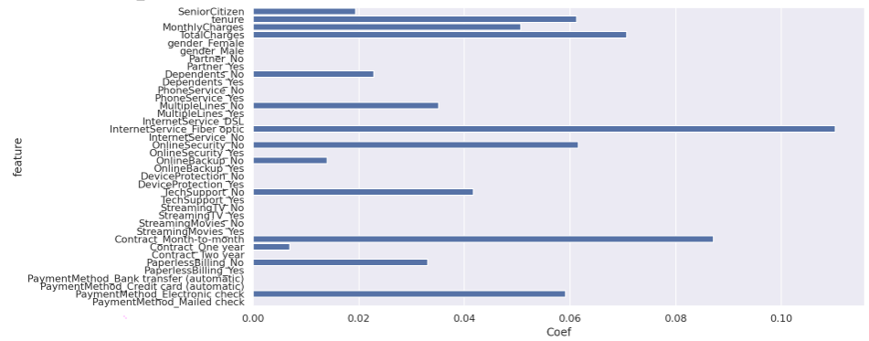
1.a. Lasso
Test AUC Score: 0.8296
Lasso Model while training on stratified 10-folds:
Regularization Constant: alpha=0.005
Average Validation AUC Score=0.8369
Top features affecting churn: Online Security_No, Contract_OneYear, gender_Female, Monthly Charges, Online Security_Yes
Features
Notes:
Lasso worked pretty well and reduced coefficients of those attributes to zero that have least impact on the target variable.
This model is run on general data, the one we had before performing over-sampling. We thought of trying on both generally splitted as well as over-sampled data because we wanted to understand the behavior of two dataset. and how over-sampling affect the model and prediction.

Slide 16
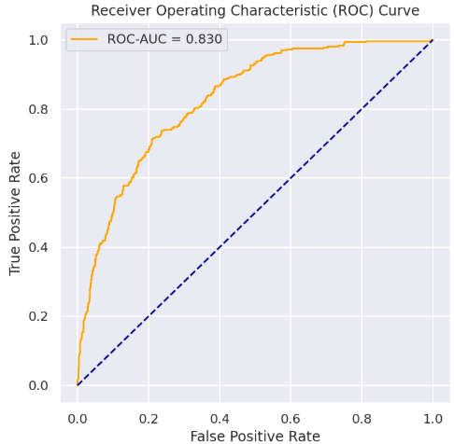
1.b. Lasso
Test AUC Score: 0.8305
Lasso Model while training on Over-sampled data with stratified 10-folds:
Regularization Constant: alpha=0.005
Average Validation AUC Score=0.85148
Notes:
It performed almost the same, without any improvement in prediction.

Slide 17
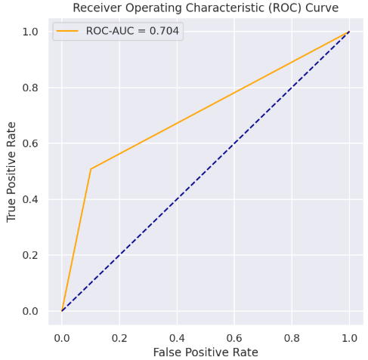
2.a. SVC
Test AUC Score: 0.7023
Support Vector Classifier while training on stratified 10-folds:
Kernel = Linear, C=1
Average Validation AUC Score=0.7204
Notes:
We tried gaussian kernel as well, but linear kernel SVM performed better which shows the decision boundary between two classes is somewhat linear.
However, SVM still couldn’t perform well for various values of C. C=1 performed the best in our case.

Slide 18
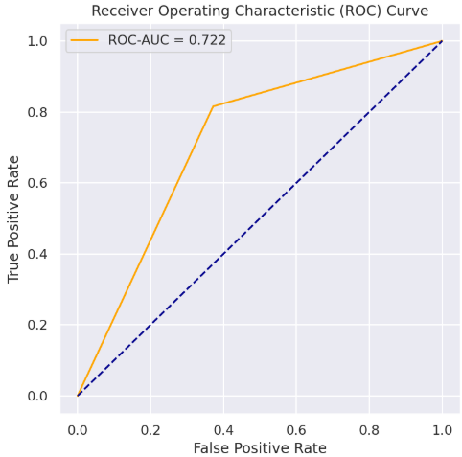
2.b. SVC
Test AUC Score: 0.7219
Support Vector Classifier while training on Over-sampled data stratified 10-folds:
Kernel = Linear
Average Validation AUC Score=0.7507
Notes:
Training on Over-sampled data performed better in case of SVM, however when we used the same data for training various other models, it pretty much gave the same results or in some case performed worse, so we didn’t move ahead with training on oversampled data.

Slide 19

3. k-Nearest Neighbor
Test AUC Score: 0.8063
k-Nearest Neighbor while training on stratified 10-folds:
k=17
Average Validation AUC Score=0.8273
Notes:
Such a high value of k suggests that the decision boundary is close to being linear.

Slide 20

4. Naive Bayes
Test AUC Score: 0.8185
Naive Bayes while training on stratified 10-folds:
Average Validation AUC Score=0.8300
Notes:
Gaussian Naive Bayes

Slide 21

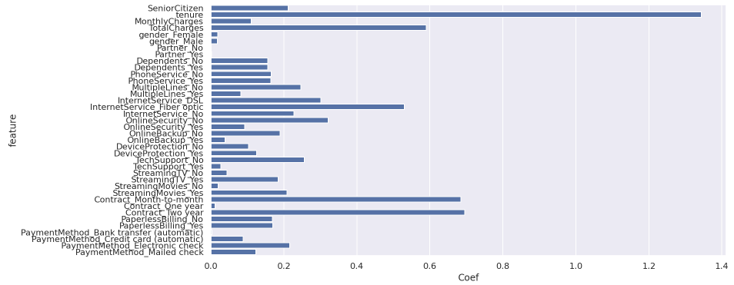
5. Logistic Regression
Test AUC Score: 0.8359
Logistic Regression while training on stratified 10-folds:
Average Validation AUC Score=0.8466
Top features affecting churn: Tenure, Contract_TwoYear, Contract_Month-to-Month, Total Charges, InternetService_FiberOptic
Features
Notes:
Affects churn the most: 2 year contracts, tenure, no internet service, internet service fiber optic, one year contracts, and total charges

Slide 22

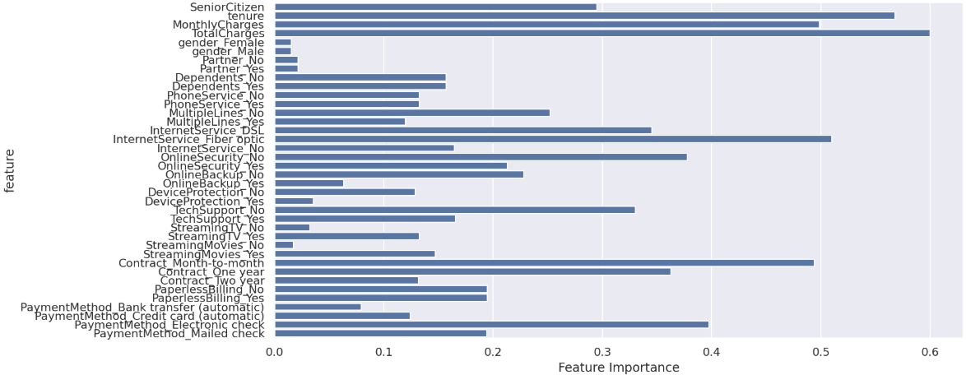
6. LDA
Test AUC Score: 0.8299
Linear Discriminant Analysis while training on stratified 10-folds:
Average Validation AUC Score=0.8422
Applied Variance Inflation Factor to remove collinearity
Top features affecting churn: Total Charges, Tenure, InternetService_FiberOptic, Contract_Month-to-Month, PaymentMethod_Electronic check
Features
Notes:
VIF dropped monthly/total charges and those that have phone services
Affects churn the most: Total charges, tenure, internet service fiber optics, month to month contract, payment method by electronic check

Slide 23

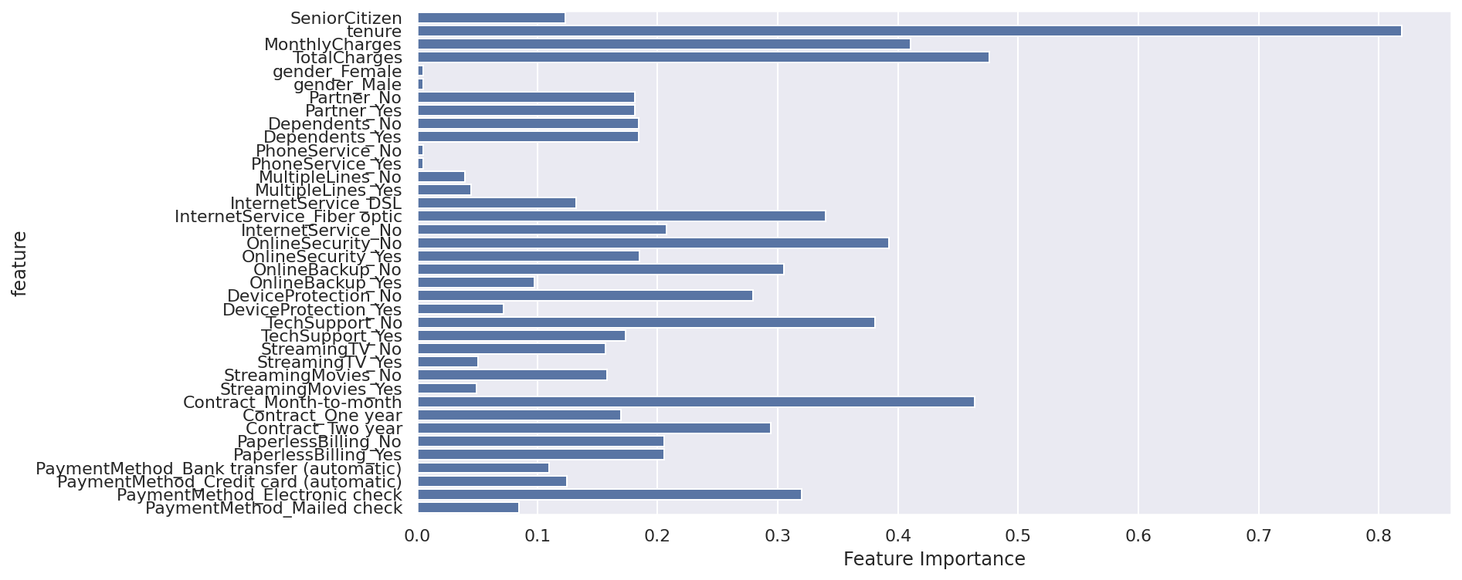
7. QDA
Test AUC Score: 0.7837
Quadratic Discriminant Analysis while training on stratified 10-folds:
Average Validation AUC Score=0.7716
Applied Variance Inflation Factor to remove collinearity
Top features affecting churn: Tenure, Total Charges, Contract_Month-to-Month, Monthly Charges, Online Security_No
Features
Notes:
Affects churn the most: Tenure, total charges, month to month contracts, monthly charges, and no online security

Slide 24

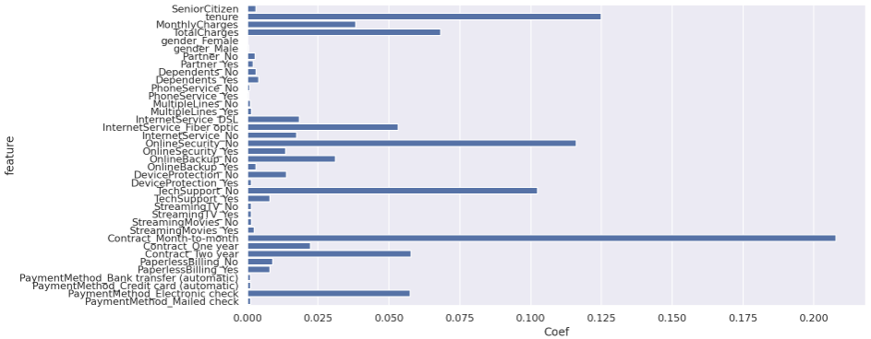
8. Random Forests
Test AUC Score: 0.8315
Random Forest Classifier while training on stratified 10-folds:
Num of Trees =200
Maximum Depth: 4 & Maximum Features: 6
Average Validation AUC Score=0.8412
Top features affecting churn: Contract_Month-to-Month, Tenure, Online Security_No, TechSupport_No,Total Charges
Features
Notes:
Affects churn the most: tenure, having internet service fiber optics, total charges, 2 year contracts, and electronic check payments

Slide 25

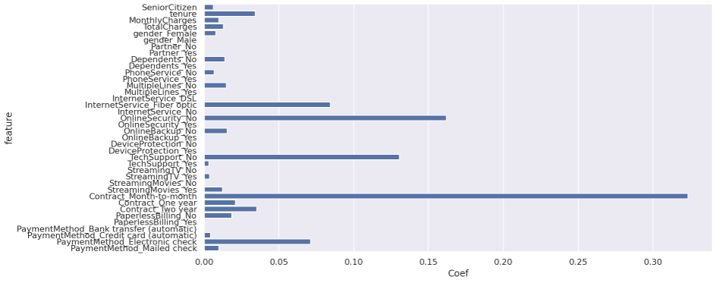
9. XGBoost
Test AUC Score: 0.8375
XGBoost while training on stratified 10-folds:
Learning Rate: 0.09
Maximum Depth: 4 & Maximum Features: 6
Average Validation AUC Score=0.8500
Top features affecting churn: Contract_Month-to-Month, Online Security_No, TechSupport_No, InternetService_FiberOptic, PaymentMethod_Electronic check
Features
Notes:
Affects churn the most: electronic check payments, 2 year contracts, 1 year contracts, internet service fiber optics, tenure

Slide 26
Summary
Model | ROC-AUC Score | Features Highly Correlated with Churn
XGBoost | 0.8375 | Contract_Month-to-Month, Online Security_No, TechSupport_No, InternetService_FiberOptic, PaymentMethod_Electronic check
Logistic Regression | 0.8359 | Tenure, Contract_TwoYear, Contract_Month-to-Month, TotalCharges, InternetService_FiberOptic
Random Forest | 0.8315 | Contract_Month-to-Month, Tenure, Online Security_No, TechSupport_No,TotalCharges
LDA | 0.8299 | TotalCharges, Tenure, InternetService_FiberOptic, Contract_Month-to-Month, PaymentMethod_Electronic check
Lasso | 0.8296 | Online Security_No, Contract_OneYear, gender_Female, MonthlyCharges, Online Security_Yes
Naive Bayes | 0.8185 | N/A
KNN | 0.8063 | N/A
QDA | 0.7837 | Tenure, TotalCharges, Contract_Month-to-Month, MonthlyCharges, Online Security_No
SVC | 0.7023 | N/A
Notes:
The features are listed in order of importance and decreasing order of coefficients describing how much it affects churn. The features that are highlighted the most are contract month-to-month, internet service fiber optic, and online security no.

Slide 27
Recommendations & Future Work
Top Attributes that influence Customer Churn:
Month-to-Month Contracts
Longer tenure
Higher Total Charges
No Online Security
Fiber Optic Internet Service
No Technical Support
Payment Method: Electronic Check
Recommendations: Improve Online Security, Fiber optic internet service, and Technical Services
Include discounts and promotions to retain customer loyalty
For the future: Try Principal Component Analysis and implement various models on the PCA result.
Try fitting a model using Neural Networks that can automatically learn data features and yield better results.
Notes:
The top attributes that influence customer churn are month-to-month contracts, longer tenure, and higher total charges. This may be because customers are not satisfied in first month but have to keep going with the service because of their contract. Customers may want try other services after they are subscribed for a longer time. In addition, higher charges could cause customers to leave who see better deals at other services.
Also, other services provided by the company such as not having online security, fiber optic, internet service, no technical support, and electronic check payments lead to higher churn rates.
Recommendations include improving online security, fiber optic internet services, and technical services as well as securing electronic check payments.
-----------------------------------------
The 2 year contract variable probably affects churn the most because usually companies offer a 2 year contract and once that is up, customers will probably look at other companies for their services.
Customers who don’t opt for internet services may look elsewhere for cheaper services or are not satisfied with the company’s plan.
Mailed check payments may get lost in transit so customers could have problems there.

Slide 28
Key Takeaways
Applying classroom knowledge to a practical situation
Work with unbalanced dataset
Categorical to Numerical Feature conversion
Handling correlated features
Application of Stratified Cross Validation
Over Sampling technique
SMOTE
Working with classification techniques
Hyper-parameter tuning
Implementation of Bagging and Boosting techniques
different number of features
different tree depths
Notes:
We learned many things from doing this project. This includes applying the various models that we learned in class, as well as models that we researched, to a practical problem. We got to perform data cleaning, feature analysis to see which features would be important, and provide recommendation that could help the business become even more successful. We also understood and applied resampling techniques, different classification models, and implementing bagging and boosting to achieve better accuracy.

Slide 29
References
https://www.datacenterknowledge.com/archives/2013/10/25/ibm-licenses-arm-for-networking-chips
https://towardsdatascience.com/increasing-kaggle-revenue-analyzing-user-data-to-recommend-the-best-new-product-f93fddbb4e0f
https://www.superoffice.com/blog/reduce-customer-churn/
https://www.presentationgo.com/presentation/category/graphics-metaphors/target-goals/
https://scikit-learn.org/stable/

Slide 30
Thank you! Questions?

